Slide 1
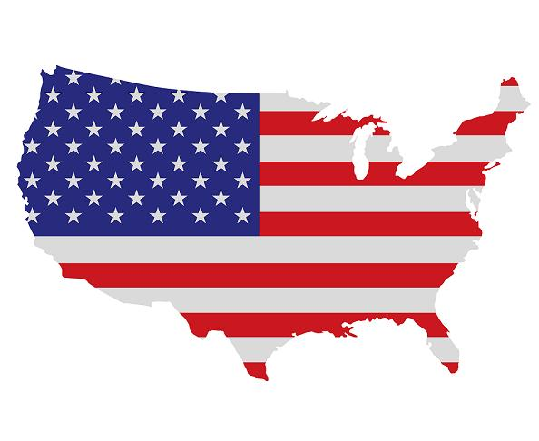
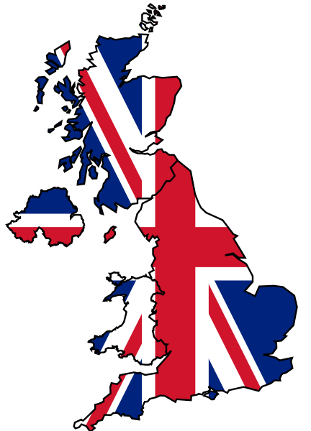
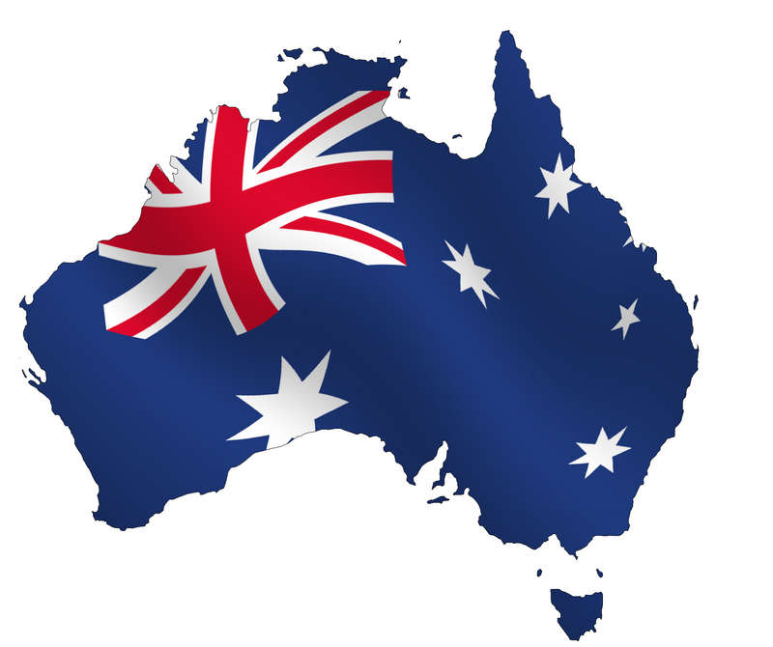
Travelling Across Three Continents

Slide 2
Our Teams
“Friendly guys”
“GG Team”
(Golden Guys Team)
“Whizz Kids”
“Champions”

Slide 3
General Information
Task 1

Slide 4
General Information
Question 1
b) Great Britain
c) Australia
d) The USA
a) Canada

Slide 5
General Information
Question 2
c) George Washington
d) Abraham Lincoln
b) Ronald Reagan
a) Bill Clinton

Slide 6
General Information
Question 3
c)Rhode Island
d)Georgia
a)Texas
b) Alaska

Slide 7
General Information
Question 4
c) Leonardo di Caprio
d) Clark Gable
b) Arnold Schwarzenegger
a)Kevin Costner

Slide 8
Places of Interests
Task 2
Match the pictures with the titles

Slide 9
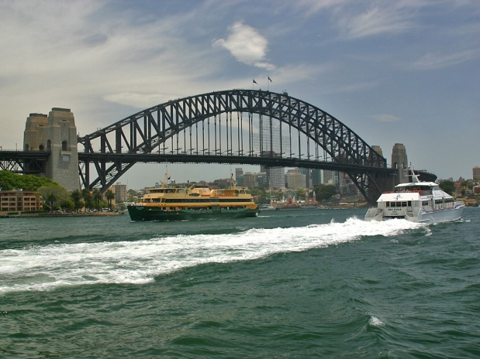
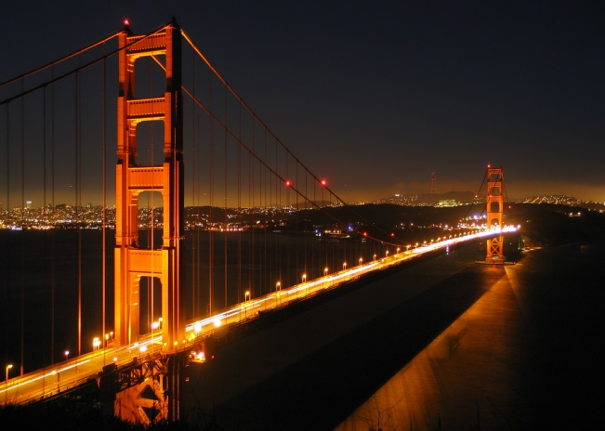
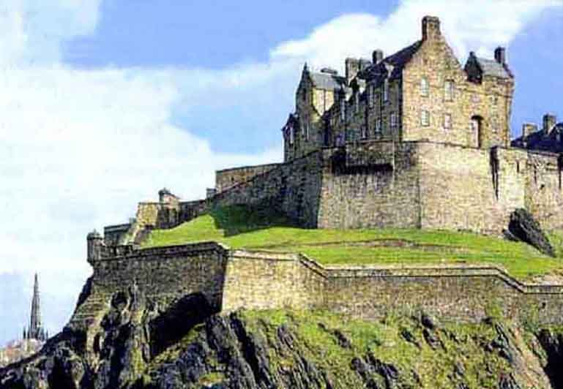
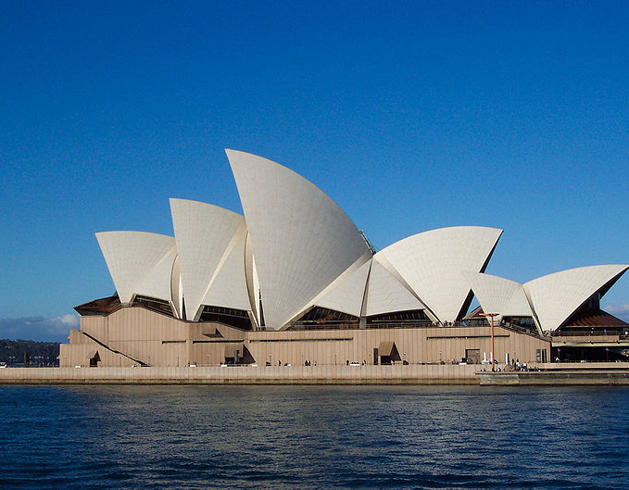
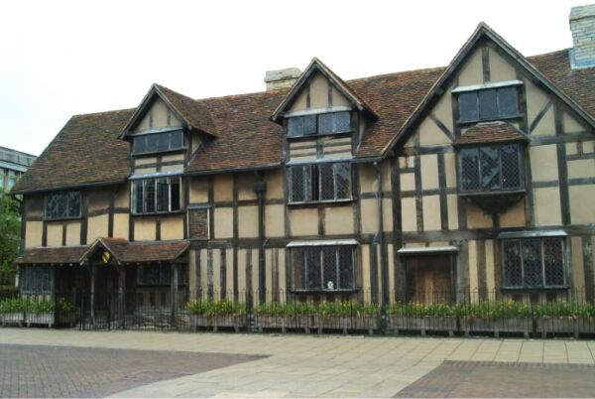
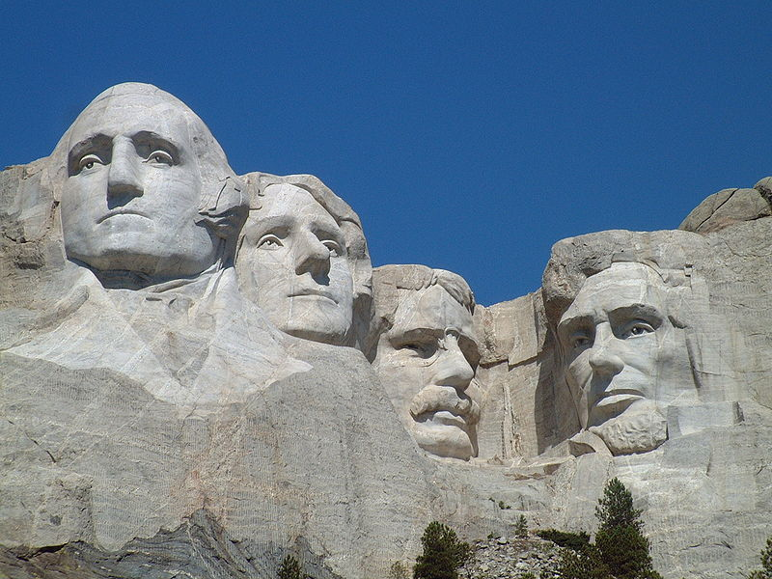
a) The Edinburgh Castle; b) Shakespeare house;
c) Mount Rushmore; d) Golden Gate;
e) Sydney opera house; f) Harbor Bridge.
f
d
a
1
2
3
e
b
c
4
5
6

Slide 10
World of Nature
Connect the words with their definitions

Slide 11
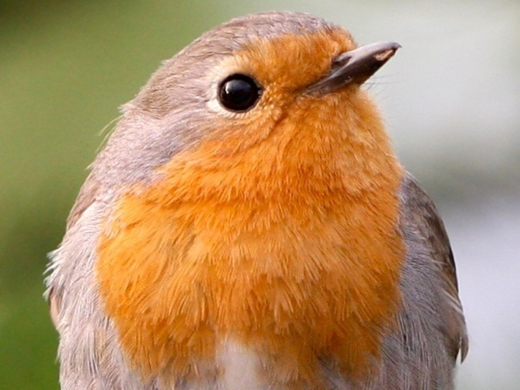
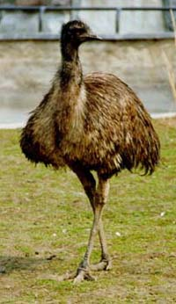
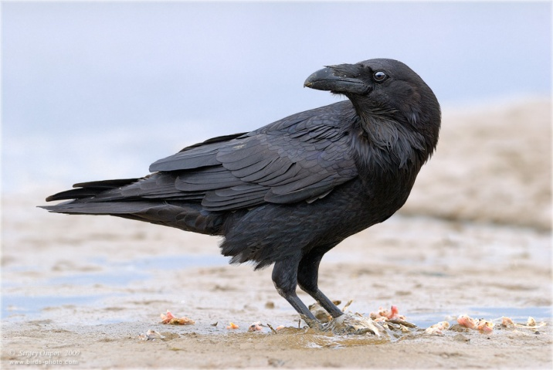
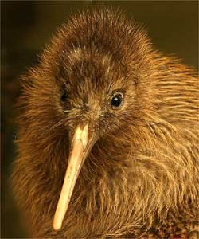
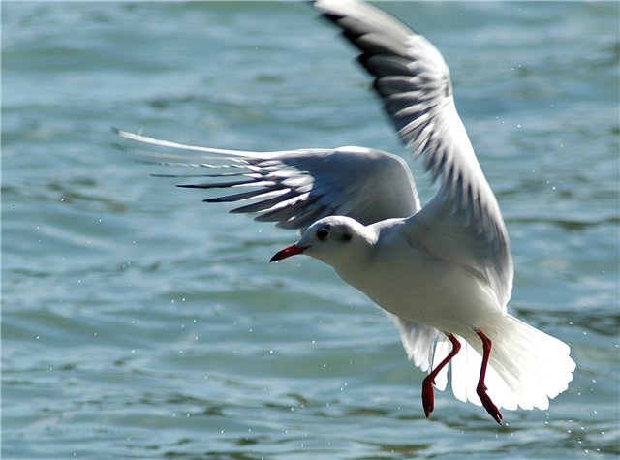
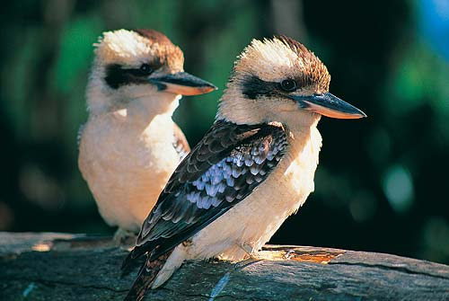
a) Kiwi b) Emu c) Seagull d) Raven e) Robin f) Kookaburra
e
b
d
1
3
2
a
c
f
5
6
4

Slide 12
Famous People
Choose the right answer

Slide 13
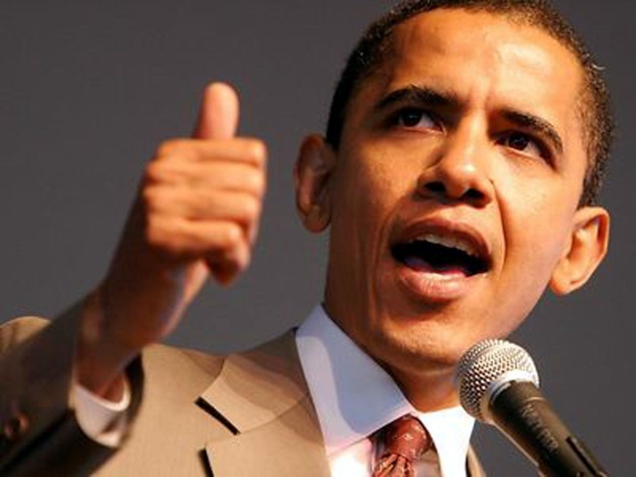
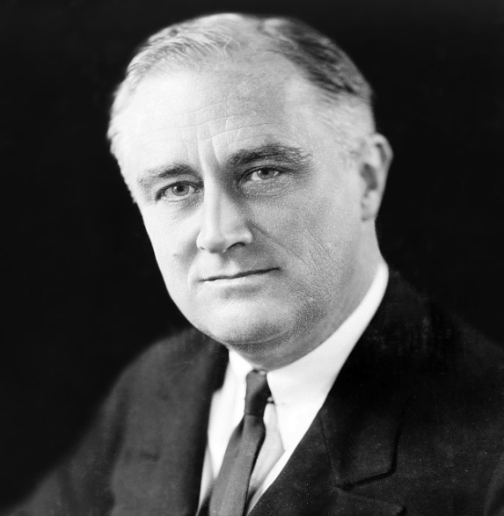
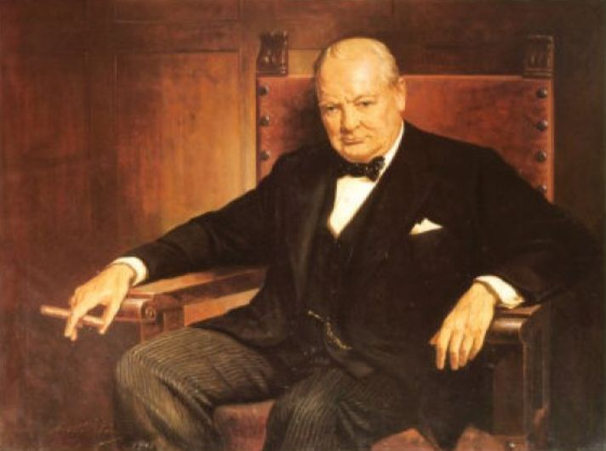
Having no pets on entering the White House, he chose a Portuguese Water Dog, which was named Bo.
1) Barack Obama 2) Franklin Roosevelt 3) Winston Churchill

Slide 14
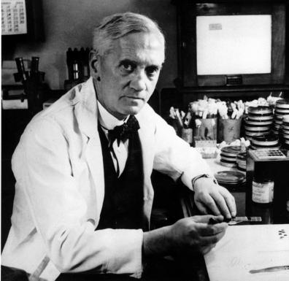
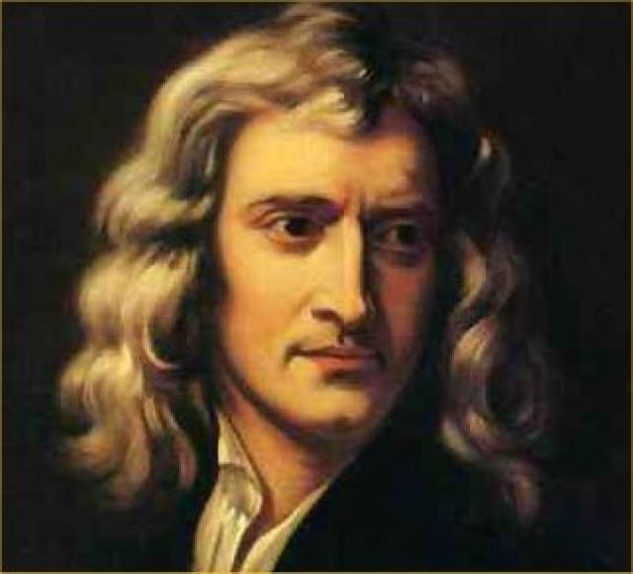
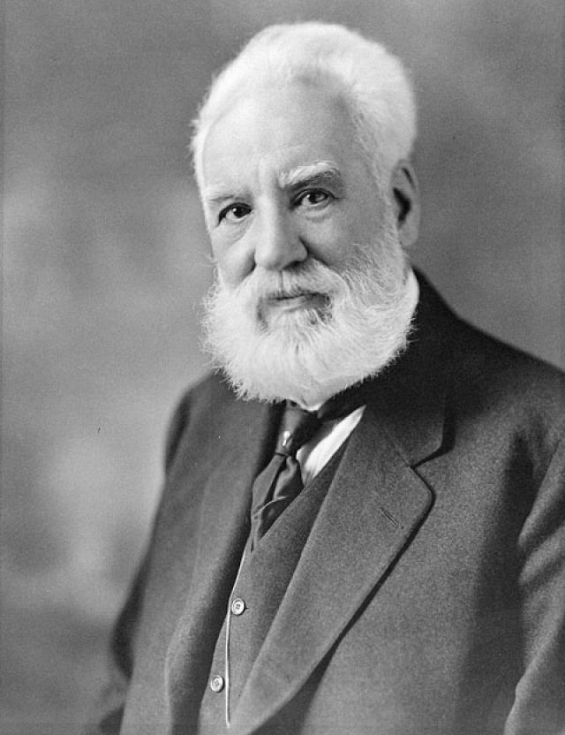
Established in 1992, the 350th anniversary of his birth, the Institute was named after him because of his great achievements in the fields of mathematics, optics, physics and astronomy.
Alexander Fleming 2) Isaac Newton 3) Alexander Bell

Slide 15
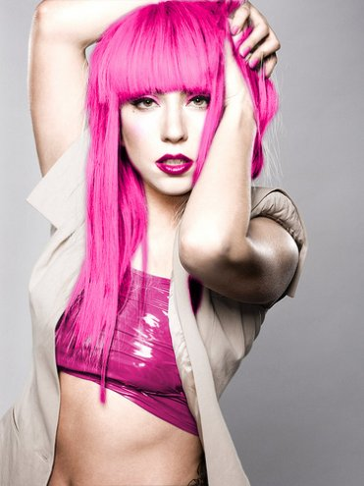
After beginning her career as a child actress on TV, she achieved recognition through her role in TV soap opera “Neighbours”, before commencing her career as a recording artist in 1987.
1) Britney Spears 2) Kylie Minogue 3) Lady GaGa

Slide 16
Task 3
Captains’ Quiz
Answer as quickly as possible.

Slide 17
1) What do the Englishmen say to be taken a photo?
Hello
Cheese
Good morning
Ham

Slide 18
2) According to the English proverb when you don’t know what to speak about,
speak about
Politics
Weather
Music
Love

Slide 19
3)When it is someone’s birthday, it is usual to say:
Congratulations
Many happy returns of the day
Good luck
I’m sorry

Slide 20
4) What colour was a famous submarine in the song of “Beatles”?
Red
Orange
Blue
Yellow

Slide 21
1)How many stars are there on the American flag?
48
50
49
51

Slide 22
2)How many stripes are there on the American flag?
12
15
13
50

Slide 23
3)How many oceans wash the USA?
1
3
2
4

Slide 24
4)Christopher Columbus landed in America in
1629
1492
1942
1812

Slide 25
1)Where is the Statue of Liberty?
New York
Atlanta
Washington D.C.
San Francisco

Slide 26
2)Washington D.C. is a
A state
Country
District
City

Slide 27
3) What is Washington?
A country
A city
A district
A state

Slide 28
4) What is Moscow in the USA?
a mount
a river
a state
a town

Slide 29
What is the National symbol of America?
The rose
The Cherokee rose
The Statue of Liberty
The bald eagle

Slide 30
2) What is the national symbol of England?
the red rose
the bald eagle
The Statue of Nelson
The star

Slide 31
3) What is the national symbol of Scotland?
The red rose
The thistle
The Edinburgh Castle
The kiwi

Slide 32
4) What is the national symbol of Wales?
The daffodil
The shamrock
The Stripes and stars
The seagull

Slide 33
Pancake day is celebrated on
31st October
14 February
Some day in February
5th of November

Slide 34
2)The Head of the State is
The Queen
The Prime Minister
The King
Parliament

Slide 35
3) What holiday has a chocolate bunny as an attribute?
Christmas
New Year
Easter
Thanksgiving Day

Slide 36
4) When is Martin Luther King day celebrated in the USA?
January
May
August
November

Slide 37
Task 4
English and American
Literature
Revise and write as many names of English and American writers or poets as possible

Slide 38
Task 5
Guy Fawkes Day
Watch the short presentation about Guy Fawkes, one of the most favorite British holidays.
Be ready to answer some questions after the video film.

Slide 39
Task 6
Black Box
What is in it?

Slide 40
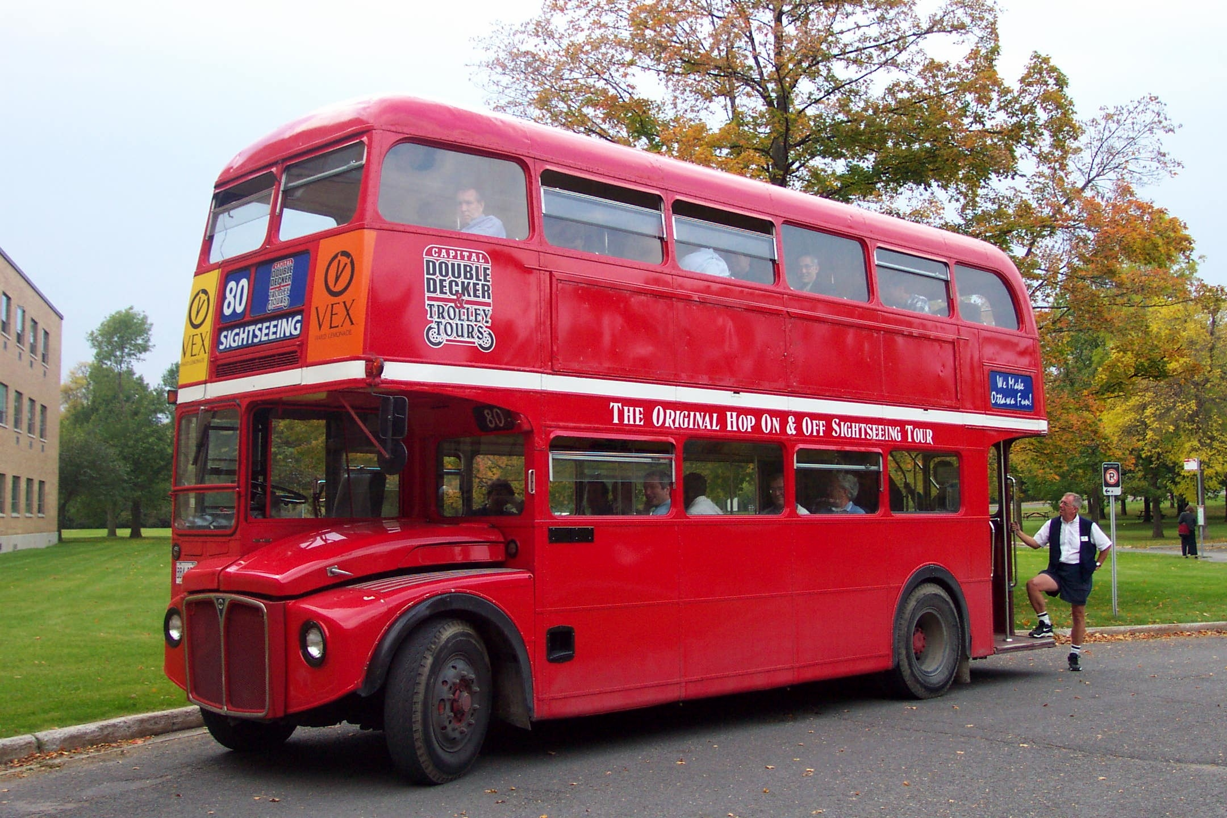
Double Decker

Slide 41
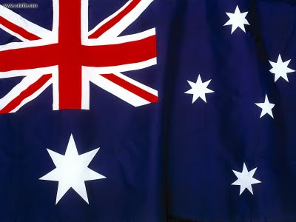
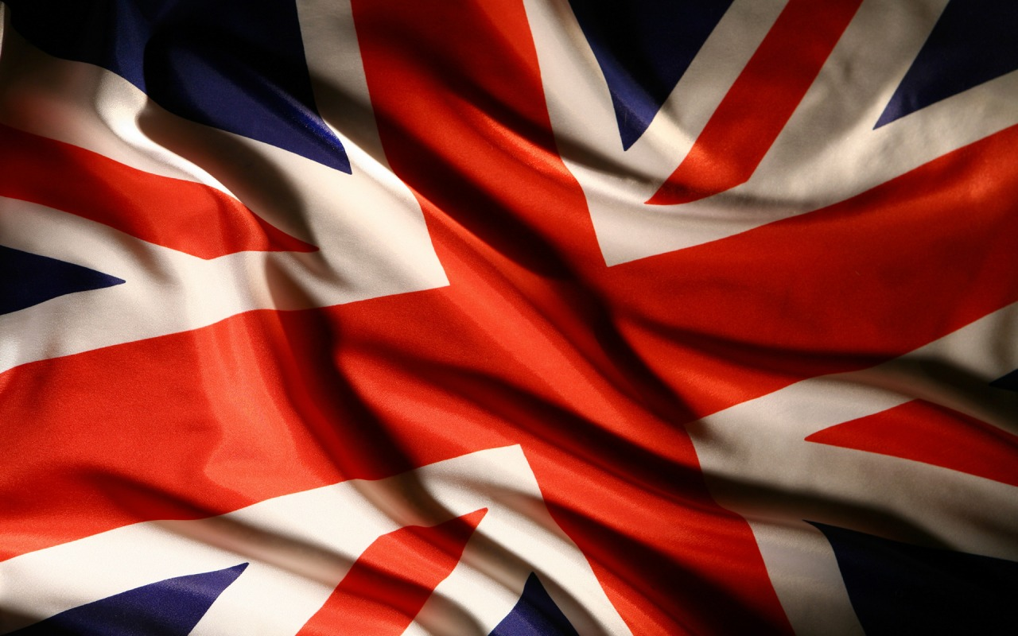
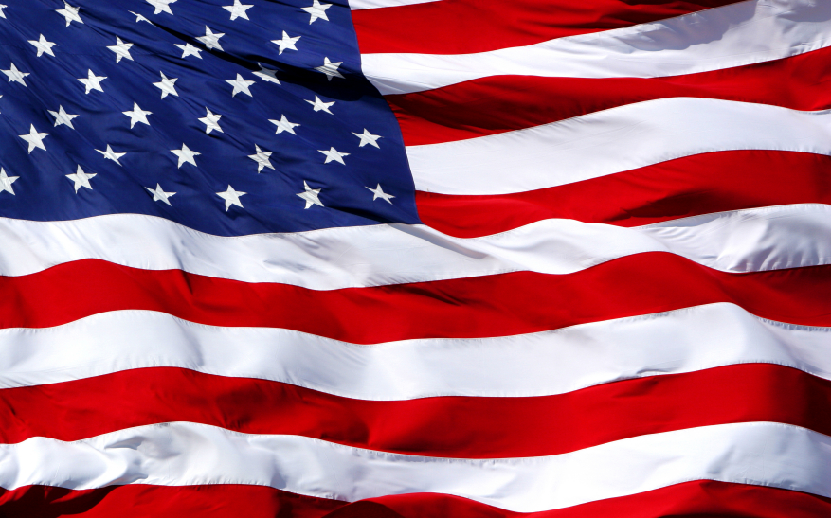
Thank you!

