Slide 1


Slide 2
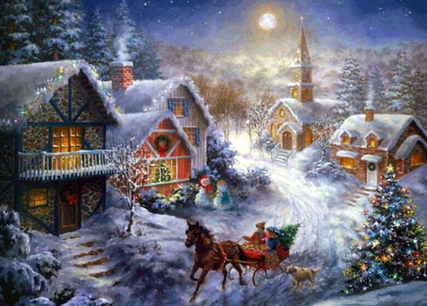
The Christmas and New Year!

Slide 3

Christmas ABC

Slide 4
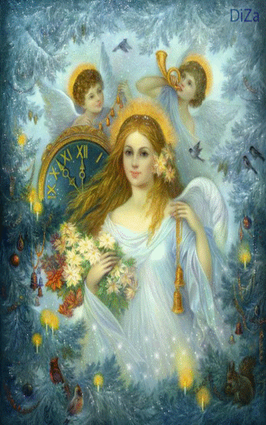
Aa
Angel

Slide 5

Bb
Bell

Slide 6
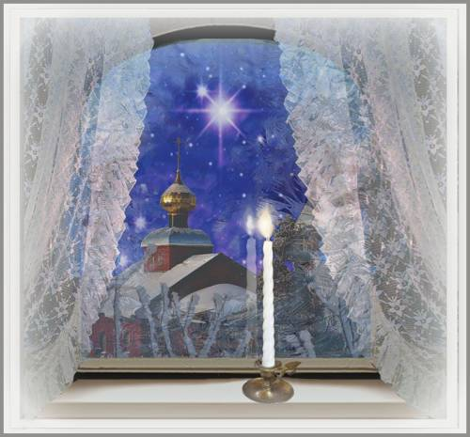
Cc
Candle

Slide 7
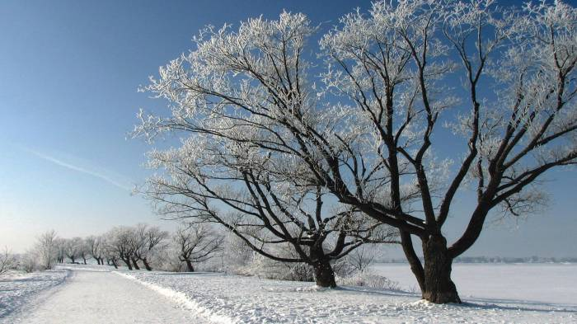
Dd
Decem
ber

Slide 8

Ee
Elf

Slide 9
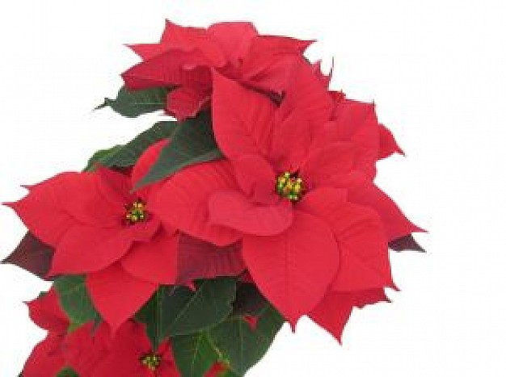
Ff
Flower

Slide 10

Gg
Gift

Slide 11

Hh
Holla

Slide 12
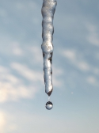
Ii
Icicle

Slide 13
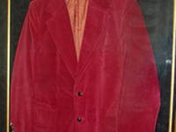
Jj
Jacket

Slide 14
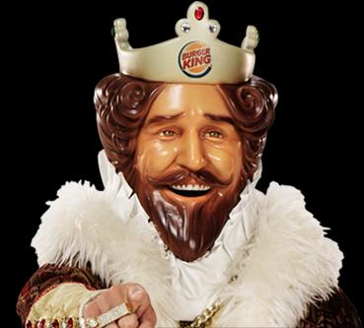
Kk
King

Slide 15

Ll
Lights

Slide 16
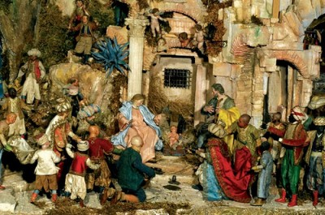
Mm
Manger

Slide 17
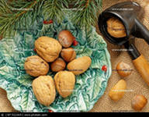
Nn
Nut

Slide 18

Oo
Orna
ment

Slide 19
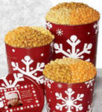
Pp
Pop
corn

Slide 20
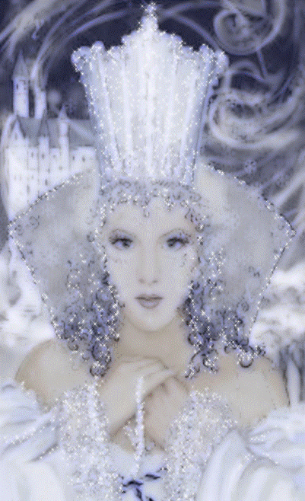
Qq
Queen

Slide 21
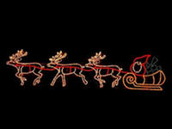
Rr
Rein
deer

Slide 22

Ss
Snow
man

Slide 23

Tt
Toy

Slide 24

Uu
Umb
rella

Slide 25
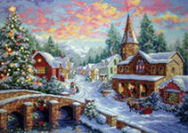
Vv
Village

Slide 26

Ww
Wreath

Slide 27

Xx
X-ray

Slide 28
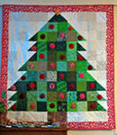
Yy
Yo-Yo

Slide 29
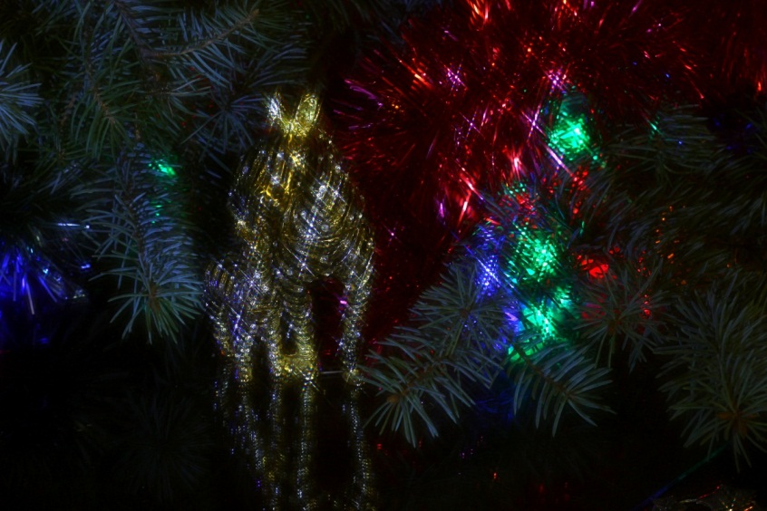
Zz
Zebra

Slide 30
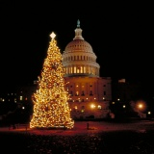
We wish you a Merry Christmas!

Slide 31
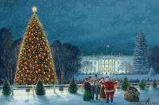
Greeting Christmas cards

Slide 32
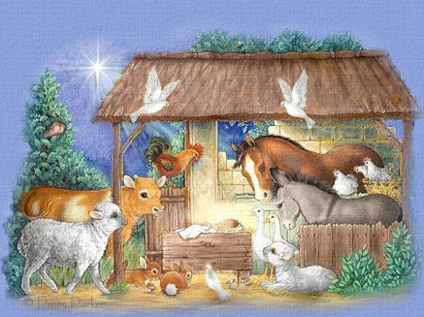

Slide 33
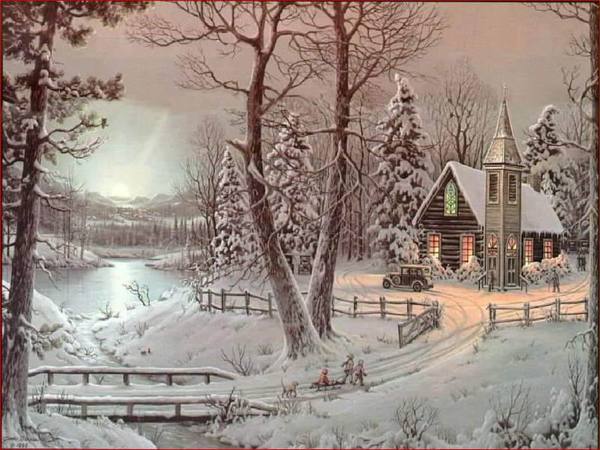

Slide 34
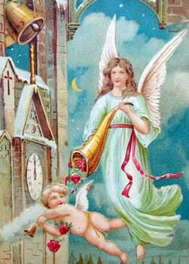

Slide 36
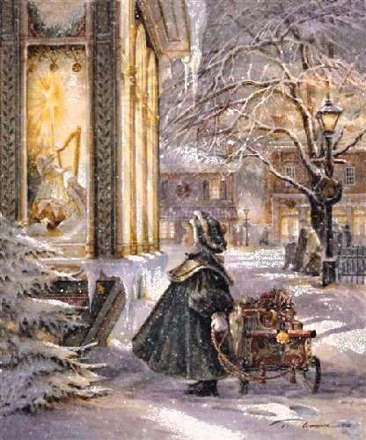

Slide 37

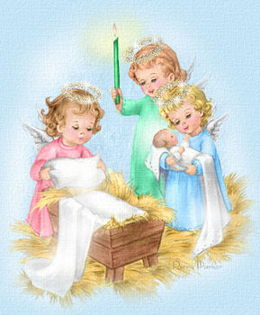

Silent Night, Holly night

Slide 38
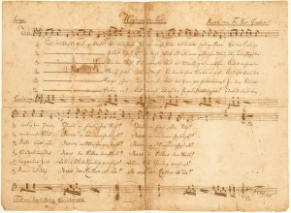
Silent night, holy night, all is calm, all is bright. Round yon Virgin Mother and Child.
Holy Infant so tender and mild, sleep in heavenly peace, sleep in heavenly peace.

Slide 39
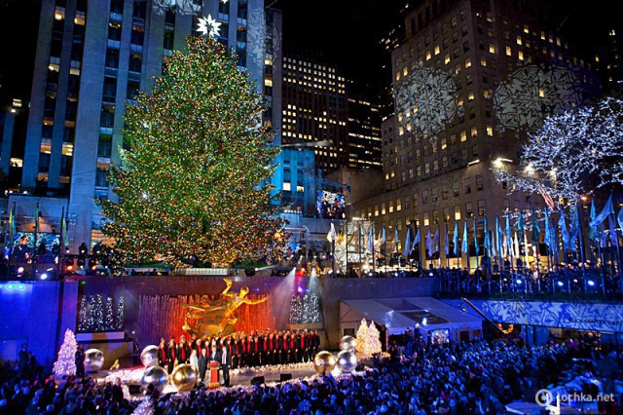
I decorate my Christ
mas
Tree

Slide 40
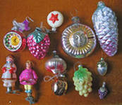
I decorate my Christmas Tree with a toy

Slide 41

I decorate my Christmas Tree with a star

Slide 42
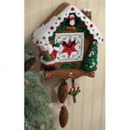
I decorate my Christmas Tree with a clock

Slide 43
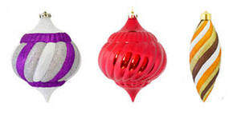
I decorate my Christmas tree with an icicle

Slide 44
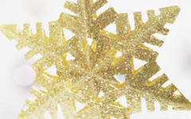
I decorate my Christmas tree with a Snowflake

Slide 45
I decorate my Christmas Tree with a bell

Slide 46
I decorate my Christmas Tree with a gift

Slide 47

I decorate my Christmas Tree with a Teddy- Bear

Slide 48
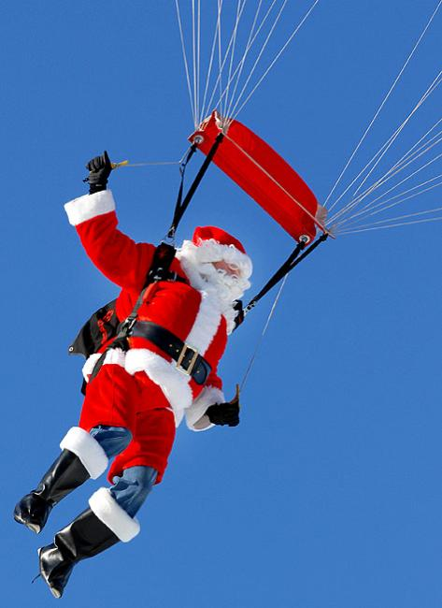
I decorate my Christmas tree with Santa Claus

Slide 49
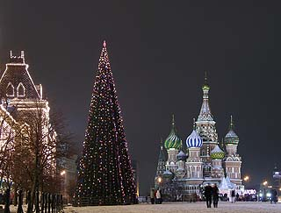
A Christmas tree was born in wood

Slide 50
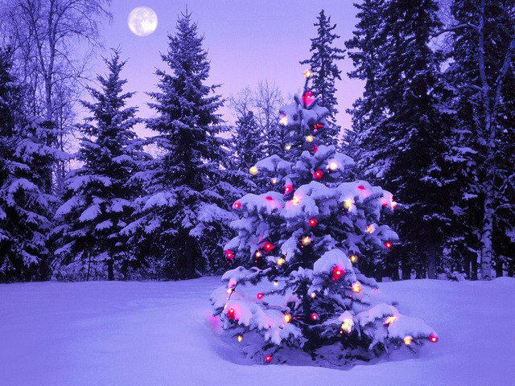
A Christmas Tree was born in Wood, and in the Wood she grew,
In winter, summer she was green and nice and beautiful- 2 раза.
A strong wind sang a song for her: sleep, Christmas Tree, sleep, sleep,
And Frosty covered by snow, by snow, don`t cold, don`t cold, don`t cold.- 2 раза
And now you are nice and beautiful, and you came on Christmas Eve,
and very many gifts and lights you bring for every child- 2 раза.

Slide 51
Презентация подготовлена с помощью ресурсов(рисунки):
Images.yandex.ru
Picturesdetstvo.ru
Razumniki.ru
Paint.kards.qip.ru
Rebzi.ru
Art.apple.ru

