Slide 1
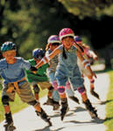
We have hobbies!!!

Slide 2
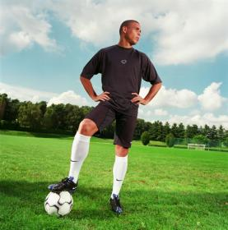
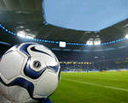
Football

Slide 3
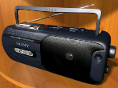
Listening to music

Slide 4
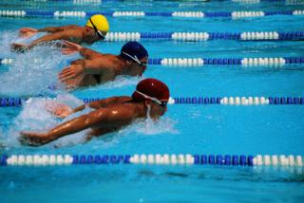
Swimming

Slide 5
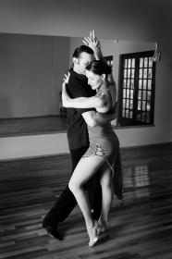
Dancing

Slide 6
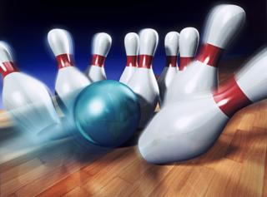
Bowling

Slide 7
Playing computer games

Slide 8
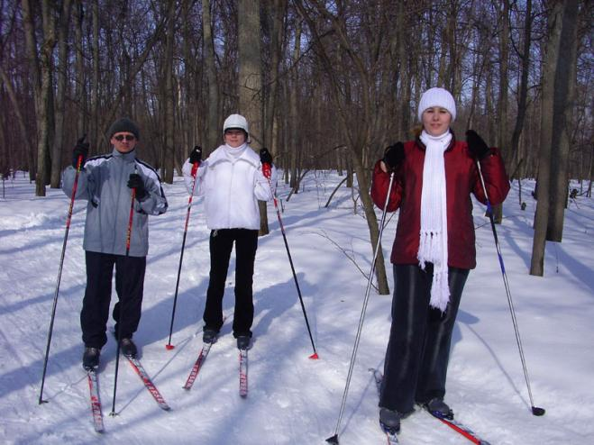
Skiing

Slide 9
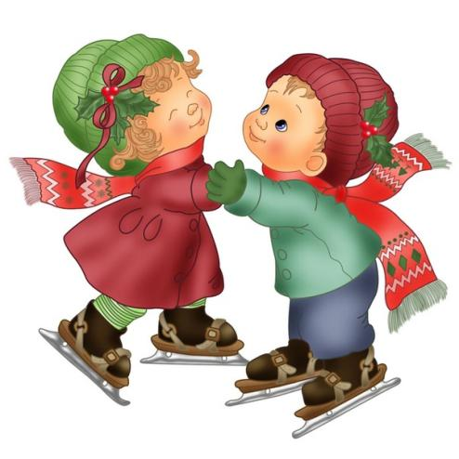
Skating

Slide 10
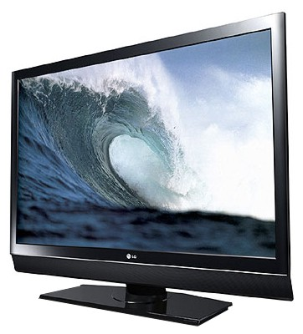
Watching TV

Slide 11
Reading books, magazines

Slide 12
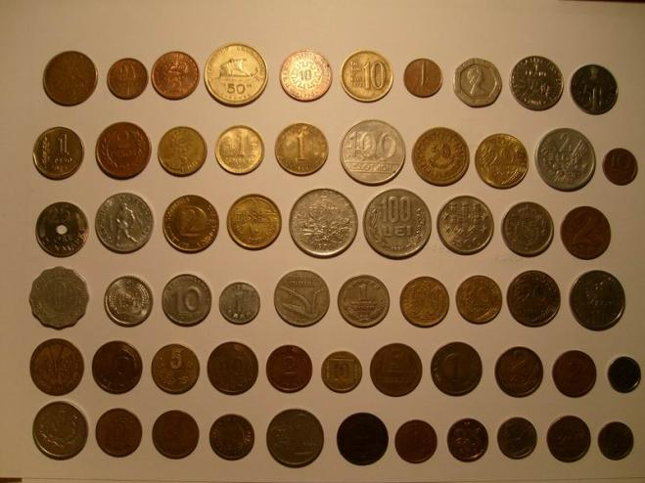
Collecting coins

Slide 13
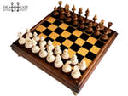
Chess

Slide 14
Athletics

Slide 15
Put the right variant.
1. I’m not very _________________ in darts. (interested/ interesting)
2. Reading books is not ______ . I am never _______ with it. (boring/bored)
3. I went to a rugby match yesterday. It was great and I was ______________ (excited/ exciting)
4. It’s __________________ (amusing/ amused) to play Lego.
5. When I’m _______________ (tired/ tiring) of watching TV, I go for a walk.
6. Animated cartoons are ___________ and all children enjoy watching them. (amused/ amusing)

Slide 16
Put the right variant.
1. I’m not very interested in darts.
2. Reading books is not ______ . I am never _______ with it. (boring/bored)
3. I went to a rugby match yesterday. It was great and I was ______________ (excited/ exciting)
4. It’s __________________ (amusing/ amused) to play Lego.
5. When I’m _______________ (tired/ tiring) of watching TV, I go for a walk.
6. Animated cartoons are ___________ and all children enjoy watching them. (amused/ amusing)

Slide 17
Put the right variant.
1. I’m not very interested in darts.
2. Reading books is not boring. I am never bored with it.
3. I went to a rugby match yesterday. It was great and I was ______________ (excited/ exciting)
4. It’s __________________ (amusing/ amused) to play Lego.
5. When I’m _______________ (tired/ tiring) of watching TV, I go for a walk.
6. Animated cartoons are ___________ and all children enjoy watching them. (amused/ amusing)

Slide 18
Put the right variant.
1. I’m not very interested in darts.
2. Reading books is not boring. I am never bored with it.
3. I went to a rugby match yesterday. It was great and I was exciting.
4. It’s __________________ (amusing/ amused) to play Lego.
5. When I’m _______________ (tired/ tiring) of watching TV, I go for a walk.
6. Animated cartoons are ___________ and all children enjoy watching them. (amused/ amusing)

Slide 19
Put the right variant.
1. I’m not very interested in darts.
2. Reading books is not boring. I am never bored with it.
3. I went to a rugby match yesterday. It was great and I was exciting.
4. It’s amusing to play Lego.
5. When I’m _______________ (tired/ tiring) of watching TV, I go for a walk.
6. Animated cartoons are ___________ and all children enjoy watching them. (amused/ amusing)

Slide 20
Put the right variant.
1. I’m not very interested in darts.
2. Reading books is not boring. I am never bored with it.
3. I went to a rugby match yesterday. It was great and I was exciting.
4. It’s amusing to play Lego.
5. When I’m tired of watching TV, I go for a walk.
6. Animated cartoons are ___________ and all children enjoy watching them. (amused/ amusing)

Slide 21
Put the right variant.
1. I’m not very interested in darts.
2. Reading books is not boring. I am never bored with it.
3. I went to a rugby match yesterday. It was great and I was exciting.
4. It’s amusing to play Lego.
5. When I’m tired of watching TV, I go for a walk.
6. Animated cartoons are amusing and all children enjoy watching them.

Slide 22
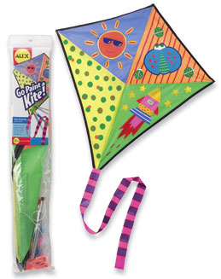
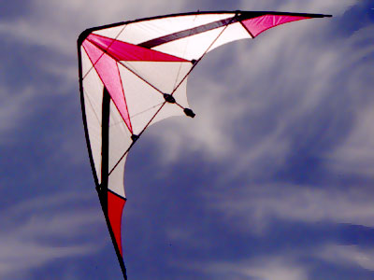
Kite - flying

Slide 23
Answer the questions.
1. In what country do people like kite-flying very much?
2. What do kites look like?
3. What are kites made of?

Slide 24
Let’s relax!

Slide 25
Translate into English.
Я получаю удовольствие от прослушивания музыки. Это расслабляет.
В мое свободное время я люблю ходить по магазинам.
Англичане смотрят телевизор очень часто.
Анна увлекается танцами. Это интересно и красиво.
Том не любит собирать монеты. Он думает, что это скучно.
Моя мама собирает кулинарные книги. Она очень хорошо готовит.
Просмотр телевизора – это скучное занятие.

