Slide 1
Home, sweet home!

Slide 3
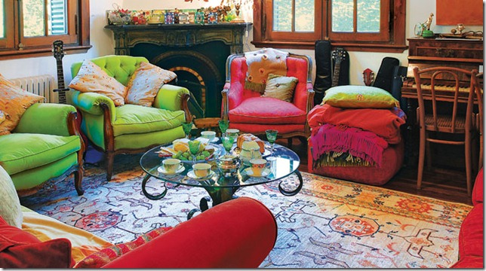
A room where people can have a rest, watch TV, sit together and talk
A living room (a sitting room)

Slide 4
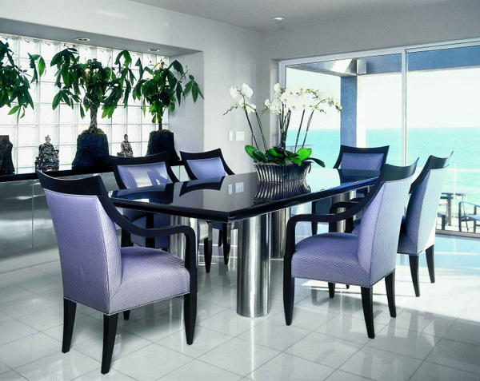
A room where people can have a meal
A dining room (a kitchen)

Slide 5
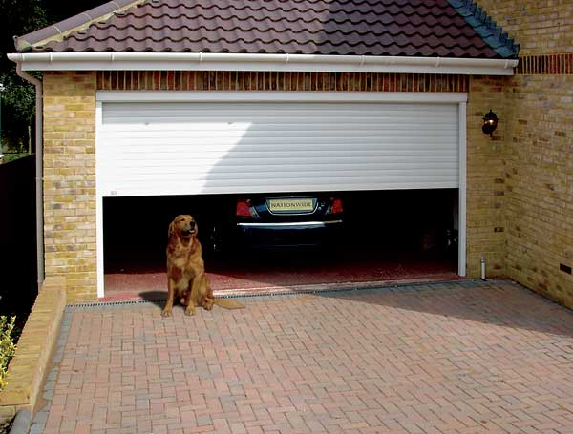
A place in a house where people can keep a car
A garage

Slide 6
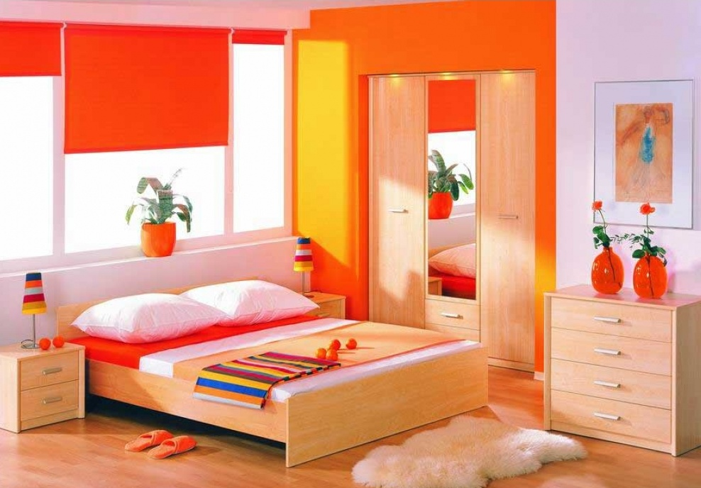
A room where people spend nearly all night
A bedroom

Slide 7
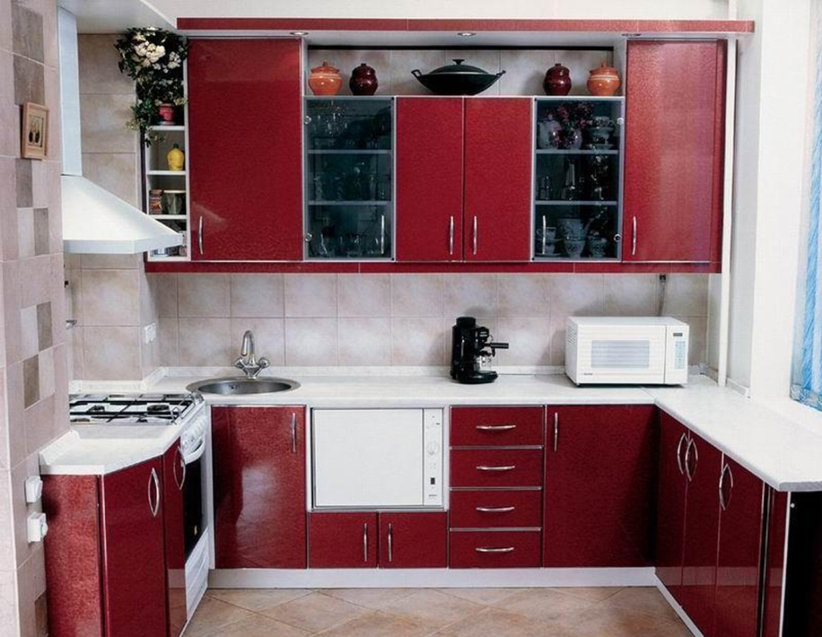
A room where people can cook something tasty
A kitchen

Slide 10
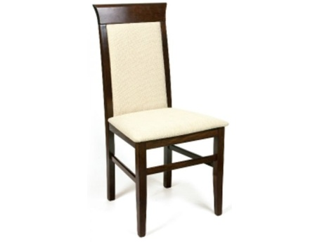
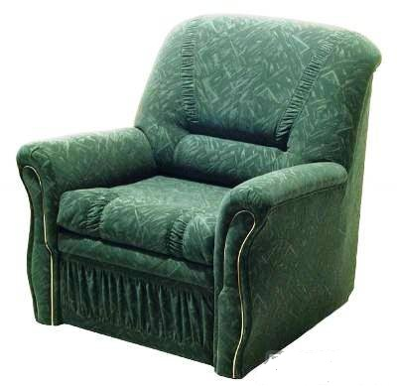
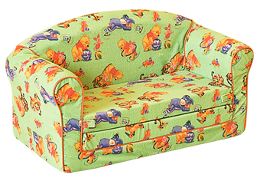
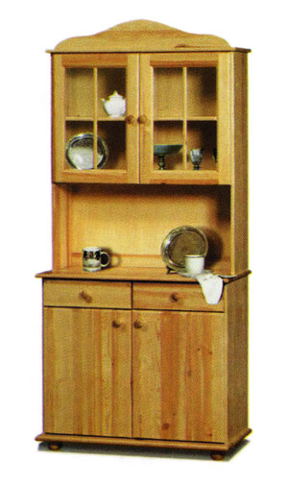
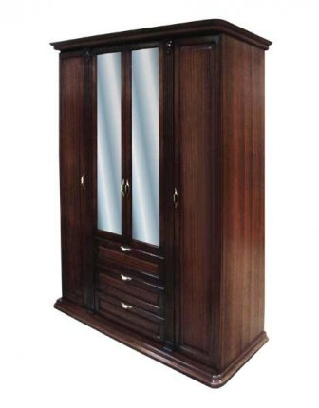
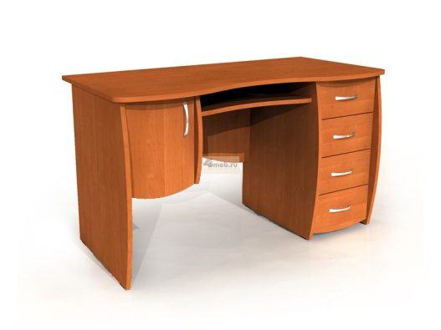
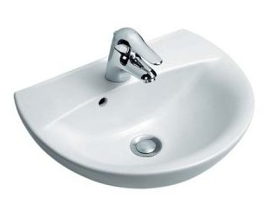

Slide 12
Check yourself

Slide 13
Now make your dream house and present it!
This is our dream house. It has got ______ rooms. They are a _______, a _______, ….
In the living room there is a ….\there are …

