Slide 1
Repeat it!
[ɜ:] -
first
[ɔ:] -
all
[i:] -
seem,
Queen,
mean
[i] -
pillar
[ɑ:] -
example
[ʌ] -
just
[ai] -
right
[iə] -
appear
[əʊ] -
over,
throne
[æ] -
that
[θ] -
thing,
everything,
throne
[ð] -
the,
that,
there,
they

Slide 2
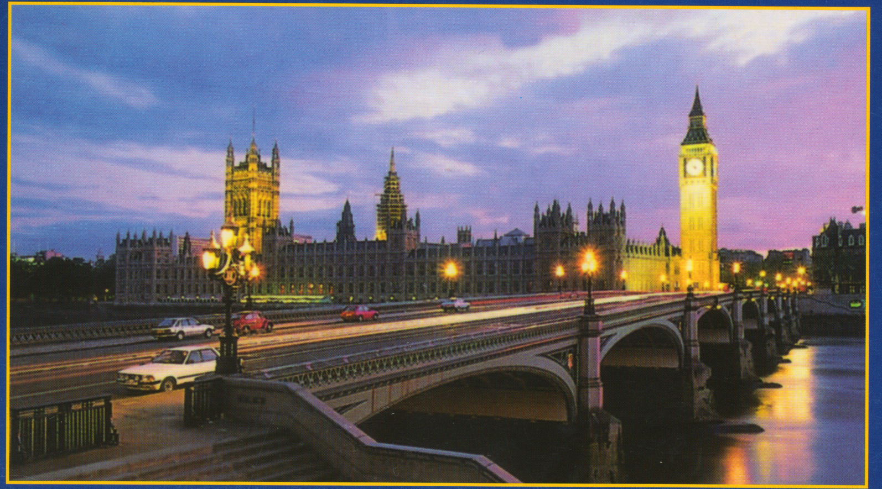
Where will we go today?

Slide 3
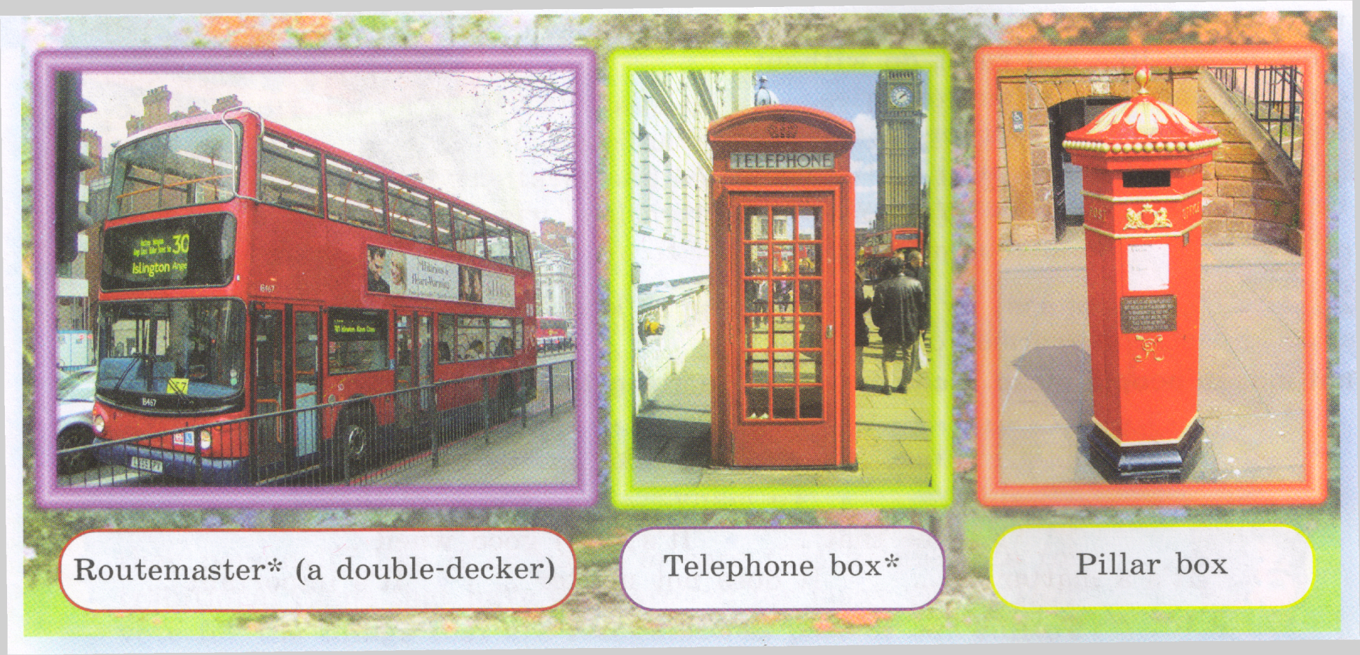
Which of the pieces of street furniture of London are Robert and Julia talking about?

Slide 4
Translate these words!
a pillar box
on the box
a letter
to send a letter
to appear
to look at

Slide 5
Answer the questions!
When did the first pillar boxes appeared?
What do the letter VR on the box mean?
How many boxes are there in London?

Slide 6
Saying that you approve
I`m all for it!
Yes, it seems just fine.
That`s very good.

Slide 7
Read the conversation!
What would you like
to see first, Julia?
I`d like to look
around here.
I`m all for it!
Why don`t we have
a look at a pillar box,
for example?
Yes, it seems just fine.
The first pillar boxes
appeared 1853. The
Letters VR on the box
mean Victoria Regina.
There are over
1000, 000 pillar boxes.
That`s very good!

Slide 8
Complete the conversation!
What would you like
to see first, Julia?
...
I`m all for it!
Why don`t we have
a look at a pillar box,
for example?
...
The first pillar boxes
appeared 1853. The
Letters VR on the box
mean Victoria Regina.
There are over
1000, 000 pillar boxes.
..!

Slide 9
Complete the conversation!
..?
I`d like to look
around here.
..!
..?
Yes, it seems just fine.
...
...
...
That`s very good!

Slide 10
Complete the conversation!
..?
...
..!
..?
...
...
...
...
..!

Slide 11
Act this conversation out!
Спроси.
Ответь.
Вырази одобрение!
Предложи.
Вырази одобрение.
Сообщи.
Вырази одобрение.

