Slide 1
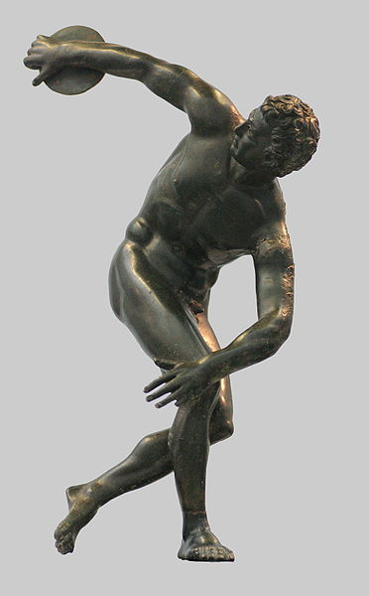
Sport

Slide 2
Contents
1) What is sport;
2) History;
3) Olympic games;
4) Sport is different;
5) Health is the men`s greatest wealth;
6) Bad habits;
7) Extreme sport;
8) The original sport;
9) Sport for everybody;
10)We are great lover of sport.

Slide 3
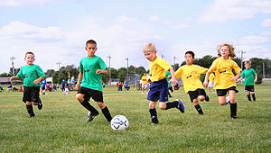
What is sport?
Sport is very important in our life. It is popular among young and old people. Sport helps people to keep in good heath. There are some popular kinds of sports in our country: football, volleyball, hockey, gymnastics, skiing, skating. Everybody may choose the sport не or she, is interested in.

Slide 4
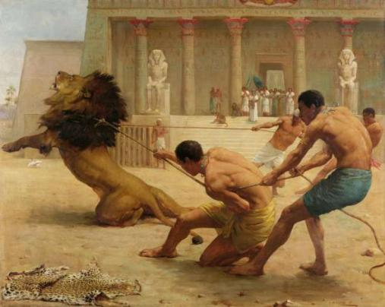
History
Some historians thinks that sports first appeared as a repetition of typical movements of a workman or a solder performed to refine practical skills some tribes of native Americans played a game which was alike football, but it had a religious meaning.

Slide 5
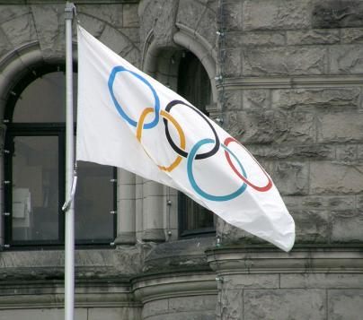
Olympic Games
European traditions started in Ancient Greece with the Olympic Games. They were started as All-Greece holidays and contest to honour Zeus in 776 BC. Every fourth year for five days all Greek athletes gathered in the city of Olympia.

Slide 6
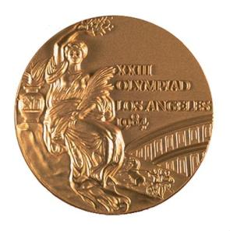
Olympic Games
The Olympic games included running, wrestling, boxing, horse-rising. The games was stopped in 394 AD because of two strong earthquakes. The present Olympic Games were started in 1896. The founder of the modern Olympics is Pierre de Coubertin. Since 1896 Olympic have been held in Britain 2 times in Landon (1908, 1948), in the USA times (1904, 1932, 1984, 1996), in Russia in Moscow 1980.

Slide 7
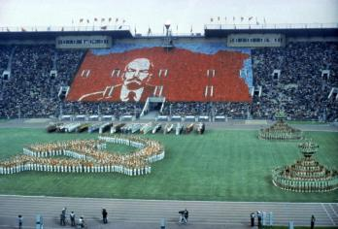
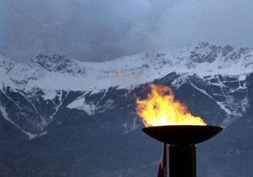
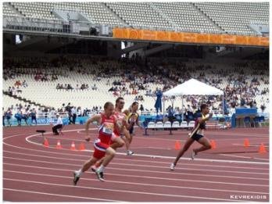
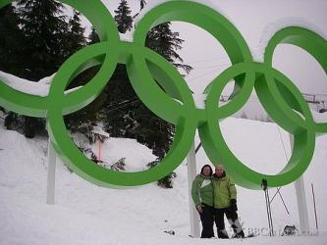
Olympic Games
Summer
Winter

Slide 8
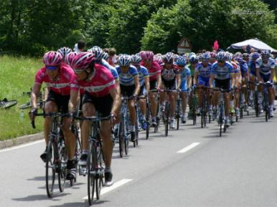
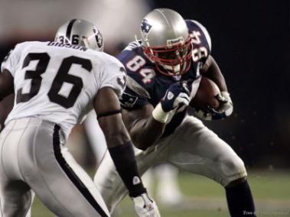
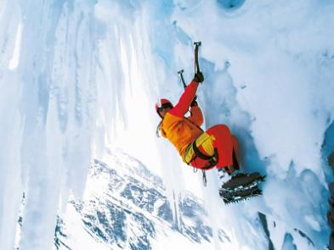
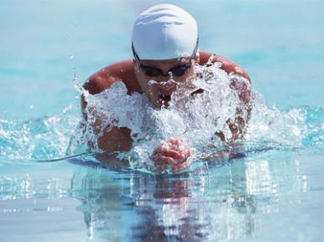
Sport is different

Slide 9
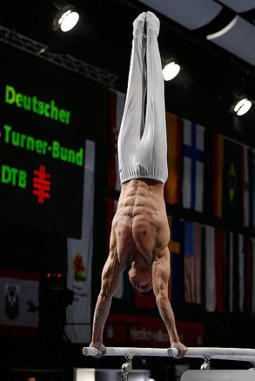
Sport as an art
Health is the man is greatest wealth. Only a healthy man can enjoy his life work well and de happy. Let is remember proverb. A sound mind in a sound body.

Slide 10
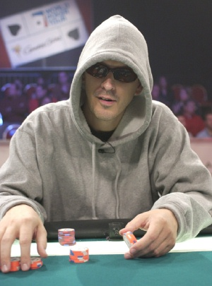
Mind sport
Bad habits can ruin your health. They are smoking, drinking alcohol and using druge. These bed habits ruin health and show your weak character.

Slide 11
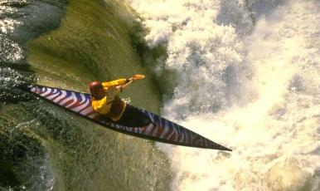
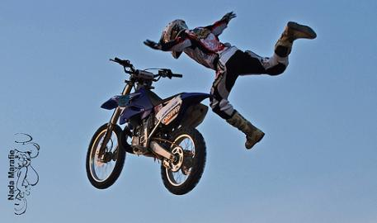
Extreme sport
Sport can be dangerous. Some people think that it is so interesting and exiting but many people think that it is the only risk.

Slide 12
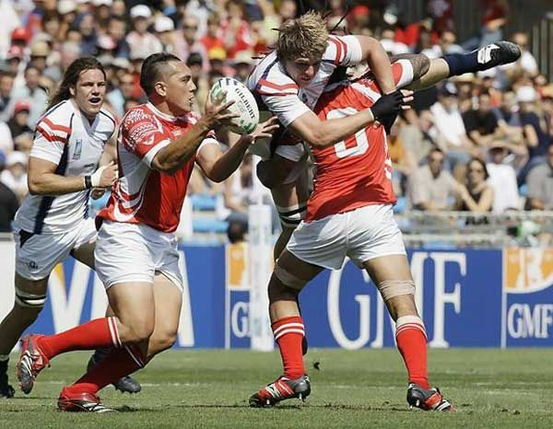
The original sport
Rugby is a team game. It was played in the city Rugby in 1823, that is why it is caled rugby. The players can pass the oval ball with their hands and their legs. The are 13 players in each professional team.

Slide 13
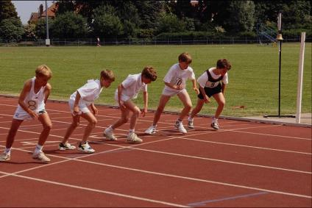
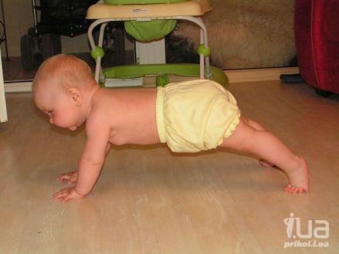
Sport for everybody
Many people do morning exercises, jog in the morning train themselves in clubs, in differernt sections and take part in different competitions.

Slide 14
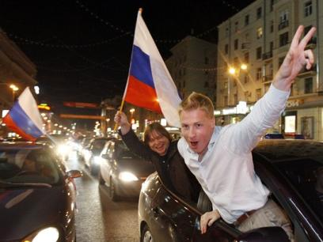
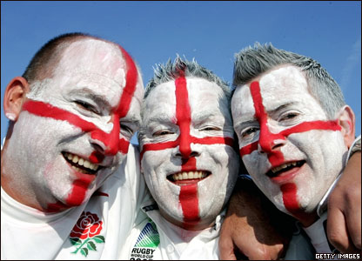
Spectators
We are great lover if sport. Sport is hobby for many of us.

Slide 15
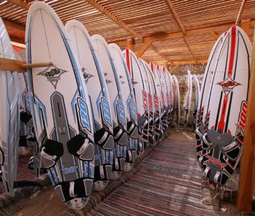
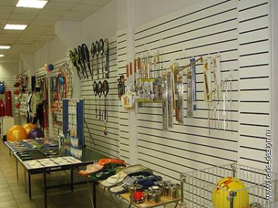
Technology
Good equipment is very important for sportsmen and lovers.

Slide 16
Future
The Olympic Games 2014 will be held in Russia in Sochi.
Before it the Olympic Games in Russia was held in 1980 in Moscow.
We all hope that our sportsmen will win all the competitions.

Slide 17
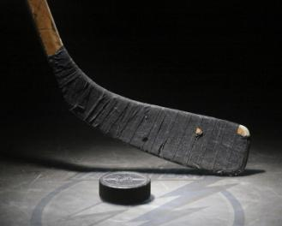
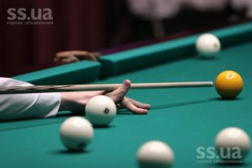
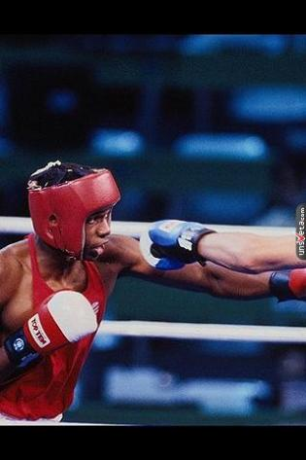
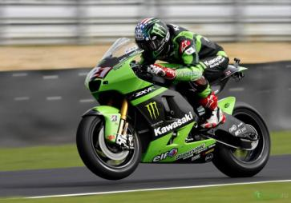
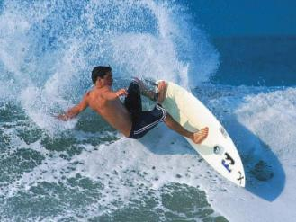
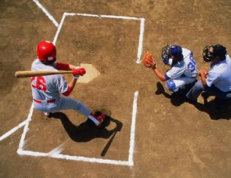
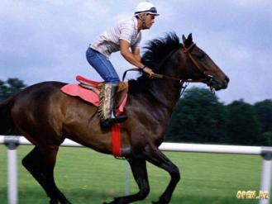
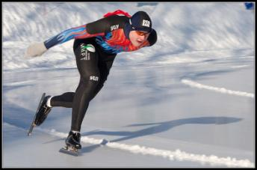

Slide 18
Tests:
1) What kinds of sport do you know?
2) Where did Olympic games start? a)1220BC b) 776BC c)336BC;
3) When was the game stopped?
a) 220AD b)500AD c)394AD;
4) Why did the Olympic Games stop?
a) the earthquake b) rain c) war;
5) When were the Present Olympic Games started?
a) 1896 b)2000 c)2005;
6) A …. mind in a …. body
a) sound b) bad c) pretty
sound bad pretty;

Slide 19
7) ……….. habits can ruin your healf.
a) bed b) good c) useless;
8) How many players in Rugby?
a) 12 b) 15 c) 13;
9) Health is the main greatest … . a) wealth b) rich c) poor.

Slide 20
Answer:
2) b, 3) c, 4) c, 5) a, 6) a, 7) a, 8) c, 9) a

Slide 21
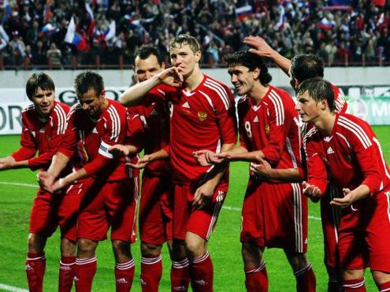
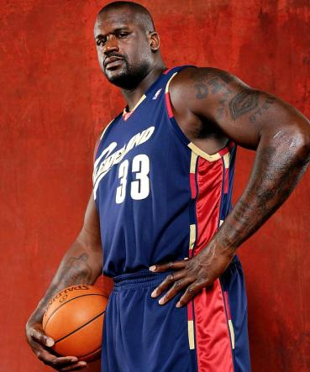
That is all!
Thanks for watching!

