Slide 1
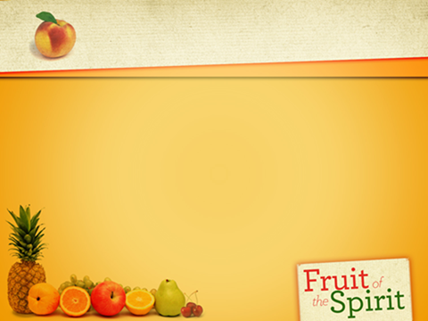
1. Health is…………….
2. Wealth is…………….
3. You are what……….. .
4. Early to bed and……..
5. Eat to live…………… .
6. An apple a day………. .
7. The best wealth………

Slide 2
Health is above wealth.
The first wealth is health.
You are what you eat.
Early to bed and you will be healthy, wealthy and wise.
Eat to live but not live to eat.
An apple a day keeps a doctor away.
The best wealth is health.

Slide 3





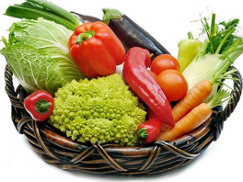
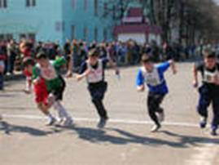

Slide 4

Health

Slide 5

a diet
fibre
obesity
smoking
alcohol
weight
to keep fit
carbohydrate
overweight
to be rich in
slimmer
inactivity
skip a meal
protein
calcium
eyesight
dairy

Slide 6
to do exercises;
to keep a healthy diet;
not to take drugs;
to eat healthy food;
to put on weight
to lose weight;
to look healthy;
to take part in the competitions….

Slide 7
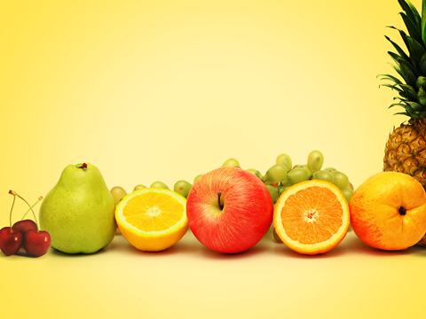
Too ----- food makes you thin.
Too ----- food makes you fat
Too ----- sweets are bad for you, especially for your teeth.
Eat ----- high fat food and ----- fibre.
----- fruit and vegetables keep you healthy.
Walking ----- makes you fit.
Sleeping too ----- or too ----- can make you nervous and restless.

Slide 8

Correct the mistakes
1. Eat more sugar. (less)
2. Don’t eat vegetables.
3. Eat many fat. (little)
4. Eat the same things. (different)
5. Eat less fresh fruit. (more)
6. Eat a lot of salt. (little)
7. Eat a lot between meals. (don’t)

Slide 9

Popular ways to lose weight and avoid gaining it
Cut out snacks and desserts – 42%
Eat less of everything – 37%
Exercise more – 32%
Cut down on fat – 32%
Do not eat at night – 29 %
Eat more fruit and vegetables – 20%
Count calories – 19%
Eat less red meat – 19%
Use low-calorie foods – 12%
Follow a diet – 1%

Slide 10


1. I exercise 3 times a week.
2. I eat at McDonald's every night.
3. I eat fruit and vegetables every day.
4. I wash my hands before breakfast.
5. I watch TV 7 hours a day.
6. I listen to very loud music.
7. I go on walks regularly.
8. I drink 5 cups of coffee a day.
9. I take vitamins every day.
10. I take a shower in the morning.
11. I sit in the sun without a suntan lotion.
12. I eat food when I watch TV.
13. I drink coke with every meal.
14. I visit a doctor regularly.
15. I eat fish for dinner.

Slide 11
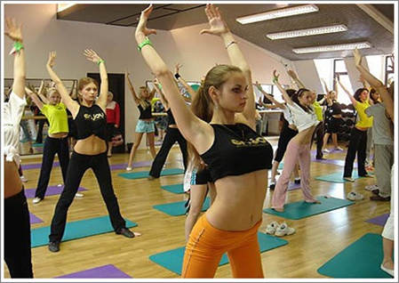




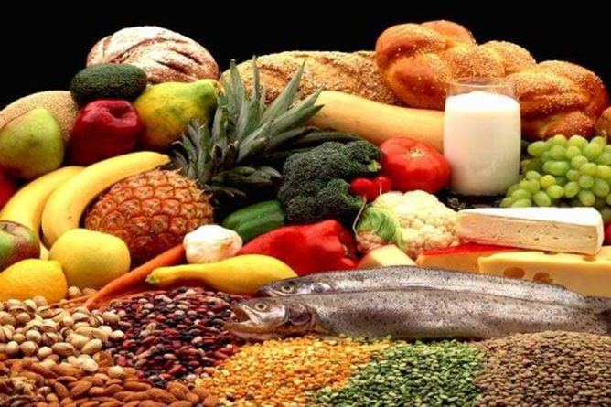

Slide 12

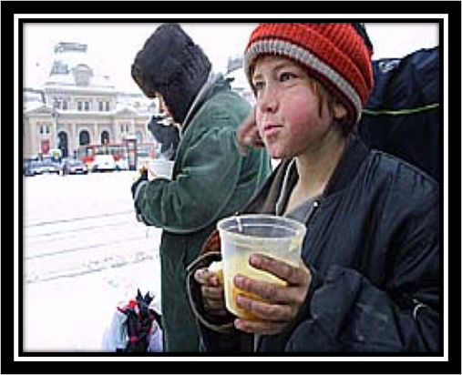



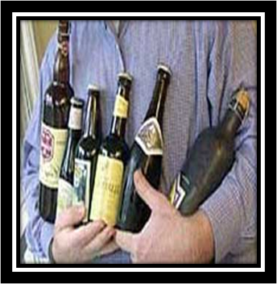

Slide 13

“Seven Deadly Health Sins“
When the Bible set down the Seven Deadly Sins they were not meant to be taken literally. Few of us will die of pride (гордость), envy or anger. There are, however, modern health sins which are in fact far more deadly.
Two of them – obesity and physical inactivity are known from ancient times .They are joined by the modern bad habits: smoking and drinking too much alcohol , and the surprising ‘danger’ of sleeping too much or too little, eating between meals and skipping breakfast. In combination, these poor health habits could double the chance of dying or lead to different diseases for those who survive.
Of course sleeping too much or too little, snacking and skipping breakfast are not quite as deadly as smoking, obesity and drinking. But they are indicative of dangerously chaotic lifestyles.
Regularity in life promotes your health. Sleeping seven or eight hours , getting up early, eating breakfast, a healthy diet and regular meals is really a good way to live.

Slide 14
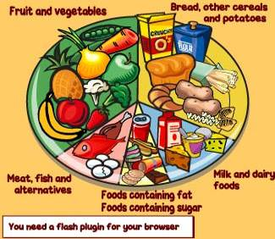

Slide 15

Too little food makes you thin.
Too much food makes you fat.
The wrong food makes you ill.
The right food makes you well.
Too many sweets are bad for you especially for your teeth.

Slide 16
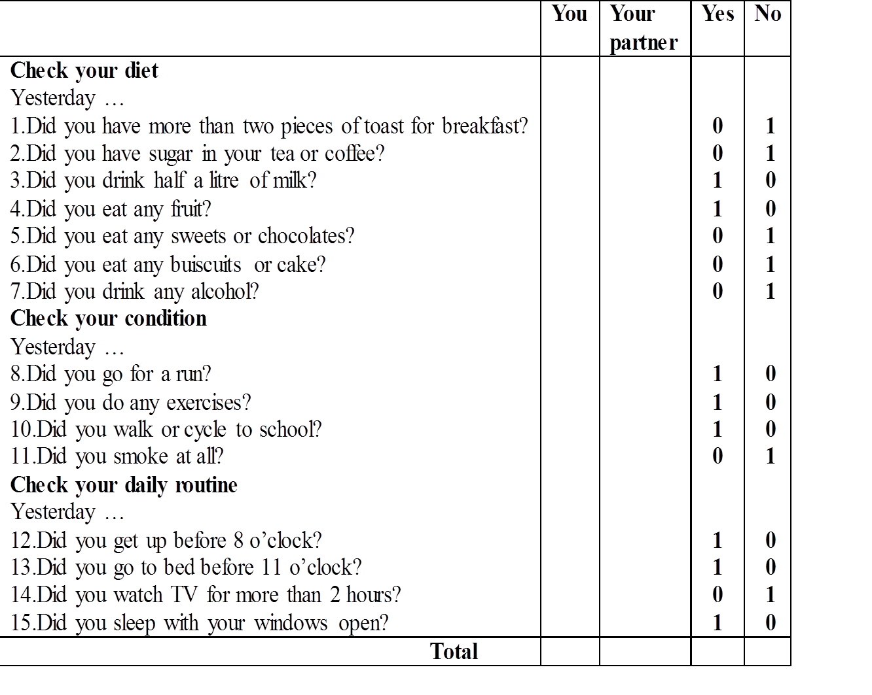
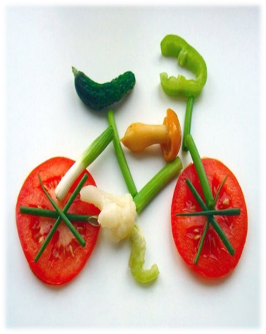

Slide 17
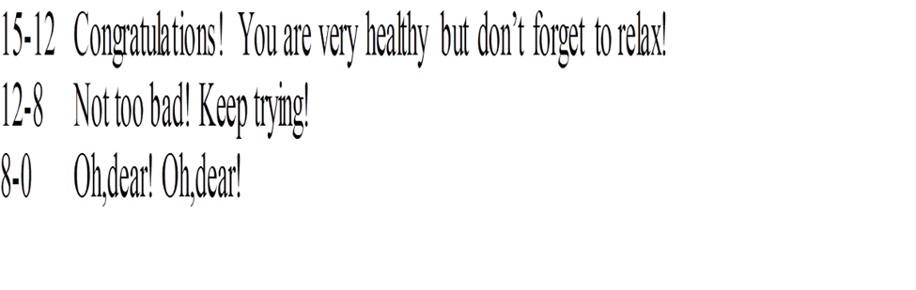
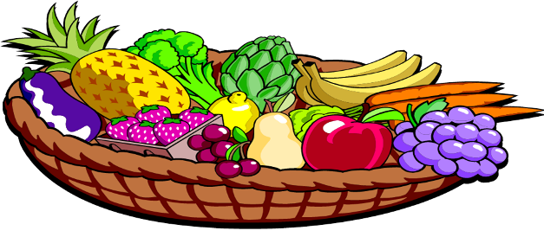

Slide 18


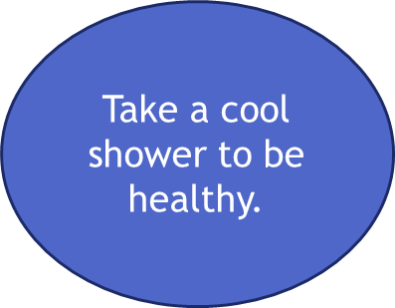

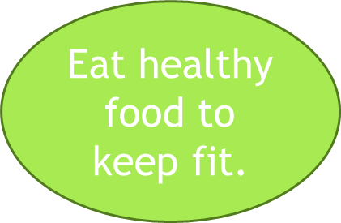

Don't smoke.
Don’t take alcohol, drugs
Don’t eat many sweets
How to
be
healthy?
Sleep 8 hours
Avoid fast food.

Slide 19


Slide 20

Page 86,91 ex.1-3
Home work

