Slide 1
Kazan — the center of XXVII World Summer Universiade 2013 г.

Slide 2
XXVII World Summer Universiade in Kazan 2013:
Competitions on 27 sports will be held during the Universiade;
About 12 thousand athletes will take part in this competition;
170 countries will come to the Universiade;
64 venues will be used for the Universiade, 36 of them are being specially built.

Slide 3
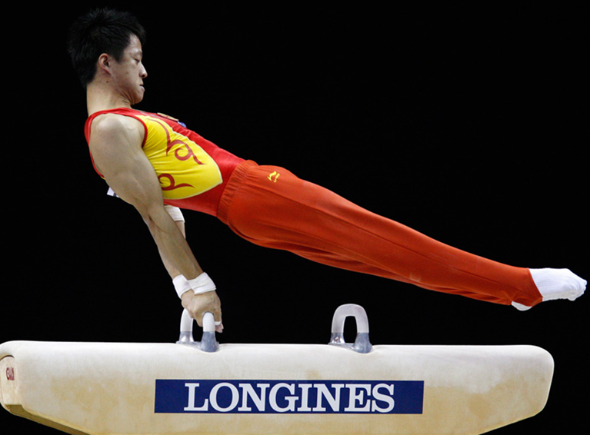
Free callisthenics and Olympic gymnastics

Slide 4
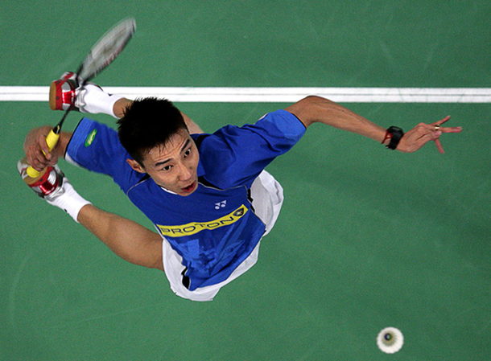
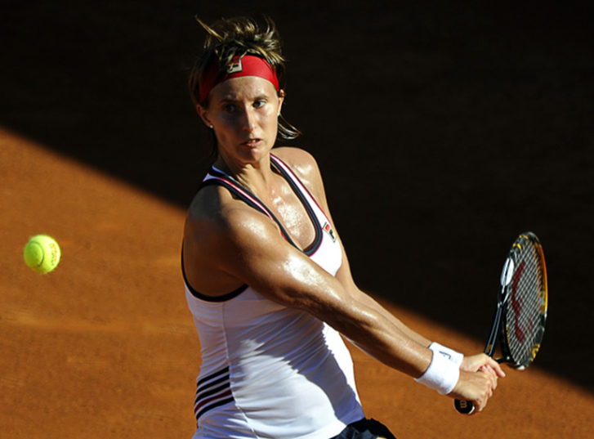
Table tennis, tennis and badminton

Slide 5
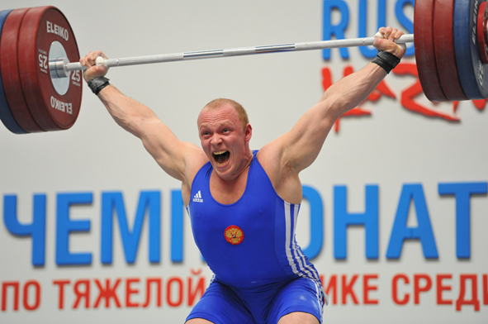
Track and field events and heavy weighlifting
Athletics

Slide 6
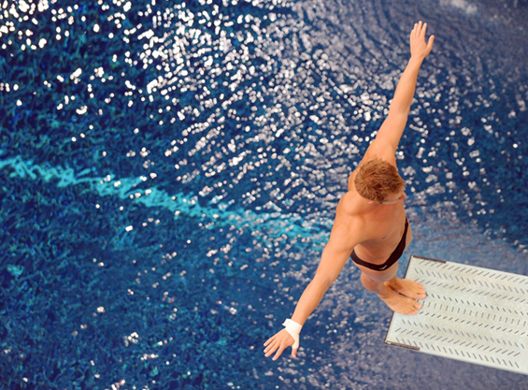
Diving and water polo

Slide 7
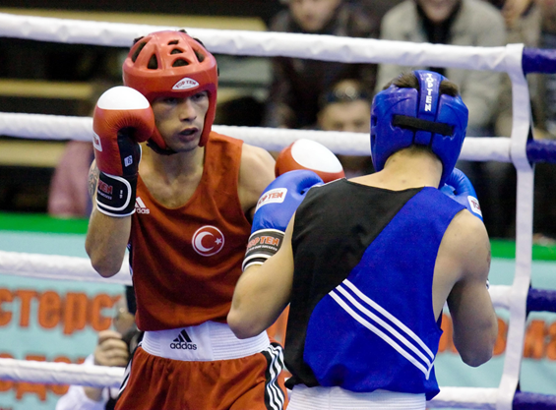
Fencing and boxing

Slide 8
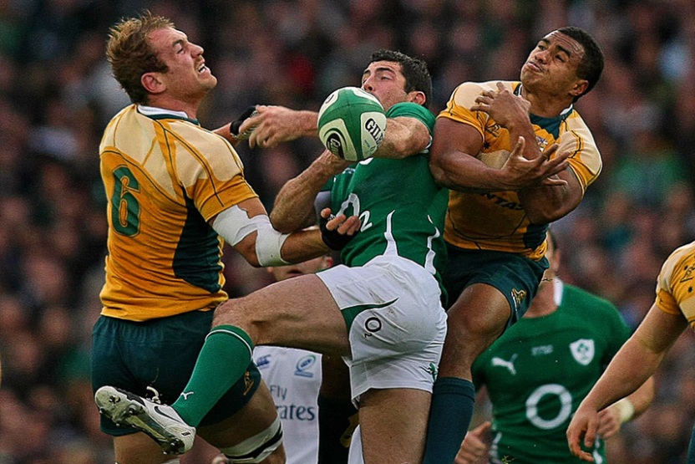
Football and rugby

Slide 9
Volleyball and beach volleyball

Slide 10
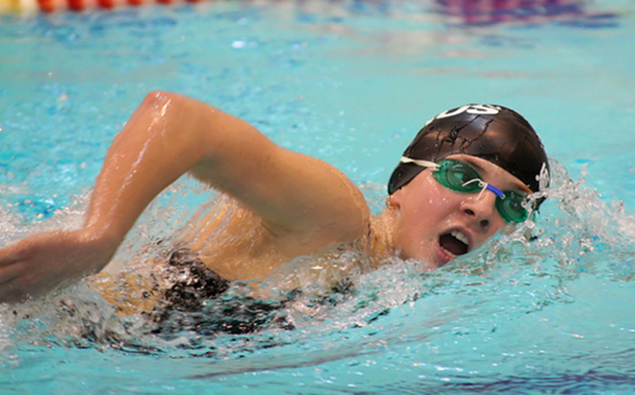
Synchronized swimming and swimming

Slide 11
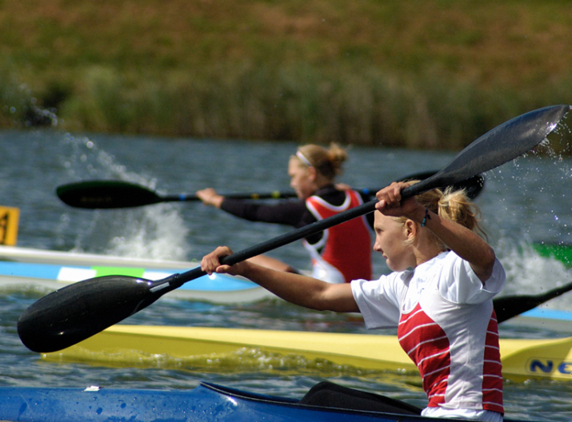
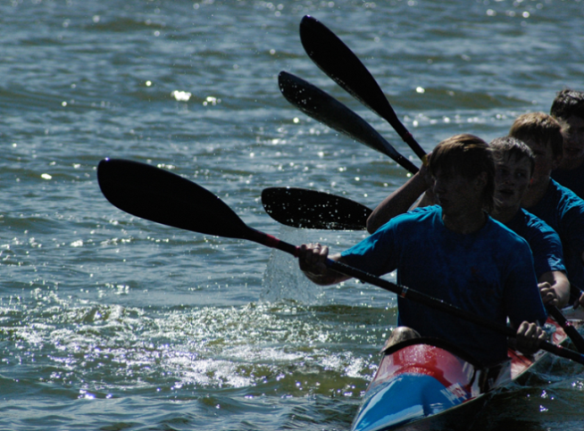
Boat-racing, rowing and canoeing

Slide 12
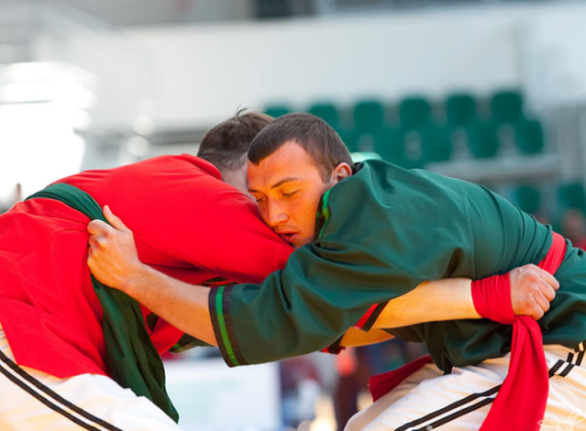
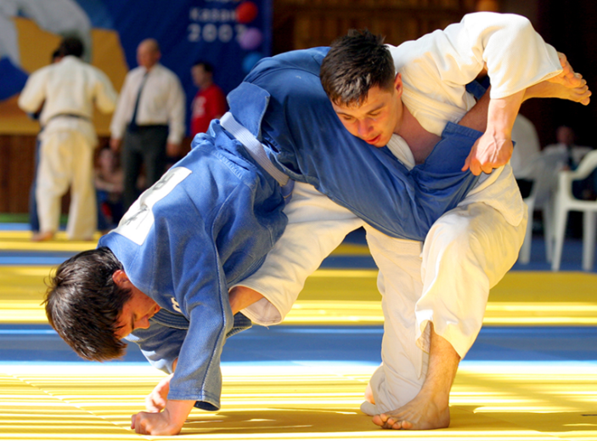
Sambo, judo and Kurash

Slide 13
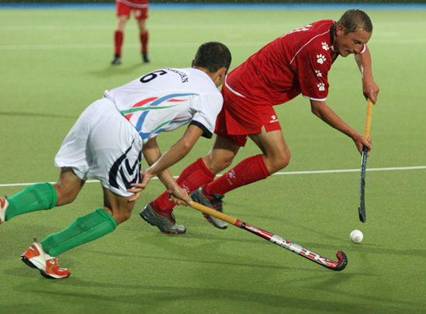
Basketball and field hockey

Slide 14
Chess

