Slide 1
Карбоновые кислоты
R – COOH
C_{n}H_{2n+1}COOH
C_{n}H_{2n-7}COOH
C_{n}H_{2n-1}COOH

Slide 2
Карбоновые кислоты
HCOOH
HOOC – CH₂ – CH₂ – COOH
C₆H₅COOH
H₃C – COOH
HOOC – COOH
CH₃ – (CH₂)₄ – CH₂ – COOH
OH
|
HOOC – CH2 – C – CH2 – COOH
|
COOH
H₃C – CH₃ – COOH
|
OH
CH₃ – (CH₂)₇ – CH = CH – (CH₂)₇ – COOH

Slide 3
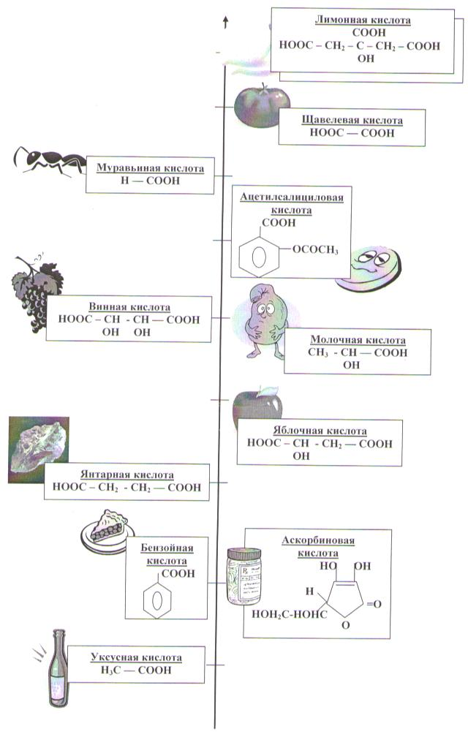
Шкала кислотности

