Slide 1
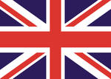
Do You Know Britain Well ?
Kartashova T. M.

Slide 2
Discover
Britain
100
150
200
250
300
350
400
450
500
Names
100
150
200
250
300
350
400
450
500
Places
100
150
200
250
300
350
400
450
500
Symbols
100
150
200
250
300
350
400
450
500

Slide 3
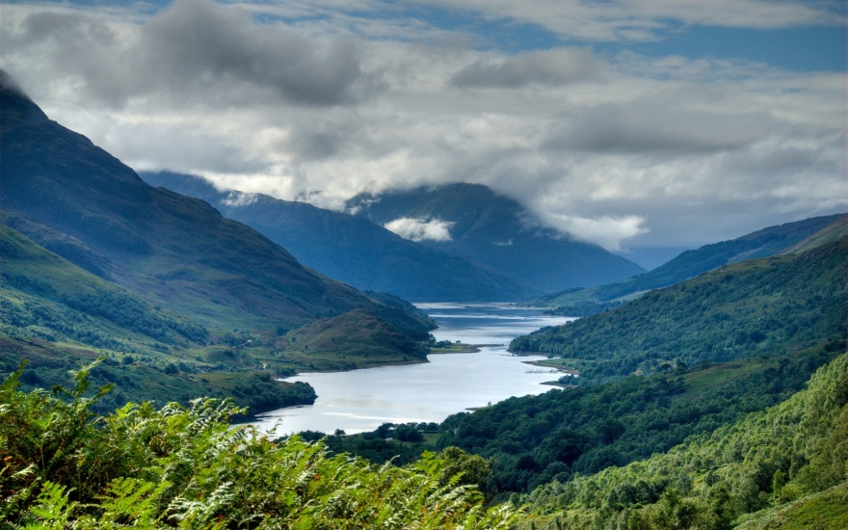
Scotland is divided into two parts.
Highlands and Lowlands
back

Slide 4
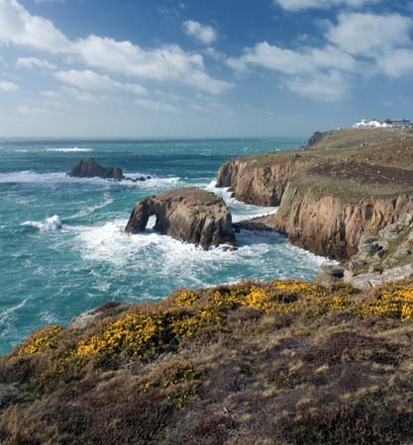
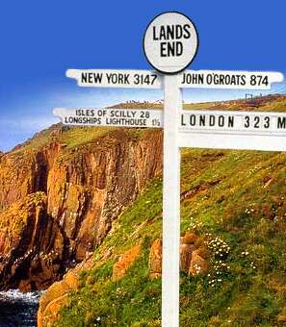
The most westerly point of Britain which is in the Southwest.
the Land’s End
back

Slide 5
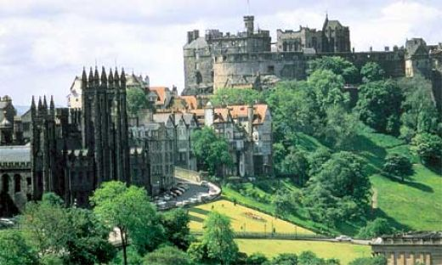
This city is known as Athens of the North.
Edinburgh
back

Slide 6
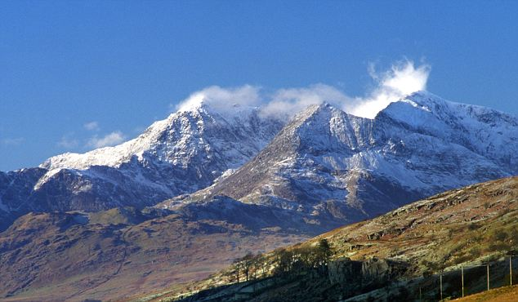
It is the second highest mountain in Britain.
Mount Snowdon
back

Slide 7
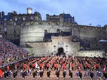
The event which takes place every August and September in Edinburgh and is known throughout the world.
The Edinburgh Millitary Tattoo
back

Slide 8
The heart of England, the largest industrial part in the country, it is connected with culture and education.
The Midlands
back

Slide 9
This part of England is famous for it resorts. Heathrow airport is there.
The Southeast
back

Slide 10
The main activity in this part of Britain is farming. It used to be known for its pirates.
The Southwest
back

Slide 11
This part of England is very flat. It’ s a farming region too and is rather isolated from the continent.
East Anglia
back

Slide 12
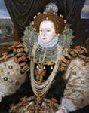
During her reign the Spanish Armada was defeated. She never married. She is famous for the saying “I have the body of a weak and a feeble woman, but I have the heart and stomach of a King.”
Elizabeth I
back

Slide 13
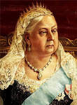
This monarch ruled for the longest period in the English history for 64 years.
Queen Victoria
back

Slide 14
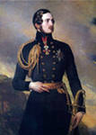
He was a German and died at the age of 42. His wife left London and never lived in the city where she was so happy with her husband and nine children.
Prince Albert
back

Slide 15
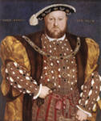
During his reign Britain became independent of the Roman Catholic Church. In 1534 the Parliament named him head of the Church of England.
Henry VIII
back

Slide 16
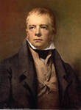
Princes Street is connected with the name of this person. His monument is there.
Walter Scott
back

Slide 17
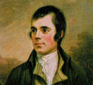
Scotland is his birthplace and he wrote a lot of poems about it.
Robert Burns
back

Slide 18
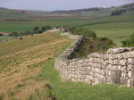
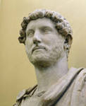
He built a wall across Britain to protect his army from the Scottish tribes.
A Roman Ruler Hadrian
back

Slide 19
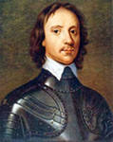
An English general and politician who was born in the Fens area. He became Lord protector of England after the Civil War.
Oliver Cromwell
back

Slide 20
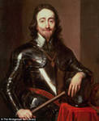
Oliver Cromwell was the leader of the army in the Civil War against this king.
King Charles I
back

Slide 21
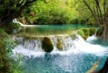
The main attraction of the North of England.
Tourists enjoy its picturesque scenery.
The Lake District
back

Slide 22
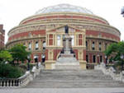
Best musicians perform classical music there.
The Royal Albert Hall
back

Slide 23
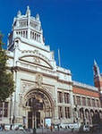
It has rich collections of paintings and other works of art and is connected with the name of queen Victoria.
Victoria and Albert Museum
back

Slide 24
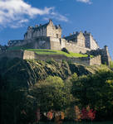
It looks good in any weather and at night it is floodlit.
Edinburgh Castle
back

Slide 25
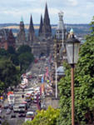
This street lies between the Old Town and the New Town. It has a lot of gardens in one side and is connected with the name of Walter Scott.
Princes Street
back

Slide 26
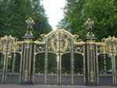
This park used to be a hunting forest , it is famous for Speaker’s Corner.
Hyde Park
back

Slide 27
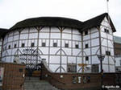
William Shakespeare worked as an actor in that theatre.
The Globe Theatre
back

Slide 28
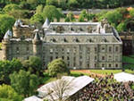
The residence of the Queen in Edinburgh.
Hollyrood Pallace
back

Slide 29
Visitors coming to Stratford admire this building and honour the memory of W. Shakespeare who was buried there.
The Holy Trinity Church
back

Slide 30
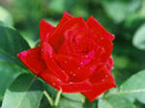
The national symbol of England.
Red Rose
back

Slide 31
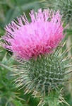
The national symbol of Scotland.
A Thistle
back

Slide 32
Patron Saint of Scotland.
St. Andrew
back

Slide 33
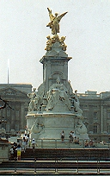
You can see this monument in front of Buckingham Pallace.
The monument to Queen Victoria
back

Slide 34
Two national symbols of Wales.
a leek and a daffodil
back

Slide 35
Patron Saint of Wales.
St. David
back

Slide 36
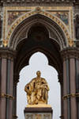
This monument is in front of the famous concert hall in London.
The monument to Prince Albert
back

Slide 37
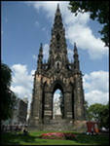
People call it a poem of stone. It’s 200 feet high. You can see it in Edinburgh.
The monument to Walter Scott
back

Slide 38
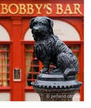
This monument is a symbol of devotion.
The monument to the dog Bobby
back

