Slide 1
The Media in Russia

Slide 2
Television

Slide 3
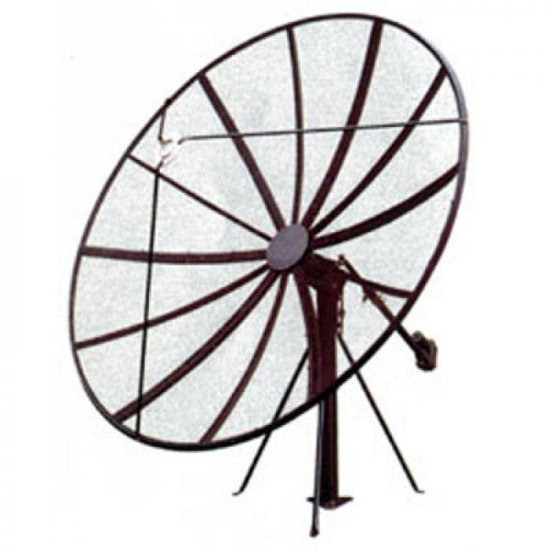
The most popular entertainment in Russia is television.
About 95% of homes have TV-sets.

Slide 4
What are the most popular TV channels in Russia?

Slide 5
Radio

Slide 6
There are about 100 radio stations in Russia.
About 60% of population listen to the radio every day.

Slide 7
Newspapers

Slide 8
There are more than 4,000 newspapers and magazines in Russia.

Slide 9
The Internet

Slide 10
9.2 million people use the Internet in Russia.
80% of Internet users go on-line every day.

Slide 11
Local statistics

