Slide 1
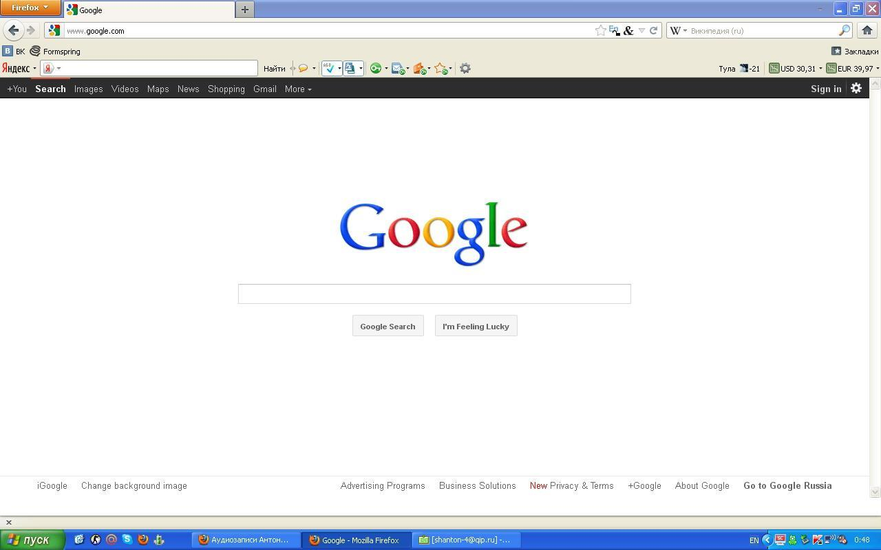

Slide 2
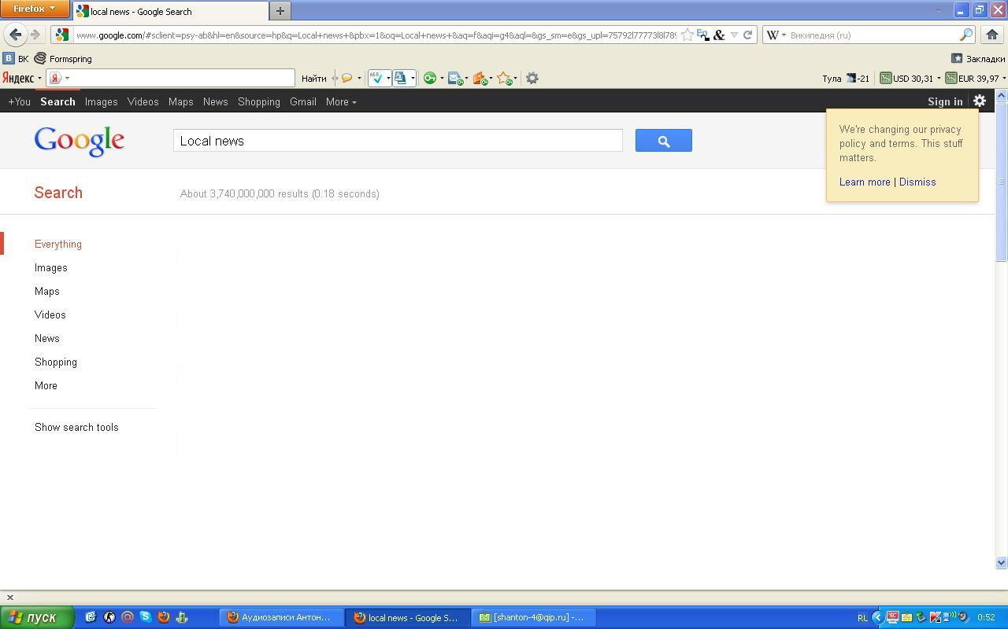
Local Heroes
A teacher from a country school rescued three people.
Accidents on the roads
A car crashed near a country pub.
True life drama
Saver or liar?

Slide 3
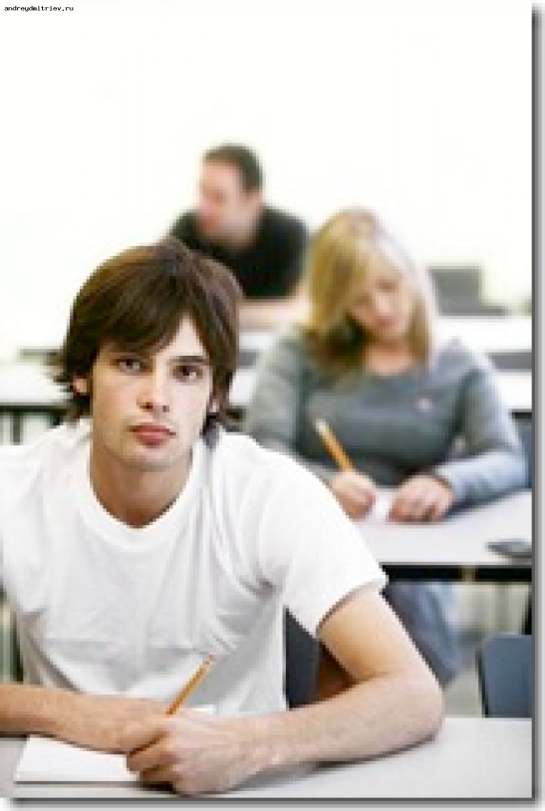
Accidents on our roads Local Heroes
Liz Pursey, a teacher from a country school, rescued three people from a burning car. We interviewed Michael Lawrence, one of her former students.
R: How would you describe her character?
M: Liz Pursey was full of enthusiasm and made everything interesting. She demonstrated things with lots of practical examples. She made me feel that I could do things. She is hardworking, inventive, generous, reliable, always ready to help.

Slide 4
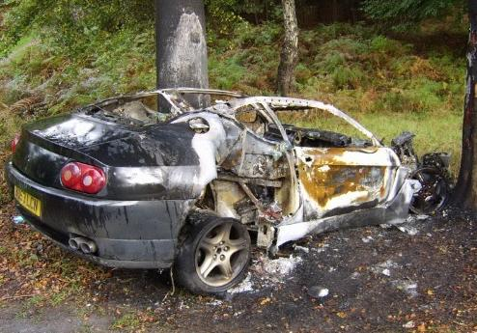
Local news Accidents on the roads
Yesterday evening a car crashed near a country pub and burst into flames. Three people were trapped inside. The driver was unconscious. People who were nearby called the emergency services. It was the third accident this week.

Slide 5
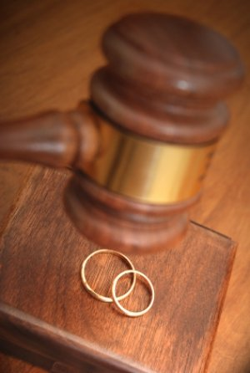
True Life Drama
Liz Pursey who saved three people from a burning car published an article in one of the women’s magazines where she told about her brave, heroic deed. Her friend Neil with whom they were going to marry broke off their relations. That’s the real life drama.

