Slide 1
Mass Media

Slide 2
Mass Media plays an important part in our life

Slide 3
The most popular nowadays is the Internet

Slide 4
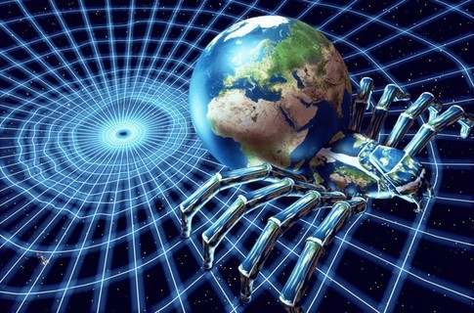
- It informs us of what is going on in the world - It gives us wonderful possibilities for education and entertainment

Slide 5
What can we find there???

Slide 6
Practically everything!

Slide 7
Teenagers prefer to use the Internet for entertainment

Slide 8
They can find information about new films, videos, modern music. They can also chat online, look for new friends and play online games

Slide 9
Some people prefer to use the Internet for education

Slide 10
They use it to get new information, to learn the news or the weather forecast
It often helps people to find a job

Slide 11
More and more people use the Internet every day
We cannot imagine our life without it!

