Slide 1
Презентация к уроку английского языка в 4 классе
по теме «Past Simple»
Выполнена учителем английского языка МКОУ СОШ №105»
Землянской Татьяной Васильевной

Slide 2
Past Simple

Slide 3
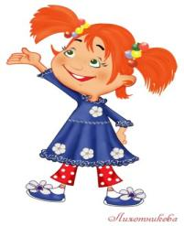
Past Simple
правильные
неправильные
V + (e)d
walk+ed=walked
V меняет форму
go=went

Slide 4
Regular verbs (правильные глаголы) [t] [d] [id]
watched played skated
walked tried wanted
talked cried collected
finished lived painted
liked listened needed
helped opened invited

Slide 5
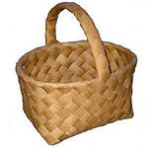
watched
learned
collected
cried
skated
played
finished
painted
walked
wanted
looked
talked
tried
smiled
needed
[t]
[d]
[id]

Slide 6
Irregular verbs (неправильные глаголы)
see
go
have
say
fly
fall
do
take
give
sit
saw смотрел
went ходил
had имел
said говорил
flew летал
fell падал
did делал
took взял
gave дал
sat сидел

Slide 7
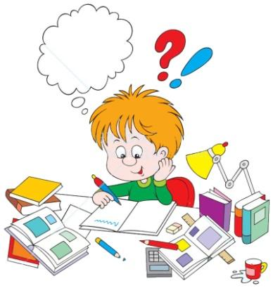
Check your homework
finish
ask
answer
listen
like
collect
walk
study
talk
look
finished
asked
answered
listened
liked
collected
walked
studied
talked
looked

Slide 8
Let’s play puzzles
put
say
see
have
go
come
walk
take
give
like
liked
said
went
had
gave
came
took
saw
put
walked

Slide 9
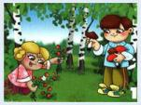
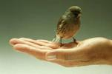
Retell the text
walked in the forest
was hot
sat down under the tree
talked and talked
saw a bird
took the bird in his hands
went home
lived in their hose two weeks
took the bird to the forest
was happy

Slide 10
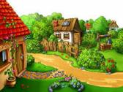
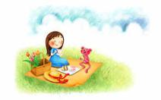
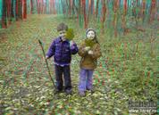
Last summer I went to the country
flew
had
went
walked
played
to the country
a kite
a picnic
in the forest
badminton/computer games

Slide 11
Dear Jim,
Last month I (be) was at Chatterplace. I (have) ___ a good time there. I (live) ___ in a small but nice room. When it (be) ___ fine and warm, I (go) ___ for a walk and (play) ___ tennis.
I (help) ____ Miss Chatter to feed the animals. I (learn) ____ to ride a horse. When it (be) ___ sunny, I (fly) ___ a kite in the field. I (see) ___ a lot of beautiful places. I (visit) ____ Tiny and (listen)____ to his new fairy tale.
I (like)____ my holidays. I’ll come back to Chatterplace next year. Would you like to go with me?
Please write back. Yours, Ben.
had
lived
was
went
played
helped
learned
was
flew
saw
visited
listened
liked

Slide 12
Choose the right answer
Jim and Jill … to the forest.
go b) went c) goes
2. They … under a big tree.
sat b) sit c) will sit
3. They … a small bird.
see b) saw c) will see
4. They … the bird very much.
a) like b) liked c) likes
5. The bird … in the house.
a) live b) will live c) lived

Slide 13
Good Bye!

