Slide 1
Степени сравнения прилагательных
Учитель английского языка МКОУ СОШ №1 г. Лиски Железняк Г. В.

Slide 2
Прилагательные:
Односложные (один слог) | Двусложные (два слога) | Многосложные (более двух слогов)
Big | Nice | Interesting
Fat | Happy | Popular
Slim | Sunny | Beautiful
Tall | Funny | Wonderful
red | Snowy | Comfortable

Slide 3
Степени сравнения прилагательных
Положительная степень
Превосходная степень
Сравнительная степень

Slide 4
Односложные и двусложные прилагательные
Положительная степень | Сравнительная степень | Превосходная степень
Small
Nice
Cold
Big
Fat
Happy
Funny

Slide 5
Односложные и двусложные прилагательные
Положительная степень | Сравнительная степень | Превосходная степень
Small | Smaller | The smallest
Nice | Nicer | The nicest
Cold | Colder | The coldest
Big | Bigger | The biggest
Fat | Fatter | The fattest
Happy | Happier | The happiest
Funny | Funnier | The funniest

Slide 6
Многосложные прилагательные
Положительная степень | Сравнительная степень | Превосходная степень
Interesting
Popular
Beautiful
Comfortable
Useful
Wonderful

Slide 7
Многосложные прилагательные
Положительная степень | Сравнительная степень | Превосходная степень
Interesting | More interesting | The most interesting
Popular | More popular | The most popular
Beautiful | More beautiful | The most beautiful
Comfortable | More comfortable | The most comfortable
Useful | More useful | The most useful
Wonderful | More wonderful | The most wonderful

Slide 8
Прилагательные – исключения
Положительная степень | Сравнительная степень | Превосходная степень
Good | Better | The best
Bad | Worse | The worst
Many/Much | More | The most
Little | Less | The least
Well | Better | The best
Far | Farther | The farthest

Slide 9
Заполни таблицу
Положительная степень | Сравнительная степень | Превосходная степень
Big |  | The biggest
Happy | Happier
 | Taller | The tallest
Cold |  | The coldest
Nice | Nicer
Interesting |  | The most interesting
 | Slimmer
Sunny |  | The sunniest
 | More beautiful

Slide 10
Заполни таблицу
Положительная степень | Сравнительная степень | Превосходная степень
Big | Bigger | The biggest
Happy | Happier | The happiest
Tall | Taller | The tallest
Cold | Colder | The coldest
Nice | Nicer | The nicest
Interesting | More interesting | The most interesting
Slim | Slimmer | The slimmest
Sunny | Sunnier | The sunniest
Beautiful | More beautiful | The most beautiful

Slide 11
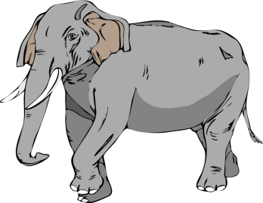
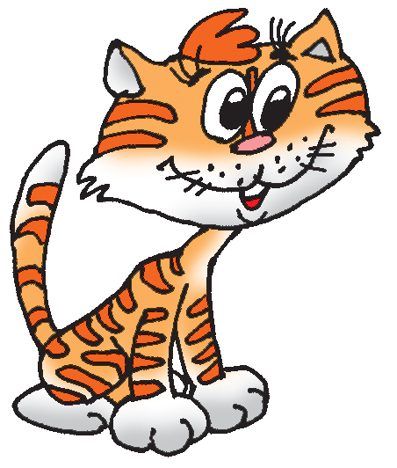
При сравнении степени качества одного предмета со степенью качества другого употребляется союз than (чем)
The cat is smaller than the elephant
The elephant is bigger than the cat

Slide 12
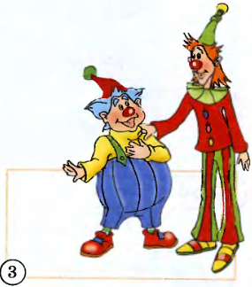
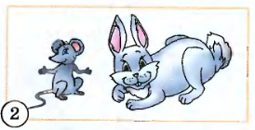
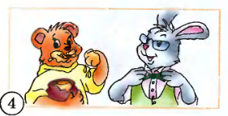
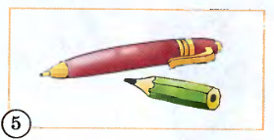
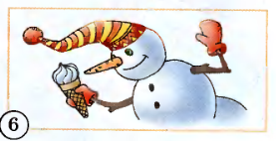
Answer the questions
Who is stronger?
Who is smaller?
Who is taller?
Who is cleaner?
Which is shorter?
Which is colder?

Slide 13
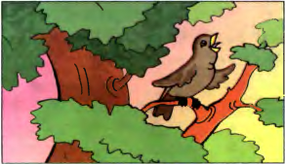
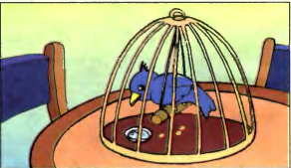
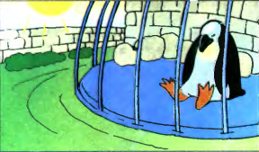
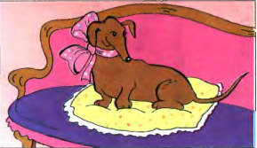
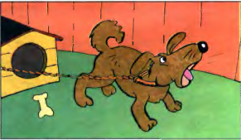
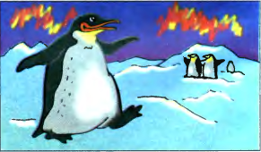
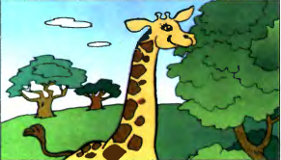
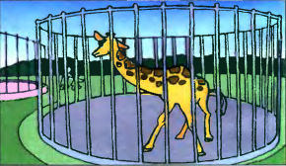
Look at the pictures and say: Which one is happier?
or
In hot summer
In the tree
In the cage
or
or
In the house
In the yard
or
In cold winter
In Africa
In the zoo

Slide 14
If you're happy and you know it, clap your hands.
If you're happy and you know it, clap your hands.
If you're happy and you know it, And you really want to show it,
If you're happy and you know it, clap your hands.
If you're happy and you know it, stamp your feet.
If you're happy and you know it, stamp your feet.
If you're happy and you know it, And you really want to show it,
If you're happy and you know it, stamp your feet.
If you're happy and you know it, slap your knees.
If you're happy and you know it, slap your knees.
If you're happy and you know it, And you really want to show it,
If you're happy and you know it, slap your knees.
If you're happy and you know it, click your fingers.
If you're happy and you know it, click your fingers.
If you're happy and you know it, And you really want to show it,
If you're happy and you know it, click your fingers.

Slide 15
Good luck!

