Slide 1
Table Manners

Slide 2
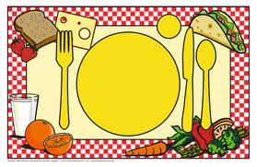
Lesson Objectives
To learn the table manners
To practice using lesson vocabulary
Lesson Vocabulary
Nouns Expressions
Dessert To sit up straight
Dinner spoon To eat with one’s fingers
Soup To put one’s elbows on the table
Dessert To talk with one’s mouth full
Dinner fork To lick one’s fingers
Salad
Butter knife
Dinner
Plate
Napkin

Slide 3
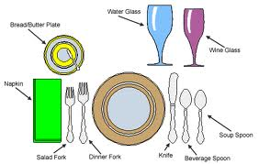
Brainstorm
Say how to set the table.
Example:
You should put a knife to the right of the plate.
Cup and saucer
bbbjg
Butter plate
Napkin
Plate
Soup spoon
Dessert spoon
Salad fork
Dinner fork
Knife

Slide 4
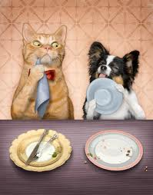
Grammar
Modal Verb Should/shouldn’t
Fill in the blanks with should/ shouldn’t
1. You ___________ wash your hands before eating.
2. You ___________ sit up straight.
3. You ___________ place your napkin on your lap .
4. You ___________ eat with your fingers.
5. You ___________ put your elbows on the table.
6. You ___________ ask for something to be passed to you.
7. You ___________ put your dirty knife, spoon on your table.
8. You ___________ talk with your mouth full.
9. You ___________ lick your fingers.
10. You __________ say “Thank you” after the meal.

Slide 5
Dialogue
Pat and Anne want to make shortbread biscuits.
Put sentences A-E in the correct place.
Pat: OK. Have we got everything we need?
Anne: [ ] [A] Well, we’ve got about half a kilo.
Pat: First, we need some sugar.
Anne: [ ] [B] Butter. Er … Oh no! We haven’t
got any butter!
Pat: Good. And flour?
Anne: [ ] [C] I don’t know. What do we need?
Pat: That’s fine!
Anne: [ ] [D] We’ve got some milk and eggs.
Do we need them?
Pat: No, we don’t. Butter. Is there any butter?
Anne: [ ] [E] Yes. Yes. We’ve got lots of sugar.
Pat: Not again! Let’s go to the shop then.

Slide 6
Skill – Reading Comprehension
To burp – рыгать
To chuckle – хихикать
To growl – ворчать
Grumpily – сердито
To wipe – вытирать
To groan –тяжело вздыхать
To fidget – ёрзать
To grab – схватывать
To shovel up the food - уплетать
To whine – хныкать
Softly – тихо
To overload - перегружать (здесь «класть много»)

Slide 7
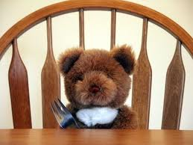
Enjoy your meal!
Thank you for the lesson!

