Slide 1
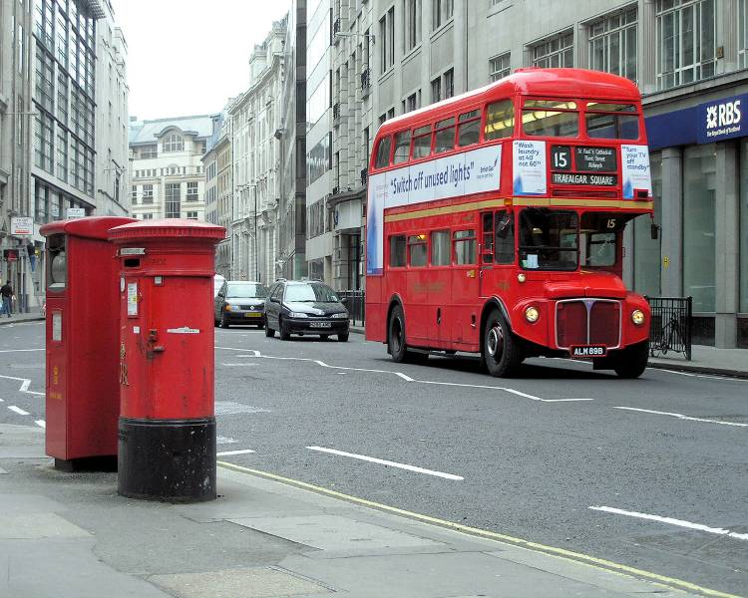
YOU ARE WELCOME

Slide 2
IT’S TIME TO BEGIN OUR LESSON.

Slide 3
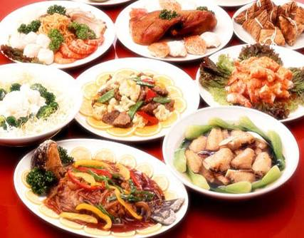
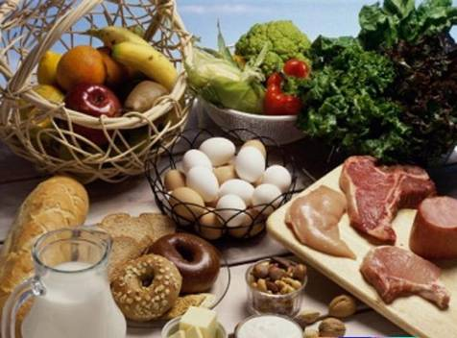

Slide 4
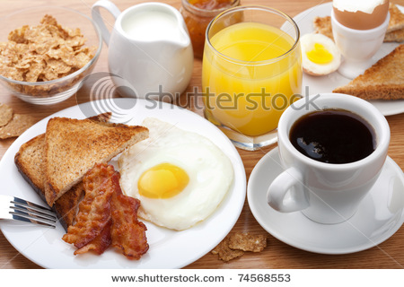
THE TRADITIONAL ENGLISH FOOD.

Slide 5
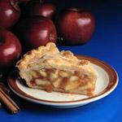
THE AIMS OF THE LESSON:
PRACTICE IN READING OF THE TEXT
PRACTICE IN LISTENING TO THE TEXT
PRACTICE IN SPEAKING
PRACTICE IN MAKING THE PROJECTS

Slide 6
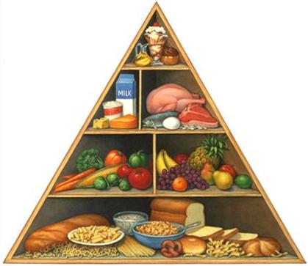
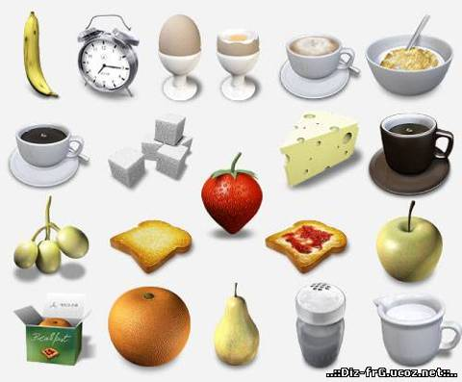
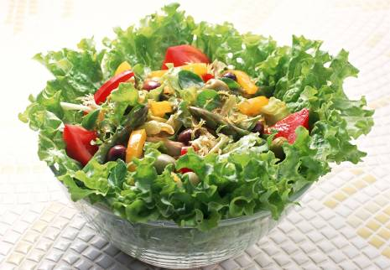

Slide 7
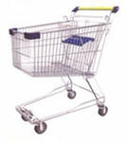
CHECK YOUR ANSWERS:
DRINKS VEGETABLES FRUIT FOOD
MILK CUCUMBERS ORANGES CHEESE
TEA POTATOES APPLES HAM
COFFEE CARROTS BANANAS ROAST
MINERAL WATER TOMATOES KIWIS CHICKEN
EGGS
PIZZA
OMELETTE
PIE

Slide 8
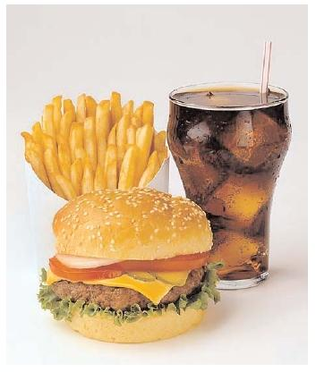
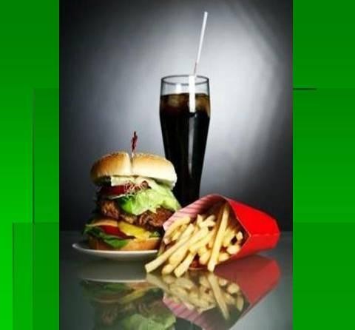
ENGLISH SANDWICHES

Slide 9
Listen to the text and then decide if the following sentences are true (T) or false (F).
The English don’t like tea.
They drink tea 6 or 8 times a day.
Working people and pupils have tea at about 11o’clock in the morning.
The English drink tea with bacon, pizza and fish.
Foreigners like English tea.
Some people drink tea with milk.

Slide 10
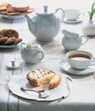
CHECK YOUR ANSWERS:
1.F
2.T
3.T
4.F
5.F

Slide 11
ENGLISH BREAKFAST

Slide 12
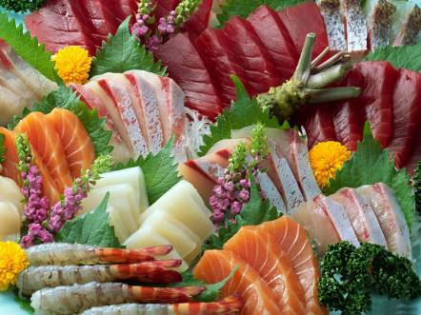
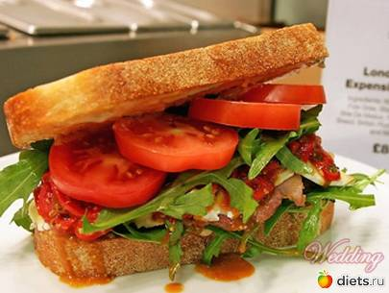
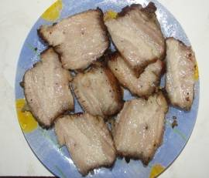
HEALTHY OR UNHEALTHY FOOD

Slide 13
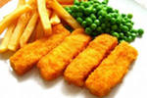
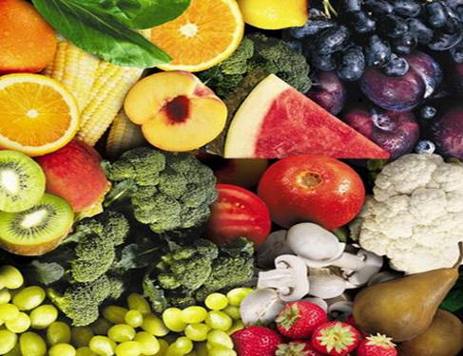
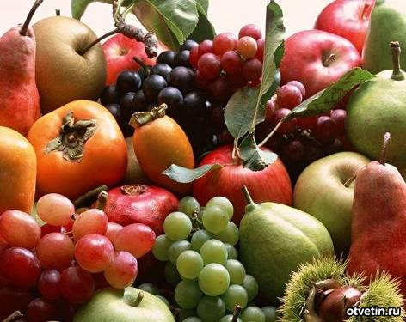

Slide 14
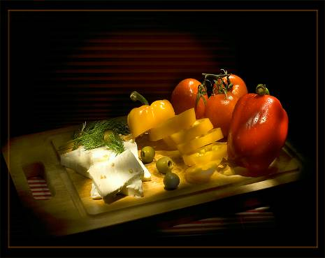
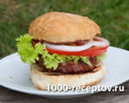
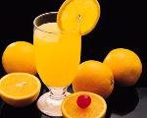
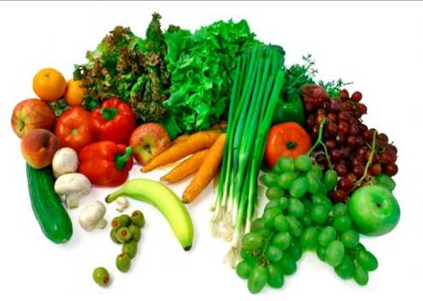

Slide 15
THANK YOU FOR YOUR WORK.
GOOD-BYE!

