Slide 1
Topic «Types of welding»
Is done by Krasnoperova A.G.
for English lesson «Complex sentences»
Specialty 143063

Slide 2
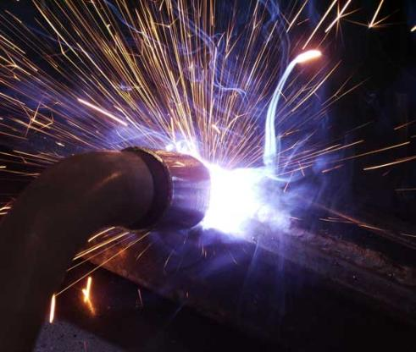
Welding
Welding - a technology that allows you to connect the homogeneous and heterogeneous metal

Slide 3
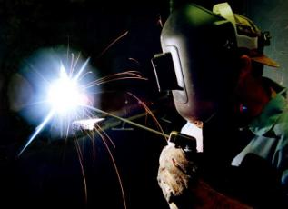
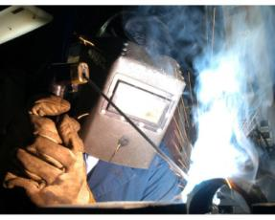
Types of welding
pressure resistance welding
Arc welding
Laser welding
Electron-beam welding
Gas welding

Slide 4
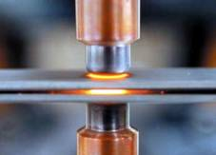
Pressure resistance welding
Resistance welding refers to the types of welding with short-term heating of the junction without melting or fusion, and a draft of heated work pieces

Slide 5
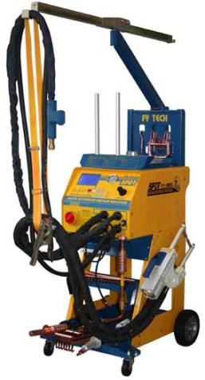
Equipment
The apparatus for resistance welding

Slide 6
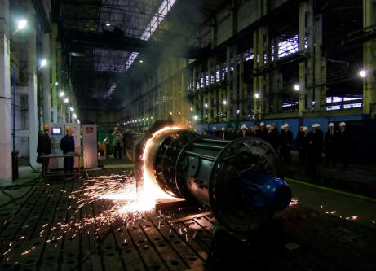
Arc welding
Arc welding - a kind of resistance welding in which the work pieces are welded over the entire surface of contact

Slide 7
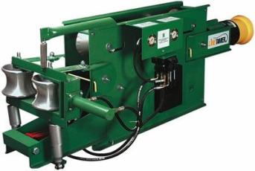
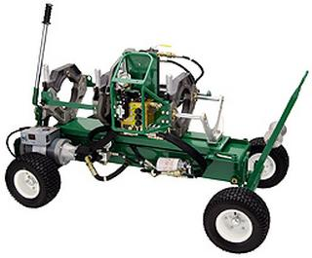
Equipment
Welding equipment for arc welding

Slide 8
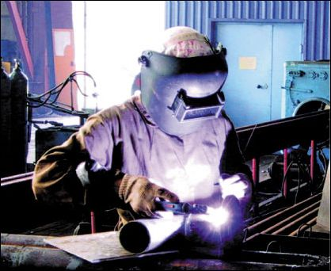
Arc welding
Arc welding - a kind of resistance welding in which the work pieces are joined at different points

Slide 9
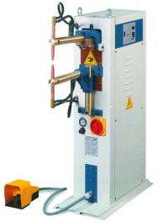
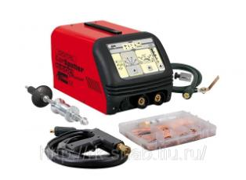
Gas Equipment
Gas Welding Machines

Slide 10
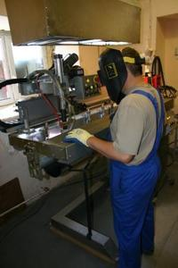
Resistance welding
Resistance welding - a kind of resistance welding in which the welded work piece is formed between the solid and tight connection

Slide 11
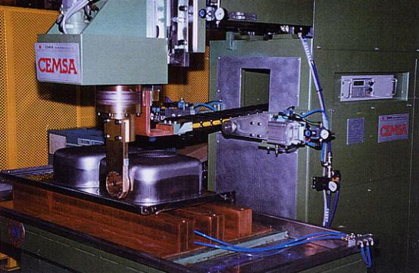
Equipment
Arc welding machine

Slide 12
Plans of the main types of welding

Slide 13
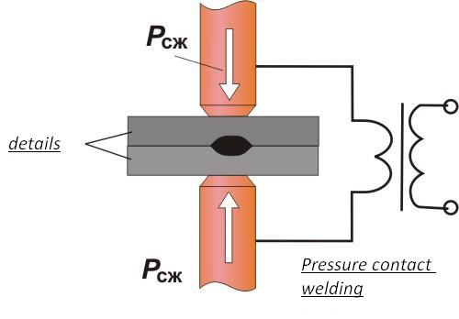
Laser welding

Slide 14
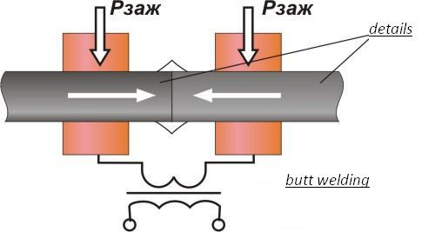
Arc welding

Slide 15
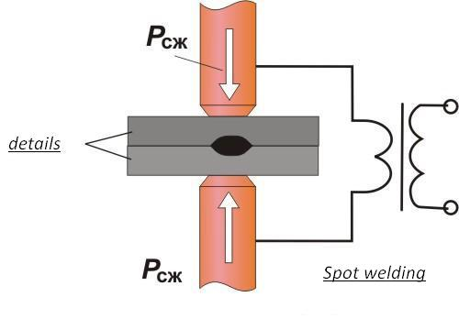
Electron-beam welding

Slide 16
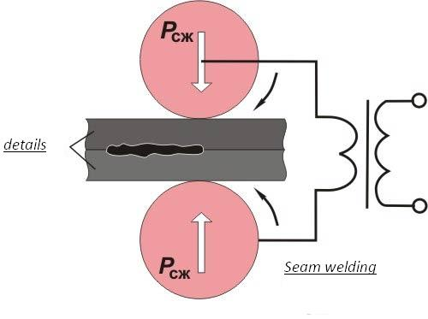
Resistance welding

Slide 17
The defects generated during welding are of two types:
External
Internal

Slide 18
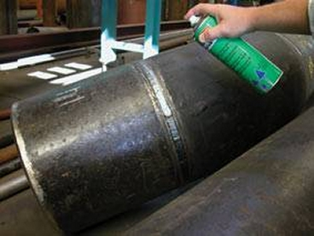
The external include:
nodules, surface cracks and deep poring over

Slide 19
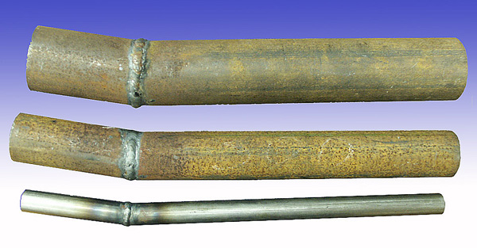
The internal include:
hidden cracks and pores

Slide 20
