Slide 1
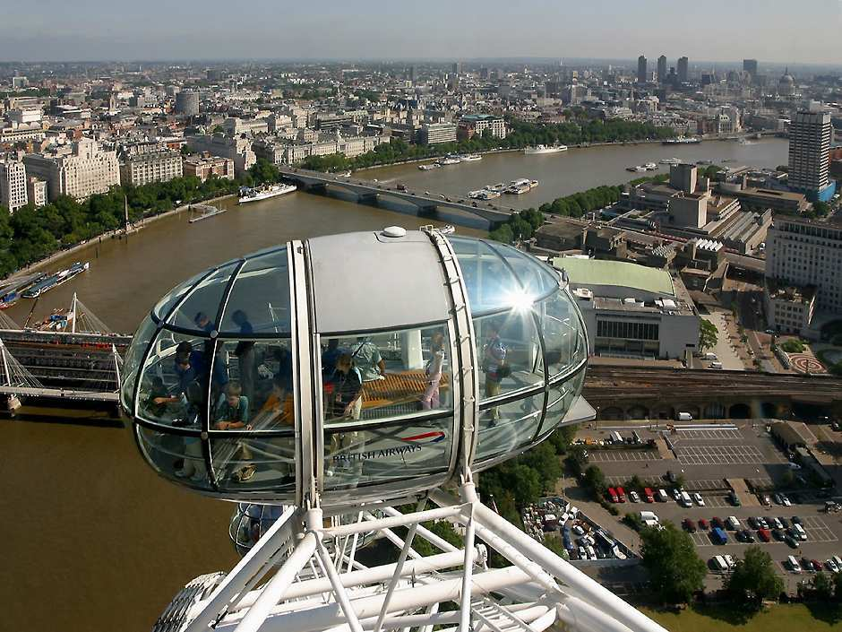
Special
City Tours
Don’t miss…
The London Eye – London
What you can do:
Take a 30 minute flight on the tallest wheel in the world
Rise up in a glass pod to 135 metres above the ground
Study the engineering of this amazing structure
What you can see:
a splendid view of London: famous buildings such as Big Ben and Houses of Parliament, bridges, the river Thames
40 km across England on a clear day
Open: Daily 10.00am – 8.00 pm
What visitors say:
This London attraction will blow you mind away.
David, USA
Terrific views will keep your camera busy! Isabelle, France

Slide 2
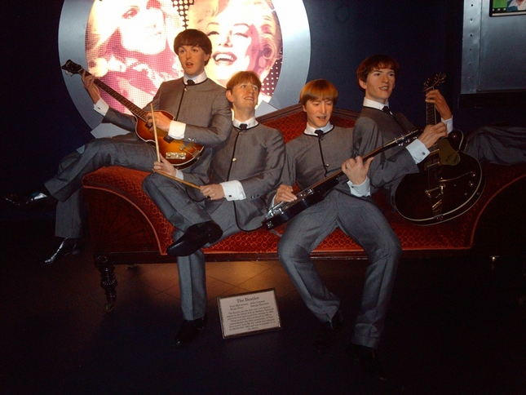
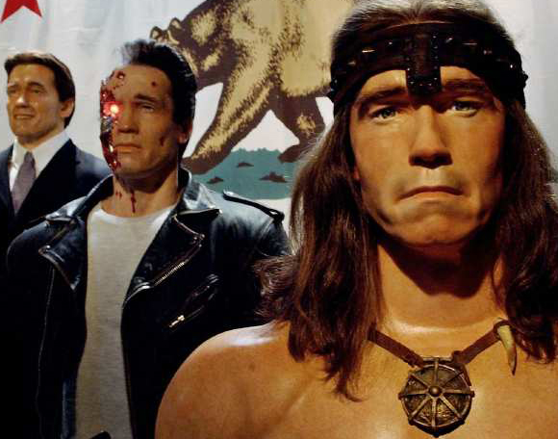
Don’t miss…
Madame Tussaud’s Wax Museum - London
Special
City Tours
What you can do:
Enter the cinema 4D with effects of wind, mist and scent
Take a ‘scary horror walk’ at “Scream” and a cute “London Taxi Ride”
Take a picture with Michael Jackson, Brad Pitt or the Queen
What you can see:
life-like wax figures of celebrities from the worlds of music, sports and history
have a look behind the scenes to learn how studio artists make the wax figures so real
What visitors say:
4D show is absolutely awesome! Joe, Australia
What an amazing place! The wax models are so realistic! Masha, Russia
Open: Daily 10.00am – 8.00 pm

Slide 3
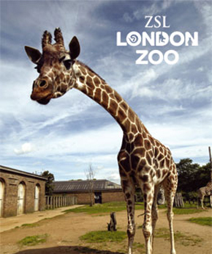
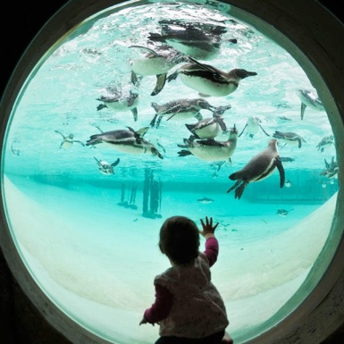
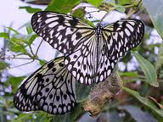
What you can do:
Experience big animals such as gorillas and giraffes
Explore the “Into Africa” exhibit
Enjoy different butterflies as they fly around you at the Butterfly Paradise
Feed penguins at the Penguin enclosure and learn more about them from the zoo’s keepers
Visit the all-new ‘Night Life’ area with bats, rats and other wonders
What you can see:
over 720 different species of animals
unusual animals including zebras and hunting dogs
Rainforest animals such as marmosets, tamarins and sloths
Open: Daily 10.00am – 8.00 pm
Special
City Tours
Don’t miss…
What visitors say:
It’s the fun-filled family attraction.
John, USA
The world’s oldest scientific Zoo is definitely worth visiting! Nicole, France

Slide 4
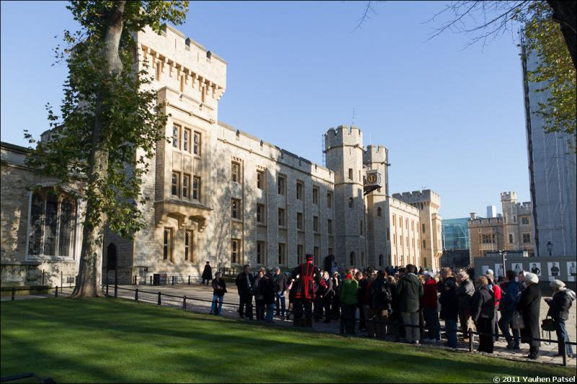
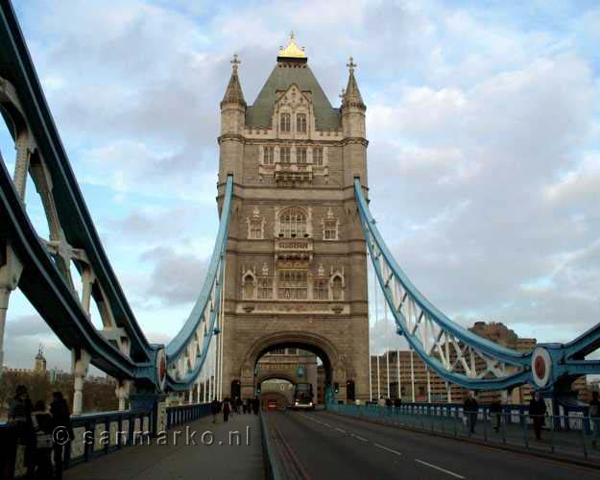
Don’t miss…
Special
City Tours
London Walking Tour of the Tower of London and Tower Bridge
What you can do:
Explore London’s history
visit the Jewel House containing the Crown Jewels
Visit Europe’s best medieval fortress - the White Tower built by the Norman Duke William the Conqueror
Visit Chapel of St John, one of the expressions of Norman architecture
See a wonderful panorama of London from the Tower Bridge
Departure Point: Tour departs from Tower of London
Duration: 3 hours 30 minutes
Return details: at Tower Bridge

Slide 5
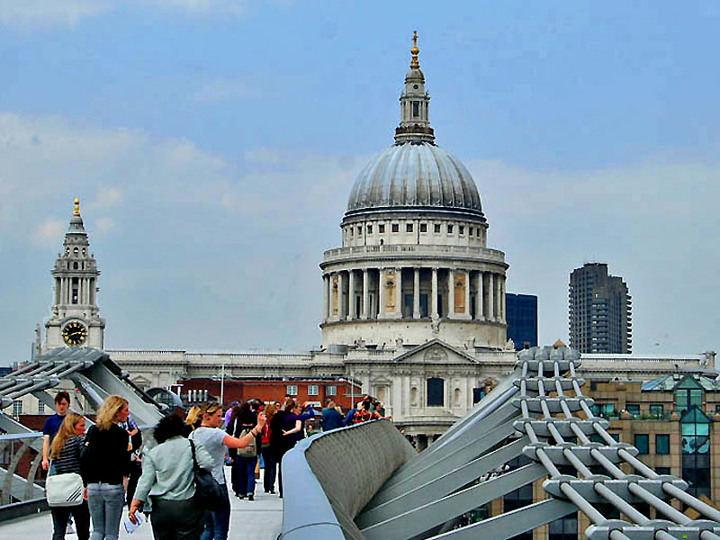
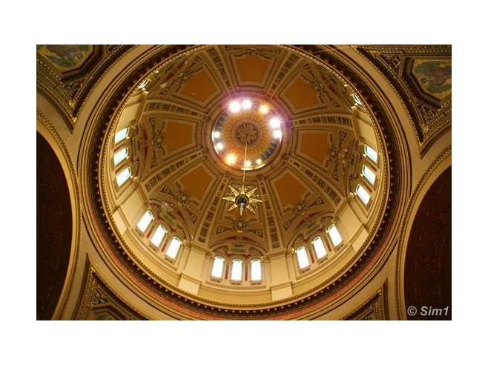
Don’t miss…
Special
City Tours
London Walking Tour of
St Paul’s Cathedral
What you can do:
Explore the history of the best Christopher Wren’s masterpiece – the Cathedral built in 1708
See the imposing Dome of St Paul’s Cathedral – one of the symbols of London
See monuments of Britain’s heroes including Nelson, Churchill
Climb the famous Whispering Gallery
Departure Point: Tour departs from St Paul’s Cathedral outside main entrance
Duration: 3 hours 30 minutes
Return details: at Canon Street

Slide 6
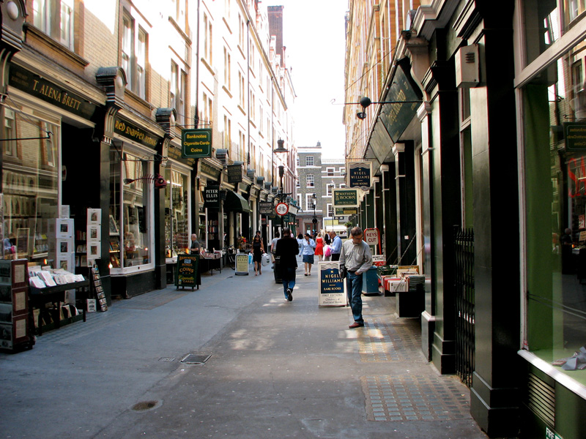
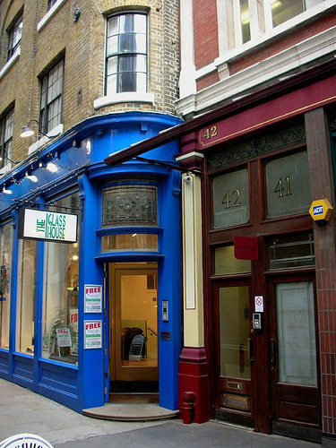
Don’t miss…
Special
City Tours
Harry Potter Walking Tour of London
What you can do:
See magical locations used in the films about the famous fictional wizard
Walk down the fictional Diagon Alley
See the entrance to the Leaky Cauldron – a popular wizarding pub in London
Stand on the bridge destroyed in the “Half Blood Prince’
Take a photo on the mythical 9 ¾ Platform
What tourists say:
A magical tour for Harry Potter fans of all ages!
Eve, Greece
Departure Point: Tour departs from Central London
Duration: 2 hours 30 minutes
Return details: King’s Cross Station

Slide 7
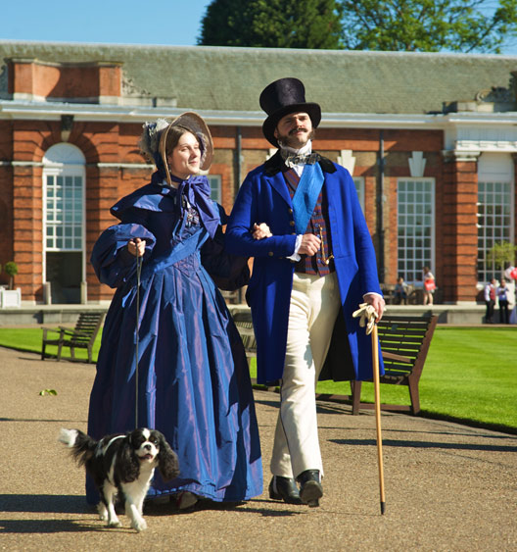
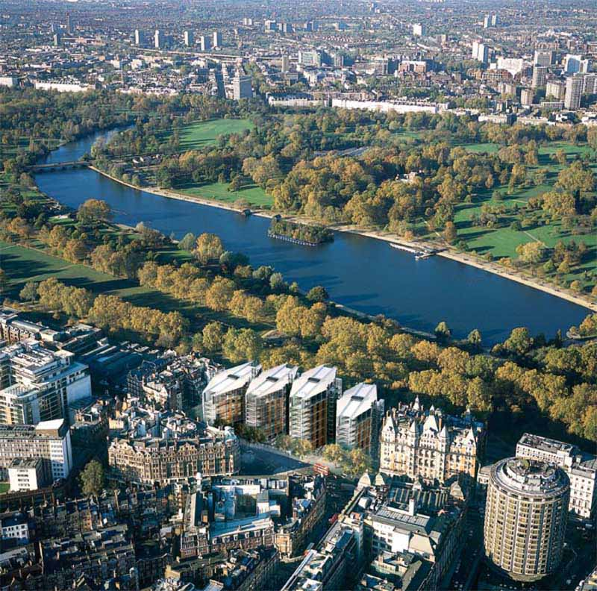
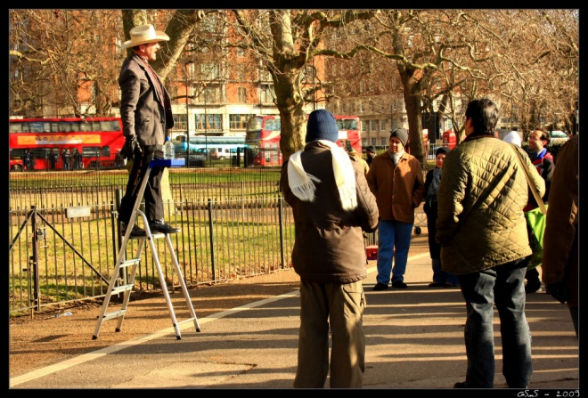
Don’t miss…
Special
City Tours
Hyde Park - London
What you can do:
Rent a boat and gently paddle along the Serpentine Lake
Have a refreshing drink or maybe fishing
Go roller skating
Have a debate with strangers at the Speakers Corner
Visit Kensington Palace in Kensington Gardens and lay flowers to pay tribute to Princess Diana
What tourists say:
This park has the best London location from where you can reach main shopping centers!
Paula, Spain

Slide 8
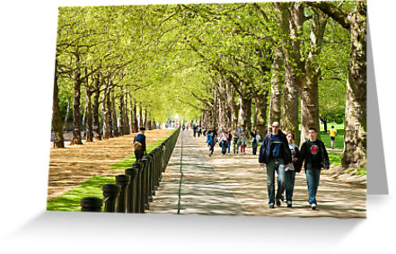
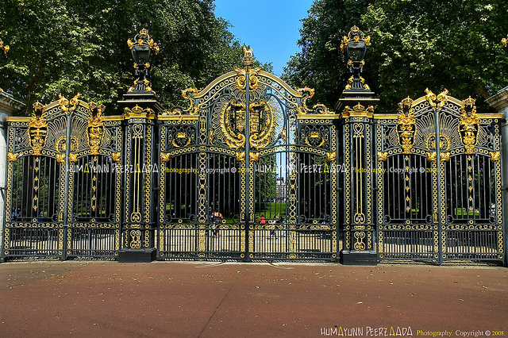
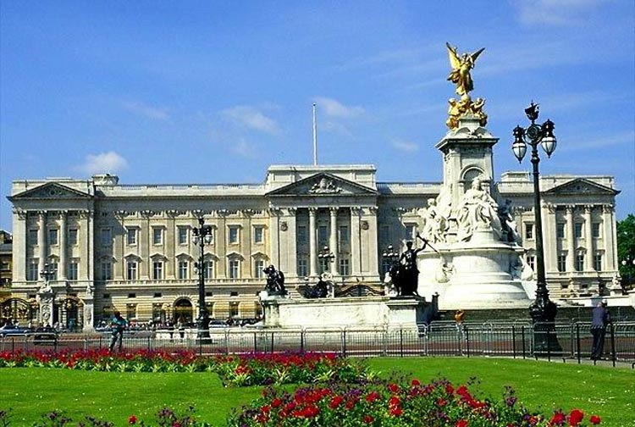
Special
City Tours
Don’t miss…
Green Park - London
What you can do:
have a walk in the royal park
visit other places of interest nearby such as Buckingham Palace which is a residence of English Queens and Kings

Slide 9
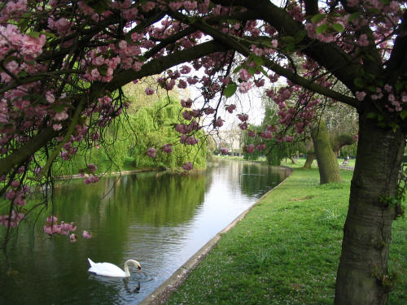
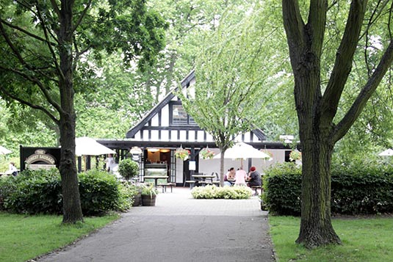
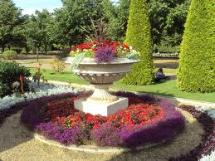
Special
City Tours
Don’t miss…
Regent’s Park - London
What you can do:
rent a boat and take pictures of birds nesting on the island
have a rest on chairs and benches around and enjoy beautiful flowers
Have a cup of coffee or tea in a small restaurant
Have a picnic with your friends on the lawn
Play tennis or football as there are lots of tennis courts and football fields

