Slide 1
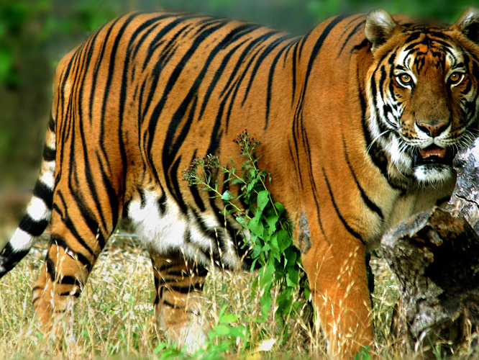
This powerful predator can be found in places such as Indonesia, India, and Russia

Slide 2
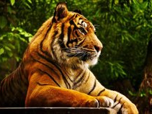
The tiger is the largest of the wild cats.

Slide 3
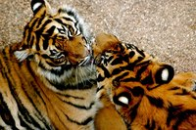
No two tigers have the same pattern of stripes.

Slide 4
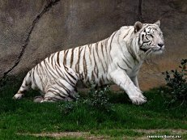
The most numerous is the Bengal tiger

Slide 5
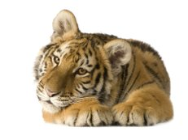
Out of the original eight sub – species of tigers, three are now extinct.

