Slide 1
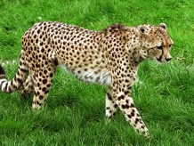
Most wild cheetahs are found in eastern and southwestern Africa.

Slide 2
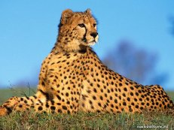
Сheetahs can be easily identified by its spotted coat and dark eye marks.

Slide 3
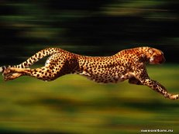
A quiet and deadly nighttime hunter, the cheetah is the world’s fastest mammal on land

Slide 4
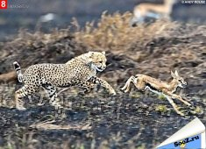
And its speed over a short distance allows it to chase its target

Slide 5
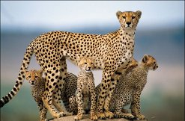
The cheetah is also a highly endangered animal.

