Slide 1
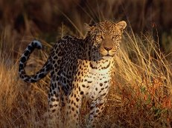
Leopards can be found in Africa, Central Asia, India, and China.

Slide 2
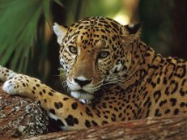
Like jaguars, most are light colored with distinctive rose – shaped dark spots called rosettes.

Slide 3
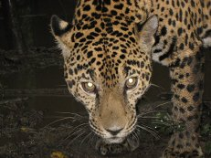
The leopard is a quiet and deadly nighttime animal.

Slide 4
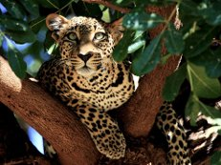
A quiet leopard can be seen hiding among the branches of a tree.

Slide 5
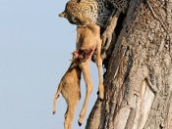
It is a useful place to hide its kill.

