Slide 1
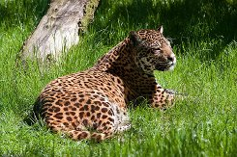
Jaguars are found only in remote regions of South and Central America.

Slide 2
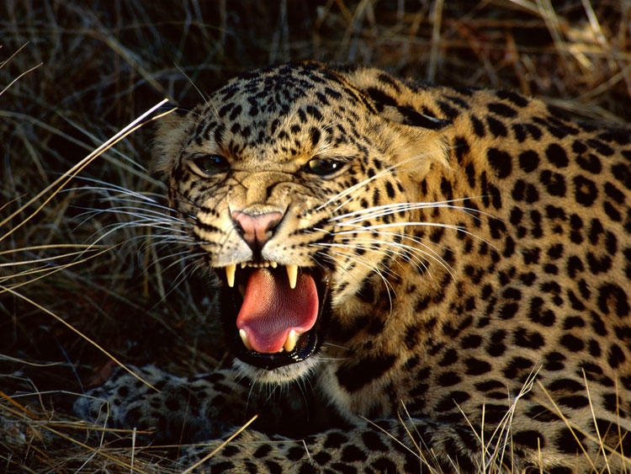
The name is derived from the Native American word yaguar, which means “he who kills with one leap.”

Slide 3
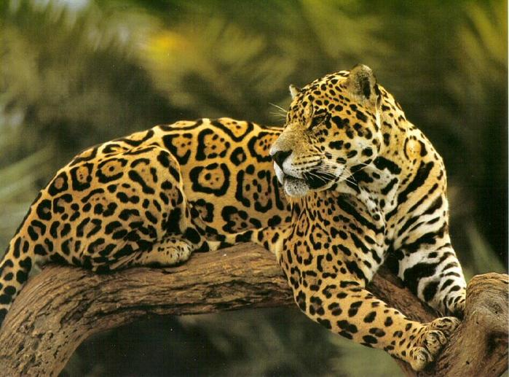
A jaguar climbs on trees

Slide 4
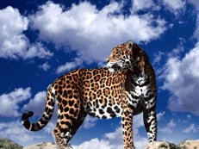
It has a big head with powerful jaws. Its paws are simply huge.

Slide 5
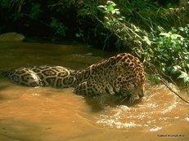
Unlike many other cats, jaguars are quite good swimmers; their prey often includes fish and turtles.

