Slide 1
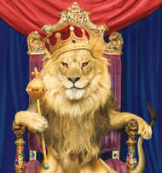
The lion is the king of beasts

Slide 2
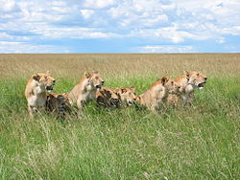
Compared to other animals, lions are unusually social; they live in groups (called prides)

Slide 3
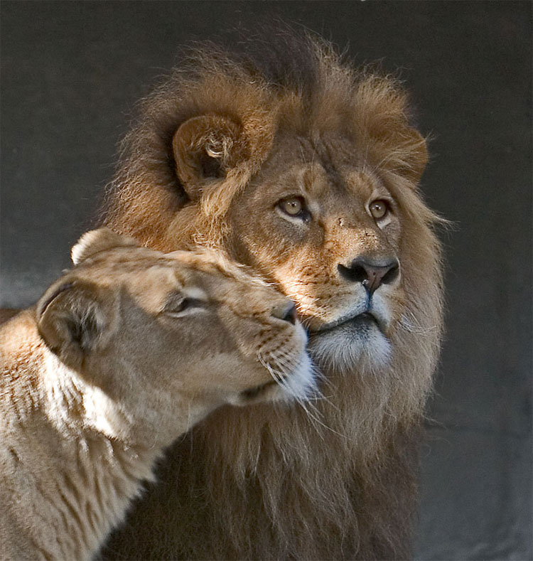
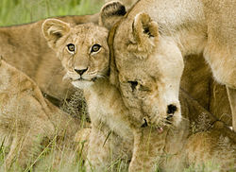
Prides consist of adult males, related females (called lionesses), and cubs.

Slide 4
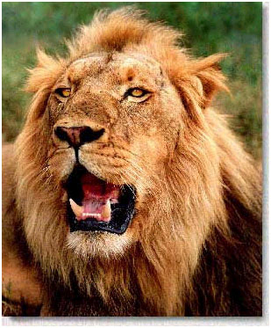
Individual lions can be identified by a unique pattern of whisker spots

Slide 5
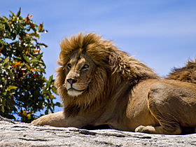
Once widespread, lions today exist only in Sub – Saharan Africa and in a small area of northwest India.

