Slide 1
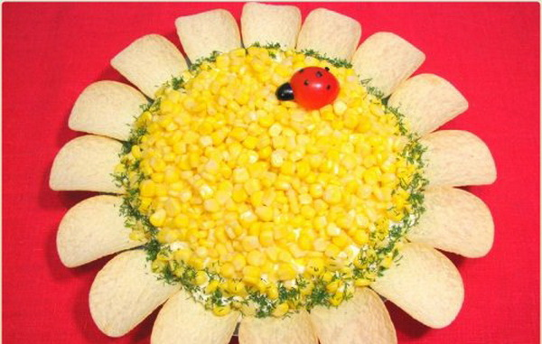
Sunflower salad recipe

Slide 2
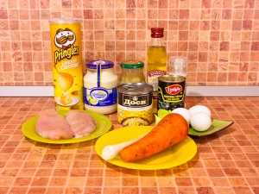
Ingredients: 200 G chicken fillet A JAR OF pickled corn 3 eggs A JAR OF pickled mushrooms 1 carrot 1 medium onion SOME olives chips salt oil mayonnaise

Slide 3
Cooking instructions

Slide 4
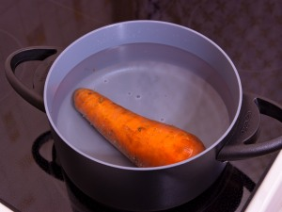
Boil the carrot

Slide 5
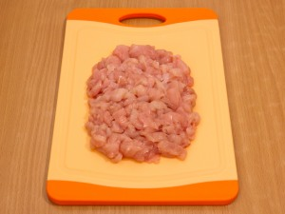
Cut the chicken fillet into small pieces

Slide 6
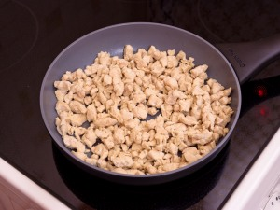
Fry and salt it

Slide 7
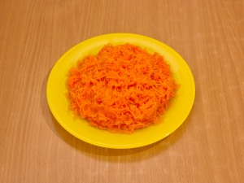
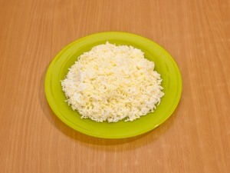
Grate the carrot and the eggs

Slide 8
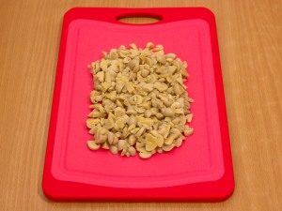
Slice the mushrooms

Slide 9
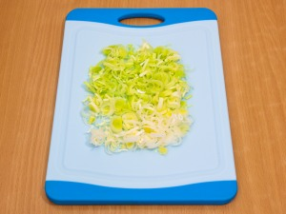
Chop the onion

Slide 10
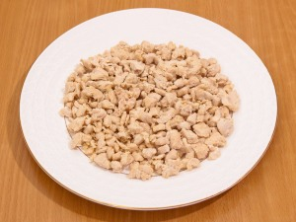
Put the fillet on the plate and add some mayonnaise

Slide 11
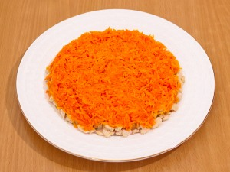
put THE carrot on the fillet and add some mayonnaise

Slide 12
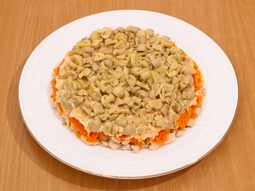
Put the mushrooms and add some mayonnaise

Slide 13
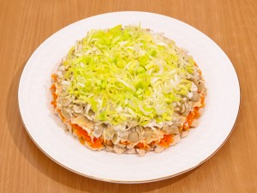
Put the onion on the mushrooms

Slide 14
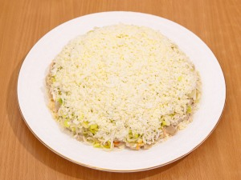
Put the eggs and add some mayonnaise

Slide 15
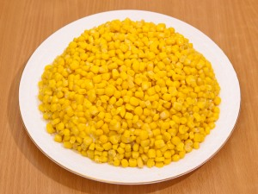
Put some corn and chips around the plate

Slide 16
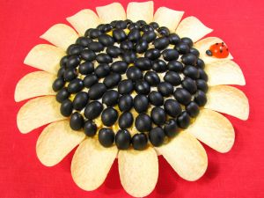
Serve with the olives

Slide 17
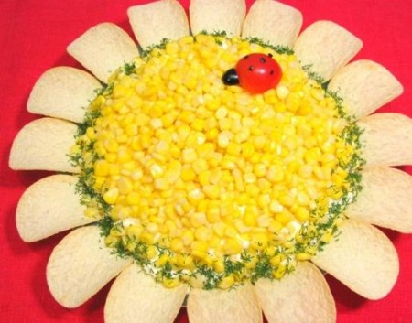
Good appetite!

