Slide 1
Do you know
what doctor to go to?

Slide 2
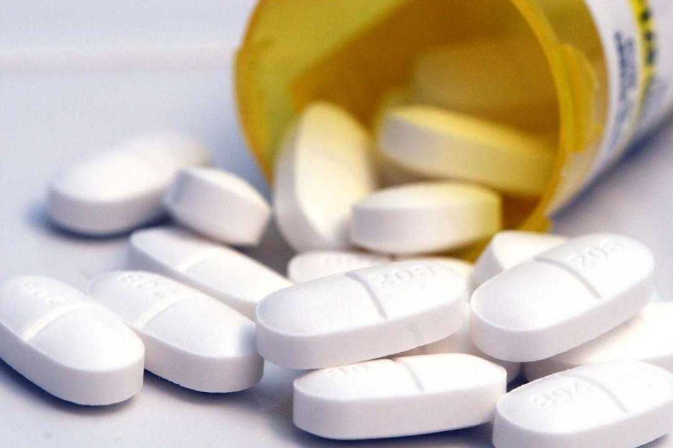
What ancient languages
are used to name doctors?
Latin and Greek

Slide 3
What does the word
LOGIST mean?
A person who
understands

Slide 4
What doctor specializes
in
skin diseases?
Dermatologist

Slide 5
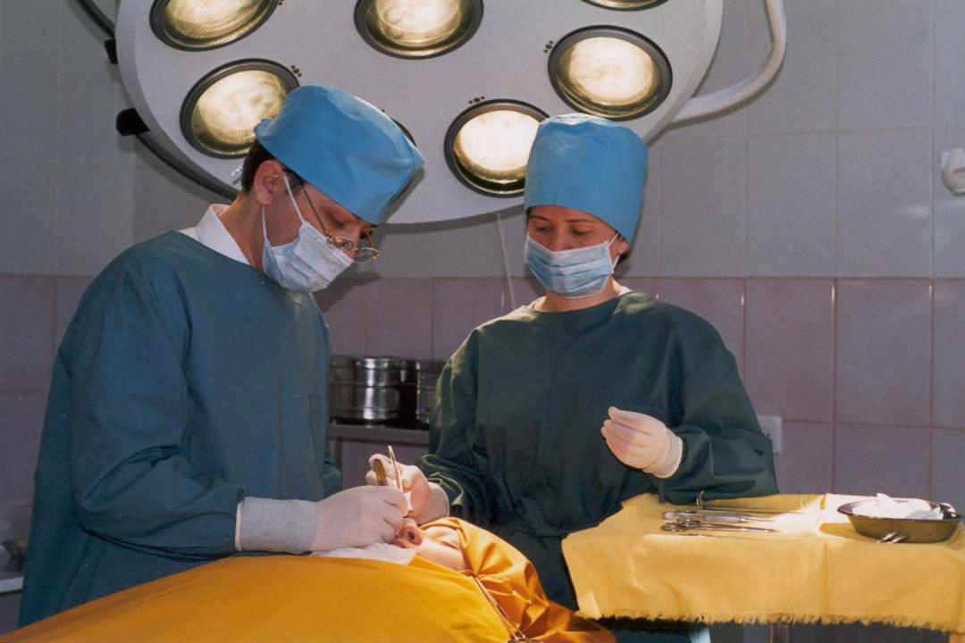
What do surgeons do?
They operate on people

Slide 6
Who will you visit
If you have problems
With your stomach?
Gastroenterologist

Slide 7
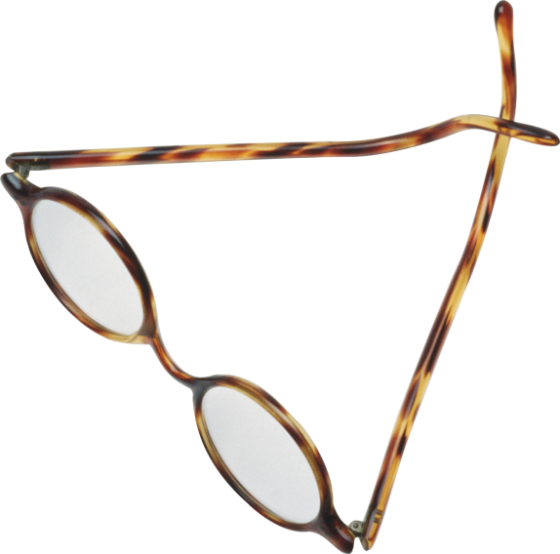
An optician will prescribe you…
Glasses

Slide 8
How do you call a doctor
who is not a very good
doctor?
A quack

Slide 9
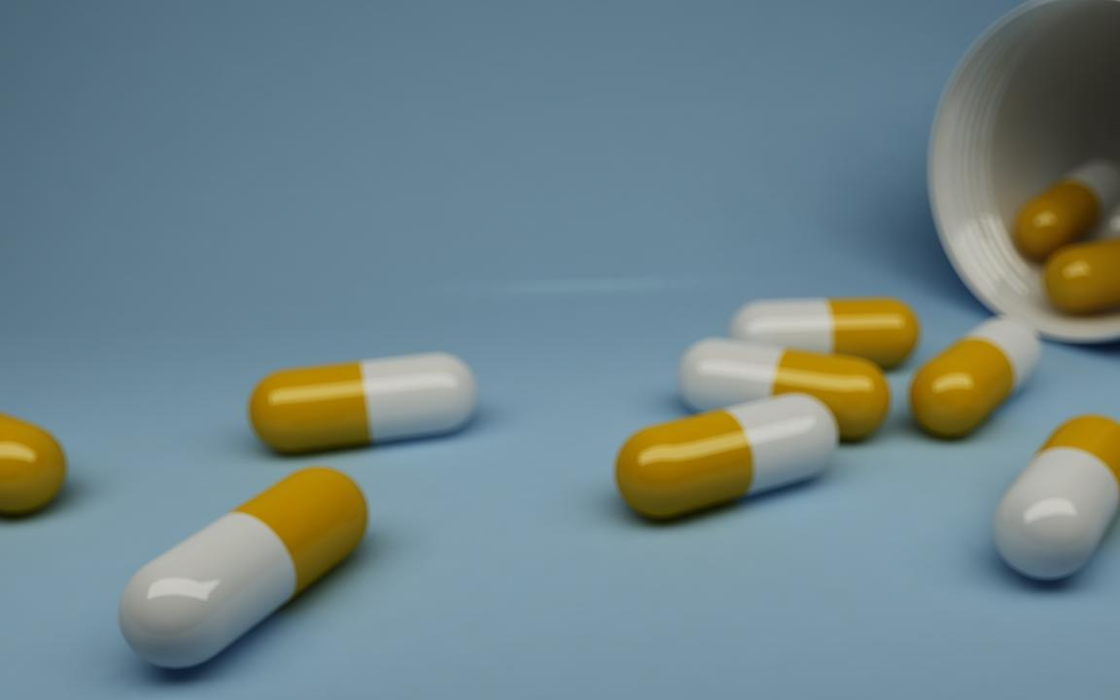
You did a great job!
That’s all for now!
See you soon!

