Slide 1
Environmental problems
Lösung der
Umweltsprobleme

Slide 2
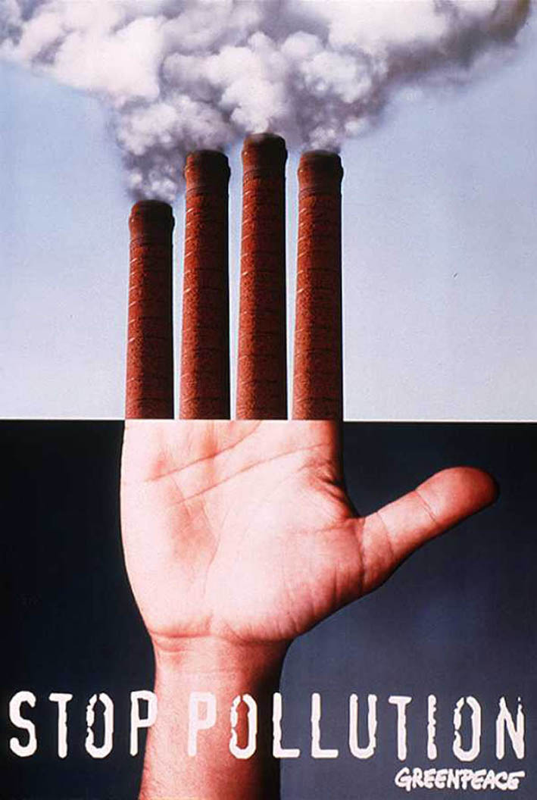
Environmental protection is of a universal concern. That is why serious measures to create a system of ecological security should be taken.
Um ökologische Probleme zu lösen, muss man ein ganzes System schaffen.

Slide 3
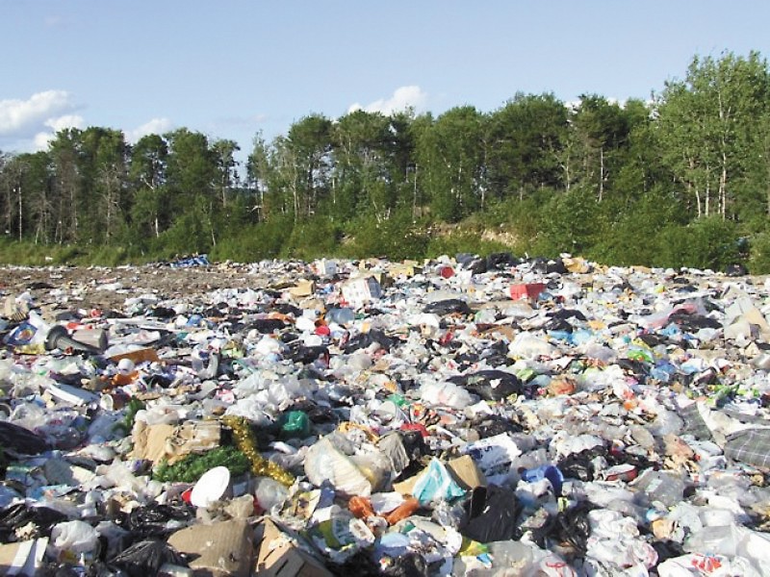
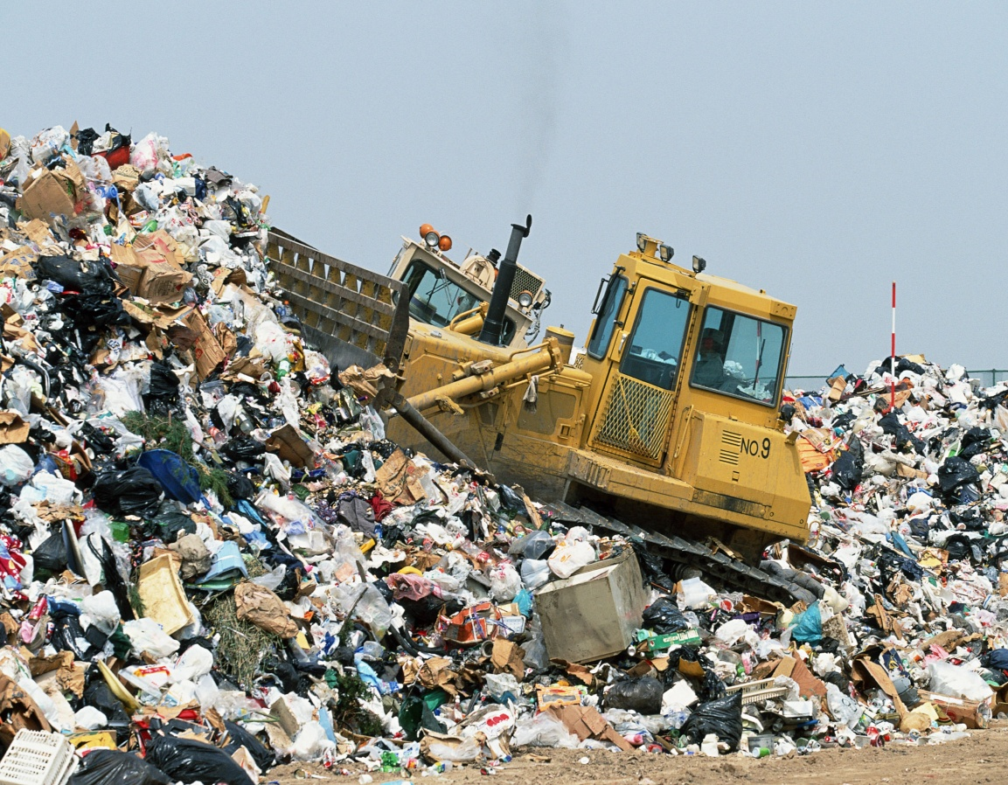
Landfill
We have the time, the money and even the technology to make our planet a better, cleaner and safer place. We can recycle litter. We can support green parties and put pressure on those in power. Together we can save the planet and all of us with it.
Die Mülldeponien verschwinden, wenn man den Müll recyceln wird.

Slide 4
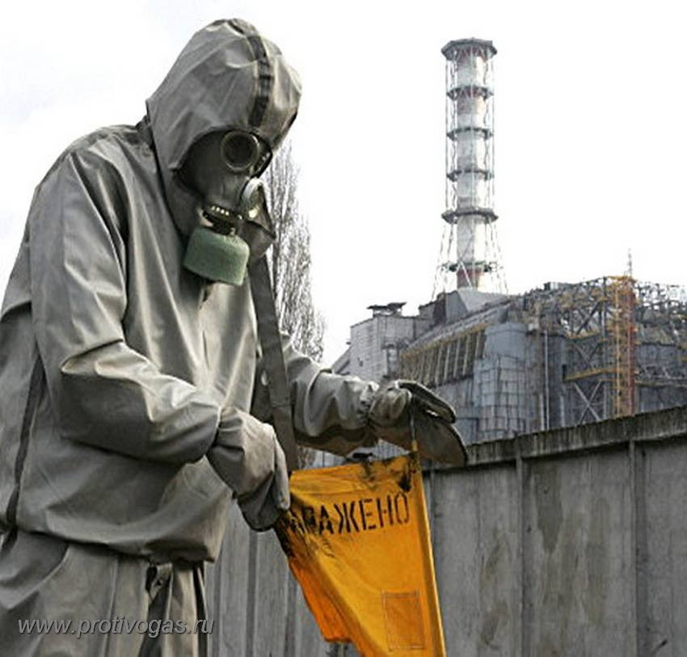
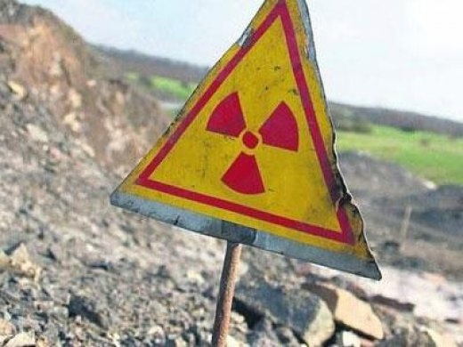
Radioactive contamination
To solve this burning problem it is necessary for people to combine efforts, to raise safety standards at all industrial facilities, to adequately process by-products of industry, to set up an international space laboratory to monitor the state of environment and set up an international centre for emergency environmental assistance. All these measures will help us in solving these important problems and prevent us from dangerous illnesses and diseases.
Radioaktive
Verschmutzung

Slide 5
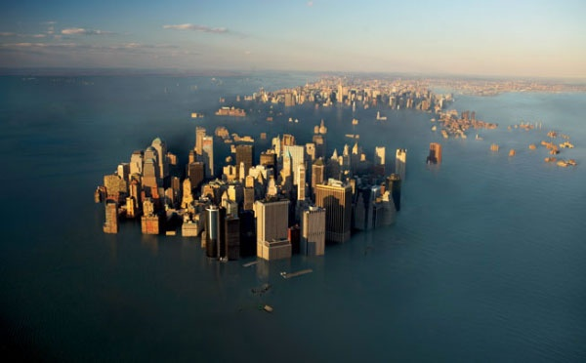
Global Warming
We don't know how to prevent warming. Stabilizing emissions isn't enough. No one knows how to lower emissions without crushing the world economy. Based on present knowledge, the best way of coping with warming - if it happens - would be to adapt to it.
Wir können damit nichts machen. Wir müssen nur in den neuen Bedingungen überleben zu lernen.

Slide 6
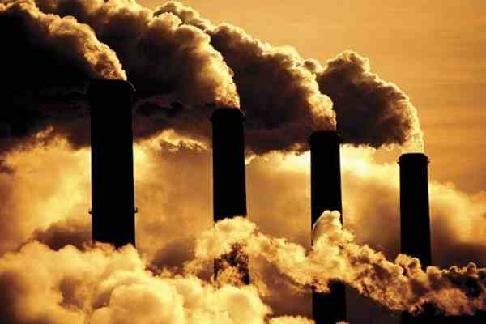
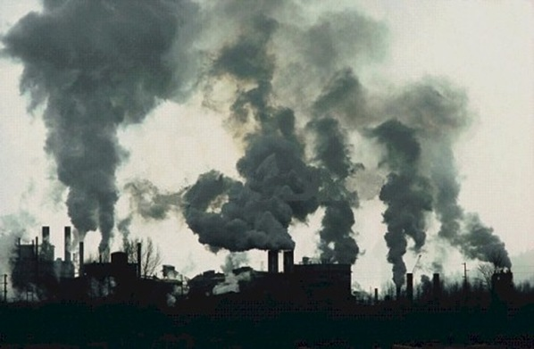
Air pollution
The ozone layer is destroyed by a stuff that aerosol sprays and refrigerators contain.
People will have to take measures because the dangerous rays get through the atmosphere, causing skin cancer and other diseases.
Halt das Auswurf in die Atmosphäre schädliche Gase. Schaft die Filteranlagen.

Slide 7
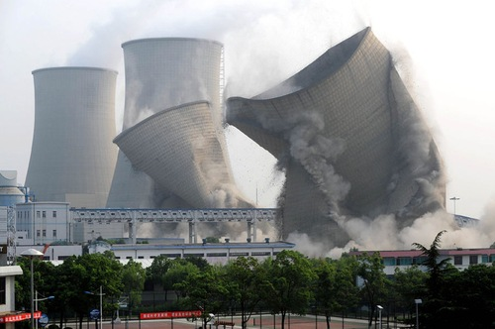
Environmental Pollution
Scientists and engineers can find the ways to reduce pollution from automobiles and factories. Government can pass the laws that would make enterprises take measures for reducing of pollution. Individuals and groups of people can work together to persuade enterprises to stop polluting activities.
Elektromobilen, Gasbrennstoff können die Situation verbessern

Slide 8
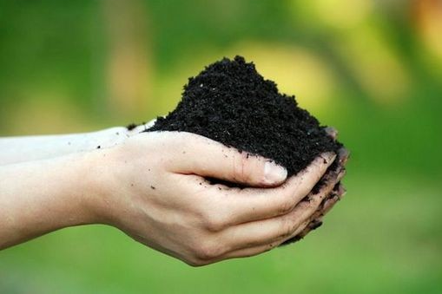
Soil contamination Bodenverschmutzung
An important problem for large cities is cleaning and disposal of garbage and industrial waste. It is necessary to solve health and environmental issues - disposal of household and municipal waste. To combat pollution of the environment should be modern methods of treatment of urban, industrial and agricultural effluents, rational application of fertilizers and crop protection chemicals.

Slide 9
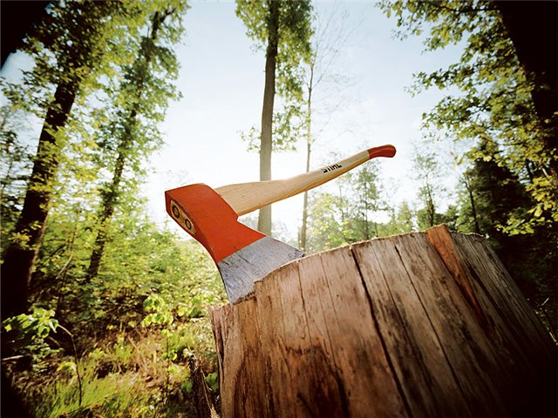
Forest destruction
As many as 159 countries — members of the UNO — have set up environmental protection agencies. Numerous conferences have been held by these agencies to discuss problems facing ecologically poor regions including the Aral Sea, the South Urals, Kuzbass, Donbass, Semipalatinsk and Chernobyl.
Waldvernichtung
Wir müssen die Wälder nicht nur ausholzen, sondern auch pflanzen und pflegen.

Slide 10
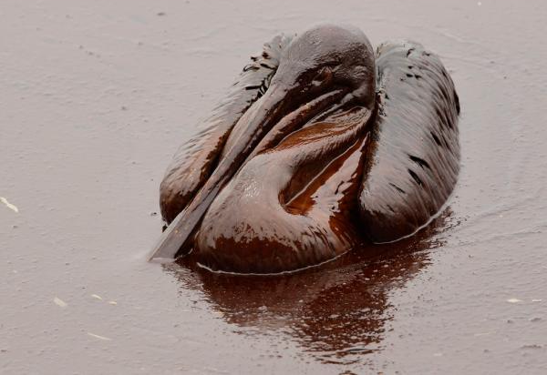
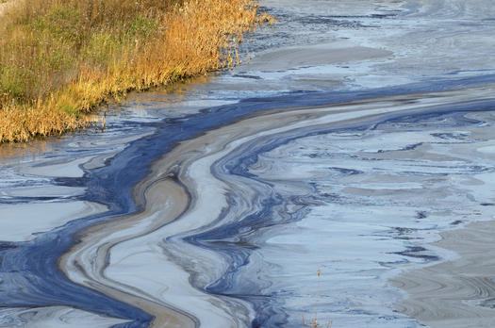
Oil Spills
Our Government will aim:
-to encourage the more prudent and efficient use of energy and other resources
-to make sure that Russian’s air and water are clean and safe, and controls over wastes and pollution are maintained and strengthened where necessary.
Wir bitten die Wissenschaftler alternative Kraftstoff zu finden. Es tut uns weh zu beobachten, wie die Vögel in den Ölflecken sterben.

Slide 11
The Kyoto Protocol
The Kyoto Protocol is an addition to the United Nations Convention on Climate Change.
Countries which ratify this protocol commit to reducing their emissions of carbon dioxide and five other greenhouse gases. A total of 141 countries have ratified the Kyoto agreement.
The Kyoto Protocol may seem just a small first step to dealing with climate change, but it is significant. We have to find ways to contribute to socio-economic growth and at the same time lower our emissions of greenhouse gases.
Kiotskij Protokoll wurde den ersten Vertrag im Gebiet der Umweltbewachtung .Aber seine Wirkung stellt im Dezember 2012 ein. Russland will aus diesem ausgehen.

Slide 12
These are only the first steps and they must be carried onward to protect nature, to save life on the planet not only for the sake of the present but also for the future generations.
Die Sache aller und eines jeden ist es, alles Menschenmögliche zu tun, um unsere Erde zu retten.

