Slide 1
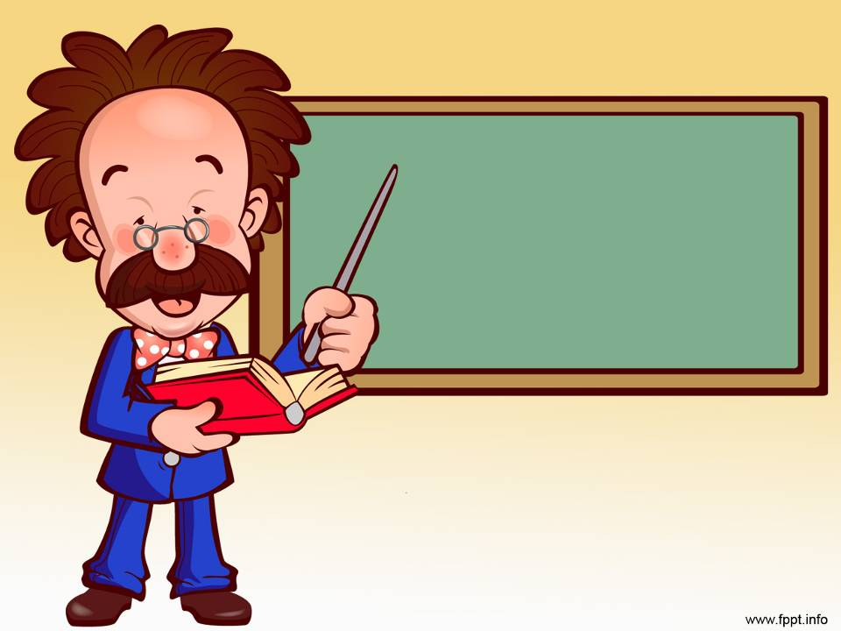
The United Kingdom

Slide 2
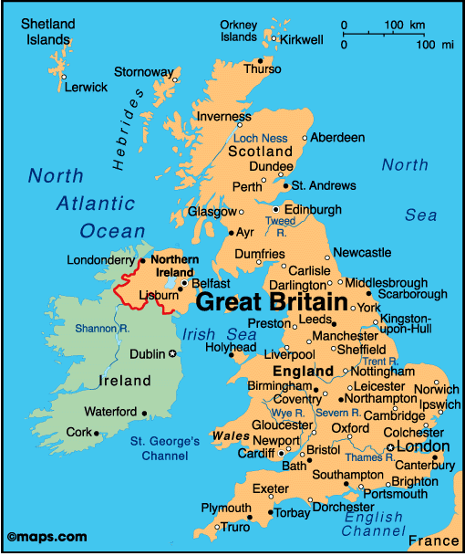
Title
The UK lies on the British Isles. The two main islands are: Great Britain and Ireland. They are separated from the continent by the English Channel and the Strait of Dover.
The United Kingdom of Great Britain and Northern Ireland is situated off the Northwest coast of Europe.
The west coast of the country is washed by the Atlantic Ocean and the Irish Sea, the east coast is washed by the North Sea.

Slide 3
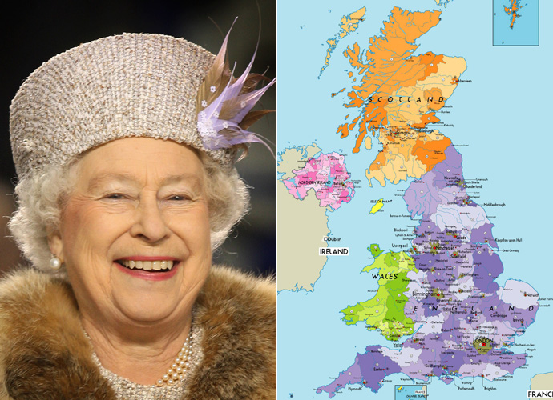
Great Britain is a constitutional monarchy. The powers of the British Queen are limited by Parliament. The British Parliament consists of the sovereign, the House of Lords and the House of Commons.

Slide 4
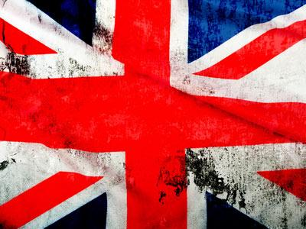
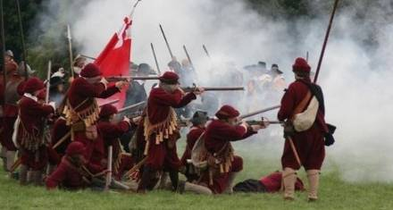
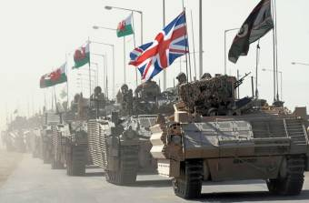
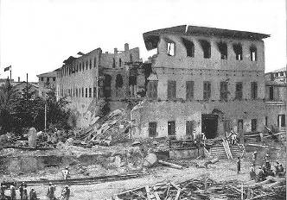
Britain has been many centuries in the making. It waged numerous colonial wars. In the modern world England was the first country where capitalism was established.

Slide 5
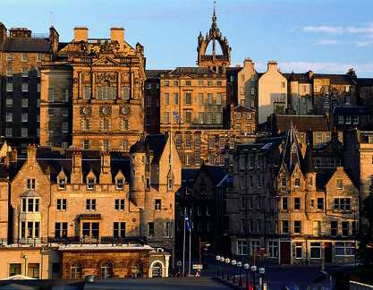
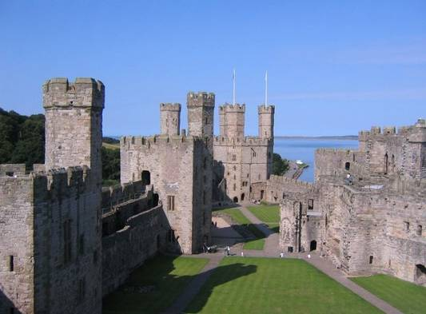
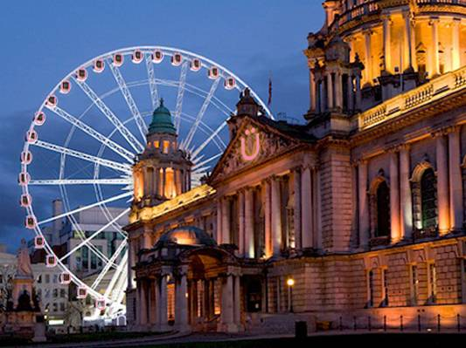
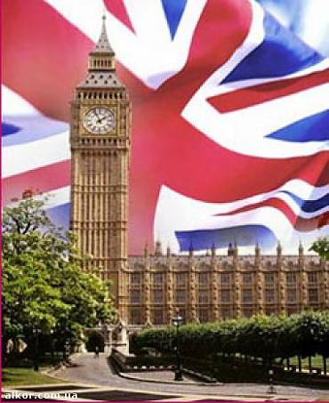
The UK consists of four parts. They are:
Northern Ireland
Wales
England
Scotland

Slide 6
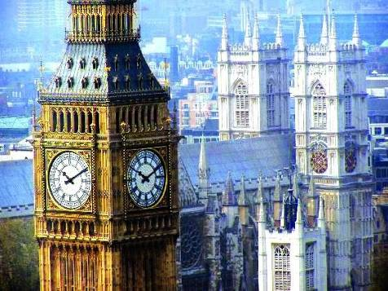
London is the capital of the UK. , its political, economic, and commercial centre. It is one of the largest cities in the world and the largest city in Europe.

Slide 7
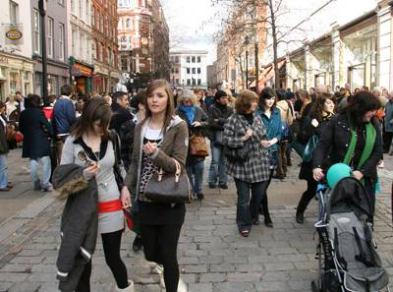


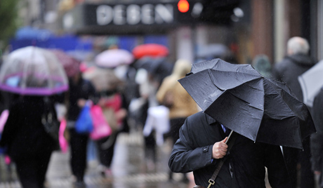
Its population is about

Slide 8
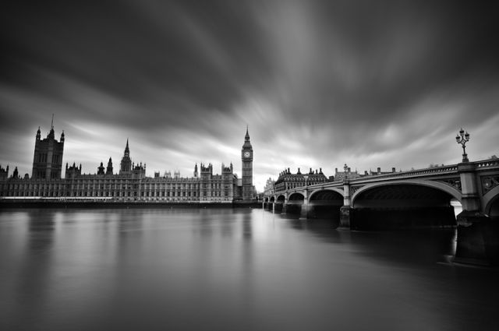
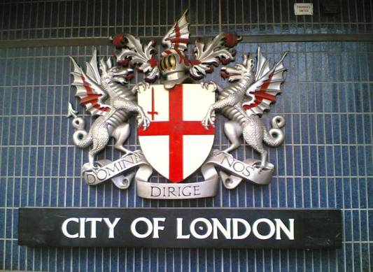
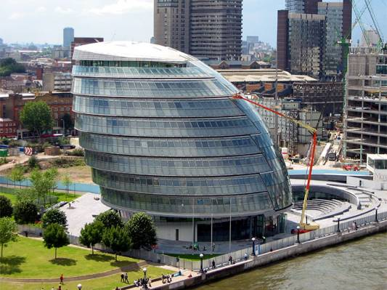
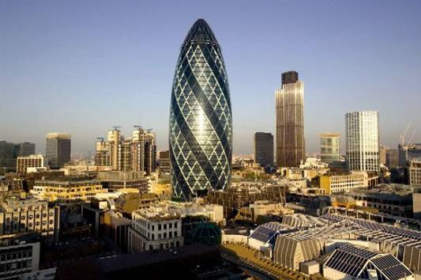
London is divided into several parts:
the City
The heart of London is the City, its financial and business centre. Numerous banks, offices, and firms are situated there, including the Bank of England, the Stock Exchange, and the Old Bailey. Few people live here, but over a million people come to the City to work. There are some famous ancient buildings within the City

Slide 9
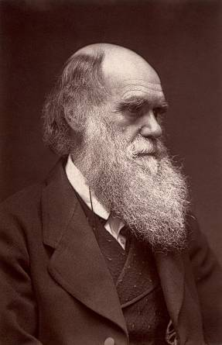
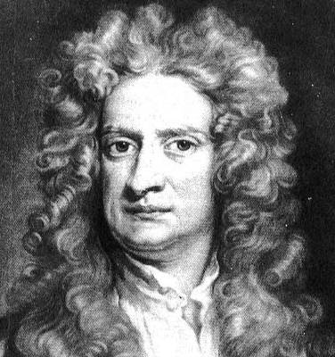
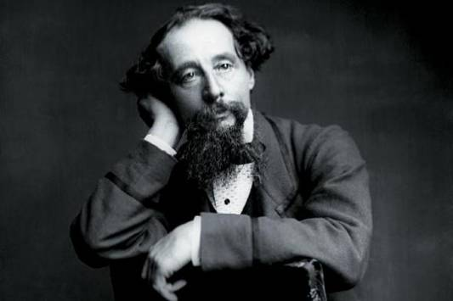
Westminster
Westminster is the governmental part of London.
Nearly all English kings and queens have been crowned in Westminster Abbey. Many outstanding statesmen, scientists, writers, poets, and painters are buried here:
Darwin
Dickens
Newton

Slide 10
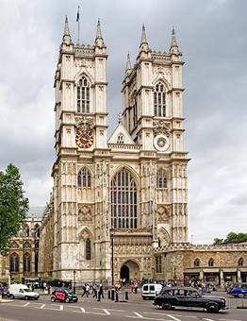
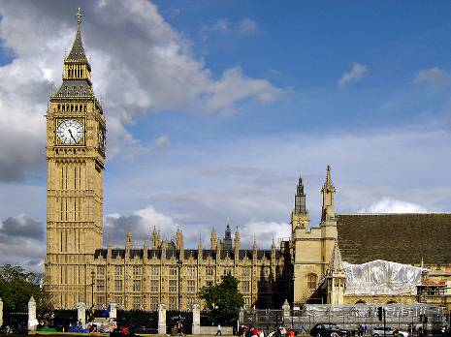
Westminster
and the East End
Across the road from Westminster Abbey
the West End
is Westminster Palace, the seat of the British Parliament.

Slide 11
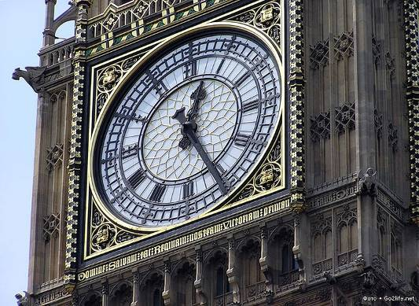
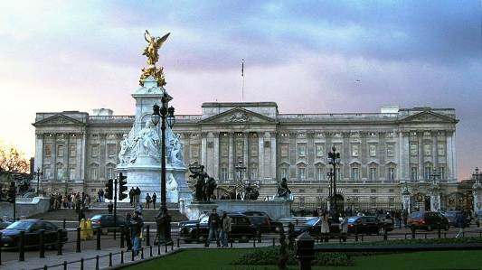
Westminster
and the East End
Tower of the Houses of Parliament is famous for its big bell, known as "Big Ben".
the West End
Buckingham Palace is the official residence of the Queen.

Slide 12
the West End
and the East End
The West End is the richest and most beautiful part of London. It is the symbol of wealth and luxury. The best hotels, shops, restaurants, clubs, and theatres are situated there.

Slide 13
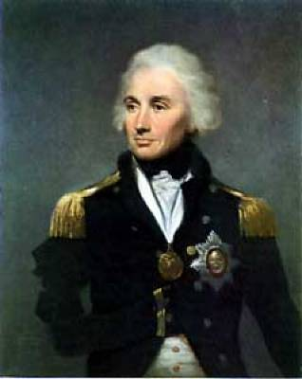
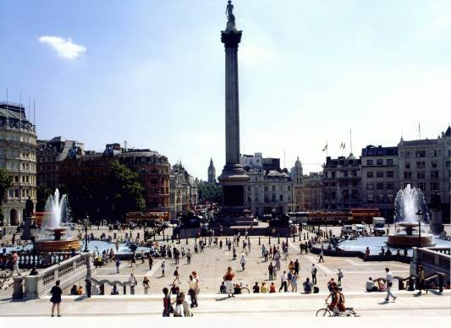
the West End
and the East End
The Trafalgar Square is the geographical centre of London.
It was named in memory of Admiral Nelson's victory in the battle of Trafalgar in 1805

Slide 14
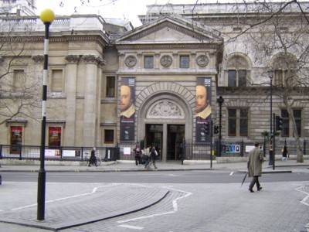
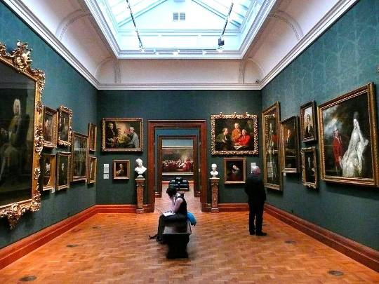
the West End
and the East End
On the north side of the Trafalgar Square is the National Portrait Gallery.

Slide 15
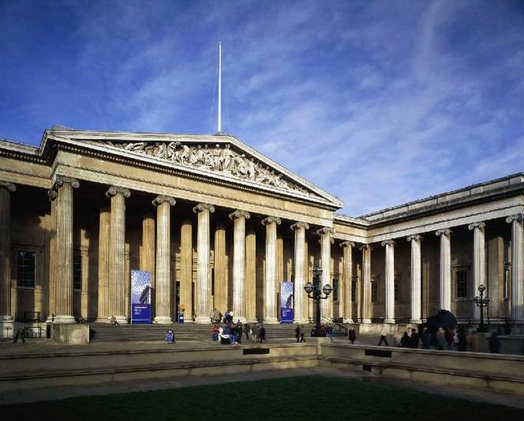
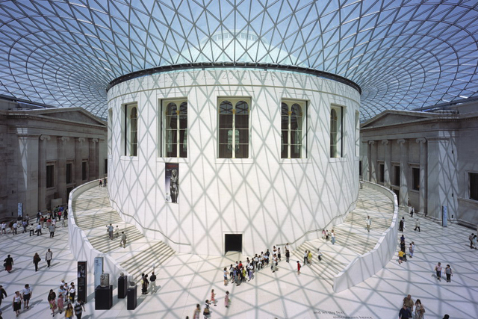
the West End
and the East End
Not far away is the British Museum — the biggest museum in London. It contains a priceless collection of ancient manuscripts, coins, sculptures, etc, and is also famous for its library.

Slide 16
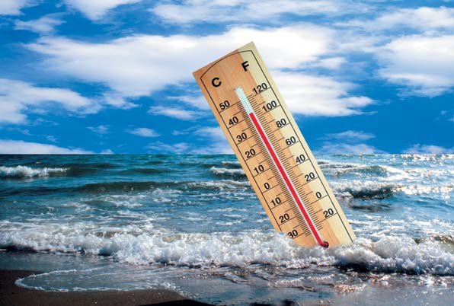
The British Isles which are surrounded by the ocean have an insular climate.

Slide 17

All these features make the climate more moderate, without striking difference between seasons. It is not very cold in winter and never very hot in summer.
There are 3 things that chiefly determine the climate of the United Kingdom: the position of the islands in the temperate belt; the fact that the prevailing winds blow from the west and south-west and the warm current — the Gulf Stream that flows from the Gulf of Mexico along the western shores of England.

Slide 18
So, the British ports are ice-free and its rivers are not frozen throughout the year. The weather on the British Isles has a bad reputation. It is very changeable and fickle. The British say that there is a climate in other countries, but we have just weather. If you don't like the weather in England, just wait a few minutes.

Slide 19
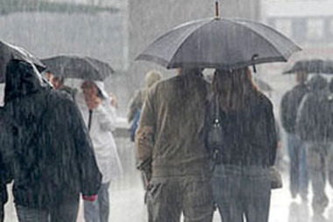
So, the British ports are ice-free and its rivers are not frozen throughout the year. The weather on the British Isles has a bad reputation. It is very changeable and fickle. The British say that there is a climate in other countries, but we have just weather. If you don't like the weather in England, just wait a few minutes.
It rains very often in all seasons in Great Britain. Autumn and winter are the wettest. The sky is usually grey and cold winds blow.

Slide 20
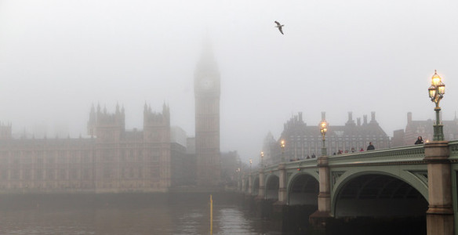
Britain is known all over the world for its fogs. Sometimes fogs are so thick that it's impossible to see anything within a few meters. The winter fogs of London are, indeed, awful; they surpass all imagination. In a dense fog all traffic is stopped, no vehicle can move from fear of dreadful accidents

Slide 21
So, we may say that the British climate has three main features: it is mild, humid and very changeable.

