Slide 1
ДРЕВНЯЯ ТВЕРЬ ПОЛЕ ЧУДЕС
ВНЕКЛАССНОЕ МЕРОПРИЯТИЕ
РАЗРАБОТАНО УЧИТЕЛЕМ АНГЛИЙСКОГО ЯЗЫКА
ВЫСШЕЙ КАТЕГОРИИ МОУ СОШ №45 Г.ТВЕРИ
РОГОВОЙ Г.В.
ДЛЯ ОБУЧАЮЩИХСЯ 8 – 10 КЛАССОВ ОБЩЕОБРАЗОВАТЕЛЬНЫХ ШКОЛ

Slide 2
ПОЯСНИТЕЛЬНАЯ ЗАПИСКА
Игровое внеклассное мероприятие «Древняя Тверь» рассчитано на обучающихся 8 – 10 классов общеобразовательных школ и может быть особенно актуальным при праздновании очередных годовщин победы в Великой Отечественной войне и освобождения города Калинина, которому присвоено звание «Город воинской славы».
Тематический способ усвоения краеведческой информации помогает систематизировать полученные сведения из разных наук и создать целостную картину истории и современной жизни нашего края.

Slide 3
ЦЕЛИ МЕРОПРИЯТИЯ
познавательный аспект - развитие умения извлекать информацию о событиях на территории древней Твери;
развивающий аспект – развитие способности к догадке, развитие творческих способностей обучающихся;

Slide 4
ЦЕЛИ МЕРОПРИЯТИЯ
воспитательный аспект- воспитание чувства гордости за свой родной город Тверь;
учебный аспект - совершенствование речевых навыков;
сопутствующая задача - развитие умения писать, аудировать с целью извлечения детальной информации.

Slide 5
ОБОРУДОВАНИЕ
жетоны;
игральные кубики (2 шт.);
призы;
компьютер;
интерактивная доска.

Slide 6
THE FIELD OF WONDERS «ANCIENT TVER»
Good morning, boys and girls!
Today we’ll play the most famous game «The Field of Wonders».
Our topic is «Ancient Tver».
We shall remember some famous people and interesting events. Are you interested in history? Do you know any facts from the history of Tver?

Slide 7
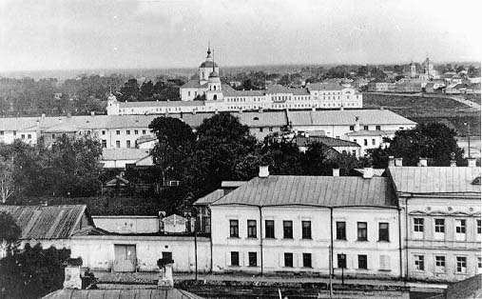
ANCIENT TVER

Slide 8
THE RULES OF THE GAME
1. YOU ARE TO THROW THE BRICKS AND TO COUNT THE POINTS. THESE POINTS WILL HELP YOU TO GET THE PRIZE.
2. YOU ARE TO GUESS THE WORD NAMING THE LETTERS.
3. THE WINNER IS THE FIRST TO PRONOUNCE THE CODED WORD.

Slide 9
INTRODUCE YOURSELVES
- Let’s start. INTRODUCE YOURSELVES.
(I am Vika. I am 14. I am from Russia. I am a pupil of the ninth (tenth) form. My hobby is reading. It helps me to know interesting facts about different countries and people. My favourite subjects are History and English. That’s why I am happy to take part in the contest today.)

Slide 10
THE FIRST ROUND
- Listen to the task, please. You will have to listen to my story and guess the word. The topic is «Ancient Tver».
THE TASK FOR THE FIRST ROUND
Artillery appeared in Russia at the end of XIV century, originally as being brought in from the Western Europe. But soon afterwards the most powerful Russian Principalities including Tver mastered the production of cannons of their own.

Slide 11
THE FIRST ROUND
Under Tver Prince Ivan Mikhailovich the Tver ordnance was so much strong and reliable that Tartar Khan Addigey, assaulting Moscow in the year 1408 demanded the Tver cannons to be brought to him for shelling Moscow. But Tver Prince «pulled the Khan’s leg treacherously». He did not get weapons to the Khan, turning cannons back home from the town of Klin.

Slide 12
THE FIRST ROUND
In the reign of Tver Prince Boris Aleksandrovich the Tver artillery was applied to Moscow Grand Prince Vassily the Tyemny in his campaign against the town of Uglitch. Then it bombarded «the obstinate town of Rzhev».
The time retained the name of the best Tver gunner. What is this name?

Slide 13
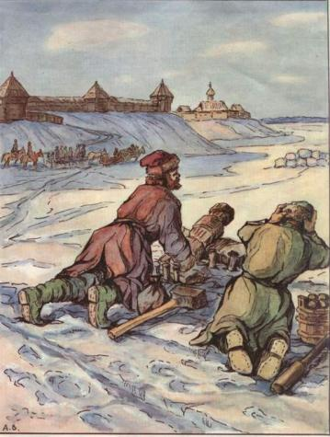
THE FIRST ROUND

Slide 14
THE SECOND ROUND
- Now the task for the next three competitors. INTRODUCE YOURSELVES. We’ll have a talk about Tver in the Middle Ages.
THE TASK FOR THE SECOND ROUND
From ancient times this Tower was known as the most powerful defensive construction of the Tver Kremlin. It protected the approaches to Kremlin from «the field». Simultaneously it was also used as the main entrance to the Kremlin.

Slide 15
THE SECOND ROUND
The Tower was a wooden construction as well as the Kremlin wall. In the course of time it burnt down repeatedly, but each time it was rebuilt again.
In 1674 the Tower was laid out and covered with white stone (it was 20 metres in height and 10 metres in width). The Tower was a three-storey construction with loopholes on each floor. Three copper cannons with shells were installed inside the Tower. What Tower it was?

Slide 16
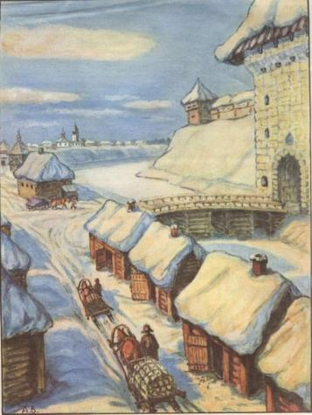
THE SECOND ROUND

Slide 17
THE THIRD ROUND
THE TASK FOR THE THIRD ROUND
Many times the wooden Tver considerably suffered from fires. The ordinary devastating fire took place in the year 1636, which destroyed the Gostinny Dvor and numerous petty shops.
Area for building the new constructions was in Zagorodsky Posad beyond the moat to the right near the Vladimir Gate. Soon afterwards the newly built rows of Shops and the Gostinny Dvor appeared in this district. Between all these structures a new square was formed. What was the name of it?

Slide 18
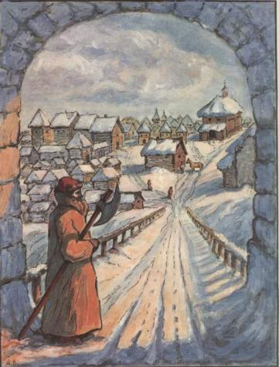
THE THIRD ROUND

Slide 19
THE TASK FOR THE AUDIENCE
- Name the places of interest in Tver. Let’s start.
- Well done! You are the winner! Take the prize.

Slide 20
THE FINAL
- There are three competitors in the final. Their names are… Please, your task.
THE TASK FOR THE FINAL
During the Years of Troubles Tver fortifications had to stand some heavy attacks undertaken by Polish-Lithuanian troops. In that hard time the regimental Voyevoda was missioned to Tver by Moscow Tzar to deliver from Tver the supplies to the Town of Byely being sieged by invaders. What was his name?

Slide 21
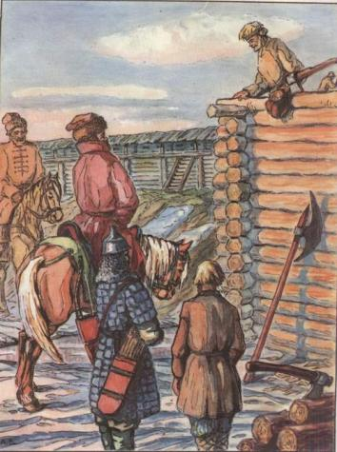
THE FINAL
-

Slide 22
THE SUPERFINAL
THE TASK FOR THE SUPERFINAL
The oldest building in Tver, the church which has been perfectly preserved up to nowadays and is located in the district of river Tmaka. The church was erected in the year 1564 on the money given by merchant Toushinsky who was very rich. To the left from the church there stood the small church of Paraskeva Pyatnitsa (the nickname).
What is the name of this church?

Slide 23
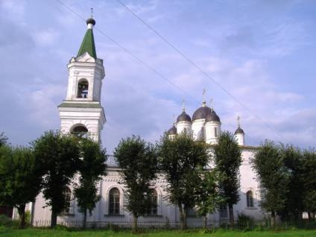
THE SUPERFINAL

Slide 24
KEYS
THE FIRST ROUND: Mikula Krechetnikov
THE SECOND ROUND: Vladimir
THE THIRD ROUND: Trading
THE FINAL: Pozharsky-Lopata
THE SUPERFINAL: White Trinity

Slide 25
ИСПОЛЬЗОВАННАЯ ЛИТЕРАТУРА И WEB – РЕСУРСЫ ИНТЕРНЕТ
Ильин М.А. Древняя Тверь (12 – 17 вв.): Историческая справка. – Торжок, 1958. – 35 с.
История Тверского края: Учебное пособие/ Под ред. В.М. Воробьева. – Тверь, 1996. – 208 с.
Колосов В.И. Прошлое и настоящее г. Твери. – Тверь, 1994. – 254 с.
http://hram-tver.narod.ru
http://oldtver.narod.ru
http://www.tversu.ru/Culture/Old_Tver

