Slide 1
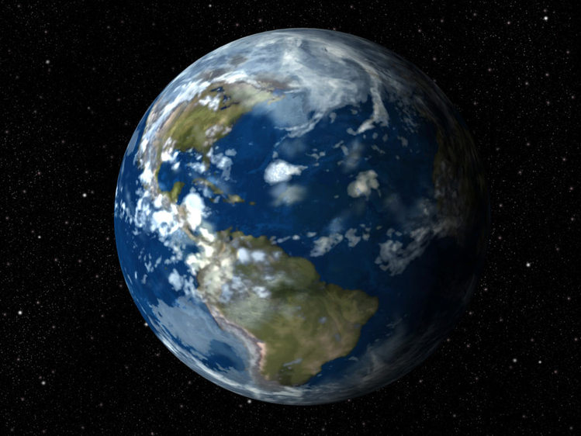
The most important discoveries of the human history.

Slide 2
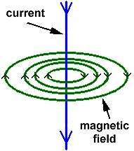
Electromagnetism
It is one of the four fundamental interactions in nature. Electromagnetism is the force that causes the interaction between electrically charged particles. The areas in which this happens are called electromagnetic fields.

Slide 3
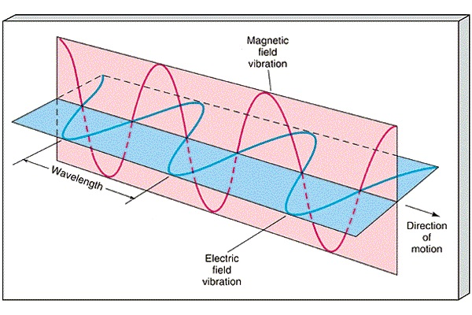
There are two types of field: electric and magnetic. Electrically-charged particles result in an electric field. A magnetic field results from the motion of an electric current and is used to generate the electricity we use.

Slide 4
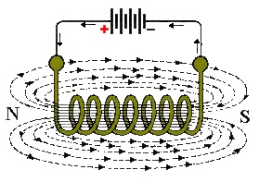
Michael Faraday was the first who produced what he called electromagnetic rotation. Heinrich Hertz, a German physicist, clarified and expanded the electromagnetic theory of light that had been put forth by Maxwell. He was the first to satisfactorily demonstrate the existence of electromagnetic waves. Later James Clerk Maxwell, the Scottish physicist, produced the equations that proved the two forces acted as one.

Slide 5
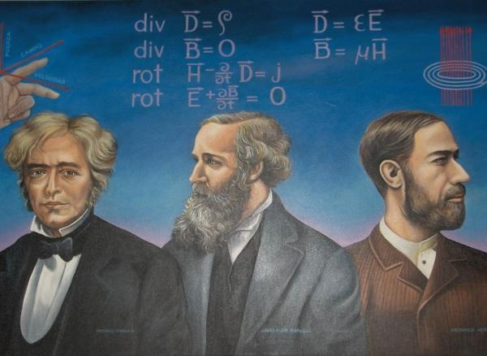
Without discoveries of these famous physicists we would not be able to enjoy the modern lifestyle that we have now.

Slide 6
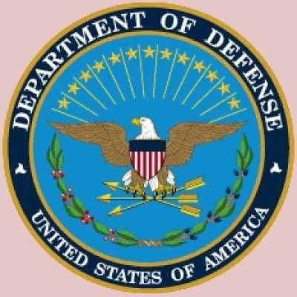
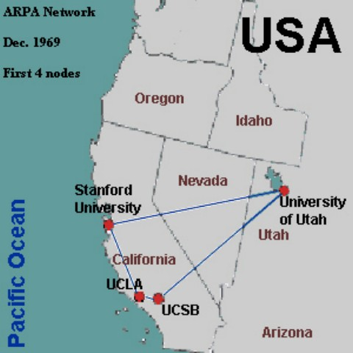
The Internet
In 1957, the U.S. Defense Department decided that in case of war America needs a reliable communication system. Agency Defense Advanced Research Projects (DARPA) has proposed to develop the computer network to the leading U.S. institutions. The network was called ARPAnet and in 1969 it united 3 institutions which made the development.

Slide 7
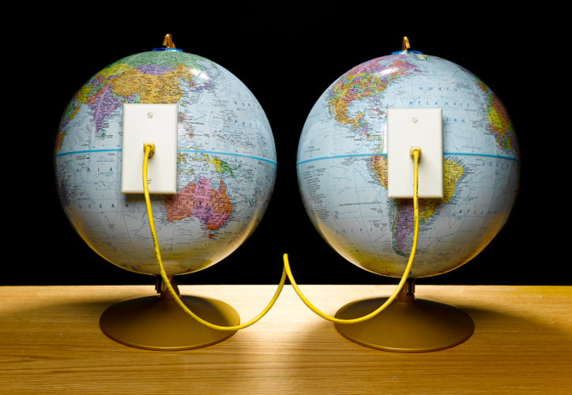
In 1973 the ARPAnet became international. England and Norway had a connection with the U.S. by the transatlantic telephone cable which length was 640 km!
Shortly thereafter, National Science Foundation (NSF) has opened NSFnet to link five supercomputer centers. And in 1990, the ARPAnet ceased to exist, completely losing the competition to NSFnet.

Slide 8
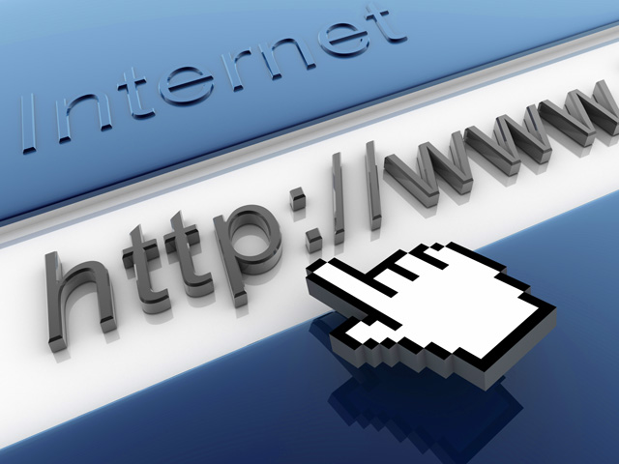
Internet became very popular, so to make it fast and easy, the system of World Wide Web (WWW) was invented. As the result of this work, in 1990 the scientific community was presented the first browser which allowed to view text files related with hyperlinks on-line. Access to this browser was opened to the general public in 1991, but it wasn’t very popular.

Slide 9
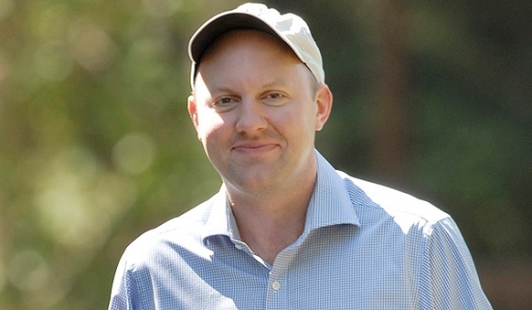
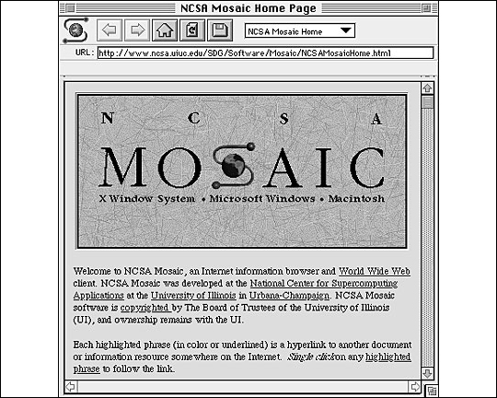
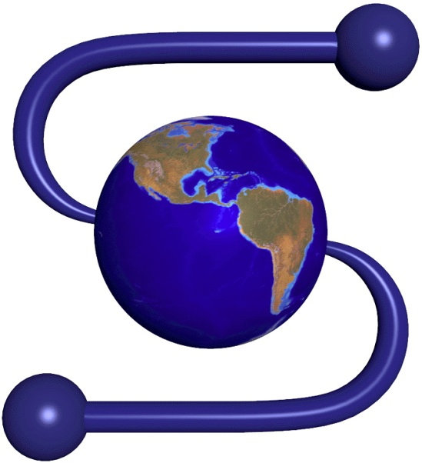
But the first version of Mosaic browser, made for Unix by the student Marc Andreessen in 1992, appeared to be the new stage for Internet.

Slide 10
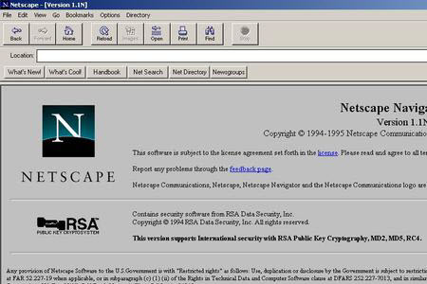
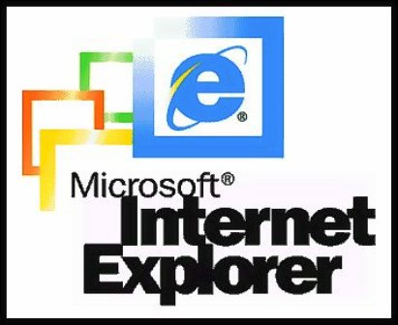
In 1994, after release of new version of Mosaic browser for Windows and Macintosh, appeared other browsers – Netscape Navigator and Microsoft Internet Explorer. This led to the fantastic popularity of WWW. Firstly it happened in the U.S.A. then it came to the other parts of the world.

Slide 11
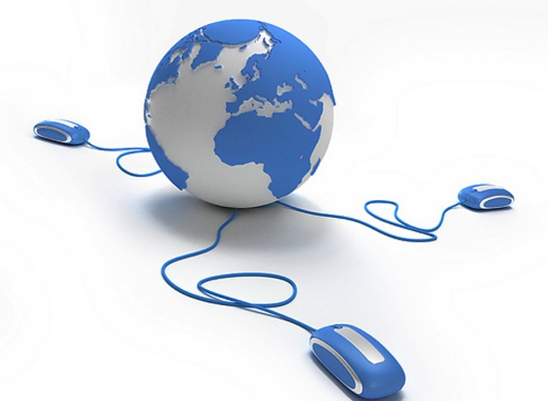
In 1995 NSF gave the responsibility for the Internet to the private sector, so since that day Internet exists in the form we know it today.
Within five years the Internet has reached an audience of more than 50 million users.

Slide 12
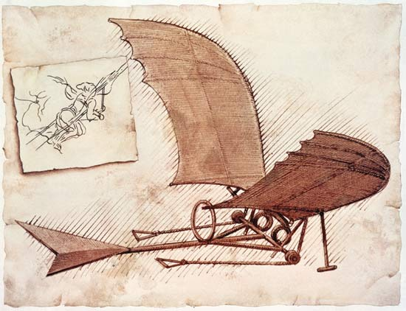
Plane
There are many stories from antiquity involve flight, such as the Greek legend of Icarus and Daedalus. Around 400 BC in Greece, Archytas was reputed to have designed and built the first artificial, self-propelled flying device.

Slide 13
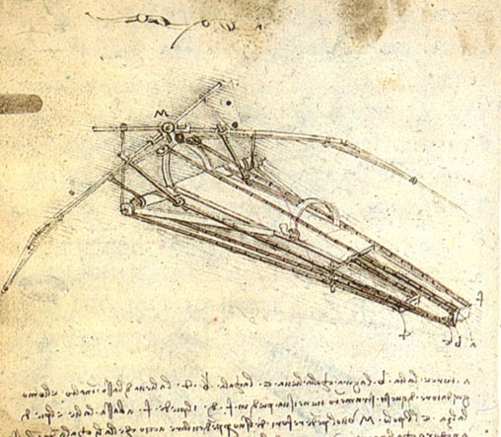
Leonardo da Vinci researched the wing design of birds and designed a man-powered aircraft in his Codex on the Flight of Birds . Many tests have been carried in period of 1600 to 1903.

Slide 14
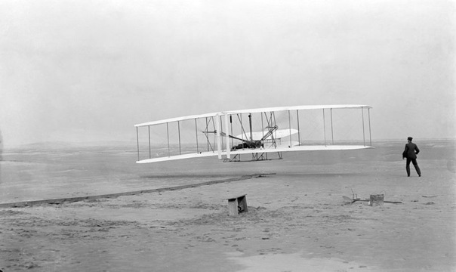
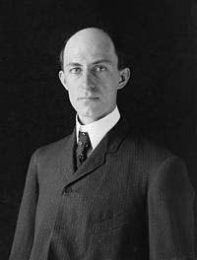
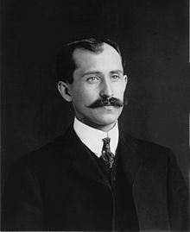
But only Orville and Wilbur Wright s device was an immediate success. They constructed controllable plane Flyer-1. In 17 of December 1903 the machine traveled 120ft in 12 seconds. In 1906, Alberto Santos Dumont made what has been claimed as the first airplane flight unassisted by catapult. The first widely adopted of the aircraft was in World War I.

Slide 15
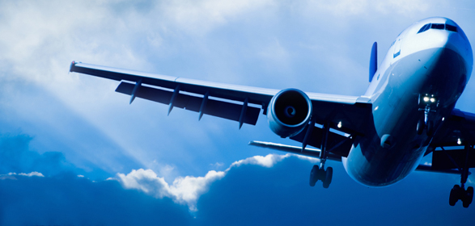
In our days modern aircraft construction is developing very fast and employed with a peaceful view and with military view.

Slide 16
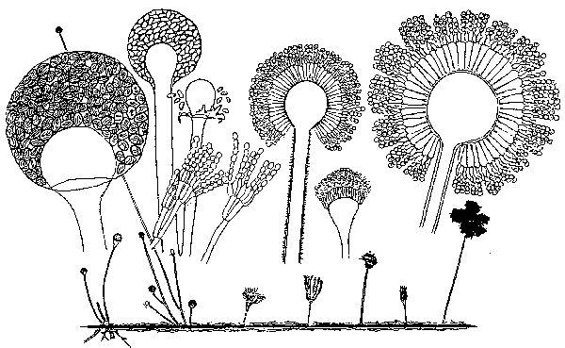
Penicillin
A lot of people died in wars. And if a man had had a little wound, he could have died because of the infection, which could get into his blood. Antiseptics didn’t help to save lives or organs.

Slide 17
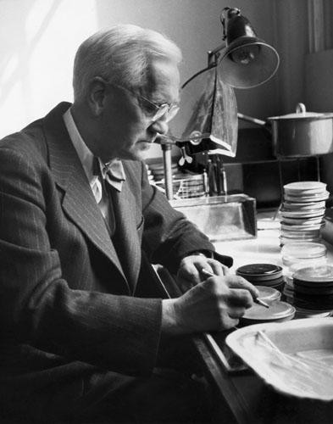
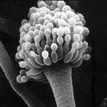
In 1928 Scotch scientist Alexander Fleming found perfect property of penicillin to kill harmful microorganisms. The discovery of this substance was rather fantastic.

Slide 18
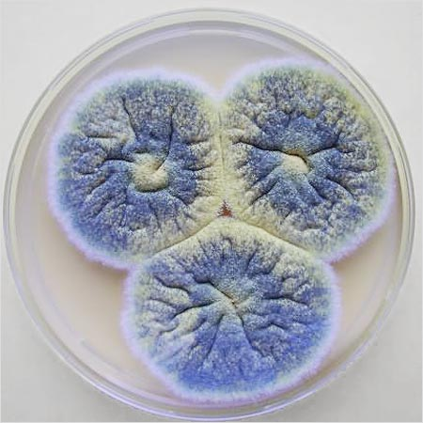
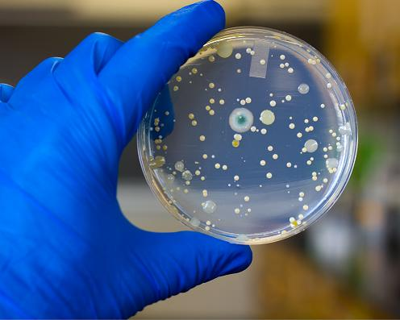
Alexander Fleming worked in St. Marie hospital. He didn’t support cleanliness on his workplace and didn’t take away special thicket, thicket of Petri along 2-3 weeks. In one of them got mushroom and covered with mould. This mould began to kill infection.

Slide 19
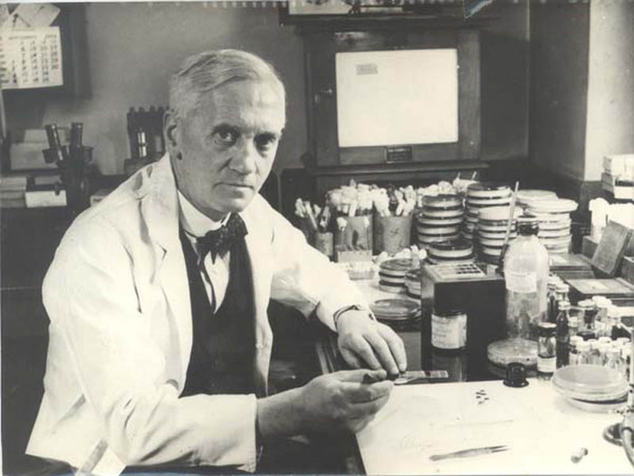
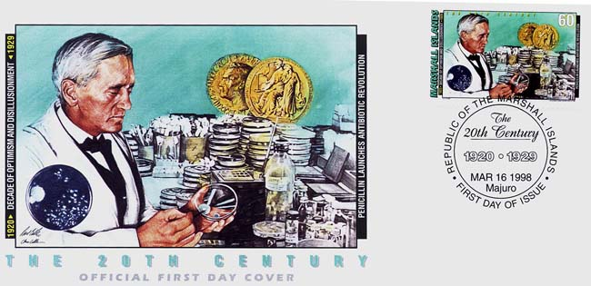
Penicillin saved lives of thousands of people, particularly in the Second World War. Diseases like tuberculosis, gangrene began to be given medical treatment. Alex Fleming received Nobel prize for this great discovery.

