Slide 1
«Ukhta is my native town”
By Vadim Bunin

Slide 2
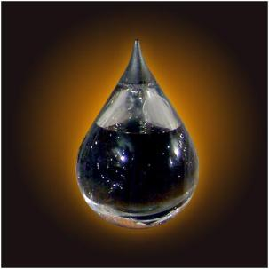
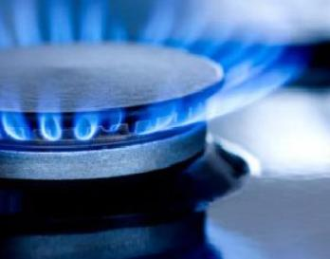
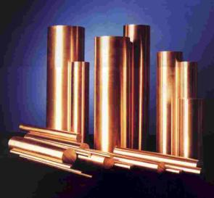
Natural Resources of Ukhta

Slide 3
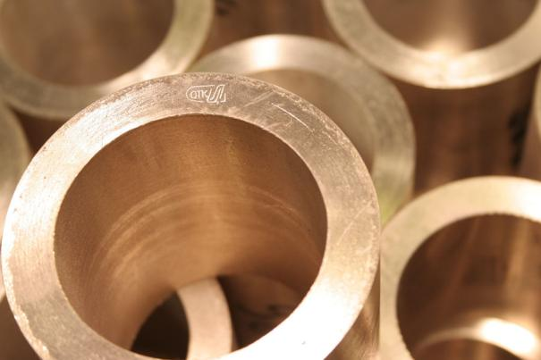
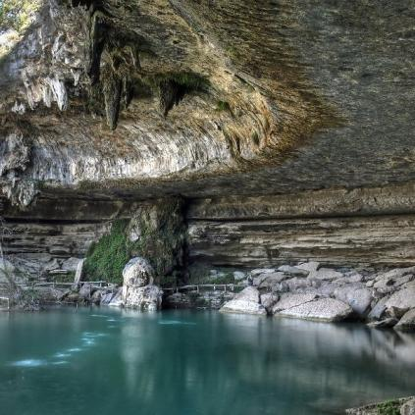
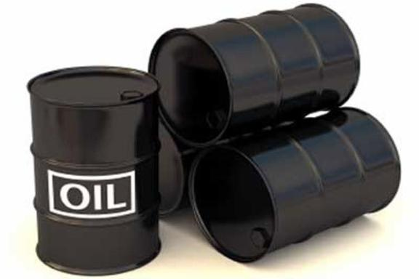
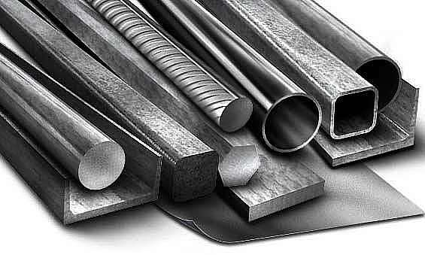
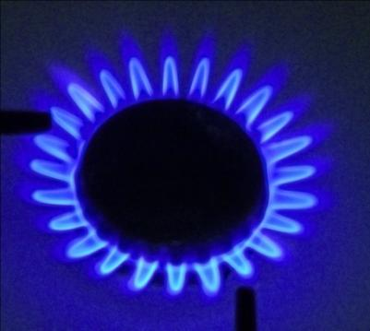
Our town is the oldest oil and gas region of the republic. The most promising are Yarega oil field and Zapadno-Timanskoe oil field.
Ukhta is rich in mineral resources including deposits of oil, gas, ferrous and nonferrous metals, different kinds of mineral building raw and also fresh and medical-mineral underground waters. On the territory of Ukhta there are 147 fields of peat, reserves of titanium, bauxite.

Slide 4
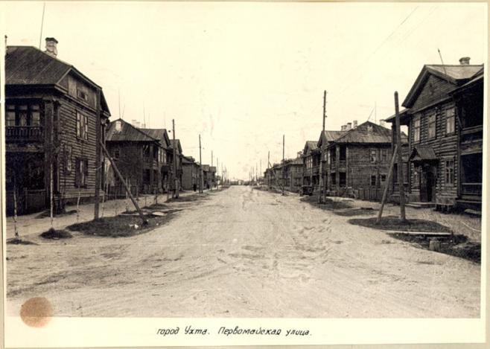
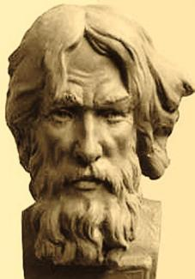
A little bit history
Ukhta was known long ago. In 1745 Russian engineer Pryadunov built the first oil plant in the area of the present suburb Vodny. People were attracted by vast wealth of this land: oil, gas, building materials and others. The first complex geological expedition in 1843 set up the beginning of industrial development of this region. Before the revolution there were only small sites and private enterprises in the area. There was a small settlement called Chibyu with a dozen streets and wooden house. Only in 1943 the settlement got the status of a town.

Slide 5
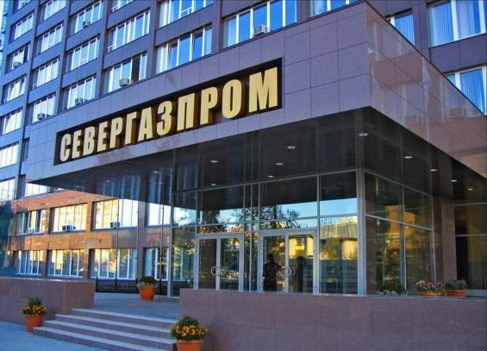
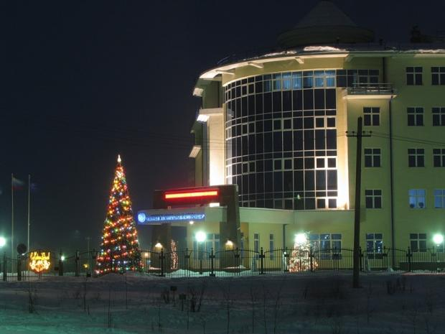
Nowadays
Since that time Ukhta has changed beyond recognition. It’s a modern town with plenty of well-equipped enterprises and great scientific and education potential. There are a lot of enterprises in the town, working in engineering, building, timber and woodworking industry, including such giants as the Ukhta oil refinery, “Severgasprom” company, “Northen oil mains” joint-stock company and others. Oil and gas products are delivered to the other parts of Russia and abroad

Slide 6
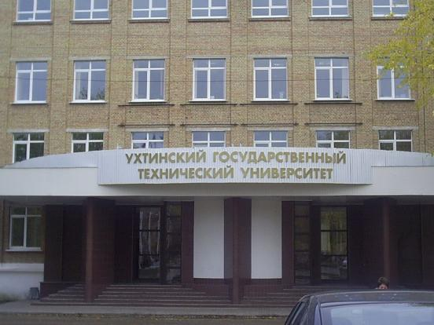
Ukhta is a town of students. In our town there is only in the Komi republic Ukhta State Technical University, which gives young people an opportunity to acquire specialties connected with plenty of industrial fields: oil, gas, timber, building, architecture, economy, geology and geophysics.

