Slide 1
ENGLAND England is the largest part of the UK.

Slide 2
The capital of England is London

Slide 3
Saint Patron of England is St.George

Slide 4
The symbol of England is a red rose

Slide 5
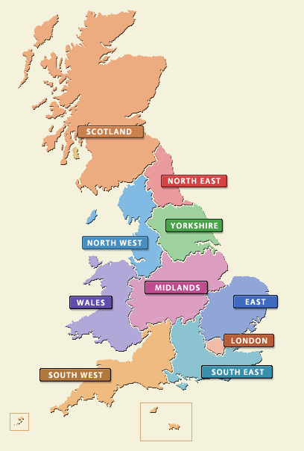
The Regions of England
This part includes several regions:
The Southeast
The Southwest
East Anglia
The Midlands
The North of England

Slide 6
The Southeast Such historical cities as Brighton and Dover are situated here.

Slide 7
The Southeast The County of Kent known as the garden of England is situated in the Southeast.

Slide 8
The Southwest It is famous for its farming, but in the past it used to be known for its pirates.

Slide 9
The Southwest Stonehenge, a pre-historic monument is located here.

Slide 10
The Southwest Bath and Bristol are located here too.

Slide 11
The Southwest “Land’s End” is the most westerly point of Great Britain.

Slide 12
East Anglia Cambridge, where the second oldest British university was founded, is in East Anglia.

Slide 13
The Duchess of Cambridge Kate Middlton was given the title of the Duches of Cambridge

Slide 14
East Anglia Oliver Cromwell, a famous British general and politician, was born here.

Slide 15
The Midlands Manchester, Liverpool and Sheffield are situated in the heart of England, which is the Midlands.

Slide 16
The Midlands Stratford-upon-Avon, Shakespeare’s birthplace, is popular with tourists.

Slide 17
The Midlands William Shakespeare is one of the world’s famous writers, poets and playwrights.

Slide 18
Romeo and Juliet It’s one of the most famous tragedies by W. Shakespeare.
The film of Franco Zeffirelli
The film of Baz Luhrmann

Slide 19
The Globe Theatre
W. Shakespeare wrote a lot of plays for the theatre. Most of his plays were performed in the New Globe Theatre.

Slide 20
The Globe Theatre in Shakespeare’s time.

Slide 21
The Midlands Oxford, another famous university city, is also connected with English culture.

Slide 22
The North of England The Lake District attracts crowds of tourists.

Slide 23
The North of England Tourists come to see the ruins of the Roman Hadrian’s Wall.

Slide 24
Использованные материалы
Картинки из Google и Yandex.
Учебник О.В. Афанасьевой, И.В. Михеевой для VI класса школ с углубленным изучением английского языка, лицеев и гимназий.

