Slide 2
Help about the house

Slide 3
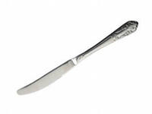
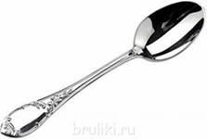
Read:
Help your mother lay the table
With the knife and fork, and spoon.
Help your mother
lay the table
Every afternoon!

Slide 4
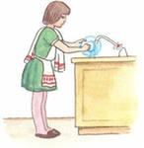
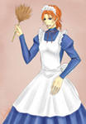
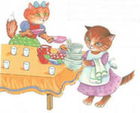
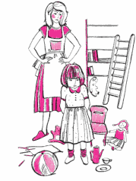

Slide 5
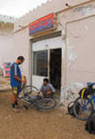
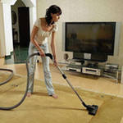
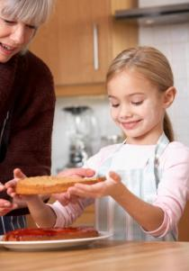
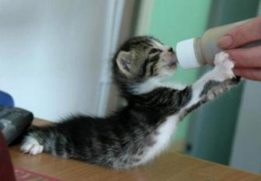

Slide 6
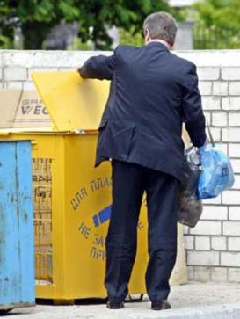
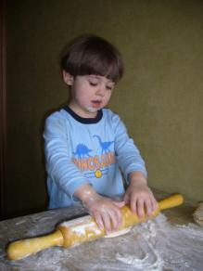
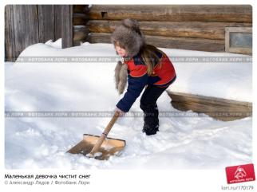

Slide 7
Key:
I v-t:
1- e ; 2- i ; 3- f ; 4- h ; 5- b ; 6- c ; 7-d ; 8- a; 9- g .
II v-t:
1- f ; 2- c ; 3- a ; 4-i ; 5- h ; 6- b ; 7- e ; 8-d ; 9- g.

Slide 8
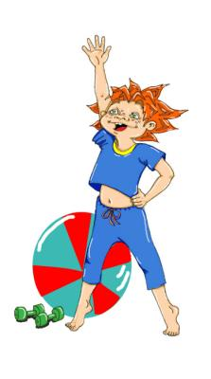
Relax:
Touch your eyes, touch your nose,
Touch your ears, touch your toes.
Jump and run, let’s have fun!
Wash your hands, wash your face,
Clean your teeth! Stay healthy, please!

Slide 9
What do you do at home?

Slide 10
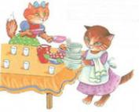
Act out:
Do you usually help at home?
How do you usually help at home?
What do you usually do?
Do you…… ? Yes, I do.
Of course.
No, I don’t.

Slide 11
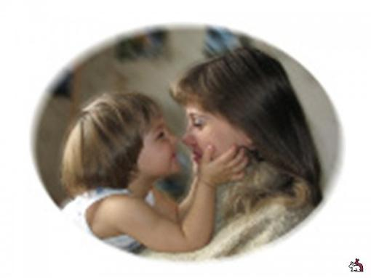
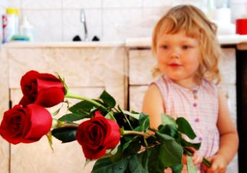
Mother’s Day/ Mothering Sunday
3 воскресенье, март

Slide 12
Act out:
…., may I help you to ……?
+ Of course. You may.
You may …….
+Thank you. That will be nice of you.
…., may I help you to ……?
- Thank you. I can do it myself.

Slide 13
Let’s sing a song:

Slide 15
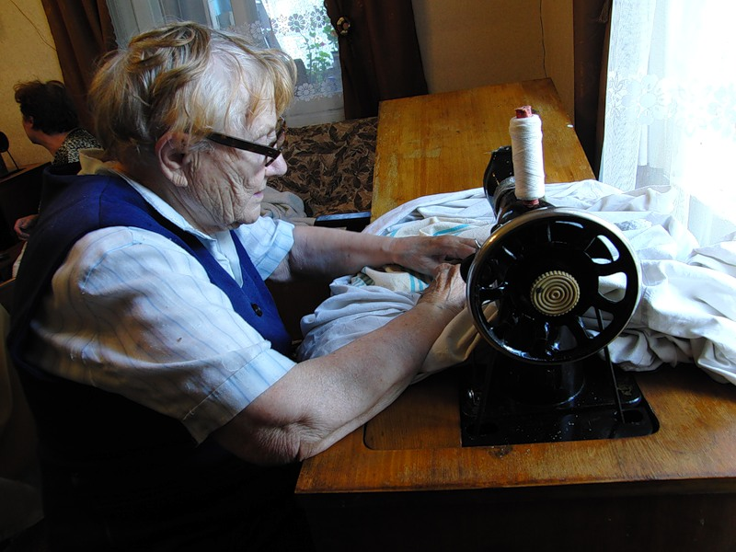

Slide 16
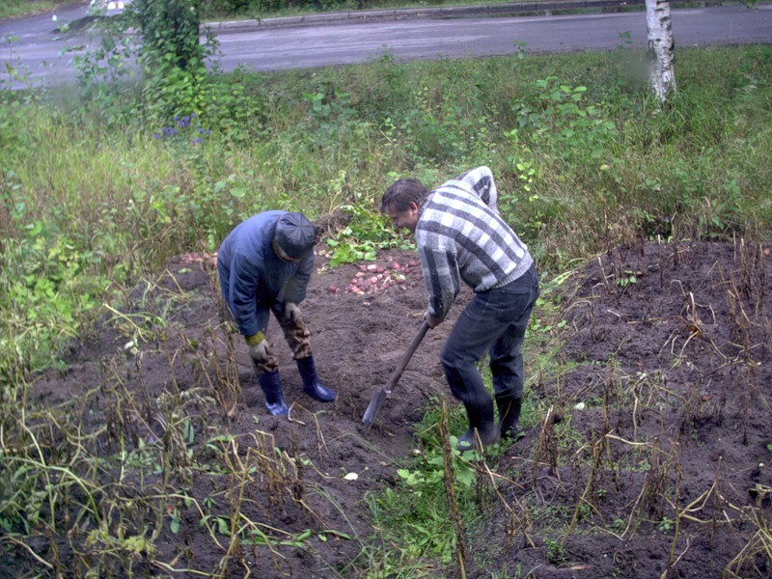

Slide 18
H/w: Help at home.
I like to….
I must….
Sometimes….
Every day….
I don’t like to…..
Usually I….

Slide 19
Express your feelings:

