Slide 1
Wild Animals’ Park

Slide 2
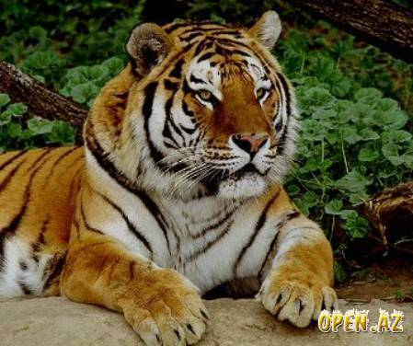

Slide 3
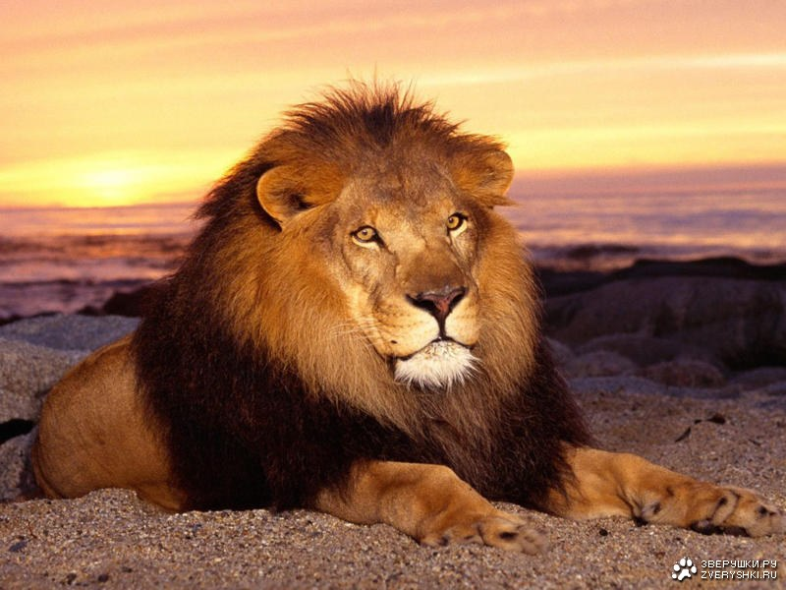

Slide 4
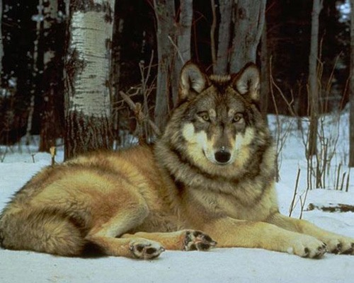

Slide 5
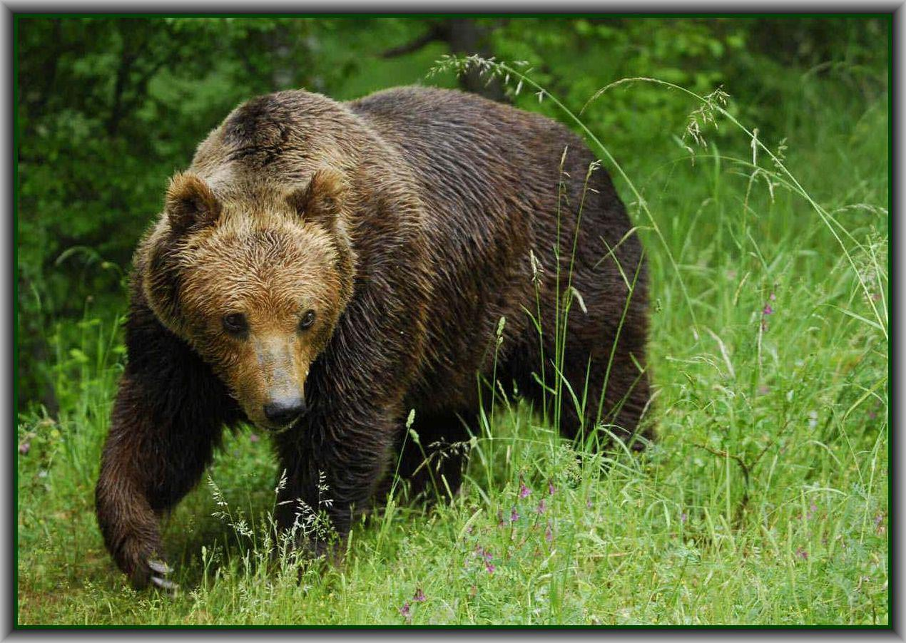

Slide 6
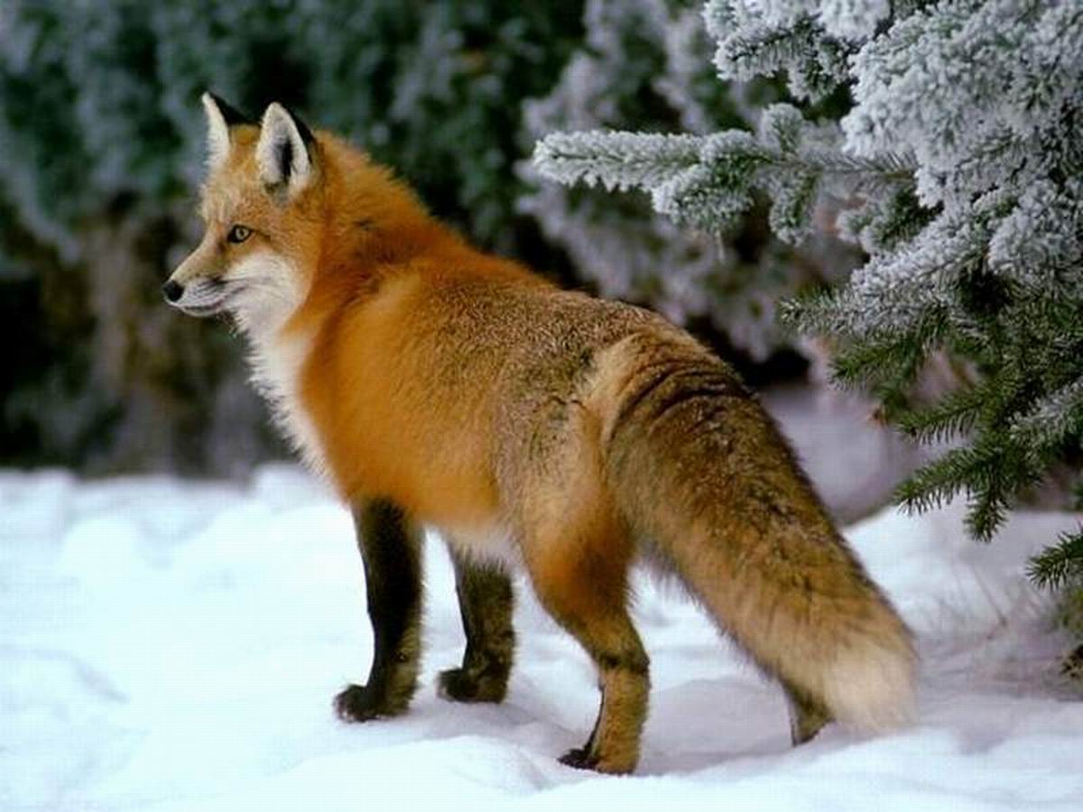

Slide 7
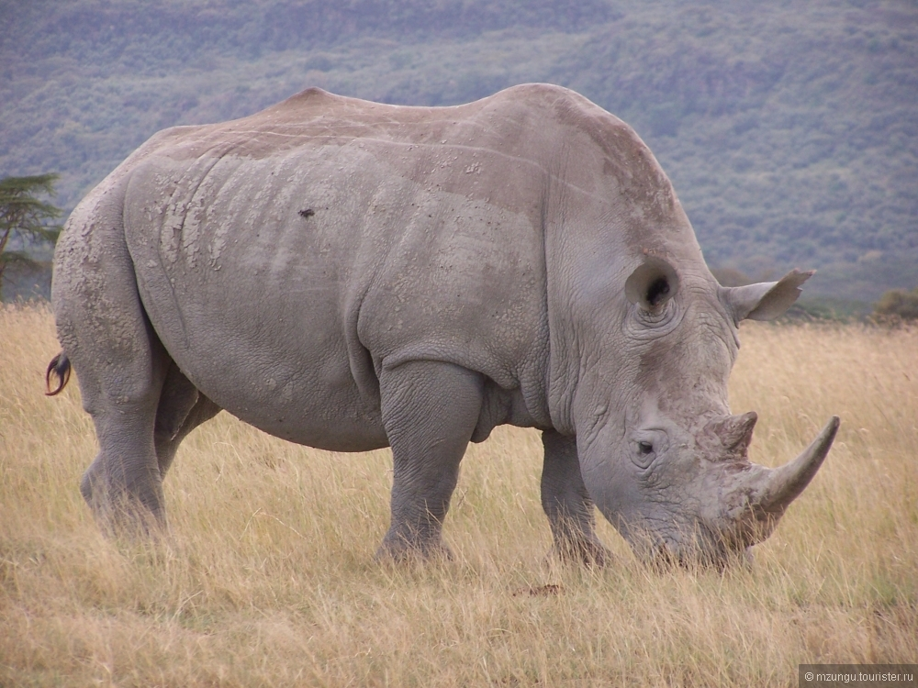

Slide 8
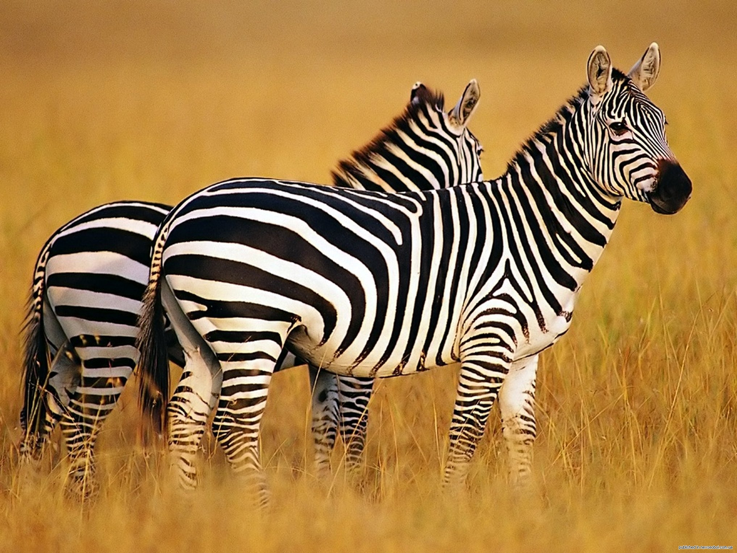

Slide 9
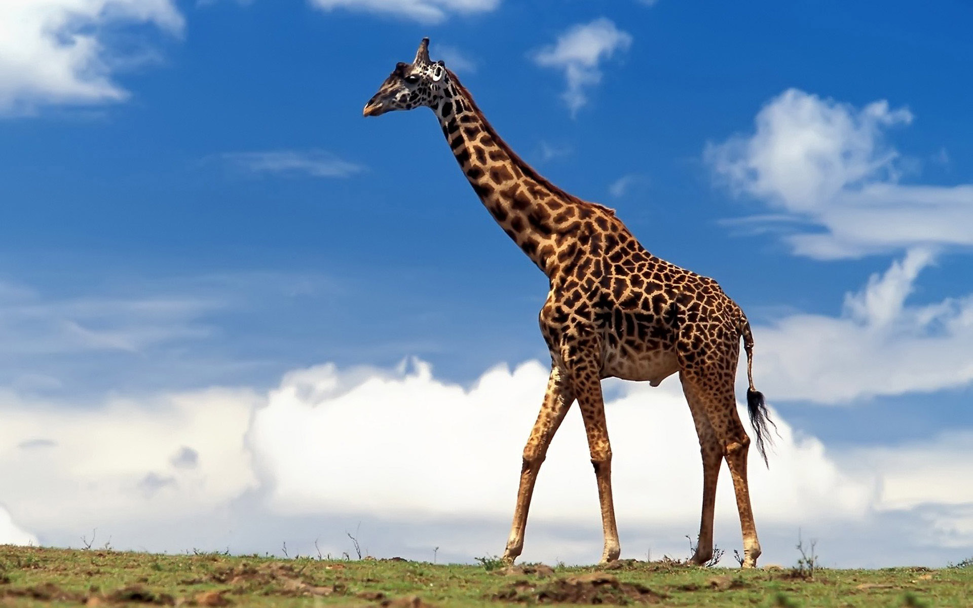

Slide 10
1. Agree or disagree.
-The Zoo which you have read about is in London.
-Trees and flowers grow in that Zoo.
-The Zoo is open every day.
-Not many animals live there.
2. Read the sentences which describe.
-Feeding animals.
-Monkey’s behavior in the Zoo.
-Elephant’s washing.
3. Decide if the following statements are true(T) or false(F).
А)Many children visit the London Zoo every day.
B) There are no flowers there in summer.
C) A good time to visit animals when they take their food.
D) It is not interesting to watch how birds eat meat.
E) There are many kinds of monkeys in the Zoo.
T
F
T
F
T

Slide 11
Circle the correct verb.
We have been/were at London Zoo lately.
Ann has feed/fed homeless dogs yesterday.
Monkey ate/ has just eaten banana.
Tiger’s cage is dirty. The keeper cleans/hasn’t cleaned it yet.
Kate and Sam have found/found kitten two days ago.
The giraffes arrived/have arrived at this wild animals’ park recently.

Slide 12
1This animal lives in the forest. It’s neither big no small. It likes to eat carrots and it is afraid of fox and wolf. This animal runs very fast.
2. This animal is very big. It is grey and sometimes white. It has a very long nose. It lives in India and Africa. It likes to eat leaves and grass.
3. This animal lives at home or in the street. It’s man’s friend. It can run, but can’t fly and climb. It is very clever and friendly.
4. This animal lives in the river or near the water. It is green. It can jump and swim, but it can’t neither run nor climb.
5. This animal is red and sly. It likes hens, cocks, hares and ducks. It lives in the forest.
6. Gena isn’t a boy. He is big, long and green. He is very clever. It can swim. He has a friend Cheburashka.
7. It is very grey. It can run, jump and walk. It is very small. It likes bread and cheese. It lives in the house.
8. This animal can be black, grey, white or red. It lives in the house. It can catch a grey mouse. It likes meat, fish and milk. It can run, climb and walk.
1
2
3
4
5
6
7
8

Slide 13
A bird may be known by its song.
A cat in gloves (перчатки) catches no mice.
Catch the bear before you sell(продавать) his skin.
It is raining cats and dogs.
When the cat is away the mice will play.
Видна птица по полету.
Без труда не выловишь и рыбку из пруда.
Не дели шкуру неубитого медведя.
Дождь льет как из ведра.
Кот из дома – мыши в пляс.

