Slide 1
project
Lakes of THE Republic of maRY el

Slide 2
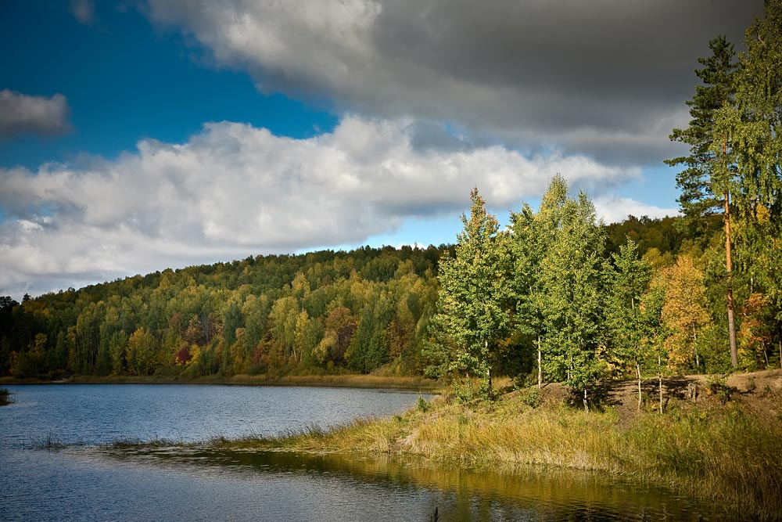
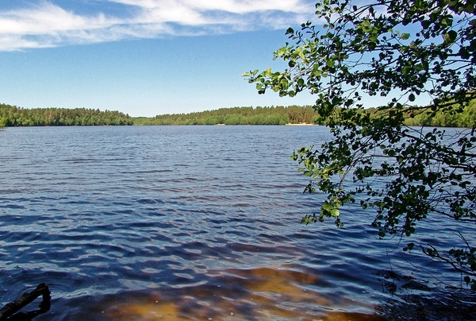
The Mary Republic is rich in lakes. They are, Mushan-er, Deaf, Kichier, Tair, Shap.The lakes are favourite destination for fishermen , hunters, and tourists.

Slide 3
Lake «Sea eye»

Slide 4
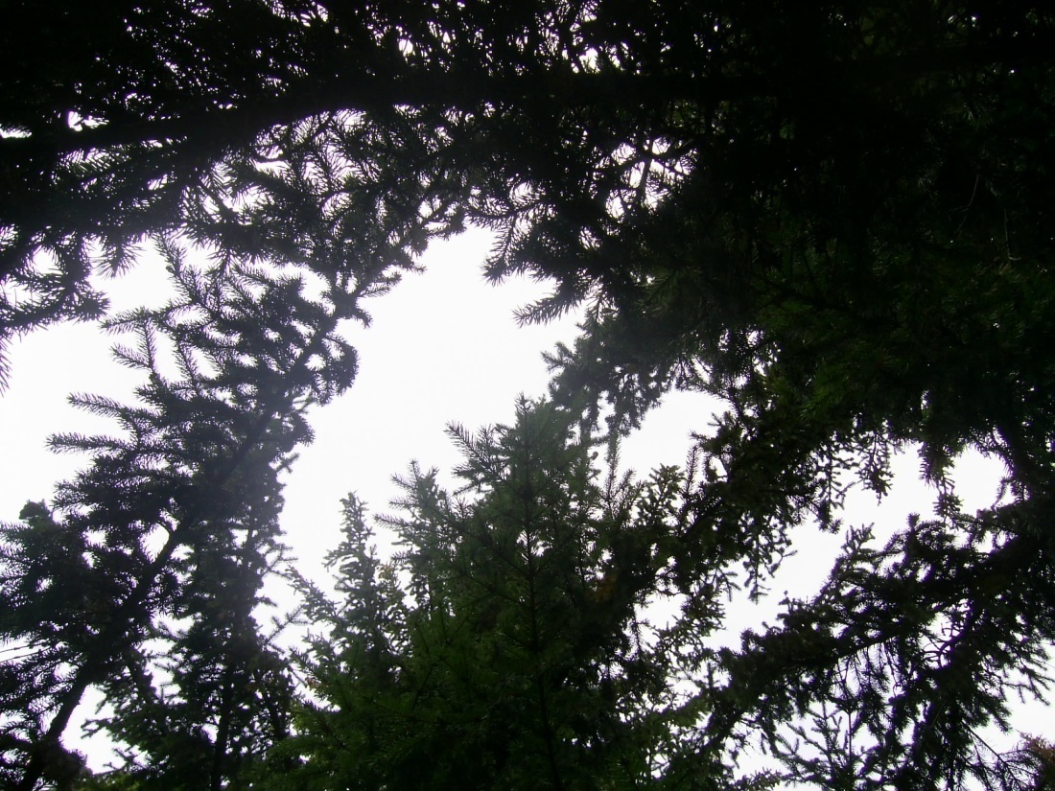
It is located not so far from village Sotnur. It’s depth is 35,5 m. The color of water is green. Probably the lake was formed 20 thousands years ago. It is surrounded with beautiful pine wood. Different species of fish live in the lake: a silver European carp, a perch, a golden European carp, a pike. You can drink clean and tasty water from the source which flows down into the lake.

Slide 5
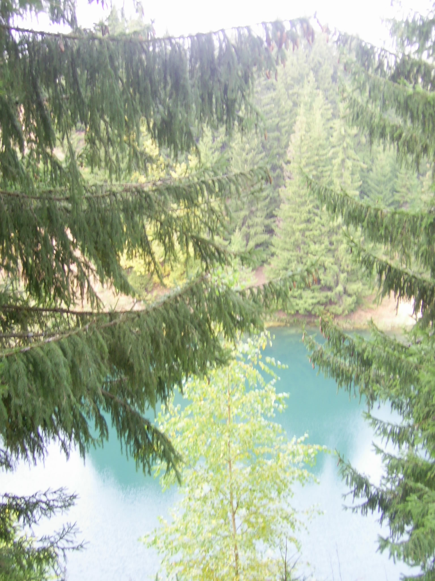
The legend says that after the wedding party the people came here . While they were leaving, they didn’t notice that the ground was being ruined on their way. Everybody fell on the bottom of the lake which was formed on place of deep collapse.

Slide 6
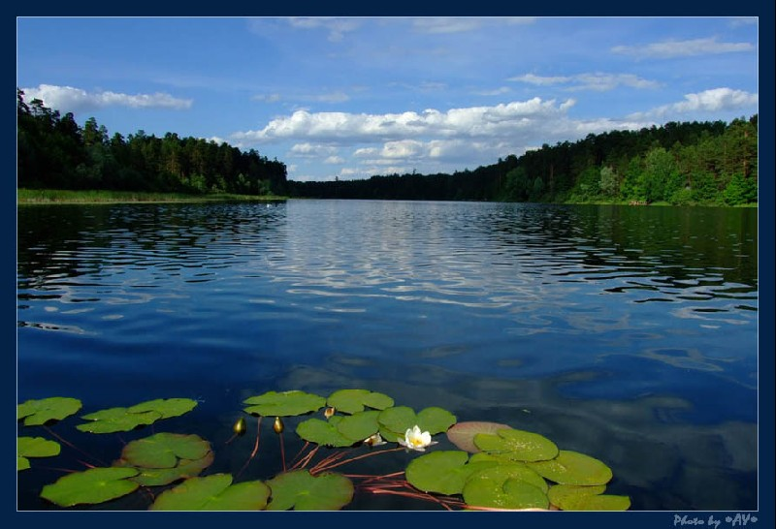
Lake yalchic

Slide 7
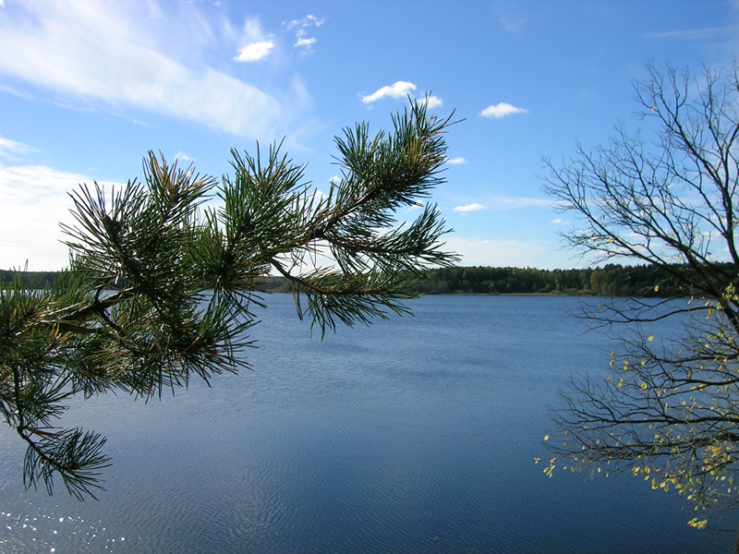
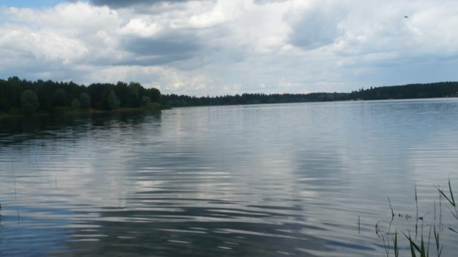
Another beautiful and big lake is lake Yalchic. It is located not far from town Volzhsk. There is clean water. It is divided into the Big and the Small Yalchic. It is deep too.

Slide 8
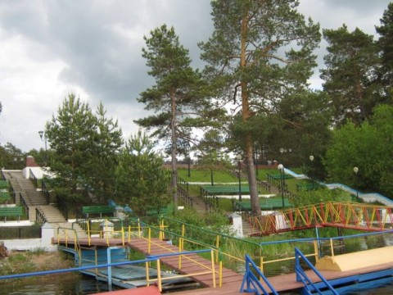
On it’s banks there are a lot of rest homes, boarding-houses, camps. Every summer thousands of people spend their holidays there.

Slide 9
Our clаss often go camping to the lake Yalchic. We swim, play games, sunburn, cook food on the camp fire . We usually go camping with our parents and class teacher.

Slide 11
Enjoying beautiful nature, breathtaking views and tranquility we can spend a day like in a paradise.

Slide 12
The project was made by pupils of class 10«A» Koshkina K., Dvinskih K., Kuznetsova L.
Thanks for
your attention

