Slide 1
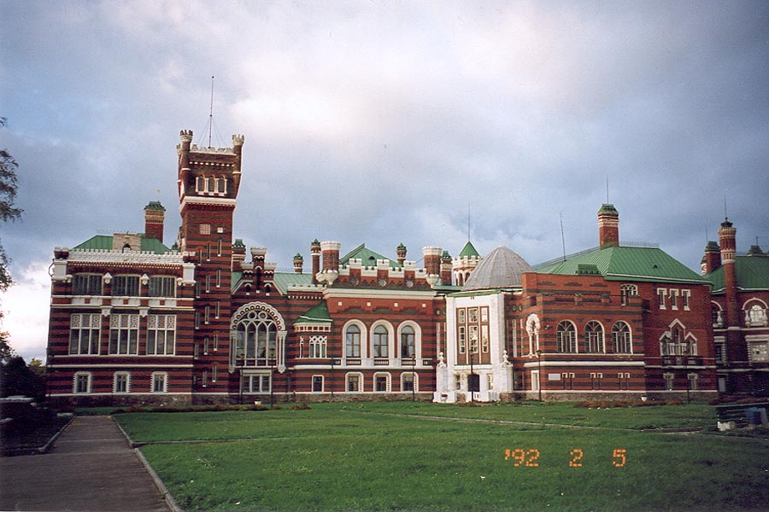
The Sheremetyevs` castle.
It is a great palace and parks ensemble, a monument of architecture of federal significance.
F

Slide 2
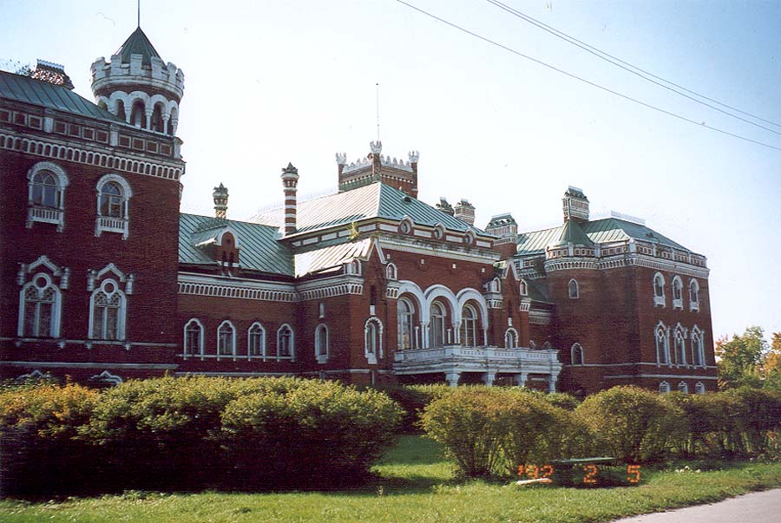
PAST
History of the castle began in 1892, when the richest landowner of Nizhny Novgorod province Vasily Sheremetev bought the village Yurino. He was a great-nephew of Count Sheremetev and Marshal in the army of Peter 1.
The castle was built in 1880 on the project of German architect R. Muller in the style of late Neogothic.

Slide 3
The owners of the castle were Vasily Petrovich and Olga Sheremetevs. Olga was a sister of a famous General Skobelev. He used to visit his relatives in the castle. Semi-owners gathered a large collection of antique fire-arms and edged weapons. Some of them belonged to Skobelev.

Slide 4
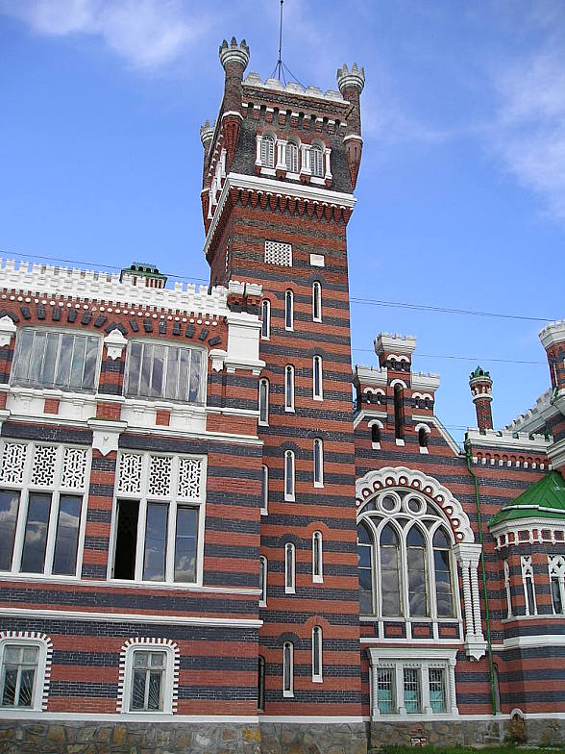
In 1916 after the death of their son, the heirs left Yurino. After Great October Revolution the castle was used as a sanatorium, rest home. During the Great Patriotic war, there was a hospital.

Slide 5
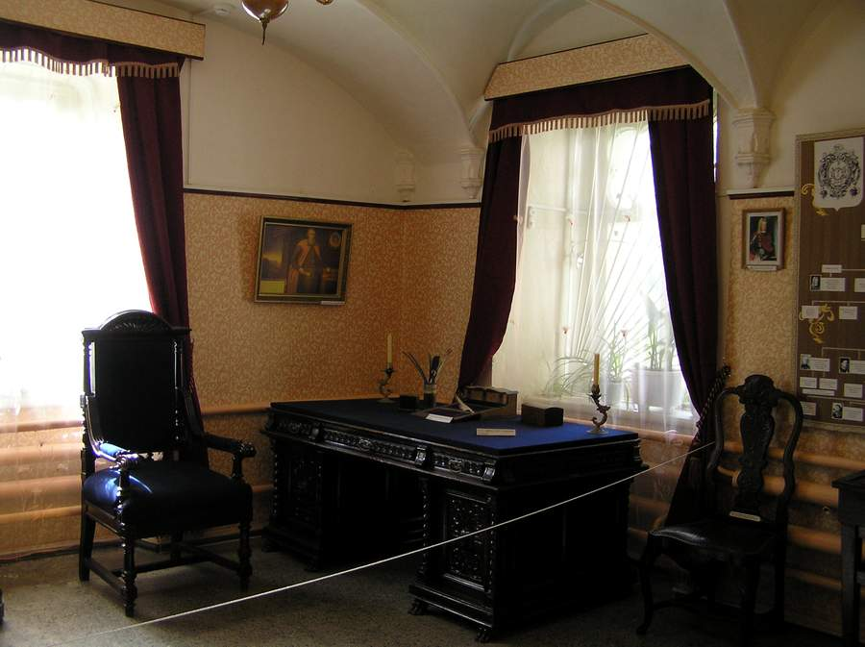
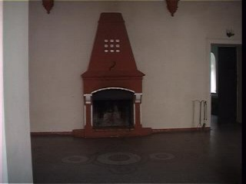
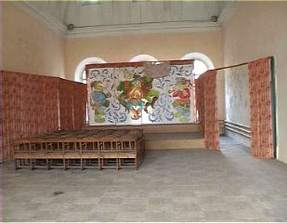
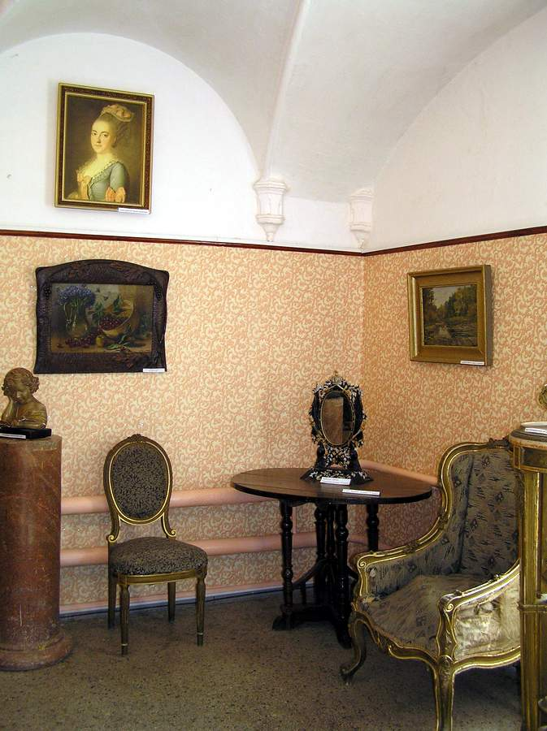
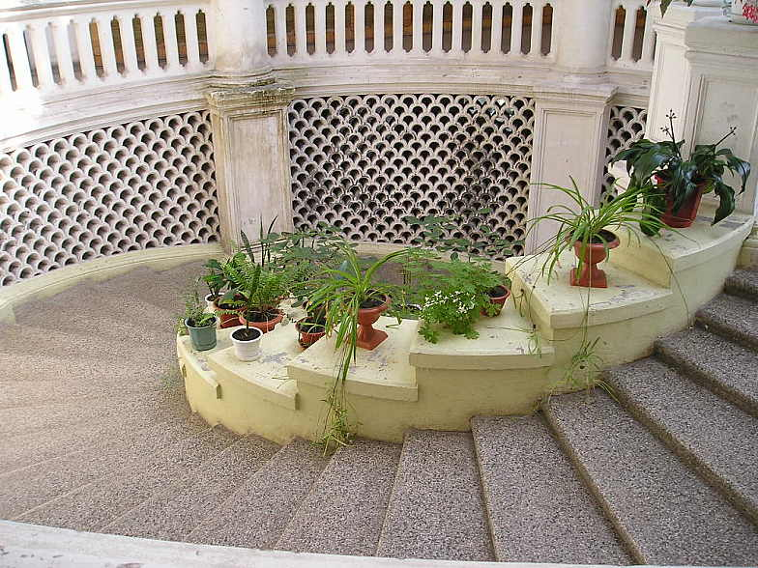
PRESENT
In the castle there are about a hundred rooms: « Art Gallery», «East Area», «Oak room», « Skobelevsky Hall».

Slide 6
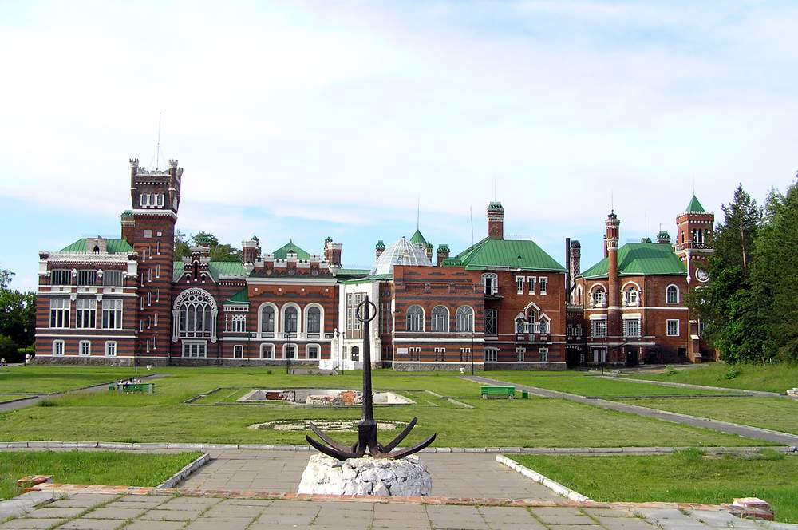
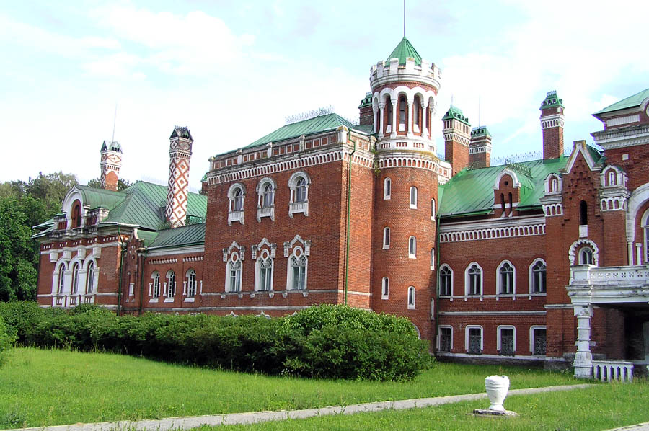
The palace is surrounded with parks and ponds.
The total area of the estate is 45 hectares.

Slide 7
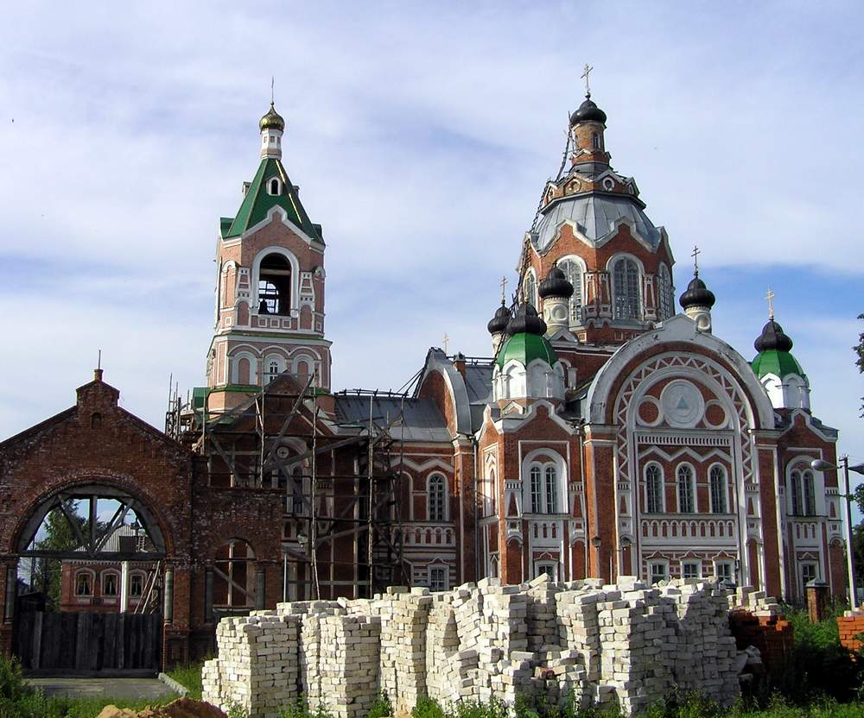
Nowadays one part of the castle is being restored but the other part is being used as a hotel complex.

Slide 8
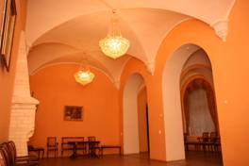
Thousands of tourists from different corners of the world visit the Sheremetyevs` castle and admire it`s beauty.

Slide 9
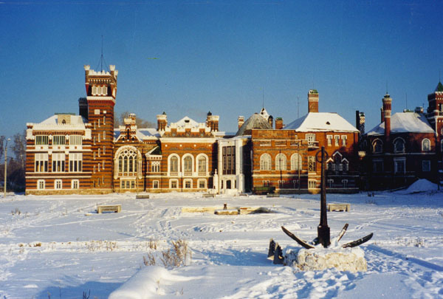
Welcome to the Museum!

