Slide 1
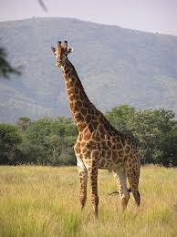
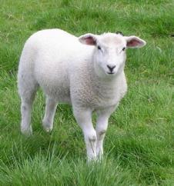
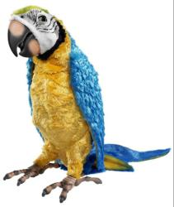
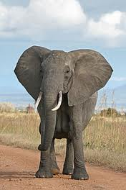
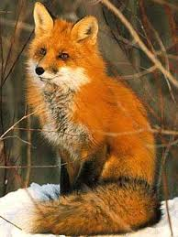
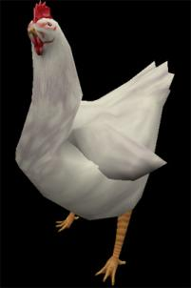

Slide 2
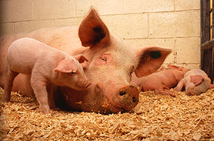
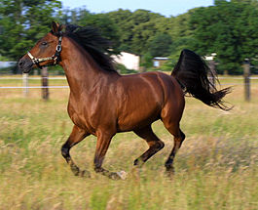
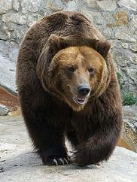
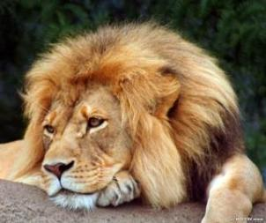
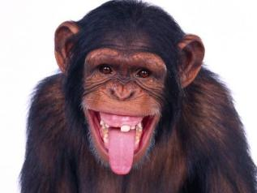
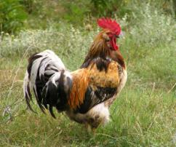

Slide 3
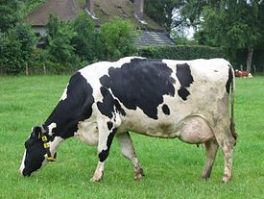
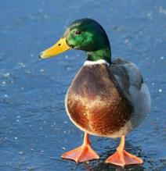
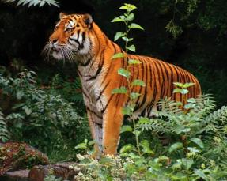
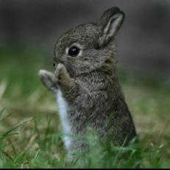
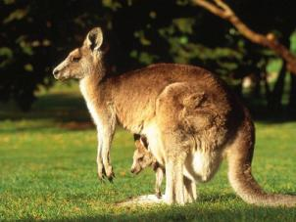

Slide 4
The Animal World
We shall know:
Where the animals live;
What they eat;
What they can do;
Some new words.

Slide 5
The Animal Song
lion
The is the king of the jungle
The is big and strong.
The is very dangerous.
The is very long.
The likes to swing through the branches.
The likes to walk, walk, walk.
The likes to sit in the mud pool all day.
The likes to talk, talk, talk……….
elephant
crocodile
snake
monkey
camel
hippo
parrot

Slide 6
Language Skills
Answer the questions:
-Who is the lion?
-What is the elephant?
-What is the crocodile?
-What is the snake?
-What does the monkey like to do?
-What does the camel like to do?
-What does the hippo like to do?
-What does the parrot like to do?

Slide 7
Where do Animals Live?
On a farm in the Zoo in the forest
A hen
A cockerel
A pig
A horse
A sheep
a rabbit
A duck
A cow
A lion
A giraffe
A parrot
A monkey
A tiger
A kangaroo
A fox
A bear
A wolf

Slide 8
Make up your own sentence.
Ex: A fox lives in the forest.

Slide 9
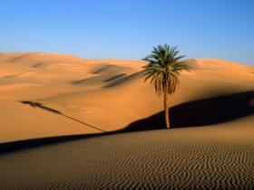
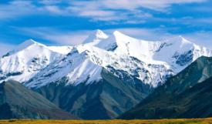
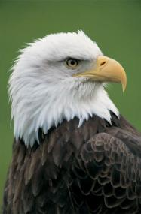
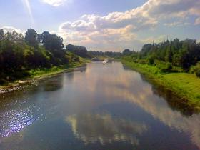
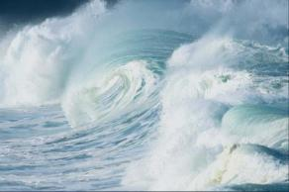
Where does an eagle live?
mountain
desert
eagle
Ocean sea
river

Slide 10
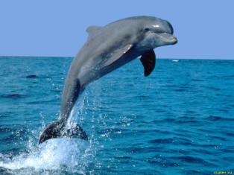
Where does a dolphin live?
mountains
desert
dolphin
ocean sea
river

Slide 11
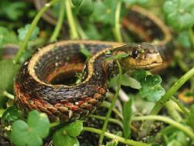
Where does a snake live?
mountains
desert
snake
river
Ocean sea

Slide 12
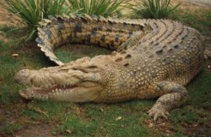
Where does a crocodile live?
mountains
desert
crocodile
river
sea ocean

Slide 13
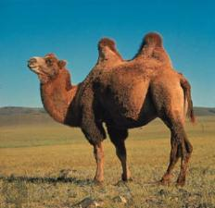
Where does a camel live?
mountains
desert
camel
river
Ocean sea

Slide 14
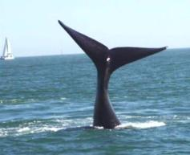
Where does a whale live?
mountains
desert
whale
river
sea ocean

Slide 15
Fill in the gaps.
-Have you got a ?
-Yes, I have got a .
-What`s name?
-Ashby.
-What does it like to ?
- and apples.
- is it like?
-Ashby is big, kind and .
-What it do?
-Ashby helps my father to .
pet
camel
its
eat
Grass
What
strong
can
carry things

Slide 16
Choose the correct option.
1.Dima would like to have a…………..
a) Camel b) snake c)
2. It is ………..
a) blue c) white
3. It lives in the……………
a) ocean c) river
4. It can…………….
a) sing b) c) play
5. Dima would like to ………….with his animal.
a) swim b) c) live
6. He thinks it is a………….. animal.
a) wonderful b) beautiful c)
dolphin
b) grey
b) sea
dive
play
nice

Slide 17
My Progress
Now I know:
- where the animals live;
- what they eat;
- what they can do.
Now I can say:
- where the animals live;
- what they eat;
- what they can do.

Slide 18
My Progress
“4 points” –
“5 points” –
“6 points” -
good
Very good
excellent

Slide 19
Homework
-draw a picture of any animal;
- write down the following sentences:
what it is like;
where this animal lives;
what it eats;
what in can do.

