Slide 1
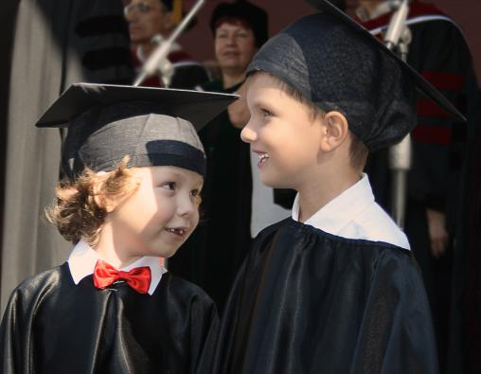
School life

Slide 2
1. Live and learn (век живи, век учись) 2. Knowledge is a power (Знание-сила) 3. It is never too late to learn. (Учиться никогда не поздно) 4. Practice makes perfect. ( Повторение-мать учения) 5. Diligence is the mother of success. (Прилежание-мать успеха)

Slide 3
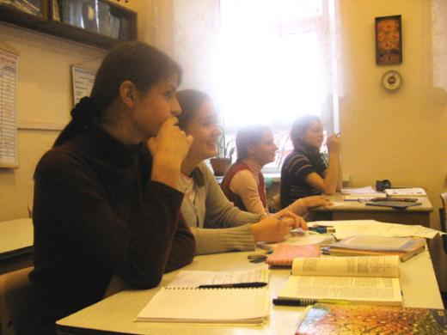
What students think of school:
It’s a place which helps you to find a good job in future.
It’s a place where you learn about people as well as subjects.
It’s a place where you make friends.
It’s a place where it is fun.
It’s a place were you take exams and write tests too often.

Slide 4
Advantages of school.
to become smarter
to develop your mind
to have time for reading
to take part in school activities
to have good and experienced teachers
to have interesting school traditions
to develop your imagination
to study interesting subjects
to learn new things
to prepare for adult life
to have a lot of friends
to enjoy school life and friendship

Slide 5
disadvantages of school.
not to need so much knowledge
to have no time for sports and hobbies
to get up early in the morning every day
to be tired of doing homework
to work too hard
not to be allowed to do what you want to
to depend on teachers’ mood
to have boring lessons
to be afraid of some teachers
to have too many extra subjects
to worry about getting good marks
to have many tests
school has nothing to do with real life

Slide 6
All grown-ups remember their school years. Listen to the story told by an Englishman. Answer the questions:
1. At what age do students finish school in Britain?
2. What first language is studied in British schools?
3. What kind of a subject is Science?
4. Why is it important to study Russian?

Slide 7
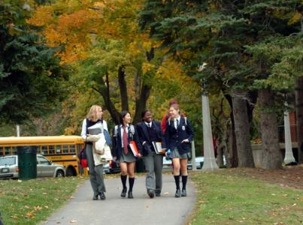
What can you say about British schools?

Slide 8
1.) What age do children start school in
Britain?
2.) When do pupils finish primary school?
3.) How many years do pupils study in
secondary school?
4.) What foreign languages do they study in British schools?
5.) Are the school subjects the same in British and Russian schools?

Slide 9
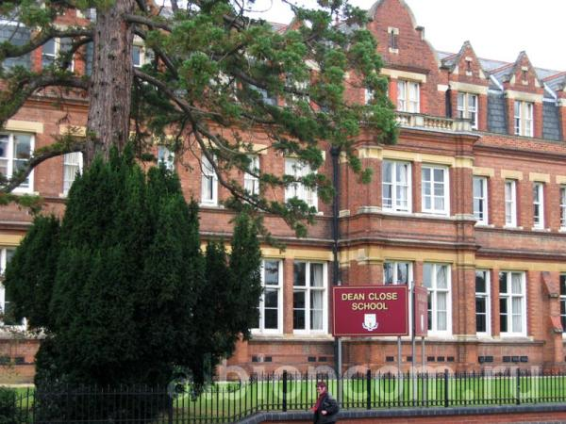

Slide 11
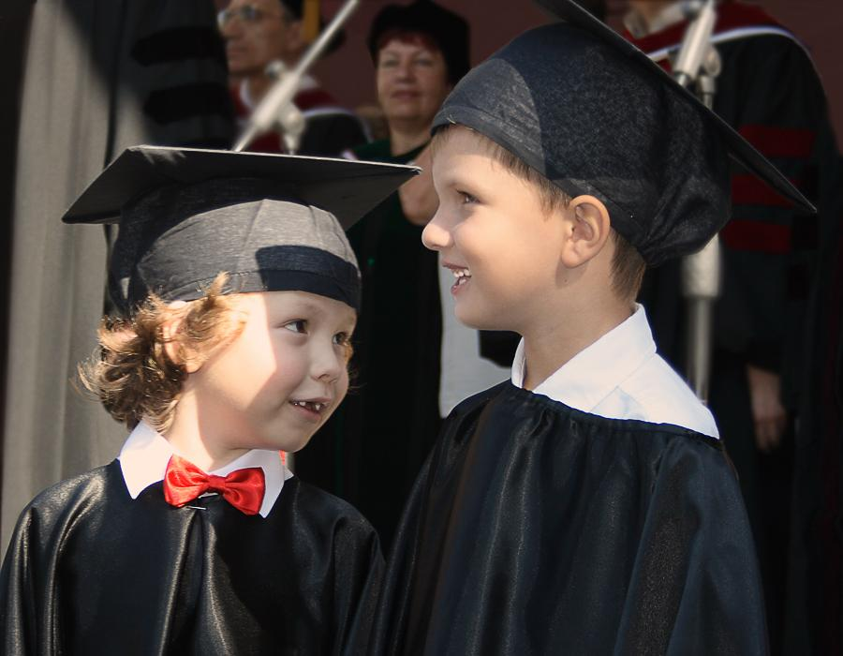

Slide 12
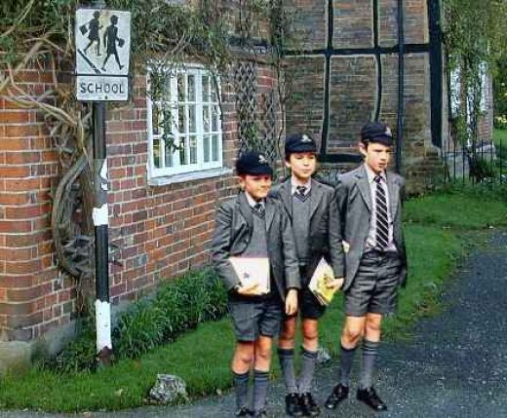

Slide 13
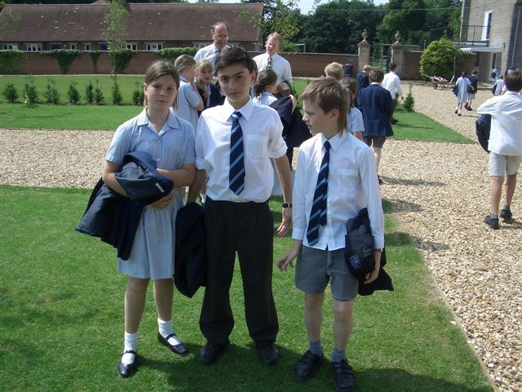

Slide 14
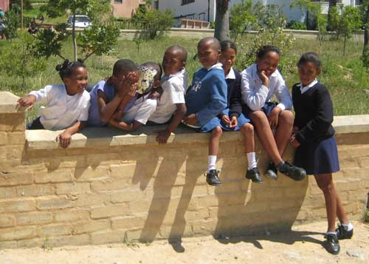

Slide 15
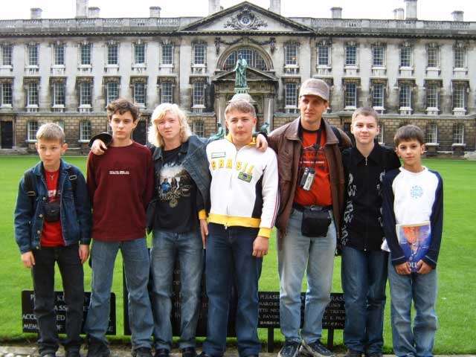

Slide 16
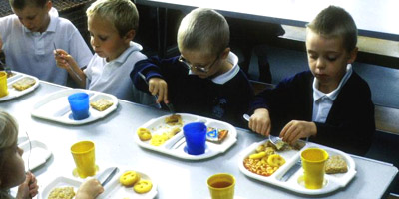
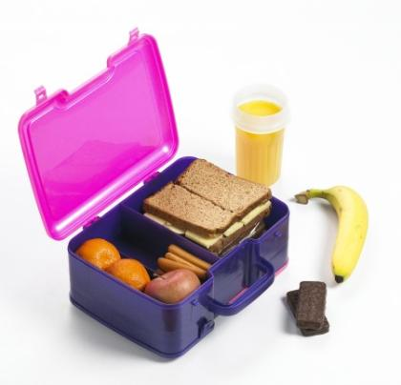

Slide 17
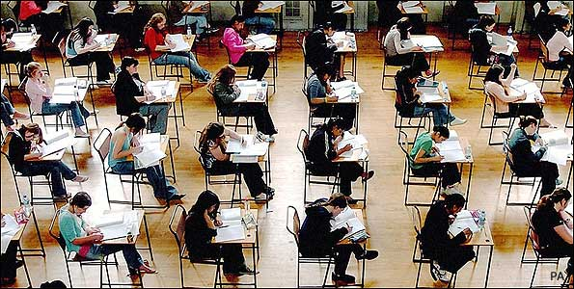

Slide 18
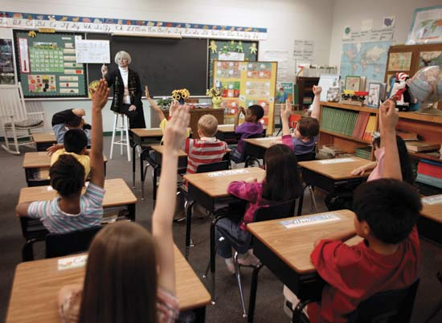

Slide 19
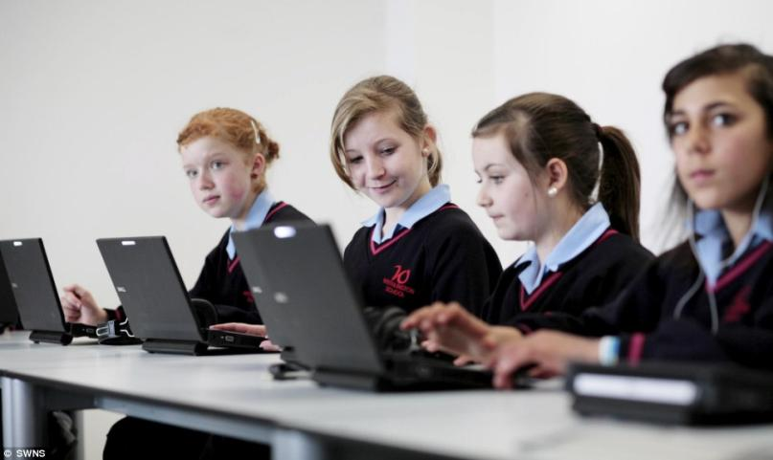

Slide 20
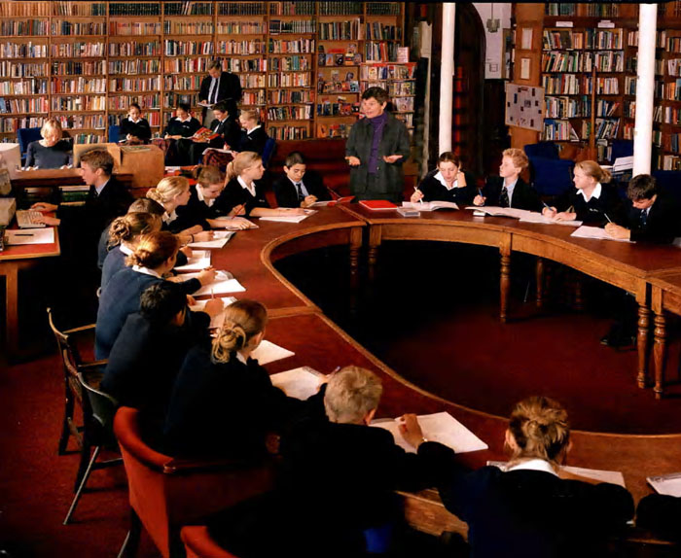

Slide 22
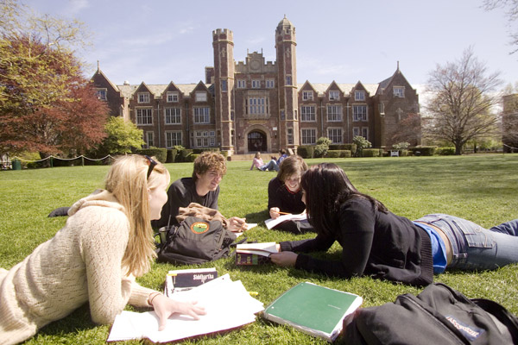

Slide 23
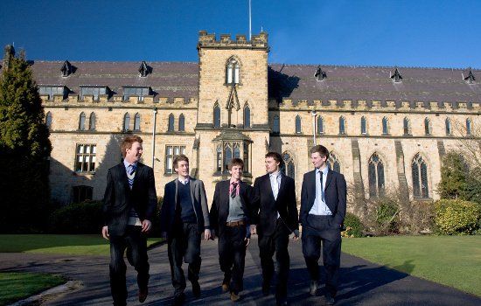

Slide 25
Information develop the mind communicate respect different activities develop imagination encourage adult life
People have always had schools and will always have them. This is the only way to prepare children for---------.In school children learn a lot of new--------- about the world. Subjects like Mathematics, Physics,and Geometry---------------,Literature, Arts, and Music--------------------. School is the place where children------------------with each other, make friends and take part in-------------------- - competitions, concerts, quizzes. In scool there are adults who are always ready to help them and to speak about their problems. Some teachers are young and enthusiastic, some are experienced and calm, but all of them try to do their best to-------------their students and to develop all their talents.Students should always treat their teachers with---------------,as being a teacher is a quite difficult job.

Slide 26
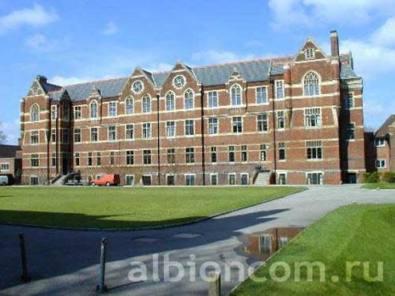
Some ideas about perfect school!
a new modern building
offer any subjects students are interested in
have no useless subjects

Slide 27
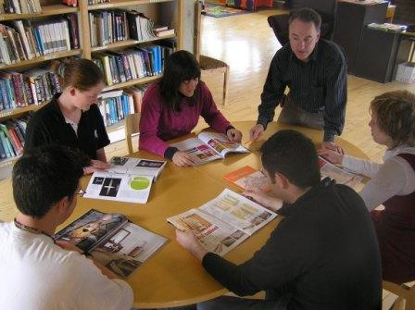
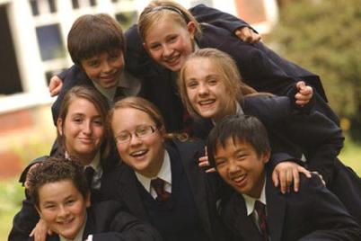
has friendly atmosphere
democratic school rules
talk freely to teachers
discuss any problems openly
listen to students problems
treat each other with respect

Slide 28
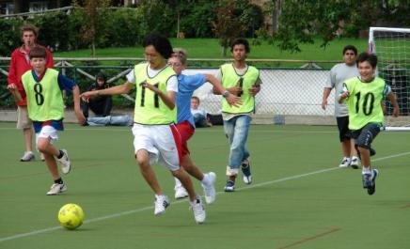
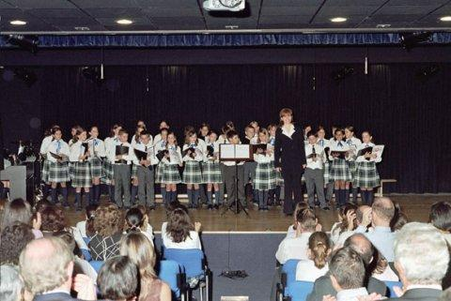
take part in different activities: sport activities,
dancing, singing, drama
encourage their students and
develop their talents
develop our mind
develop our imagination

Slide 29
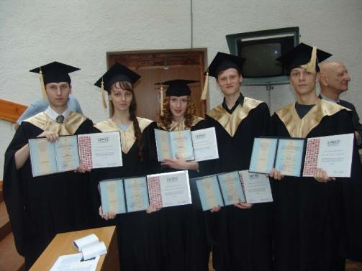
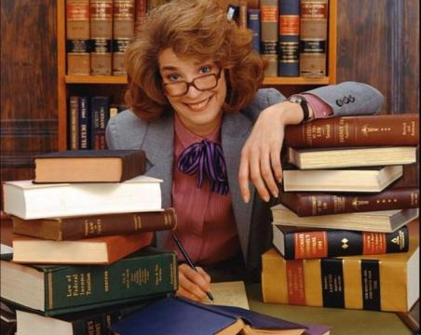
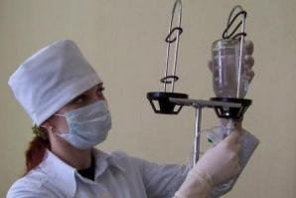
-prepares for real life
-it is important for their education

Slide 30
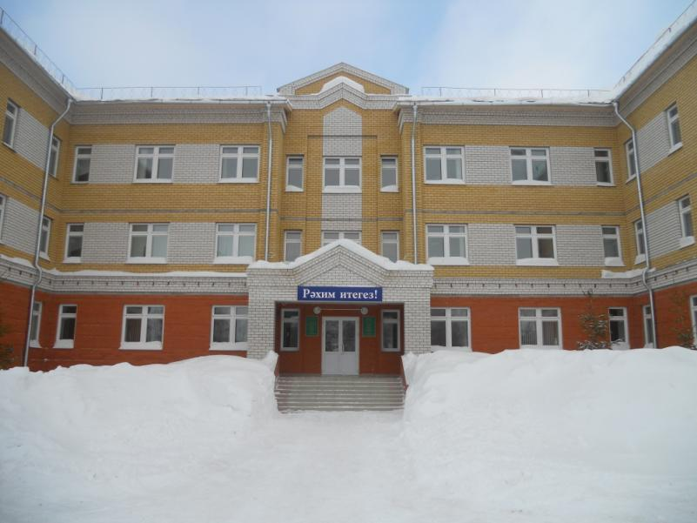

Slide 31
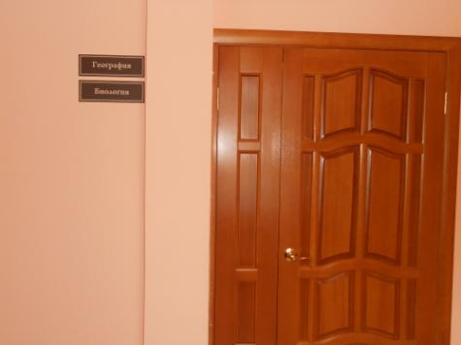
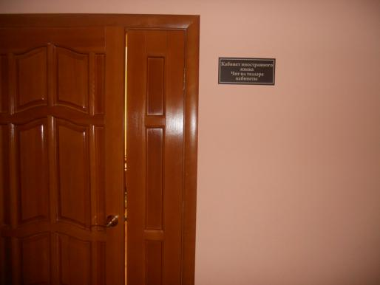

Slide 32
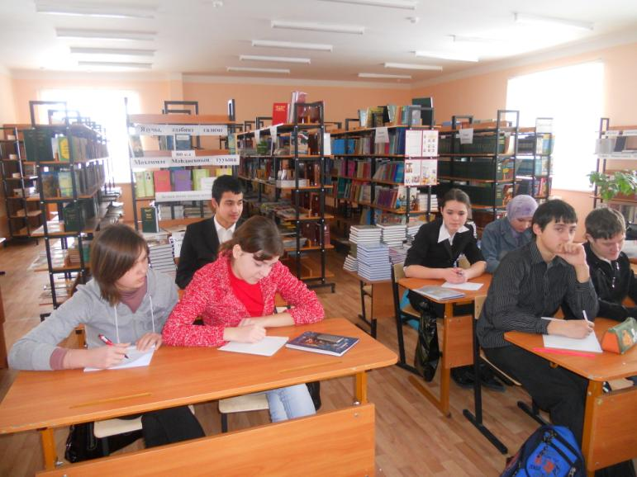

Slide 33
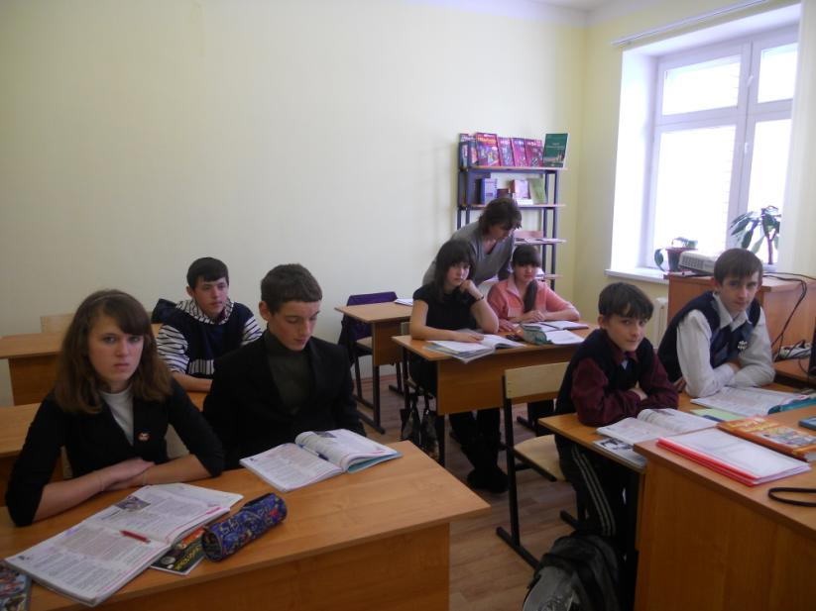

Slide 34
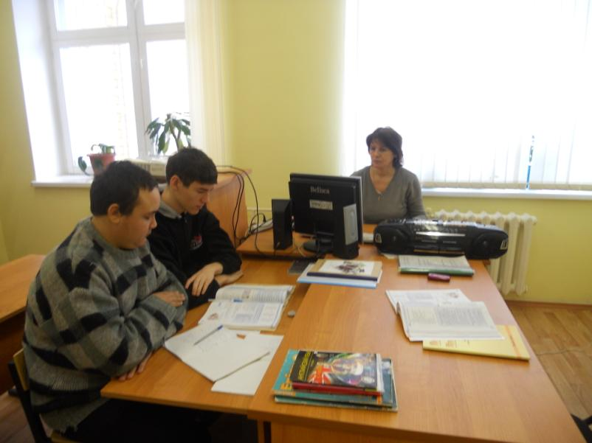

Slide 35
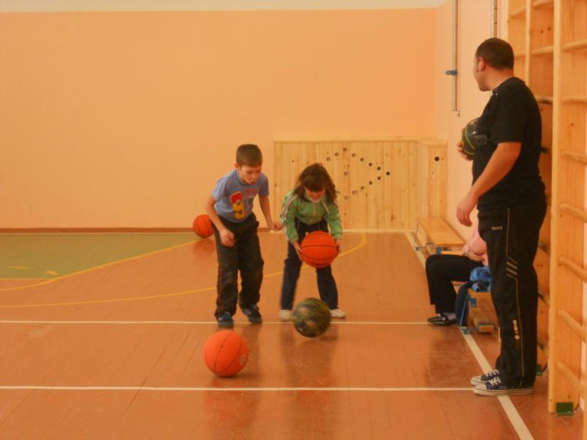

Slide 36
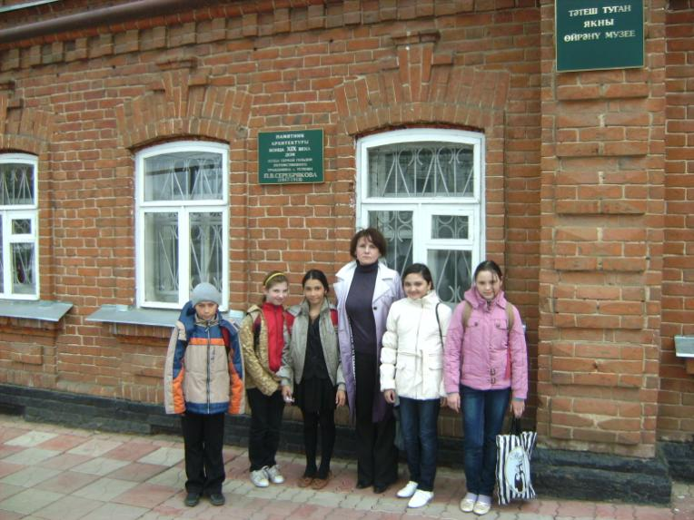

Slide 37
