Slide 1
Past simple
Yesterday, ago, in 2011, last week

Slide 2
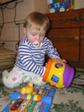
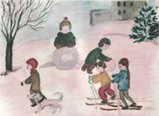
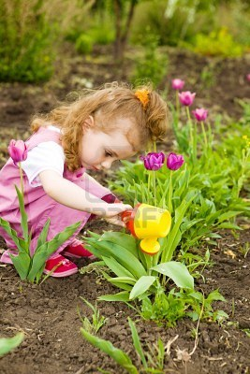
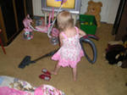
Verb + ed [ d ]
Play- played
ski - skied
water- watered
vacuum - vacuumed

Slide 3
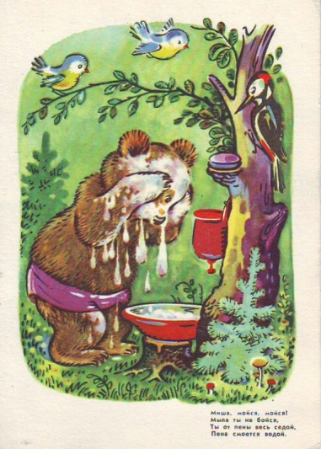

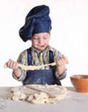

Verb + ed [ t ]
Brush - brushed
Cook – cooked
wash - washed
Jump- jumped

Slide 4
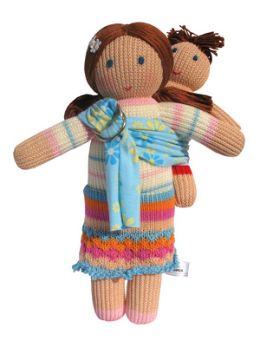



Verb + ed [ id ] Carry – carried count- counted Dust – dusted want – wanted

Slide 5
Now your turn
Pick
Clean
Dust
Watch
Walk
Wait
Copy
Rain
Plan
mix
Picked Cleaned Dusted Watched Walked Waited Copied Rained Planned mixed

Slide 6
Did you go to the club yesterday?
Yes, I did. I went to the club yesterday. No, I didn`t. I didn`t go to the club.
ASK and ANSWER the questions. …he (play tennis) last Sunday? …she ( brush) her teeth in the evening? … you ( wash) the floor yesterday? … your friend (help) you? …your mother (prepare) tasty dishes last week? …your brother( clean) the room last Saturday?

Slide 7


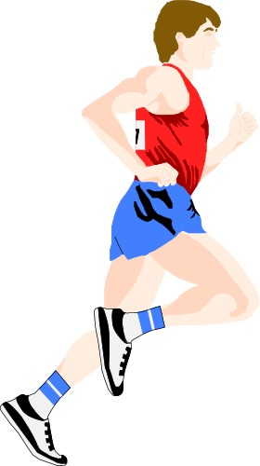

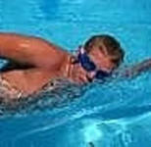
ASK THE QUESTIONs

Slide 8
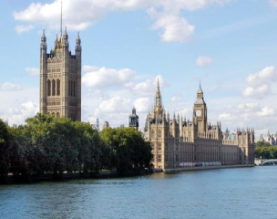
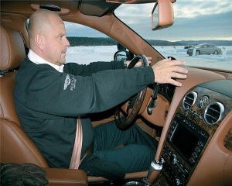
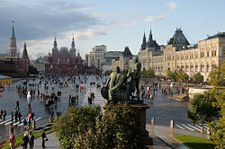
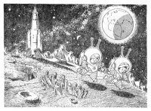
Give the negative answer
Did you visit London in 2011? Did you drive a car yesterday? Did you walk along the Red Square in Moscow last week? Did you travel to the Moon a year ago?

Slide 9

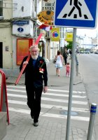
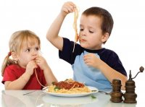
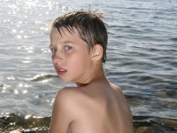
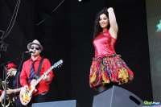

Irregular verbs
Hold-held-held go-went-gone eat-ate -eaten Swim-swam-swum sing-sang-sung drink-drank-drunk

Slide 10


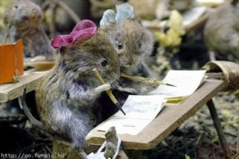
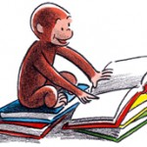
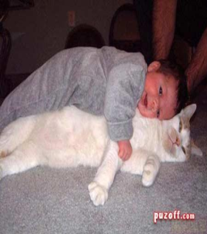
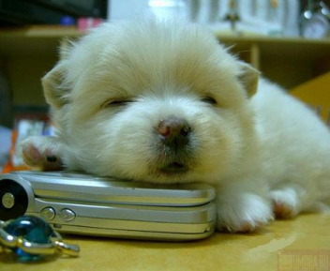
Fly-flew-flown sit-sat-sat write-wrote-written Read-read-read spend-spent-spent sleep-slept-slept

Slide 11
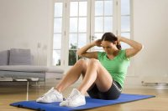
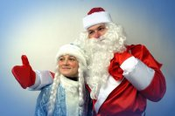
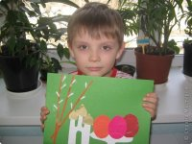
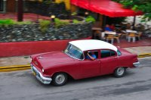
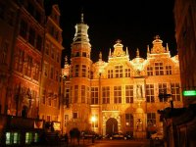
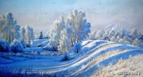
do-did-done come-came-come draw-drew-drawn Drive-drove-driven build-built-built freeze-froze- frozen

Slide 12



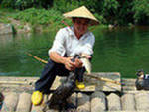


Buy-bought-bought ride-rode-ridden speak-spoke-spoken
Catch-caught-caught win-won-won teach-taught-taught

Slide 13
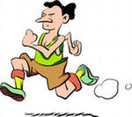
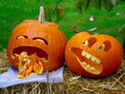
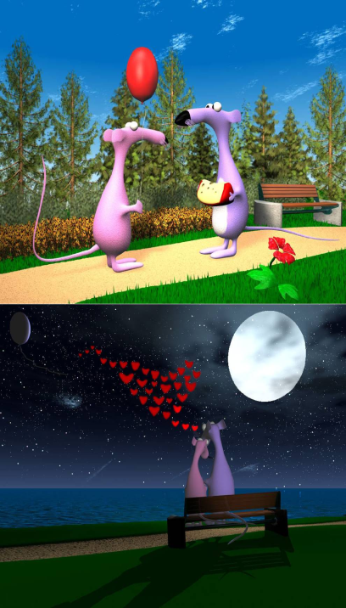

Run-ran-run forget- forgot- Lose-lost-lost forgotten Meet-met-met See-saw-seen

Slide 14
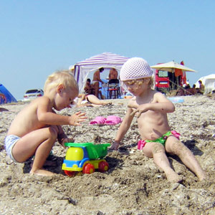
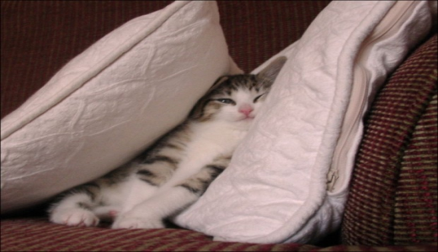
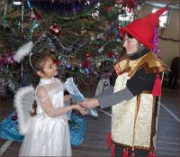
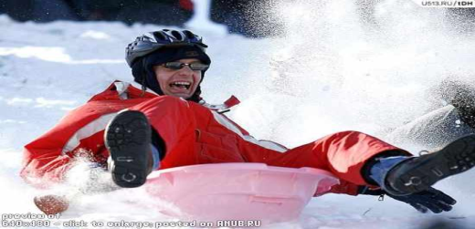
Take-took-taken hide-hid-hidden Give-gave-given slide-slid-slid

Slide 15


