Slide 1
jobs
jobs
All jobs are nice
only choose the best
Galina Chistotkina

Slide 2


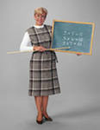
If a job is worth doing it is worth doing well
We are students. We study at the university.
I am a teacher. I work at school I teach English
What am I? I am a Pupil. I go to School.

Slide 3



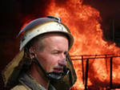
Only fools and horses work
Steve is a programmer. He works in the office. Jack is a builder. He builds new houses. They are businessmen. They work in big firms. Steve is a fireman. His profession is dangerous.

Slide 4
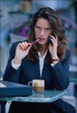
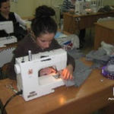

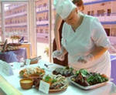
A woman`s work is never done
Jane is a writer. She writes detective novels. Ann is a sewer. She sews nice clothes. Nelly is a journalist. She makes reports. Susan is a cook. She bakes tasty cakes.

Slide 5
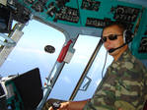



Hard work never did anyone any harm
Sam is a pilot. He flies on the plane. Tom is а police officer. He stands on the street crossing. Nick is a cleaner. He washes the floors. Ann is a ballet dancer. She dances in the theatre.

Slide 6
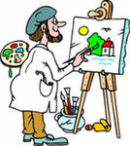
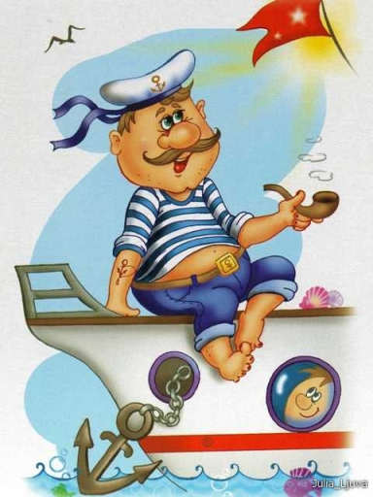
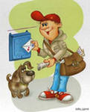
A bad workman blames his tools
Steve is a painter. He paints beautiful pictures. Mike is a sailor. He sails across the seas and oceans. He is brave. Juliet is a postwoman. She brings letters And telegrams. She enjoys her job.

Slide 7
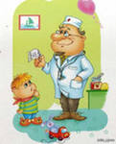
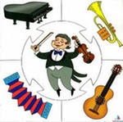
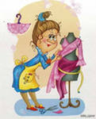
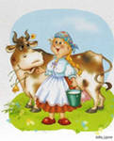
All work and no play makes a dull day
Andrew is a doctor. He cures children. He is kind. Robert is a musician. He plays the piano. He enjoys the violin too. Mag is a clothes designer. Her fancy dresses are beautiful. Kate is a milkmaid. She milks cows and makes sour cream and curds.

Slide 8
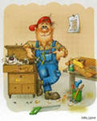



The devil finds work for idle hands to do
Nick is a worker. He can repair any furniture. Smith is an astronaut. He dreams of flying into space. Brown is an archeologist. He explores caves And dales. Stuart is a soldier. He serves in the army. He defends the country.

Slide 9


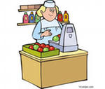
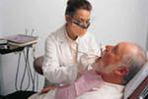
A Jack of all trades is master of none
Jack is a driver. He can repair his car. Steve is a carpenter. He can saw any wood. Mary is a shop-girl. She sells fruit, Vegetables and juice. Mrs. Smith is a dentist. She cures teeth.

Slide 10


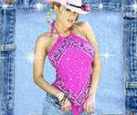

Little strokes fell great oaks
This is a magician. She tells tales and brings happiness. Barbara is a barber. She makes modern hairstyles. She is a top model. She travels a lot. Nick is a football player. He takes part in UEFA. He won cups and medals.

Slide 11


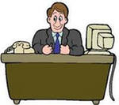

No pains no gains, no song no supper
Bob is an operator. He works at a film company. He loves his profession very much. John is a traveller. He visited many islands and rivers. Jack is a manager. He works in Microsoft Company. He is lucky. Britney is a jazz singer . She is talented and very popular.

Slide 12


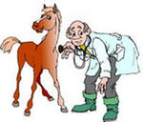
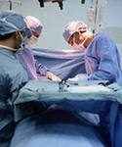
Business before pleasure
He is a taxi driver. He can take you to any place. He is a scientist. He is very clever. He invents new laws. He is a vet. He likes animals. He is a surgeon. He operates people.

Slide 13
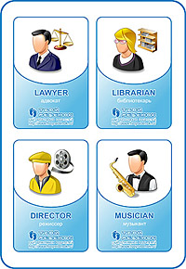
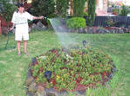
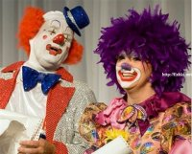
As you make your bed, so you must lie on it
A gardener. He must take care of trees, flowers, lawns.
A clown. He jokes, tells funny stories, makes people laugh.

Slide 14
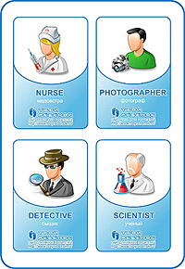
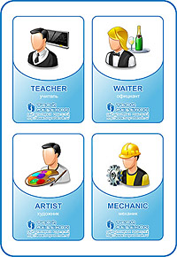
A good beginning makes a good ending

Slide 15
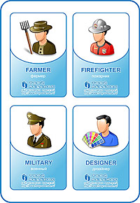
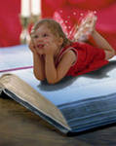
What is done cannot be undone

Slide 16



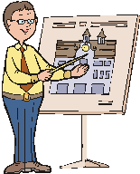
A lazy sheep thinks its wool heavy
He is a plumber. He repairs the bathrooms. He is a lawyer. He defends people. He is a joiner. His job is creative. He is an architect. He creates new houses and towns .

Slide 17
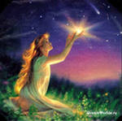
Never put off till tomorrow what you can do today
What are you dreaming about? What are you going to be? What professions do you know? What do you like to do? What is you favourite hobby? What are you parents? What proverbs about jobs do you remember?

Slide 18

He works best who knows his trade
Let your dreams come true!

