Slide 1
The Astrakhan Museum of the State Department of Motor Vehicles and Traffic Control.
The slide show of OUR EXCURSION TO …

Slide 2
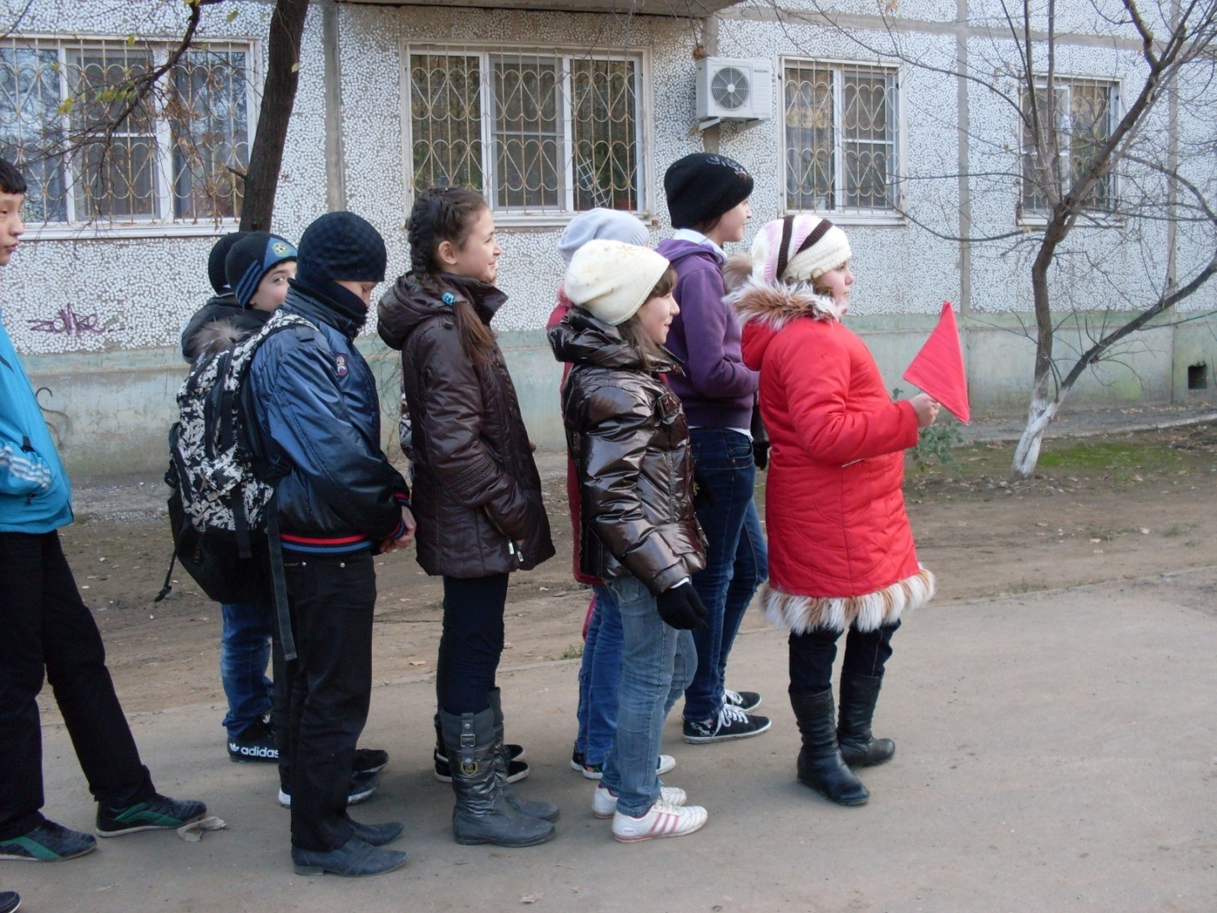
Today we are going on an excursion!
We are visiting The Astrakhan Museum of the State Department of Motor Vehicles and Traffic Control. It is a long way to go! Are you ready?
Come on ! Let’s go!

Slide 3
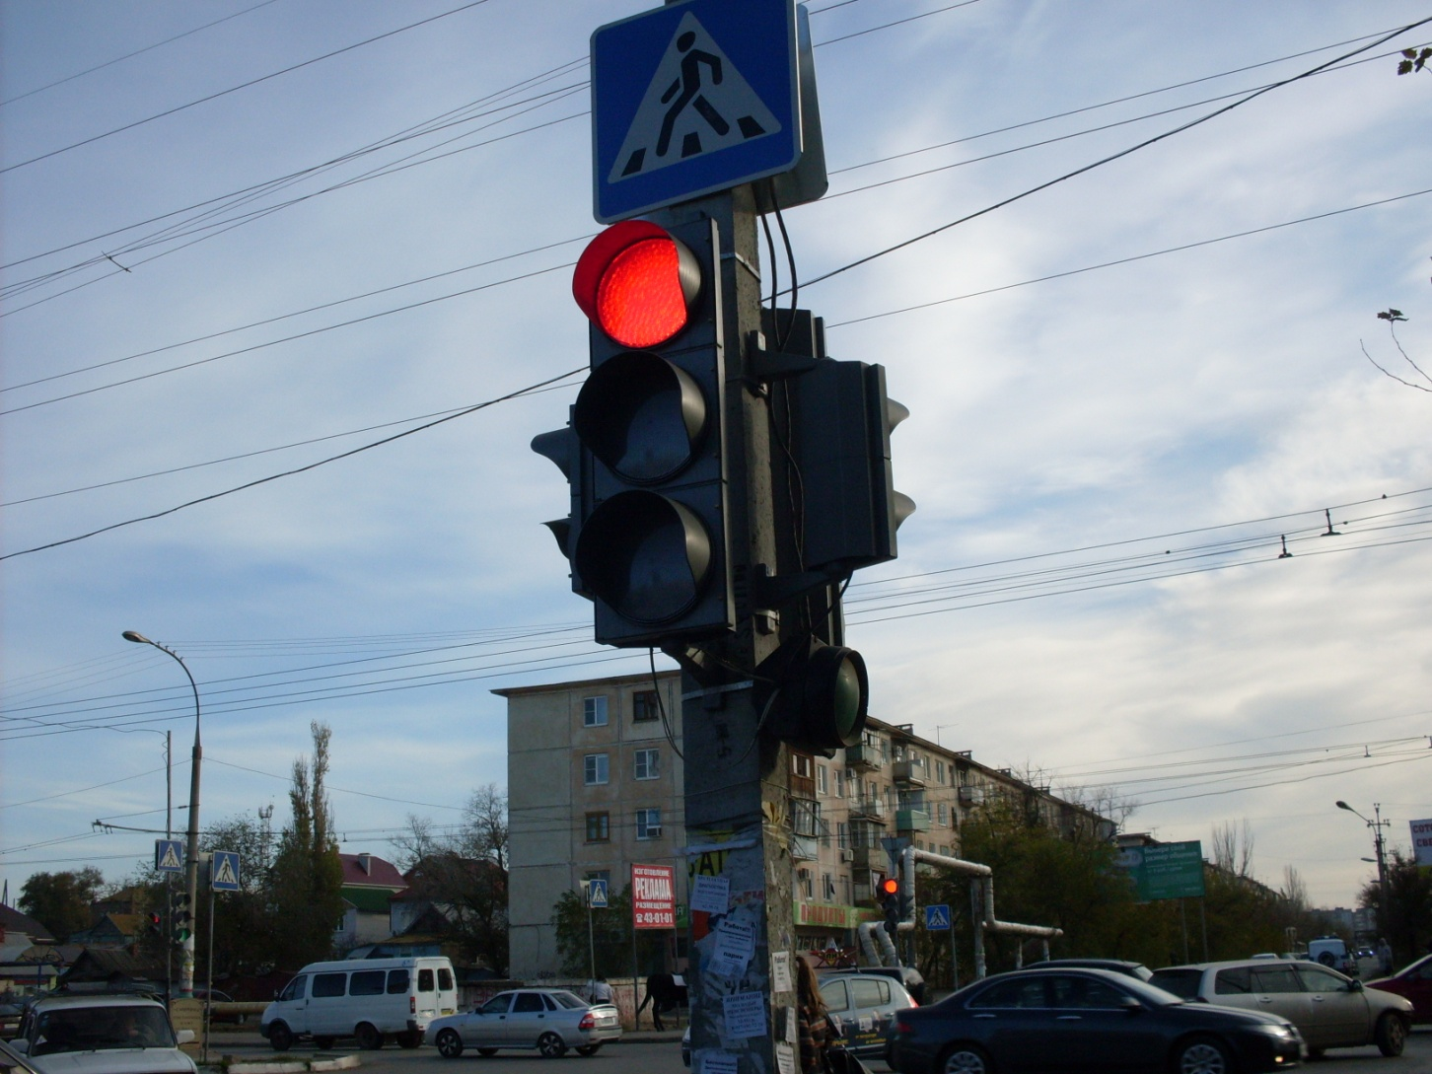
Watch out! Look at the signs! You can’t go because the traffic light is red! Stop and wait!

Slide 4
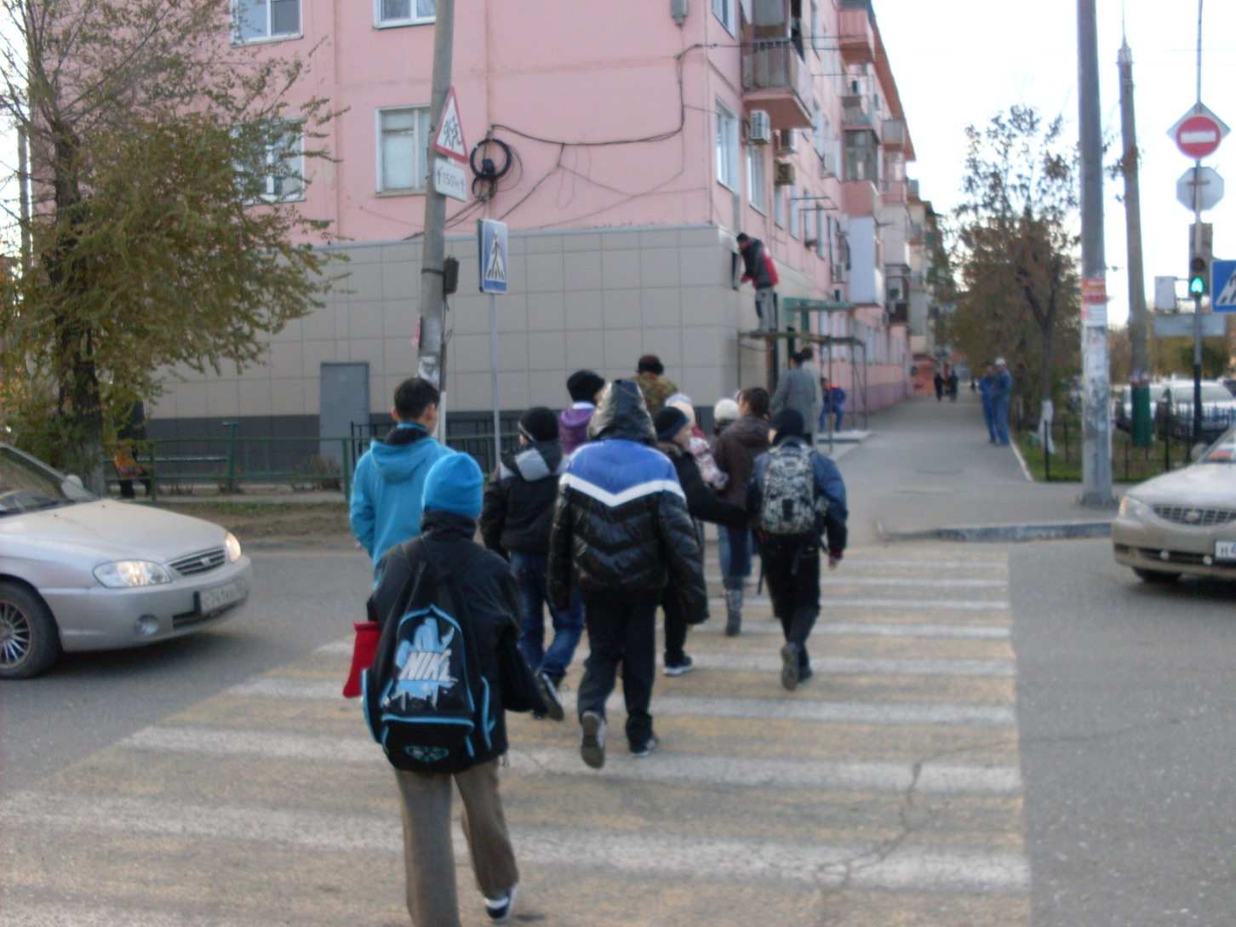
Now when the traffic light is green we’ re crossing the street!

Slide 5
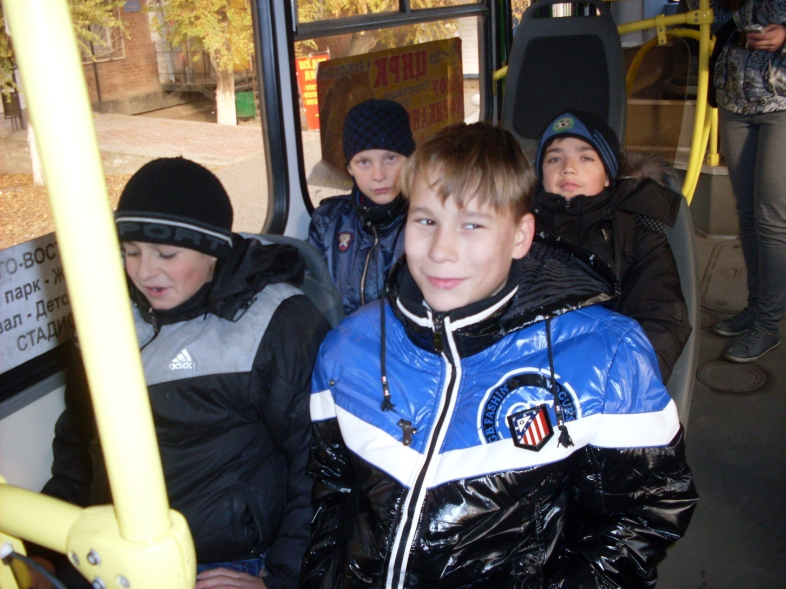
We are on the bus.
There are free seats. The boys are sitting quietly.

Slide 6
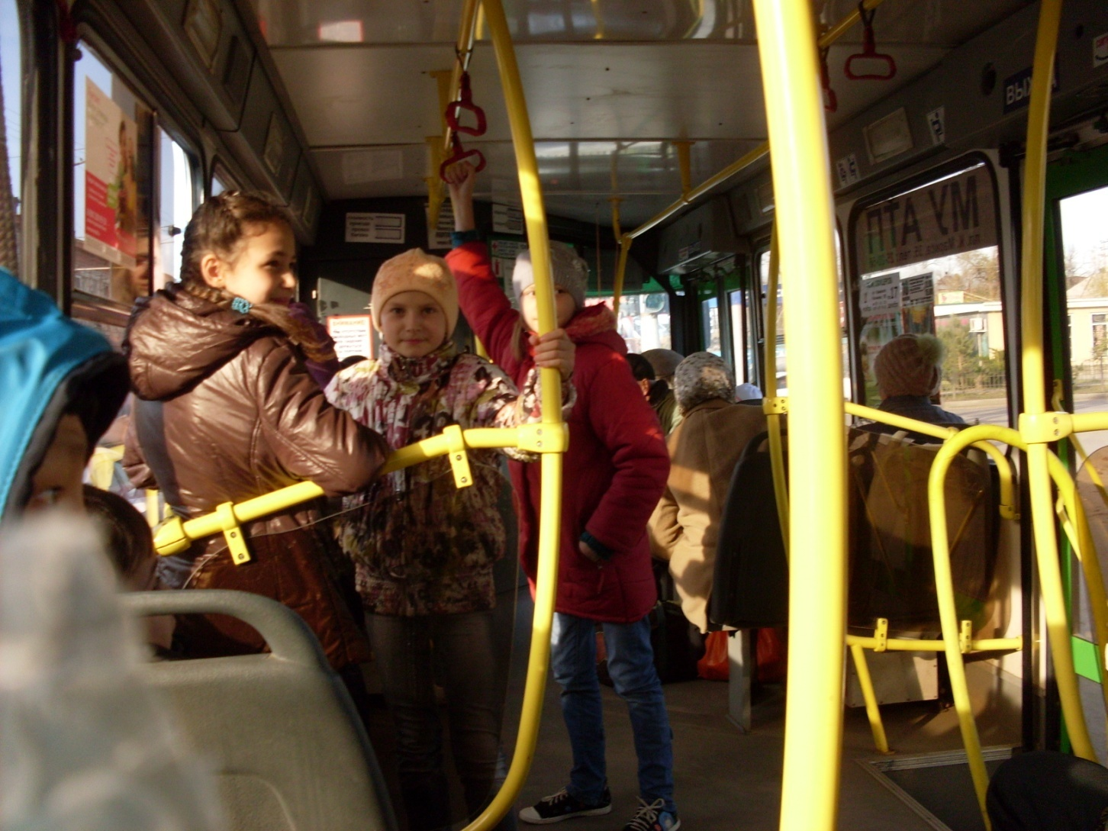
The girls don’t want to sit.
They are using handgrips. Angela is standing well back. They aren’t leaning out of the window.

Slide 7
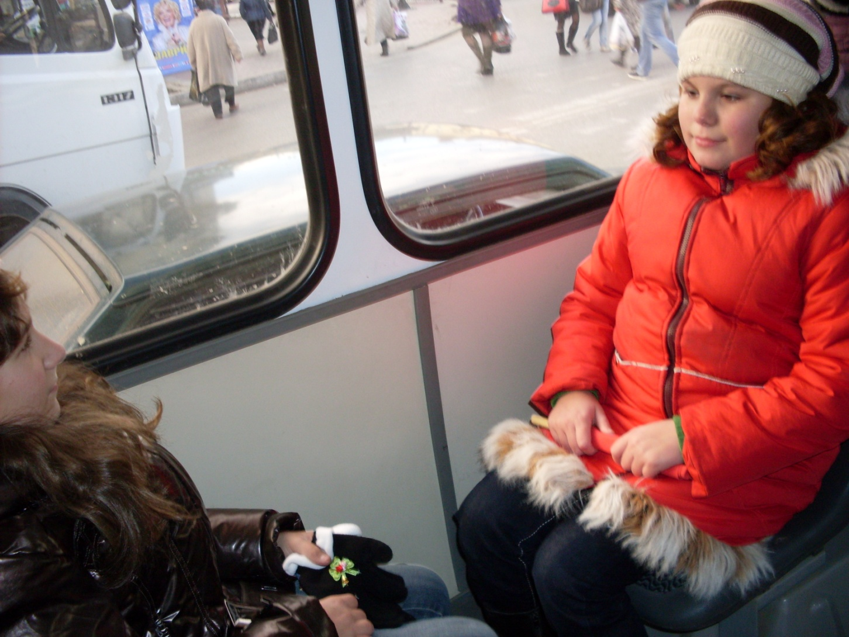
Elina and Arina are sitting .
They are not waving from the bus window.

Slide 8
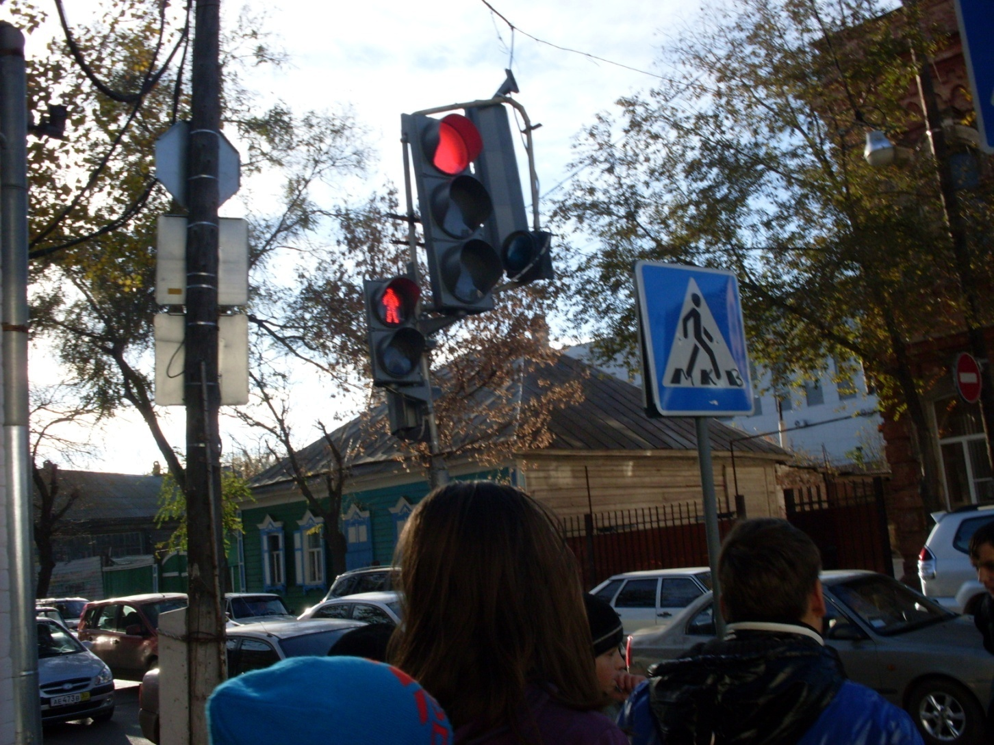
The last crossing. We are waiting for the green light.

Slide 9
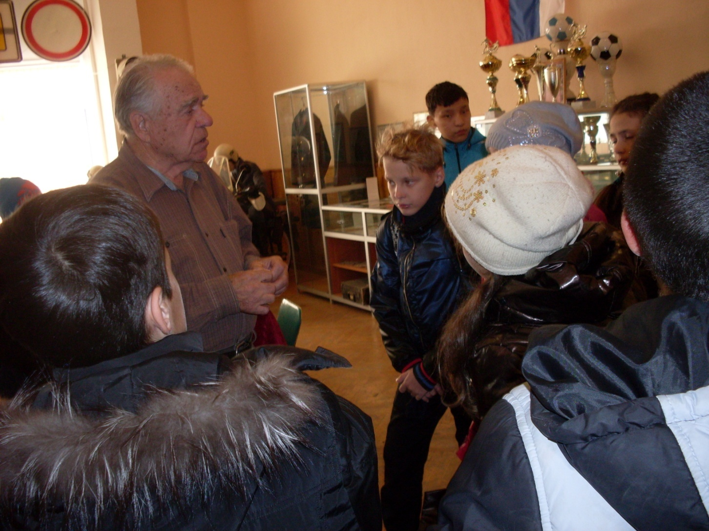
This is the war veteran, the former traffic policeman Beglyary Boris Borisovich. He is meeting us and telling about the history of the museum.

Slide 10
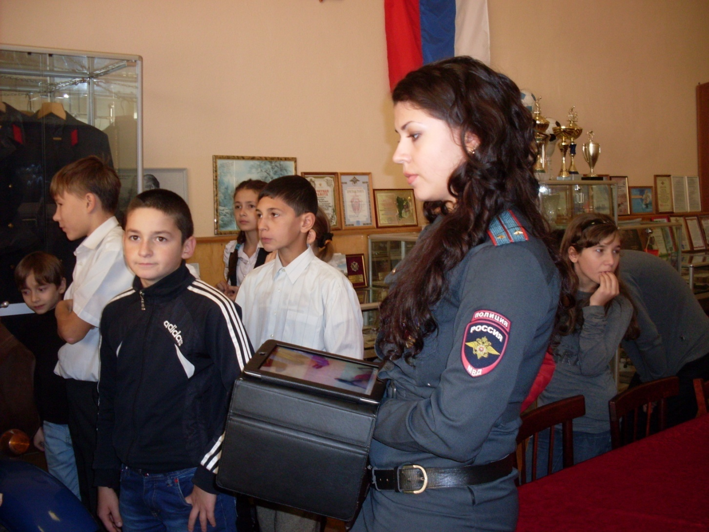
This is Vankova Irina Victorovna. She is a traffic policewoman. She is telling us about road safety rules.

Slide 11
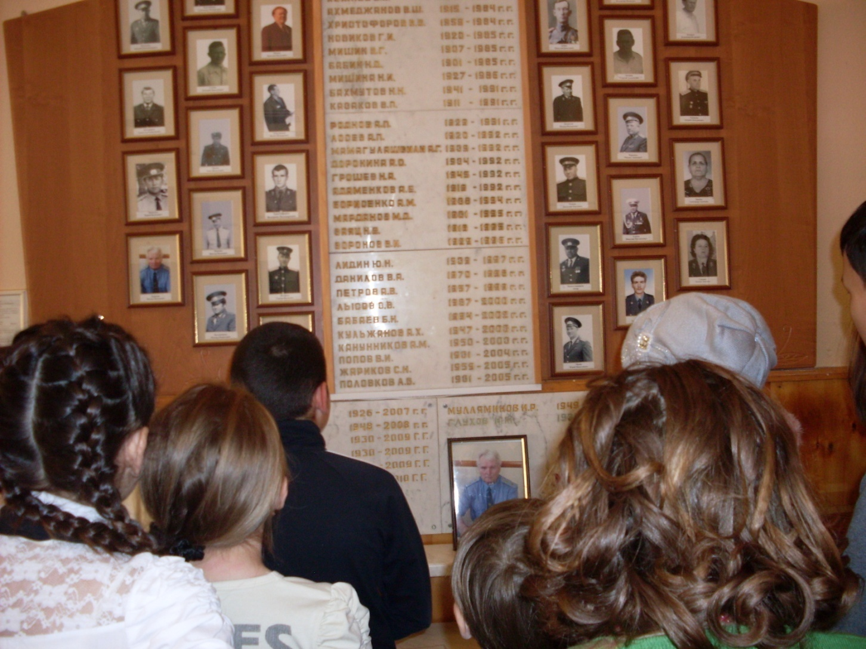
The silence minute in memory of traffic policemen who died saving people’s lives.

Slide 12
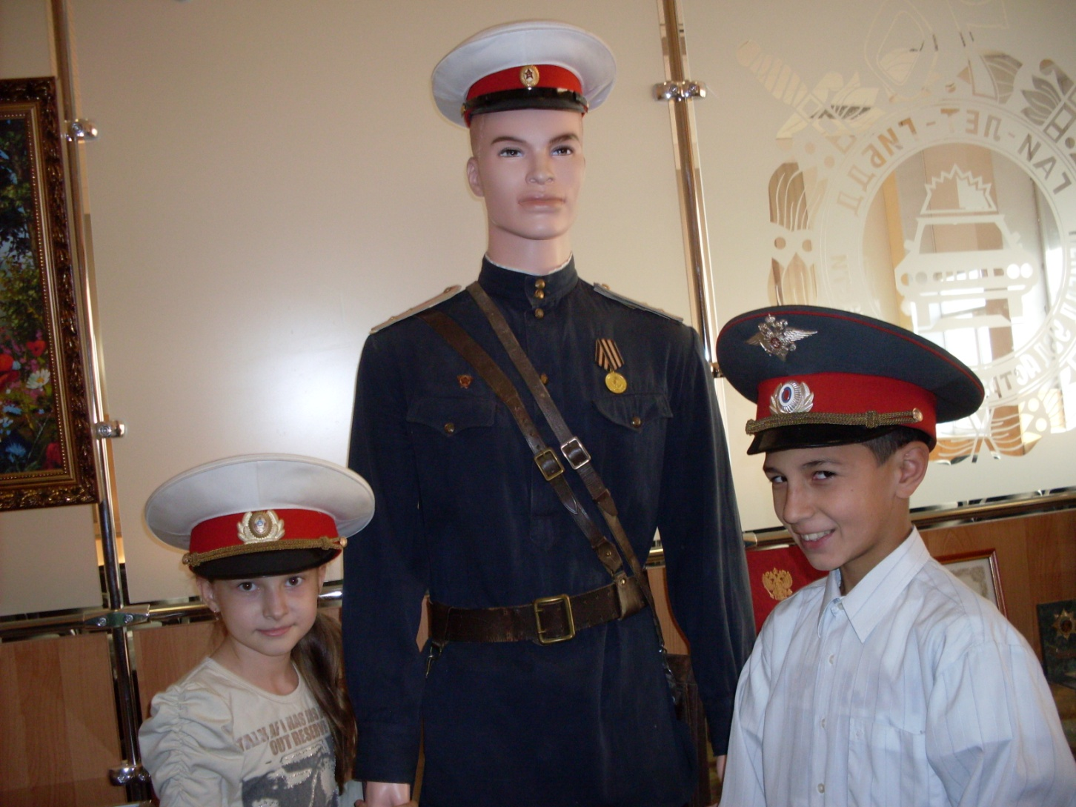
The uniform of the traffic policeman

Slide 13
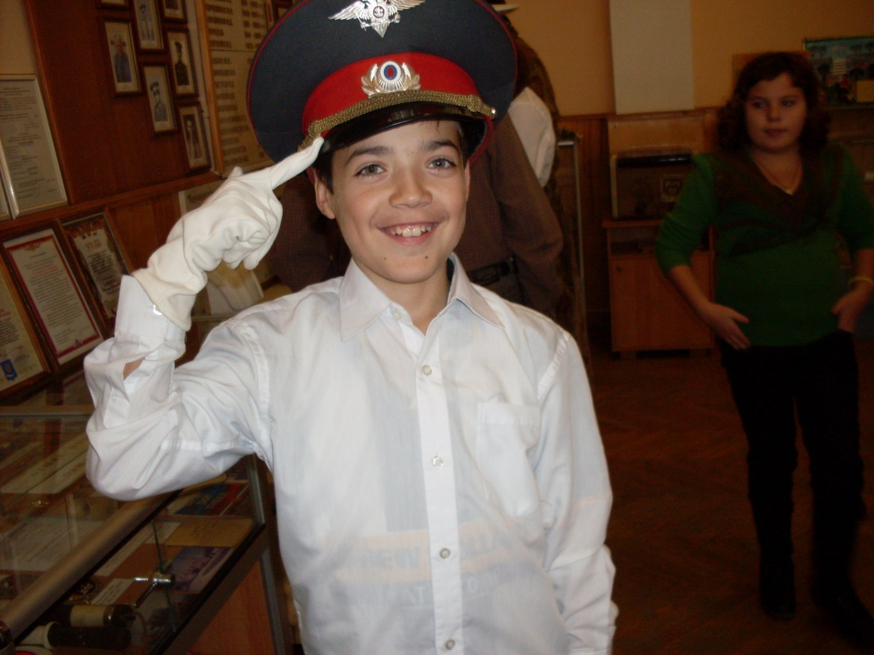
We are trying on traffic policemen’ caps and gloves

Slide 14
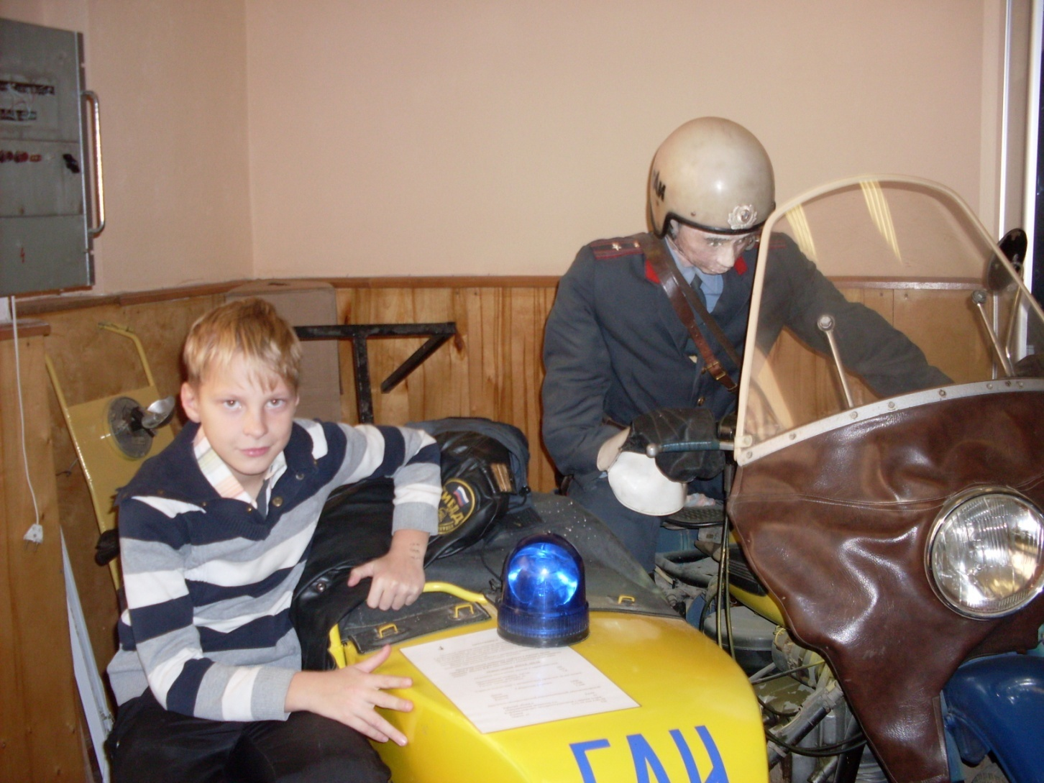
And this is a traffic police motorcycle

Slide 15
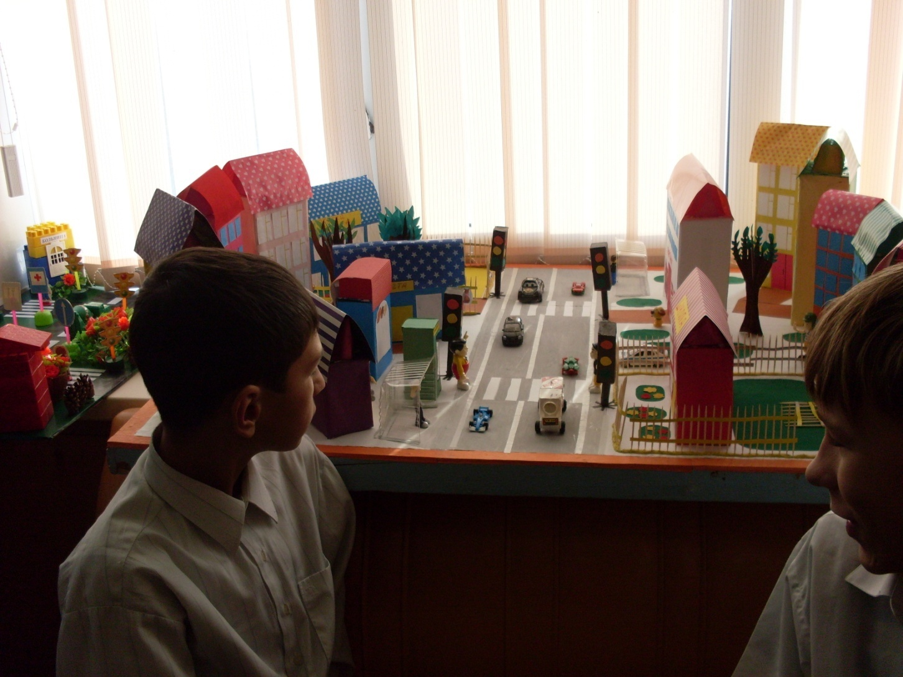
Rasul is looking at the model of our town with traffic signs.

Slide 16
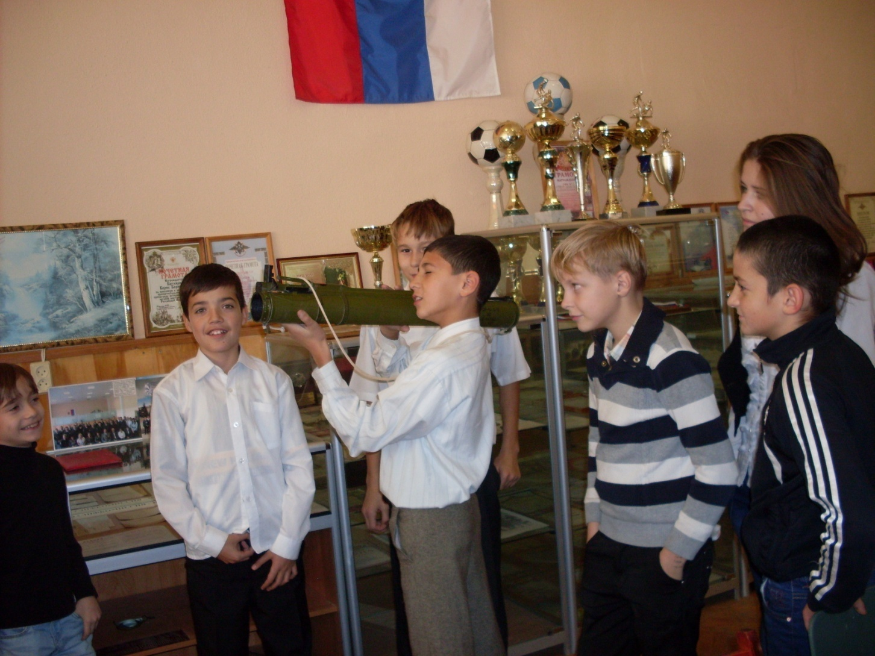
The boys are holding a flame thrower. Cool!

Slide 17
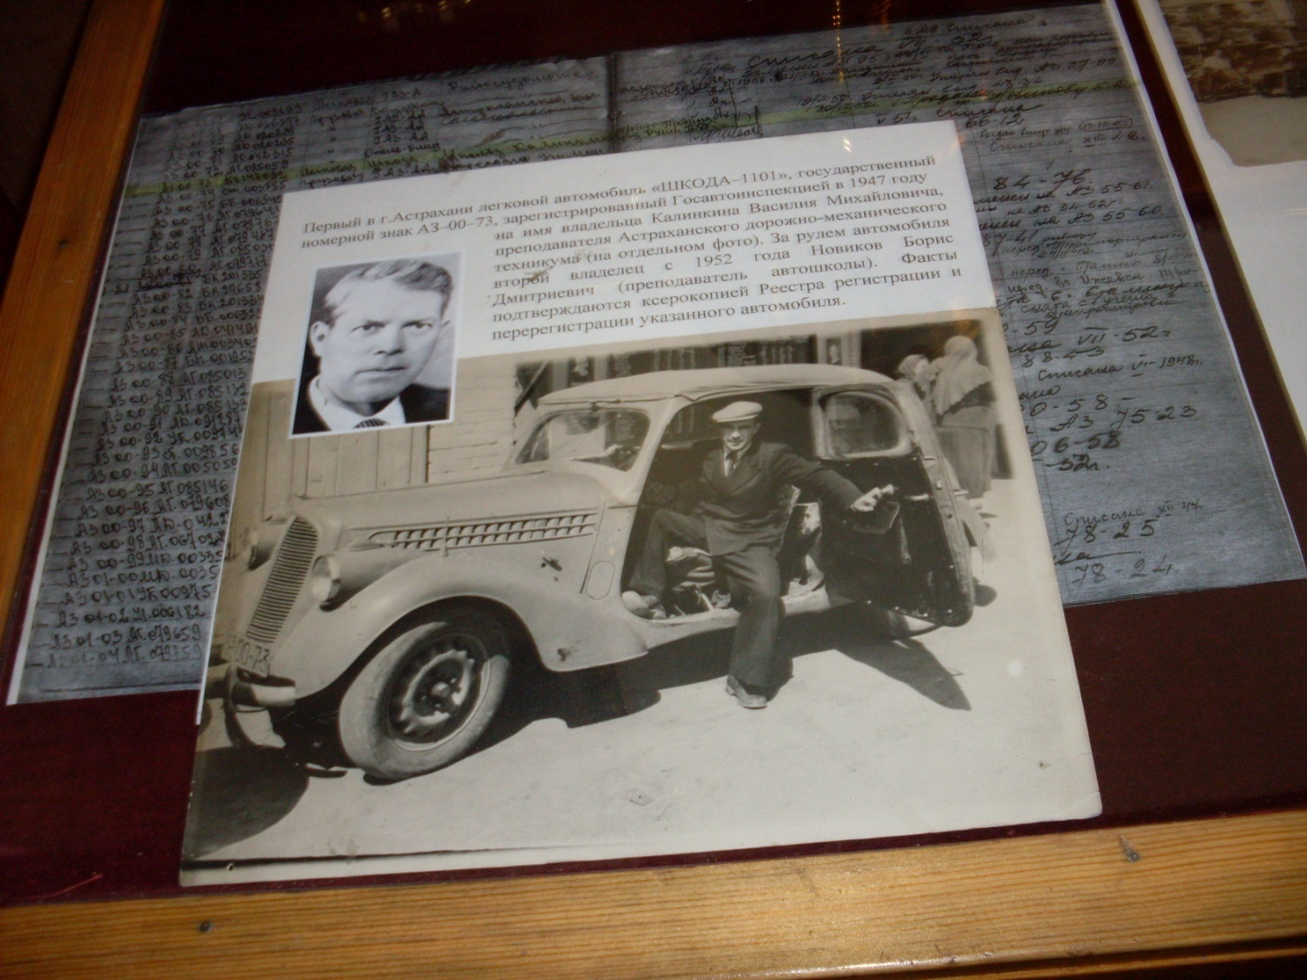
The first car in Astrakhan.

Slide 18
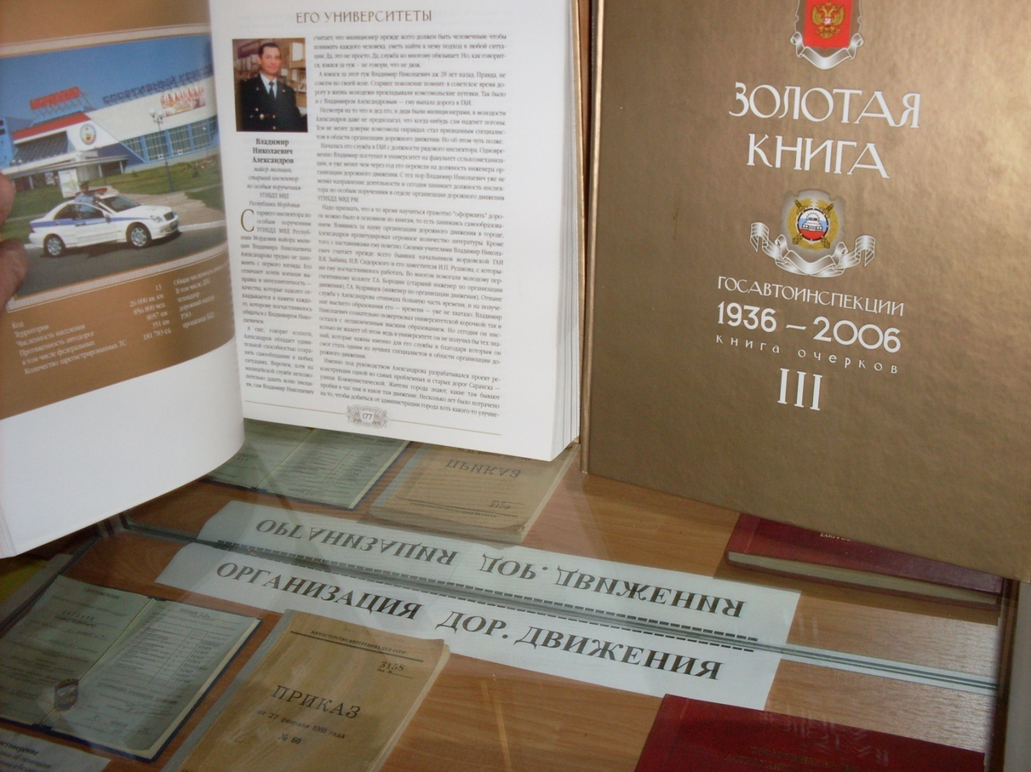
The golden book of the history of the Russian State Department of Motor Vehicles and Traffic Control.

Slide 19
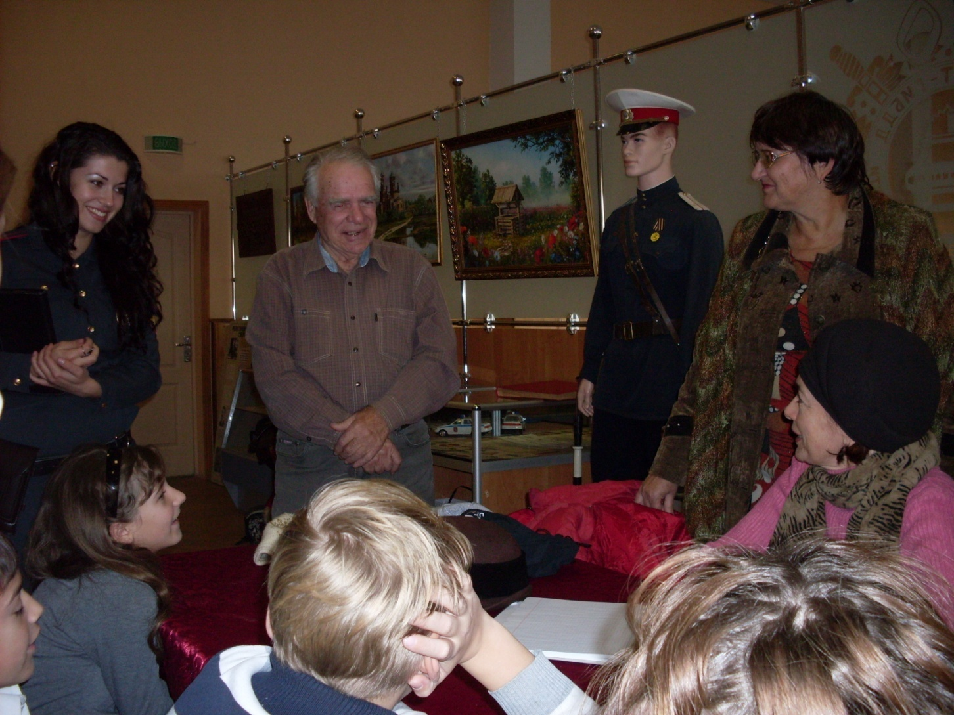
Thank you ! It was great!

Slide 20
Learn and follow the road safety rules!
The slide show was done by the students of the 6th form Plechko Artur and Bagryantsev Kostya

