Slide 1
Shopping for food
Review
1.Transcription
2.Pronouns : some ,any, no
3.Prepositions
4.Irregular verbs
5.Dialogues
6.Listening comprehension

Slide 2
[əʊ]
no, go, slow ,most, snow, show
[аʊ]
now, cow, round,loud, how, ground
[аi]
my, fly ,cry, five, nice, like,dry
[ɪə]
near, hear, ear, clear, dear,
[i]
is, big, live, hill,him,give,honey,
[æ]
cat,granny,can,apple,fat,battle,
[ɒ]
dog, hot ,donkey,coffee,forest,fox
[eɪ]
name,face,grey,brave,April,break

Slide 3
to write-wrote to see-saw to go-went to begin-began to give-gave to buy-bought to send-sent to eat-ate to run-ran to feed-fed
писать
видеть
ходить
начинать
давать
покупать
посылать
кушать
бегать
кормить

Slide 4
Fill in some, any, no
some
1. There is ________ juice in the glass.
Would you like ________ orange juice? – No, thank you. I don’t want ______ .
Are there ______ people on the farm? – Yes, there are ______ .
They have _____________ bread at home.
Can I have ______ tea?
some
any
any
some
some/no
some

Slide 5
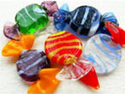
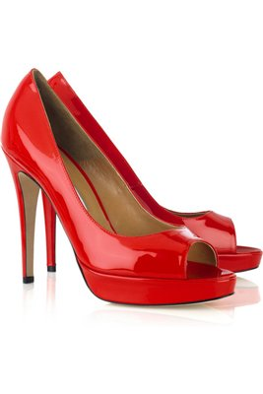
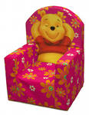
Fill in prepositions.
On (2), under, of, in, for
of
There were some sweets and a box ____ chocolates ____ the table.
Is there any coffee ____ the cup? – Yes, there is some.
What can I do ____ you?
He had a new suit and new shoes ____ yesterday.
There were mittens and boots ______ the armchair.
on
in
for
on
under

Slide 6
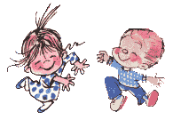
With my foot I tap, tap, tap,
With my hands I clap, clap, clap,
Right foot first, left foot then,
Round and round and back again.
http://www.animationlibrary.com
http://mypersonal-site.ucoz.ru/load/pesni/with_my_foot_i_tap_tap_tap/3-1-0-25

Slide 7
Listening to the dialogue about the baby elephant’s birthday

Slide 8
Say if it is true or false
1.Mary’s father came into the room.
2.Her mother cooked some tasty pancakes with jam for breakfast
3.Mary went to the shop.
4.Mary went to school.
5. She went to school by car..
6.She went to school by bus.
7. Children gave her a nice dog.
8. Children gave her a book and a box of chocolates.
1.false
2.true
3.false
4.true
5.false
6.true
7.false
8. true

