Slide 1
Advertising
- a Curse or a Blessing?

Slide 2
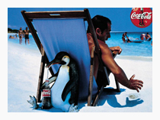
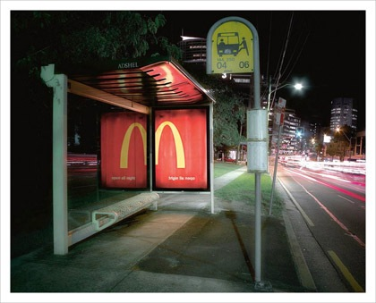
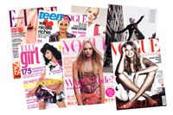
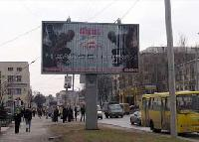
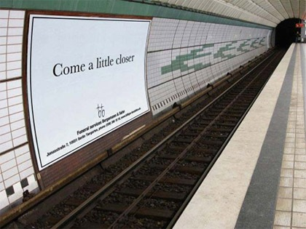
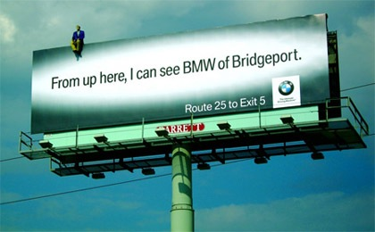

Slide 3
Advertisements
Radio
The Internet
Television
billboards
badges,
T-shirts,
carrier bags
newspapers
and
magazines
transport
posters
shop windows
hot air balloons

Slide 4
People benefit a lot from advertising
for
People benefit from advertising as it just provides extra information to help them make an informed choice. Consumers take their own decisions about purchases.
Against
Advertising cannot be beneficial to people as it brainwashes the public into buying through constant repetition of images and slogans. It takes away freedom or choice.

