Slide 1
The 24th of April.
Nature

Slide 2
homework
Сочинение по картинке (природа)

Slide 3
[’rivə] [si:] [ouʃn] [sΛni]
[ə:θ] [hil] [’klaudi]
[’mauntin] [’frϽsti] [hilz]
[snouwi] [leik]
[sta:] [’neitʃə]
[’windi] [mu:n] [’reini]

Slide 4
o | l | c | k | e | b | s | m | s
d | s | l | w | a | s | t | o | u
e | n | o | i | r | t | r | o | n
m | o | u | n | t | a | i | n | n
l | w | d | d | h | r | v | h | y
a | y | y | y | w | s | e | a | e
k | y | h | i | l | l | r | b | r
e | s | o | c | e | a | n | o | c
f | r | o | s | t | y | f | e | g

Slide 5
1. There are four ______ on the Earth.
2. Severodvinsk is on the White ____.
3. The highest ________ on the earth is Everest.
4. Mountains are higher than ______.
5. The water in the _______ is usually warmer than in the _____.
6. You can see many ____ and the ____ in the sky at night.

Slide 7
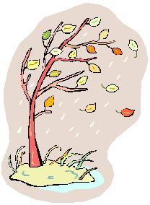
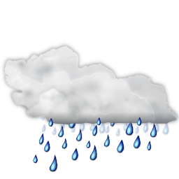
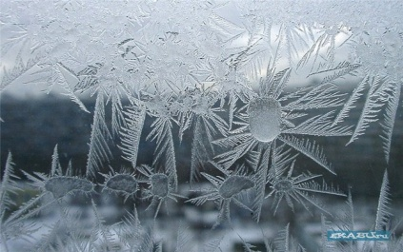
It is cloudy.
It is sunny.
It is windy.
It is frosty.
It is rainy.
It is snowy

Slide 9
The river is full of fish
see - fish

Slide 10
The river is full of fish
garden - flowers

Slide 11
The river is full of fish
forest – mushrooms and berries

Slide 12
The river is full of fish
hills - snow

Slide 13
River - ? Forest - ?
Hills - ? Trees - ?

Slide 14
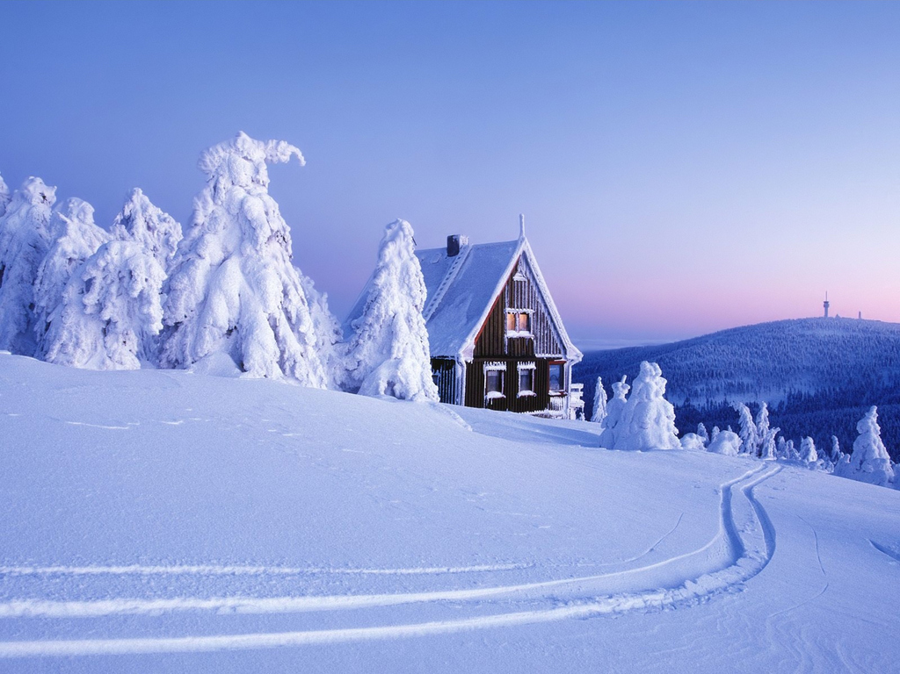
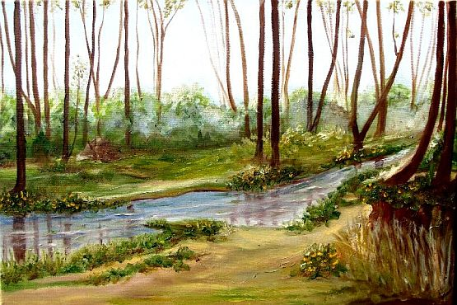
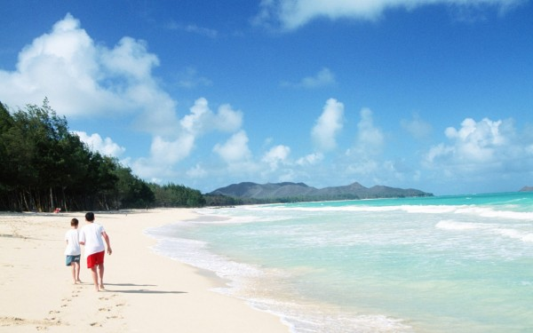
A
B
C
D

