Slide 1
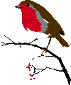
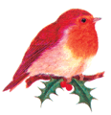
Курлович Н.П.
ГБОУ СОШ 1740
Зеленоград

Slide 2
Read the words
Stocking, holiday, small, ball, hobby.
Candy, candy cane, candle, cat, happy.
Winter, windy, with, window, gift
Merry, presents, angel, ten, pen.

Slide 3
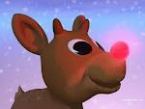
Match the words with
the pictures
a Christmas tree
1.Christmas tree
2. Candy cane
3. Bells
4. Rain deer
5. Stockings
6. Gifts
a
b
a Christmas tree
a Christmas tree
c
d
e
f

Slide 4
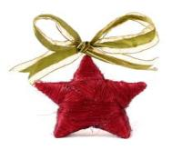
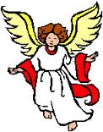
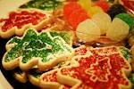
7.Christmas carol
8. candles
9. sleigh
10. star
11.angel
12.Santa Claus
13. cookies
g
h
i
j
m
k
l

Slide 5
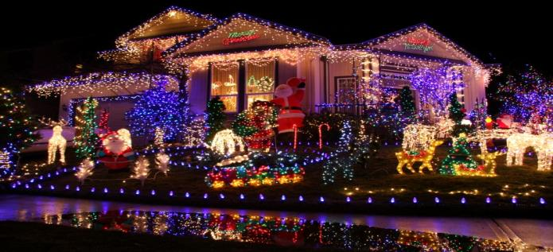
1.December 25 is Christmas.
Many people enjoy
Christmas.
2. People decorate their homes. 3.They decorate Christmas trees too.

Slide 6
4. People make or buy
gifts
for
their family and friends.

Slide 7
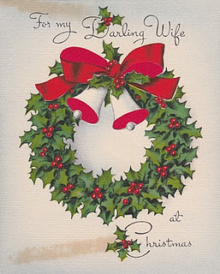
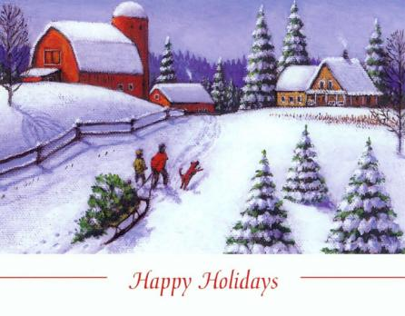
5. People send Christmas cards. 6.It is time to remember poor
people too.

Slide 8
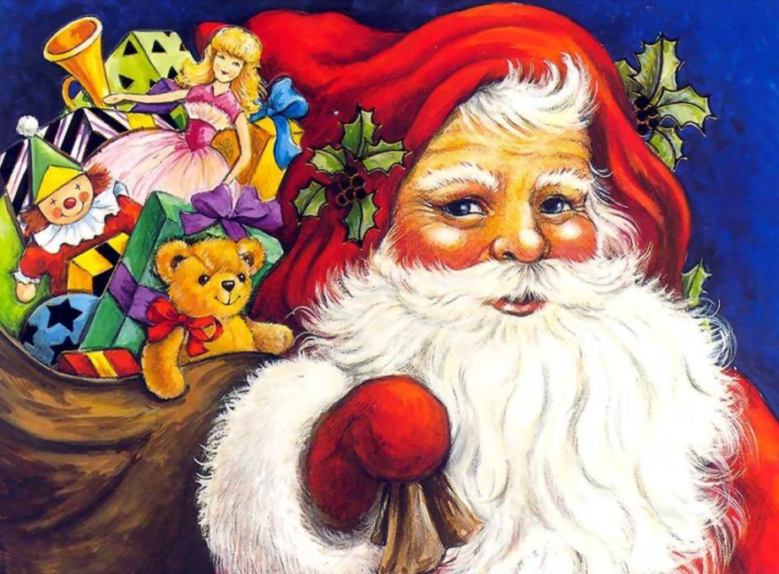
7. Many people bake cookies for
Christmas. 8. Children visit Santa Claus
in stores.
Other children write letters to him.

Slide 9
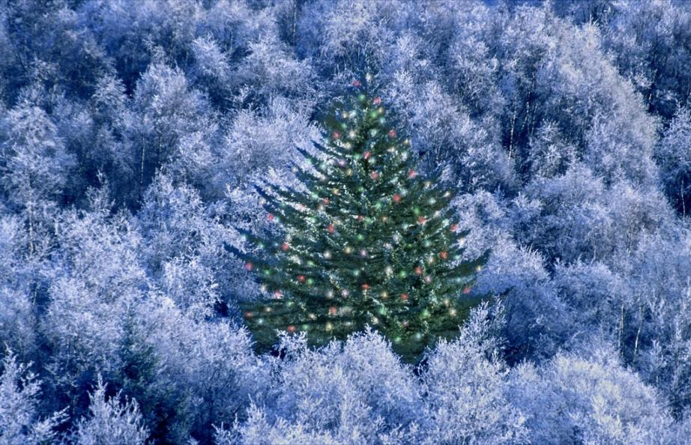
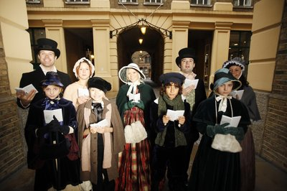
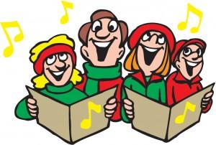
9. People sing Christmas carols.
They sing carols in the streets, in hospitals, and in
nursing homes.
10. People tell Christmas stories.
11. On Christmas Eve, many people go to church.

Slide 10
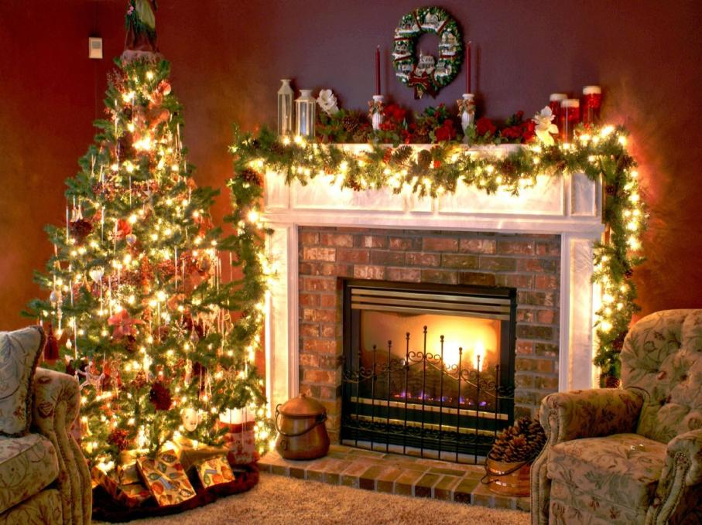
12. Children hang up stockings.
They hope that Santa Claus will fill
the stockings with toys.

Slide 11
1.December 24 is Christmas.( )
2. People don’t decorate their homes.( )
3. People send Christmas cards.( )
4. Many people bake cookies for
Christmas.( )
5. People sing Christmas carols and
go to the church.( )
6. Children don’t hang up stockings. ( )
True or false?

Slide 12
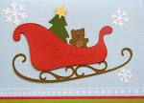
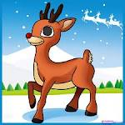
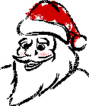
c -ndy c -ne
st -r
c -ndle
ang -l
pr -sent
S -nta Cla -s
g -ft
sle -gh
Sto -kings
Ra -n De -r
Chr -stmas tr -e
Write the correct letters

Slide 13
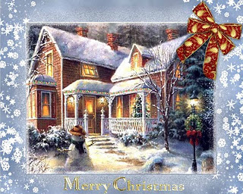
Christmas is famous for its symbols.
Let’s remember them!

Slide 14
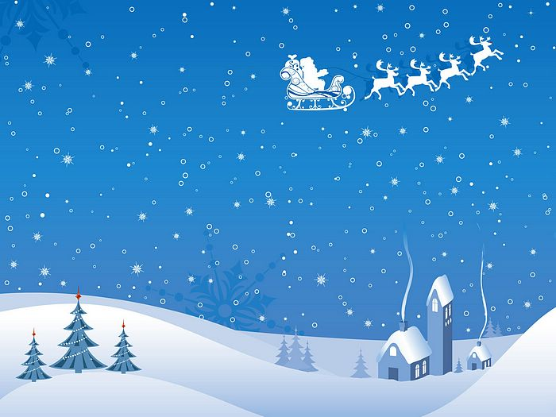

Slide 15
Hello!
I’m a snowman.
I want you to meet my friend. His name is Rudolf! He is an unusual deer.

Slide 16
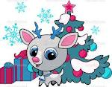
Hello!
I’m Santa’s chief reindeer. Look at my nose! It’s very red.
I live at the North Pole with Santa for most of the year.
It’s very cold there.
On Christmas Eve 24th December
I help Santa to take the Christmas presents to good children.
We fly through the air very fast.
Santa has a very big sleigh to carry all the presents. Maybe we’ll bring you a present!
1. What colour is Rudolf’s nose?
2. What kind of animal is Rudolf?
3. Where does Rudolf live?
4. What is Rudolf’s job?
5. How does Santa take all the presents?

Slide 17
Now I’m a famous deer.
There are cartoons about me!

