Slide 1
BIOGRAPHY BOOKS QUIZ
RUDYARD KIPLING
A FAMOUS
CHILDREN'S WRITER
Презентацию подготовила Лерман Светлана Петровна,
учитель английского языка
ГБОУ СЛШ №11, Московская область
Notes:
Biography, books, quiz – triggers

Slide 2
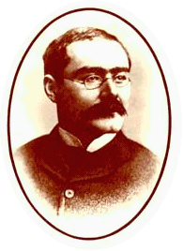
JOSEPH RUDYARD KIPLING
An English writer, poet and novelist
PART I
1865 – 1936

Slide 3
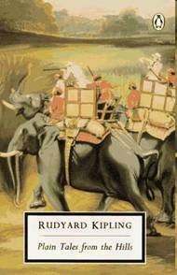
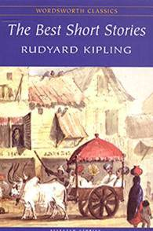
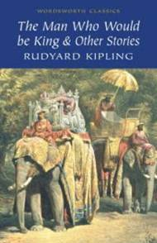
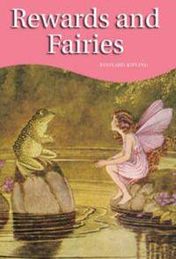
Rudyard Kipling was born in Bombay, in India.
He travelled a lot, and wrote many books for children.
In 1907 he was awarded
the Nobel Prize in Literature.

Slide 4
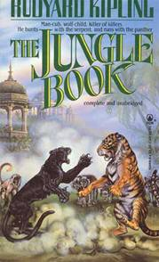
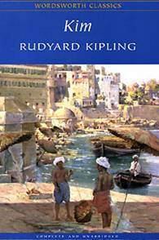
His best books are:
«The Jungle Book»
(Книга джунглей),
a short story
«Rikki-Tikki-Tavi»
(Рикки-Тикки-Тави),
tales and short stories,
a novel «Kim» (Ким).

Slide 5
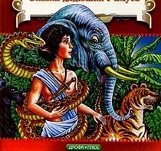
TRY TO MEMORISE THE NAMES OF THE BOOKS
WHAT ARE THEY ?

Slide 6
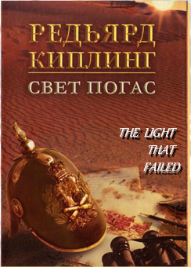
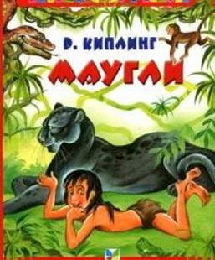

Slide 8
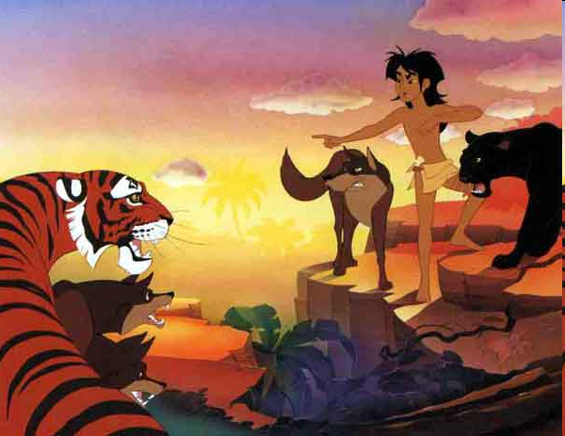
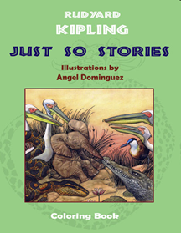
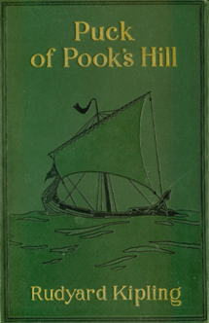
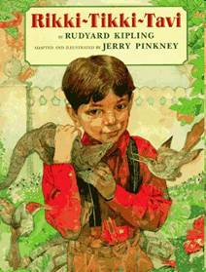
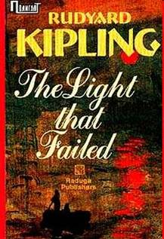

Slide 9
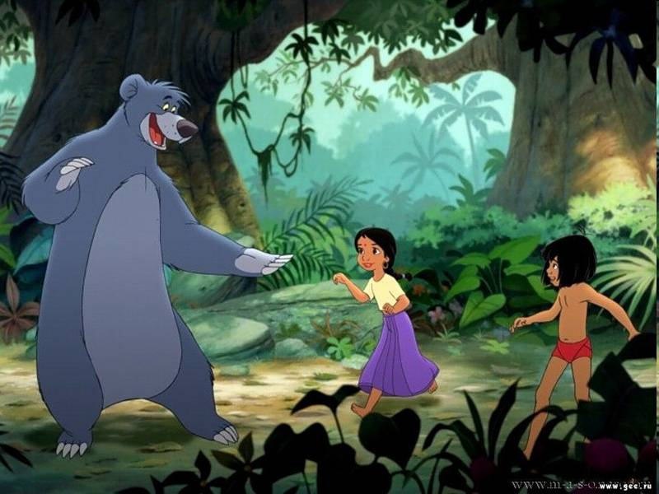
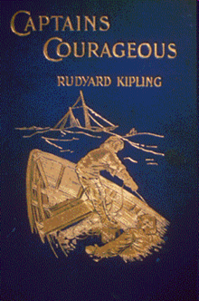
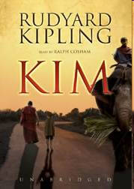

Slide 10
PART II
ANSWER THE QUESTIONS
AND
FIND OUT THE HIDDEN TITLE
OF THE BOOK
BY RUDYARD KIPLING

Slide 11
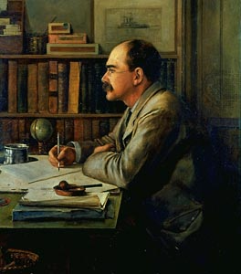
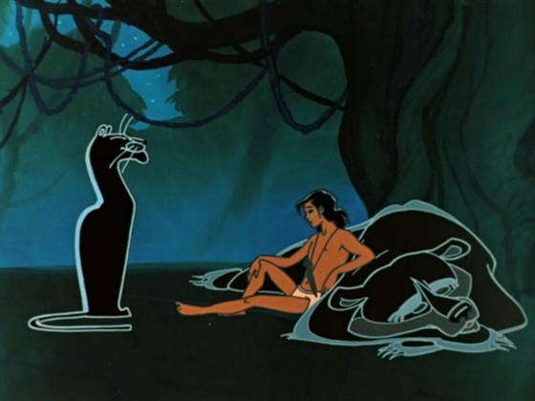
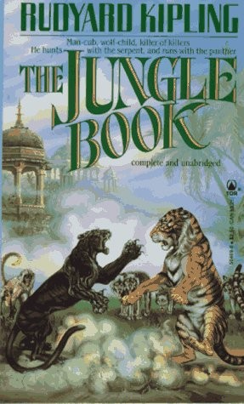
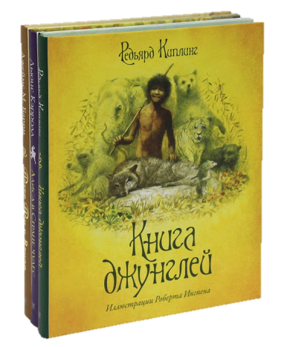
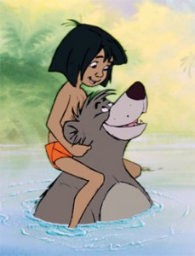
QUIZ

Slide 12
QUIZ
1
JONATHAN SWIFT IS THE
AUTHOR OF THE BOOK
RUDYARD KIPLING
The Adventures of Sherlock Holmes
Gulliver's Travels
Alice in Wonderland
click

Slide 13
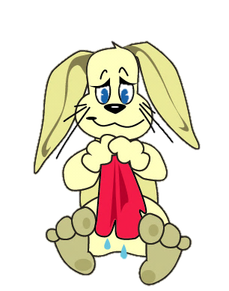
IT’S WRONG

Slide 14
YOU ARE RIGHT

Slide 15
QUIZ
2
WHO OF THESE WRITERS IS NOT AN ENGLISHMAN?
RUDYARD KIPLING
William Shakespeare
Arthur Conan Doyle
Mark Twain
click

Slide 16
IT’S WRONG

Slide 17
YOU ARE RIGHT

Slide 18
QUIZ
3
WHO IS THE AUTHOR OF THE BOOK “ALICE IN WONDERLAND”?
RUDYARD KIPLING
Jonathan Swift
click
Lewis Carroll
Mark Twain

Slide 19
IT’S WRONG

Slide 20
YOU ARE RIGHT

Slide 21
QUIZ
4
WHO IS THE AUTHOR OF THE BOOK “WINNIE THE POOH”?
RUDYARD KIPLING
click
Alexander Duma
Hans Christian Andersen
Alan Milne

Slide 22
IT’S WRONG

Slide 23
YOU ARE RIGHT

Slide 24
QUIZ
5
WHAT COUNTRY WAS ROBERT BURN BORN?
RUDYARD KIPLING
England
click
Scotland
Great Britain

Slide 25
IT’S WRONG

Slide 26
YOU ARE RIGHT

Slide 27
QUIZ
6
JOAN ROWLING WROTE THE BOOK
RUDYARD KIPLING
click
Harry Potter
King Lear
The Lord of the Ring

Slide 28
IT’S WRONG

Slide 29
YOU ARE RIGHT

Slide 30
QUIZ
7
WHAT KIND OF BOOKS DID
ARTHUR CONAN DOYLE WRITE?
RUDYARD KIPLING
Poems
Comedies
click
Detective stories

Slide 31
IT’S WRONG

Slide 32
YOU ARE RIGHT

Slide 33
QUIZ
8
THESE PEOPLE ARE THE CHARACTERS
OF THE BOOK BY M. LERMONTOV
RUDYARD KIPLING
Ruslan and Ludmila
Romeo and Juliet
click
Tom Sawyer and Huckleberry Finn

Slide 34
IT’S WRONG

Slide 35
YOU ARE RIGHT

Slide 36
QUIZ
9
WHAT WAS THE REAL NAME OF MARK TWAIN?
RUDYARD KIPLING
click
Samuel Clemens
click
Samuel Twain
Mark Clemens

Slide 37
IT’S WRONG

Slide 38
YOU ARE RIGHT

Slide 39
QUIZ
10
CHARLES PERRO DID NOT WRITE THIS BOOK
RUDYARD KIPLING
click
The Snow Queen
click
click
The Cat in High Boots
Cinderella

Slide 40
IT’S WRONG

Slide 41
YOU ARE RIGHT

Slide 42
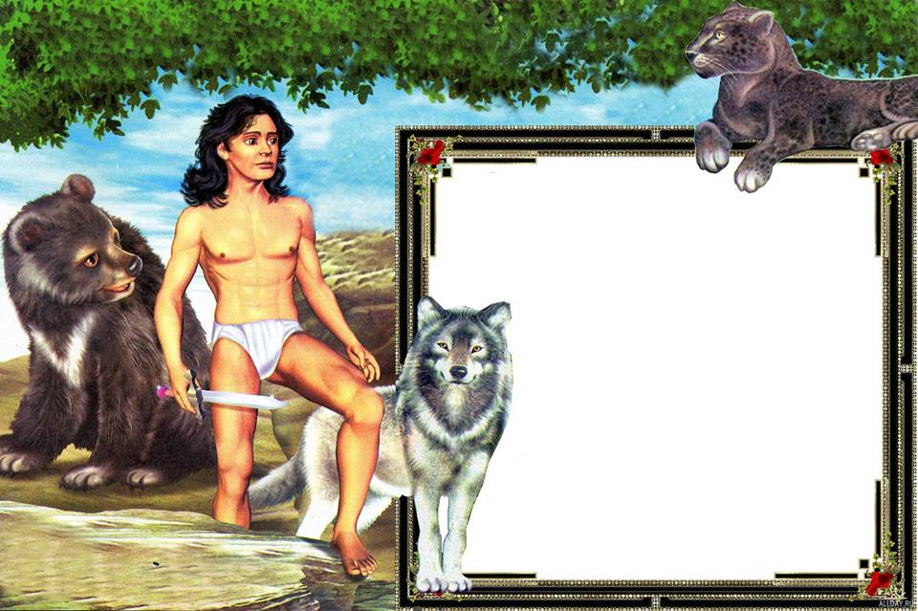
Презентация может быть использована для проведения внеклассных мероприятий
и в качестве дополнительного материала при изучении темы «Писатели»

Slide 43
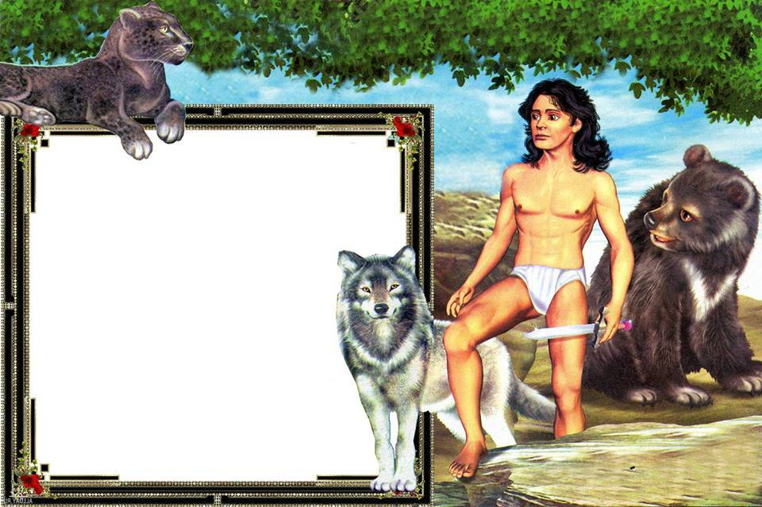
ИСПОЛЬЗОВАННЫЕ РЕСУРСЫ
Википедия
http://en.wikipedia.org/wiki/Rudyard_Kipling
Портрет
http://bibliogid.rgdb.ru/system/files/1381/original/i_kipling-6_1.jpg
Обои
http://allday.ru/uploads/posts/2008-12/1228347213_maugli.jpg
http://chelise.typepad.com/.a/6a00d8341c864153ef011570ca922b970b-800wi
http://johngushue.typepad.com/.a/6a00d83451f25369e20120a58690b8970c-800wi
http://vindeep.files.wordpress.com/2011/01/junglebook_baloo_mowgli-229x300.jpg
http://static.ozone.ru/multimedia/books_covers/1003214603.jpg

Slide 44
http://roosenmalouzijnlief.files.wordpress.com/2010/01/the-jungle-book.jpg
http://s.imhonet.ru/element/180x270/49/64/496403b4aba457396b04b2e9e3a1a4af.jpg
http://img.afisha.ru/Afisha7Files/UGPhotos/090318213859/090319150547/p_f.jpg
Обложки книг
http://www.bookline.ru/poisk.php?tochno=1&nazvanie=&opisanie=&author=%D0.%20%CA%E8%EF%EB%E8%ED%E3&izdatel=&isbn=&series=&price1=0&price2=0&year1=0&year2=0&p=2
http://images.amazon.com/images/P/0152253866.01.LZZZZZZZ.jpg
http://blog.moonshadowecommerce.com/WEBLOG-NAME/Booklists/2008/07/friendships_across_boundaries.html
http://www.cd4you.ru/graf/oblo_b/1349_b.jpg
http://www.prodalit.ru/images/200000/198144.jpg

Slide 45
http://bearbooks.ru/image/book/206/i206902.jpg
http://sbooksa.narod.ru/covers/ABCD/ABCD01648_b.jpg
http://manofroma.files.wordpress.com/2007/11/rikki-tikki-tavopti.jpg
http://img1.fantasticfiction.co.uk/images/c0/c1113.jpg
http://www.ozon.ru/multimedia/books_covers/1000661660.jpg
http://www.p-synd.com/wild/c54big.jpg
http://www.char.ru/books/p580995.jpg
http://www.ibiblio.org/pub/docs/books/gutenberg/2/6/0/2/26027/26027-h/images/cover.jpg
http://www.knigisosklada.ru/images/books/1886/big/1886639.jpg
http://read.ru/covers_rr/big/372273.jpg
http://alexgetti.narod.ru/imag098.jpg
http://lib.aldebaran.ru/books/kipling_redyard/kipling_redyard_pak_s_volshebnyh_holmov/cover.jpg
http://www.audiobooksonline.com/media/Kim-Rudyard-Kipling-unabridged-Blackstone-Audio-books.jpg
http://www.epubbooks.com/img-book-covers/kipling-captains-courageous-bookcover.jpg

