Slide 1
WHAT do we know about GREAT Britain?
1)Read the following texts and expand your knowledge of English history.
London draws people all over the world. The city shows examples of monuments, historic buildings, parks, and districts. The London Borough of Greenwich is one of them. It is situated in the southeast of London. It is known for its maritime history, and for the Greenwich Meridian. It can be seen in the Royal Greenwich Observatory built in 1675 by King Charles II. The building is located on a hill in Greenwich Park and looks at the River Thames. The word “greenwich” means the green place on the bay (wich). The name was given to the place by Anglo-Saxon settlers in V – XI AD. It is a lovely place where Londoners like walking in their free time.
2) Ask the question in the direct speech: what part of London he/she likes most of all and why.
3) Write down the pictures.

Slide 2
1)Read the following texts and expand your knowledge of English history.
The Tower of London is a historic castle on the north bank of the River Thames in central London. William the Conqueror (reigned 1066 –1087) built the White Tower as a strong fortress to protect himself from the people of London in 1066. He was the 1st Norman King of England from 1066 until his death. Before his conquest of England, he was known as William the Bastard because of the illegitimacy of his birth. Now it is a part of the Tower of London. The Tower of London was used as a royal palace, an arsenal, a state prison, where many people have been executed, a menagerie, a treasury, and the home of the Royal Mint. Nowadays it is the home of the Crown Jewels – the Queen’s gold and diamonds – are kept there, and a museum. Many tourists visit the Tower of London every year. It is protected by UNESCO (the United Nations Educational, Scientific and Cultural Organization).
2) Ask the question in the direct speech: what the Tower of London used to be what it is now.
3) Write down the pictures.

Slide 3
1)Read the following texts and expand your knowledge of English history.
The black ravens of the Tower of London live in the Tower of London for many centuries. They are seven birds (six required, with the seventh in reserve). There is an old legend connected with the Tower of London. It says that, "If the black ravens fly away, the Kingdom of England will fall and Great Britain with it." The other legend puts the origin of the black raven population at the time of King Charles II (reigned 1660–1685) who ordered to take care of them as many of the birds were killed by poor people for food. So they could only live at the Tower in captivity, and with official support. Many historians believe that it is a Victorian flight of fantasy. The Tower's ravens cannot fly away because the flight feathers on one wing are kept clipped. With the single wing clipped, they can only fly for short distances to perch. Each Tower raven has a different coloured band on one leg, to make it easier to identify individual birds. The Tower's ravens live over 40 years. They are given individual names, and are all under the care of the Yeomen Warders. The diet of the ravens includes fresh fruit, eggs, cheese and meat, as well as vitamins and other supplements. They give them biscuits, soaked in blood from the meat. And in winter they get capsules of cod liver oil. That’s why they look so healthy. During World War II, only one raven was able to survive the hardships of the bombing during the Blitz, so the Prime Minister, Sir Winston Churchill, ordered to catch more black ravens in order to bring the flock up to the correct size. The Tower ravens are enlisted as soldiers of the Kingdom, and have attestation cards as soldiers and police. The black ravens can be dismissed for unsatisfactory conduct.
2) Ask the question in the direct speech: why Londoners keep black ravens in the Tower of London.
3) Write down the pictures.

Slide 4
1)Read the following texts and expand your knowledge of English history.
The City of London is a small area within Greater London. It is the historic core of London around which the modern conurbation has grown and held city status from time immemorial. The City’s boundaries have remained almost unchanged since the Middle Ages (XI – XV centuries). The City of London is usually associated with the Square Mile, as it is just over one square mile (1,12 sq mi / 2,90 km²) in area. These names are also often used as synonyms for the UK’s financial service industries. The City of London is today a major business and financial centre of the world. It has a resident population of a little over 11, 000 people, but around 330, 000 people work there every day.
2) Ask the question in the direct speech: what place in London is believed to be its historic centre.
3) Write down the pictures.

Slide 5
1)Read the following texts and expand your knowledge of English history.
Queen Elizabeth II was born on the 21st of April in 1926. She became the Queen on 6th February 1952. She was crowned on 2nd June 1953. The Queen is a symbol of Britain. Her official title is: “Elizabeth the Second, by the Grace of God of the United Kingdom of Great Britain and Northern Ireland and of Her other Realms and Territories Queen, Head of the Commonwealth, Defender of the Faith.” She is the Head of State, but in fact she doesn’t rule the country as she has no power. The Prime Minister and Ministers receive their appointments from the Queen at Buckingham Palace. Laws are not laws until they have received the Royal Assent. She is the Head of the Church of England and Commander-in- Chief of the armed forces. She is also the Head of the Commonwealth and the Queen of Canada, Australia and New Zealand. She meets ambassadors and important visitors from abroad. She gives audiences to her ministers and officials. She opens Parliament with a speech from the throne. She is very rich.

Slide 6
The Queen and the members of the Royal Family: the Queen’s husband – Prince Philip (born 10 June 1921), her son – Prince Charles (born 14 November 1948), her daughter – Princess Ann (born 15 August 1950), her son – Prince Andrew, born 19 February 1960, her son – Prince Edward, born 10 March 1964) and the Queen’s sister – Princess Margaret (born 21 August 1930) visit many parts of Britain for charity. Buckingham Palace is the London home of the Queen. Soldiers always guard the Palace. You can stand outside the front of the Palace and watch the daily ceremony of the Changing of the Guards. It takes place in its courtyard. The Palace was built in 1703 by the Duke of Buckingham. The Tourists can visit the Queen’s Gallery and see the Queen’s collection of paintings. The gallery is open all day from Tuesday to Saturday and on Sunday afternoon. It is closed on Monday.
2) Ask the question in the direct speech: what role the Queen plays in the life of modern Britain and where the Queen lives.
3) Write down the pictures.

Slide 7
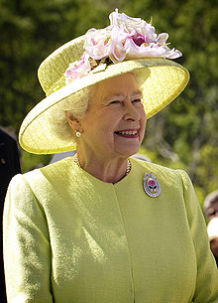
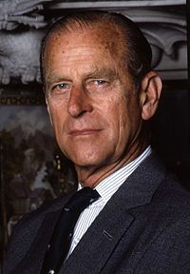
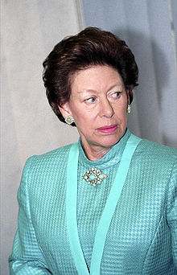
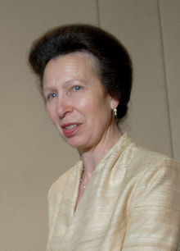
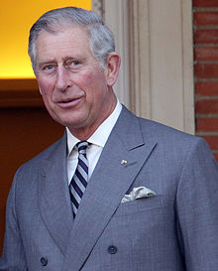
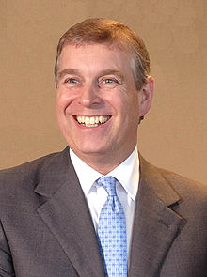
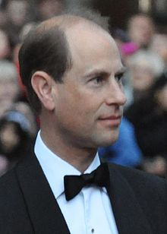
Pictures
1
2
3
4
5
6
7

Slide 8
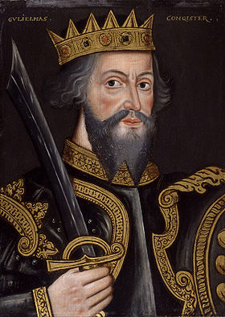
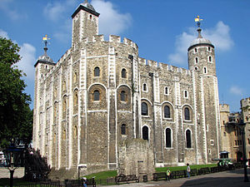
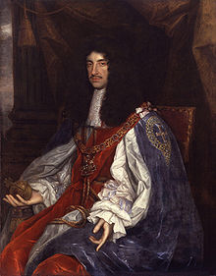
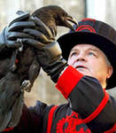
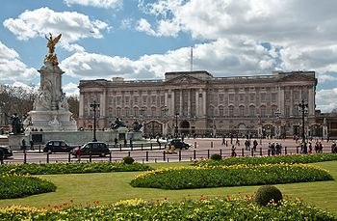
8
9
10
11
12
13

Slide 9
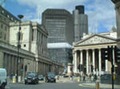
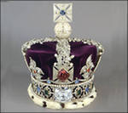
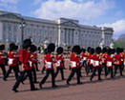
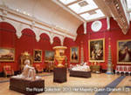
14
17
15
16

