Slide 1
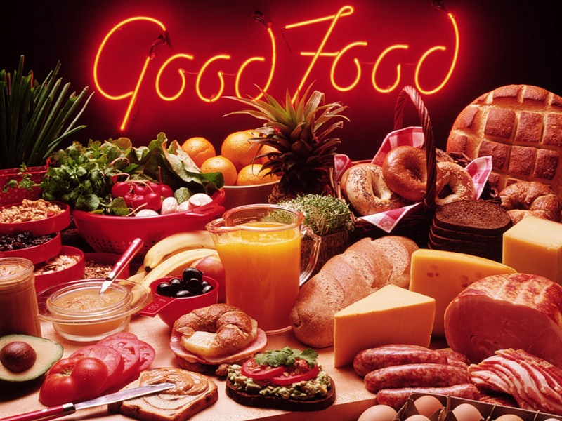
FOOD

Slide 2
[d]
[s]
[t]
[n]
[w]
[a:]
[o:]
[k]

Slide 3
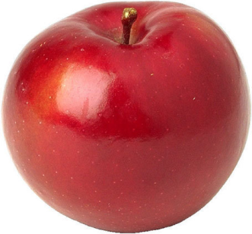
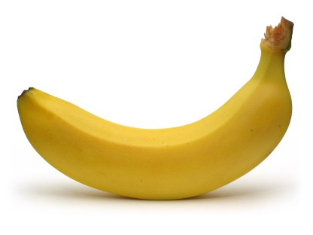
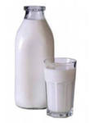
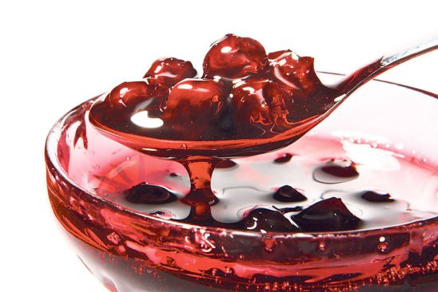
apple
pleap
abnaan
banana
lmki
milk
mja
jam

Slide 4
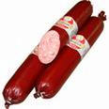
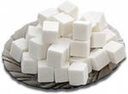
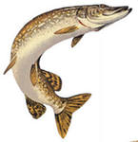
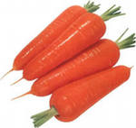
usgaase
sausage
guras
sugar
sihf
fish
roctar
carrot

Slide 5
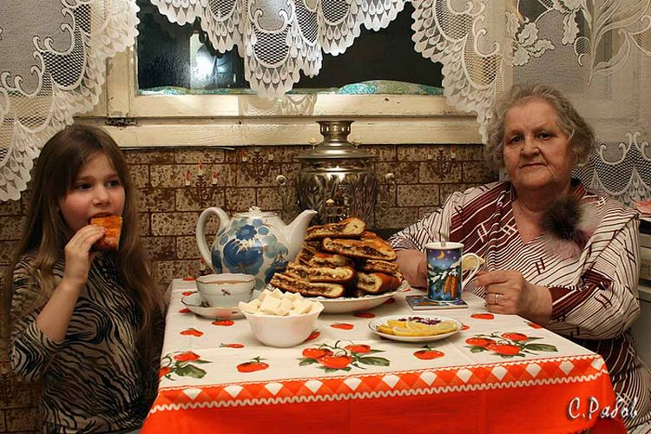
HELP YOURSELF

Slide 6
much
неисчисл.сущ-е
many
исчисл.сущ-е
с любыми
сущ-ми
A lot of

Slide 7
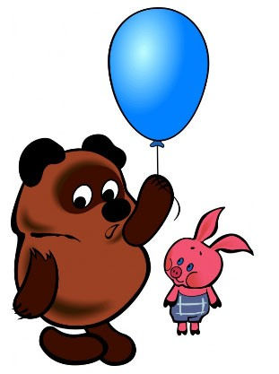
You must …
You mustn΄t…

Slide 8
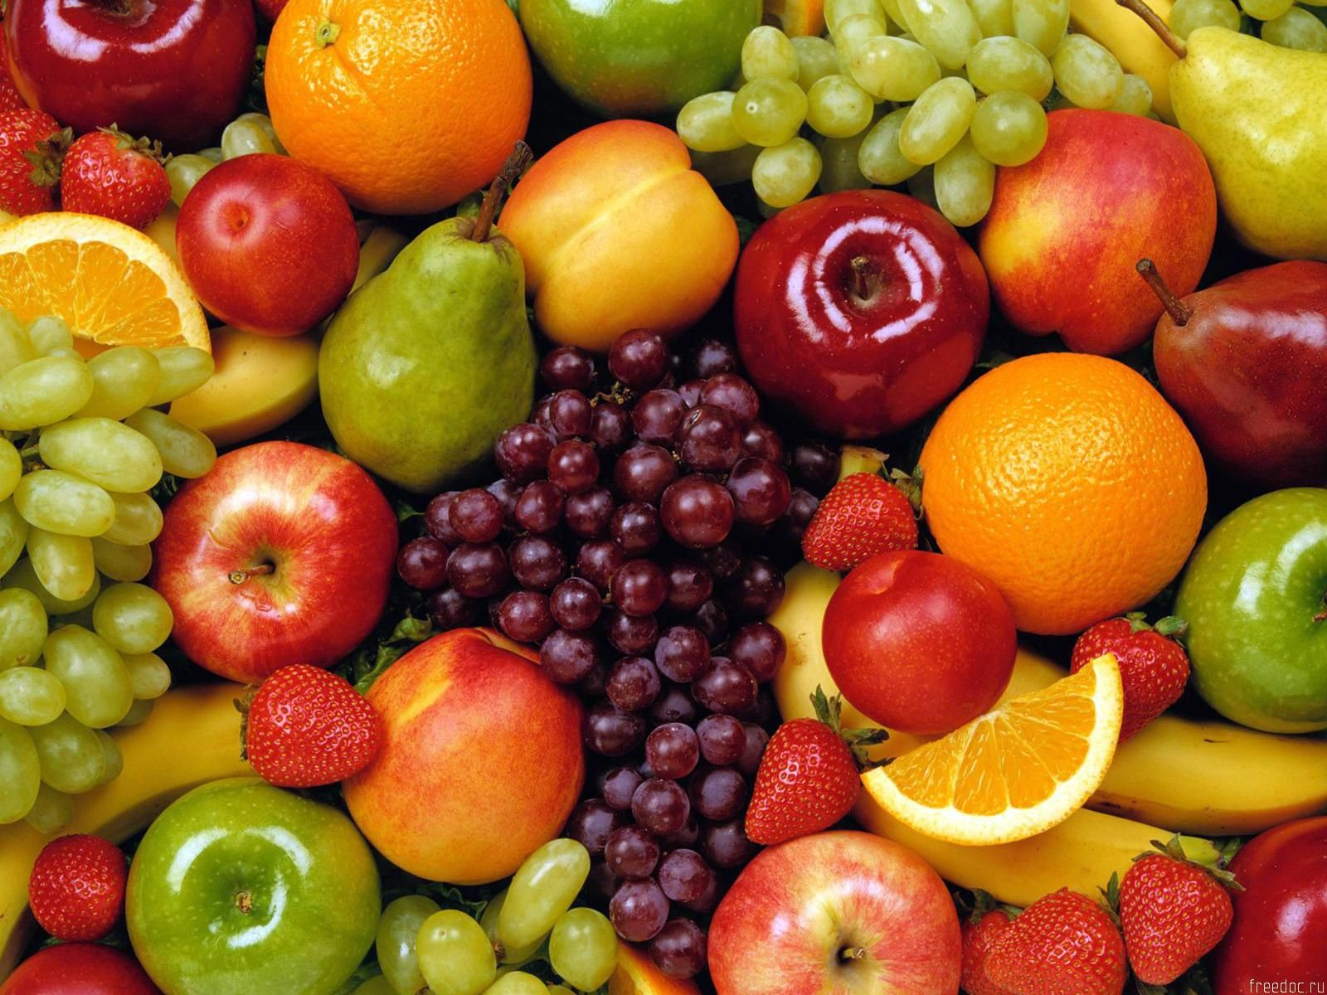
THANK YOU
VERY MUCH
FOR THE LESSON!

