Slide 1
Bestest Best Friend Forever And Always
Topic: B B F FA A
Семенова Ольга Александровна
ГБОУ СОШ №1062
Москва
2012

Slide 2
English and Russian proverbs
A friend in need is a friend indeed.
Друг познается в беде.
Before you make a friend eat a bushel of salt with him.
Друга узнать – вместе пуд соли съесть.
A friend is not so soon got as lost.
Нет друга, так ищи, а нашел, так береги.
Make new friends, but keep the old. One is silver, the other is gold.
Старый друг лучше новых двух.

Slide 3
English and Russian proverbs
A friend to everybody is a friend to nobody.
Друзей-то много, да друга нет.
A man is known by his friend.
Скажи мне кто твой друг, и я скажу, кто ты.
The only way to have a friend is to be one.
Единственный способ иметь друга – это быть другом.
Money can’t buy friendship.
Друга на деньги не купишь.
One man – no man.
Один в поле не воин.

Slide 4
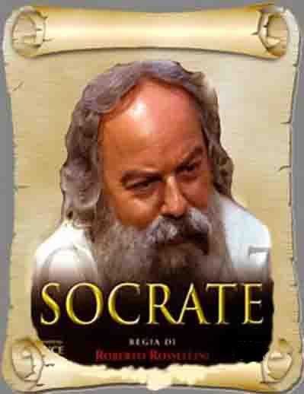

Slide 5
Match the words:
Use
Bad
Useful
Worst
Useless
Usefulness
True
Truth
Worse
Truly
Good
Goodness
Плохой
польза
хороший
Хуже
Правильный, правдивый
Наихудший
Правда
Бесполезный
Полезный
Правдиво, правильно
Пользоваться, польза
Доброта, добродетель

Slide 6
New words:
Triple [ tripl ] -тройной
On the contrary – наоборот
Something – что-то
Conclude – сделать заключение
Avoid - избегать

Slide 7
A True Friend (Socrates)
great
One day a young boy met the (1) ________ philosopher and said, "Do you know what I heard about your friend?". "Hold on a (2)___________," Socrates replied. "Ok, but first I'd like you to (3)________ a little test. It's called the Triple Filter Test. Before you talk to me about my friend, it is a good (4)_________ to take a moment and filter what you're going to (5)_______. The first filter is (6) _________. Are you absolutely sure that what you are about to tell me is true?" "No," the man said, "in fact I just heard about it and...". "All right," said Socrates. "So you don't know if it's true or not. Now the second filter is(7)____________. Is what you are about to tell me about my friend something good? ». "No, on the contrary..."."So," Socrates continued, "you want to tell me something (8) _________ about him, but you're not sure it's true. In my test there's one filter (9)_________: the filter of Usefulness. Is what you want to tell me about my friend going to be
(10) _______________ to me?" "No, not really." "Well," concluded Socrates, "if what you want to tell me is neither true nor good nor even useful, why tell it to me at all?"
minute
pass
idea
say
Truth
Goodness
bad
useful
left

Slide 8
A True Friend (Socrates)
Lesson:
Always avoid talking behind the back about your near and dear friends.

Slide 10
Task: Listen to American girls telling about their friendship and say if the sentences are true or false.
The blonde-haired girl is Yana. T F
Jana is Yana’s sister. T F
They live in Buffalo, New York, USA. T F
Yana and Jana are of the same age. T F
They like playing with dolls. T F
Jana has got two hamsters. T F
Yana hasn’t got any pets. T F
Yana wants to be a veterinary. T F
Jana wants to be a fashion designer. T F
The girls hope their friendship will last forever. T F

Slide 11
A friend is a person who:
is
can
has

Slide 12
Are you a good friend?
Results:
0-3 points: Many people think you are unfriendly. You are a person who sometimes can be not very helpful. You are a little bossy too.
4-6 points: You are a good friend but why not always. You can give a helping hand and do not demand much. But you still do not know many things about your friend. Make the friendship stronger.
7-10 points: You are a true friend. Everyone would like to have such a close friend as you are.

Slide 13
Michael Jackson. “BEN”(1972)

Slide 14
Thank you!

Slide 15
Использованные ресурсы:
http://www.funquizcards.com/quiz/friendship/are-you-really-best-friends.php
http://goodsongs.com.ua/song58299_michael-jackson_ben.html
http://www.facebook.com/notes/friendship-quotes/a-true-friend-socrates/184453824916398
http://masterrussian.com/proverbs/russian_proverbs.htm
http://ya-jerexis.ya.ru/replie…
http://vk.com/id46676239
http://prazdnikigoda.ru/photo/…
http://www.ownskin.com/home?u=…
http://wision-nastus.boosterhi…
http://forum.myjackson.ru/topi…

