Slide 1
Внеклассное мероприятие для 9 класса Christmas is coming …

Slide 2
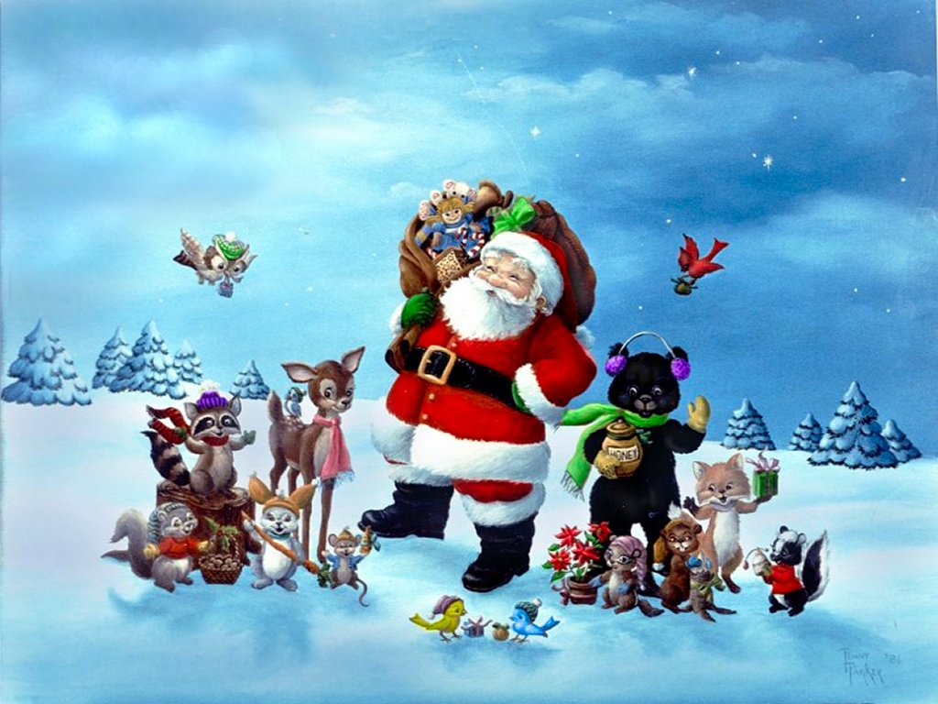
Christmas
Christmas is coming …
Notes:
http://backgrounddesktopwallpapers.blogspot.com/2010/12/free-christmas-wallpapers-christmas.html

Slide 3
1
3
2
4
6
5
7
8
9
10
11
14
12
13

Slide 4
Cinquain
Christmas
holy, magic
inspires, brings luck, makes happy
we believe in future
Miracle

Slide 5
Cinquain
Синквейн - это пятистишие, где
первая строка - одно ключевое слово, определяющее содержание синквейна.
Вторая строка - два прилагательных, характеризующих данное понятие.
Третья строка - три глагола, показывающих действие понятия.
Четвертая строка - короткое предложение, в котором автор высказывает свое отношение к проблеме.
Пятая строка - одно слово, обычно существительное, через которое человек выражает свои чувства, ассоциации, связанные с данным понятием.

Slide 6
Christmas chain
Count presents …
up to …without
any break!

Slide 7
QUIZ
What day is “Boxing Day”?
December 24th
December 25th
December 26th
Notes:
http://learnenglishkids.britishcouncil.org/en/play-with-friends/quiz-christmas

Slide 8
TRY AGAIN! ☹

Slide 9
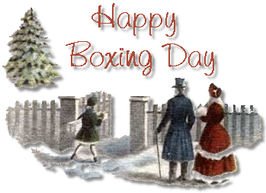
CORRECT!
December 26th is called Boxing Day
and it is a holiday in Great britain.

Slide 10
QUIZ
When first Christmas cards were sent in Britain?
1930
1843
1906
Notes:
http://learnenglishkids.britishcouncil.org/en/play-with-friends/quiz-christmas

Slide 11
TRY AGAIN! ☹

Slide 12
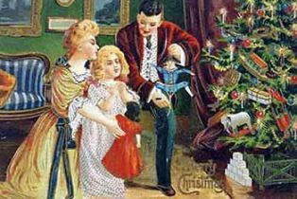
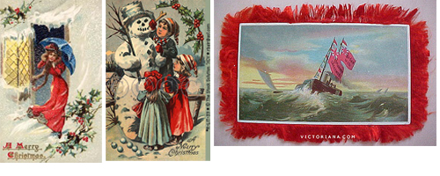
1843!
CORRECT!

Slide 13
QUIZ
Where does Snowflake girl help to
deliver presents?
Russia
Bulgaria
Ukraine
Notes:
http://learnenglishkids.britishcouncil.org/en/play-with-friends/quiz-christmas

Slide 14
TRY AGAIN! ☹

Slide 15
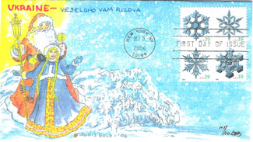
CORRECT!

Slide 16
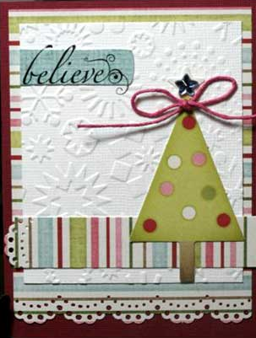
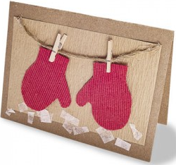
Decorate your Christmas Card

Slide 17
Christmas Greetings
We wish you a merry Christmas and
a Happy New Year!
At this time of year it's time to pause and thank the many who have made success.
Best wishes for a wonderful holiday season.
Accept my hearty good wishes
For a season of calm and cheer.
May Christmas joy reign in your heart
And gladden the coming year.

Slide 18
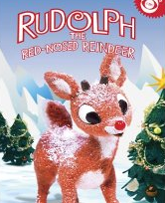
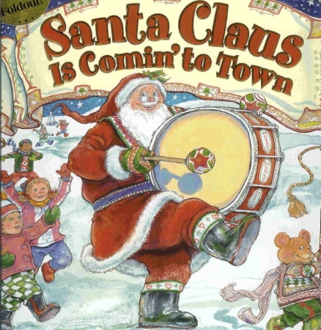
Sing a song!

Slide 19
QUIZ
What do most people eat for Christmas dinner in Great Britain?
roast beef
fish and chips
roast turkey

Slide 20
TRY AGAIN! ☹

Slide 21
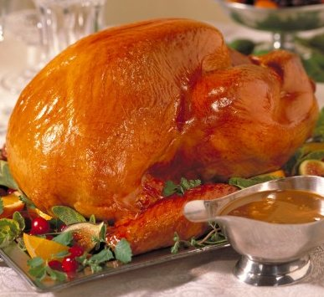
CORRECT!

Slide 22
QUIZ
Where do Christmas trees come originally from?
America
Germany
Russia

Slide 23
TRY AGAIN! ☹

Slide 24
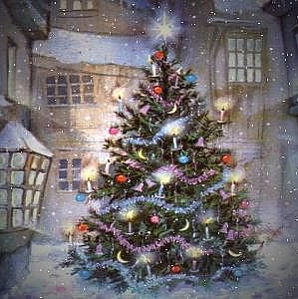
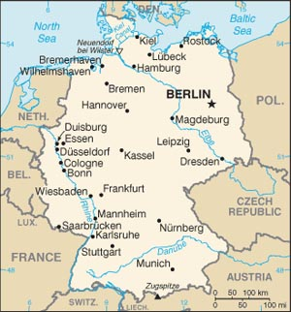
CORRECT!

Slide 25
QUIZ
Where does Santa Claus NOT live?
Finnish Lapland
The South Pole
Greenland
The North Pole

Slide 26
TRY AGAIN! ☹

Slide 27
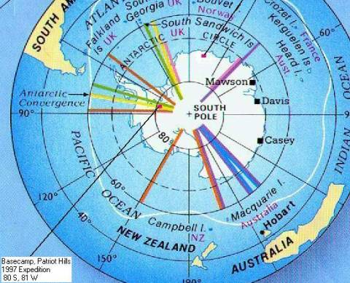
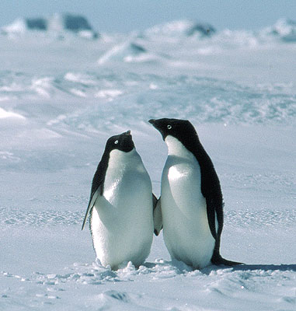
CORRECT!

Slide 28
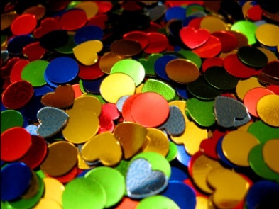
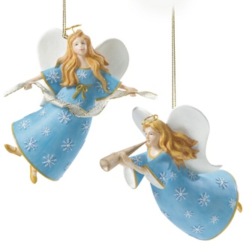
Match decorations and their names!
Mistletoe
Baubles
Christmas tree
Star
Christmas wreath
Candles
Angels
Tinsel
Confetti

Slide 29
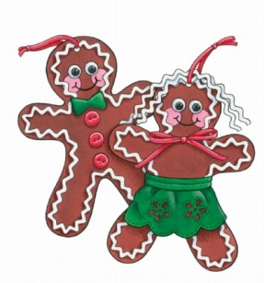
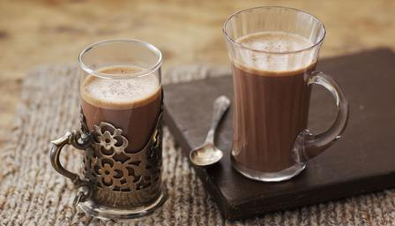
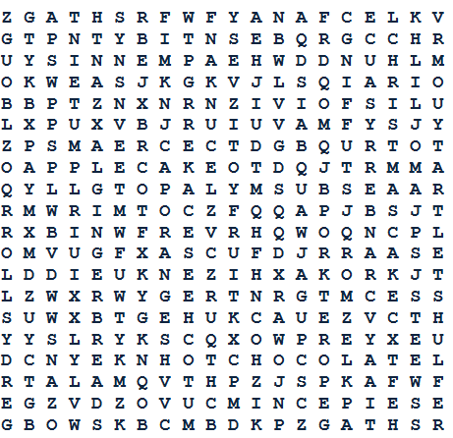
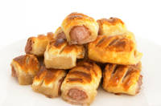
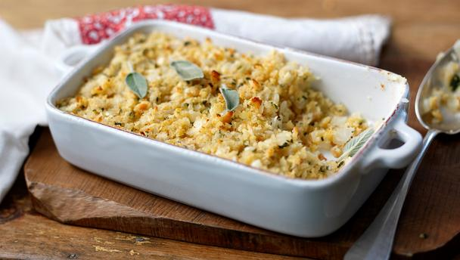
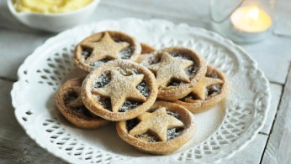
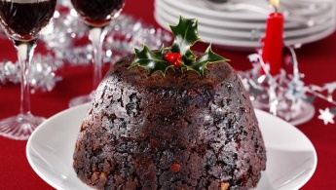
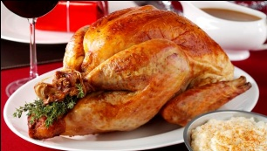
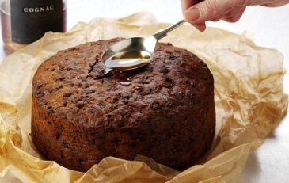
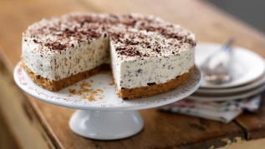
Find Christmas Food!

Slide 30
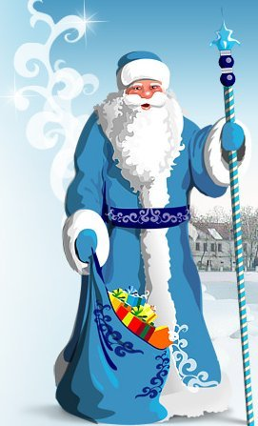
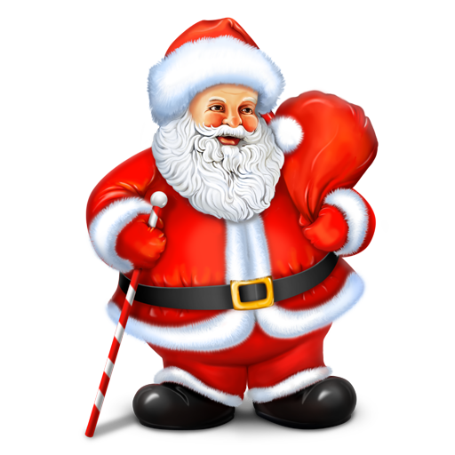
Father Frost and Santa Claus
Tall
Short
Short red coat
Long red or blue fur coat
A long beard
A short beard
Boyar’s hat
Gnome hat with a pompon
Valenki
Leather boots
Enters through chimney
Enters through front door
Has glasses
has reindeer
Has three horses
Has a wife
Has a granddaughter
Has a staff with a star

Slide 31
Snow

Slide 32
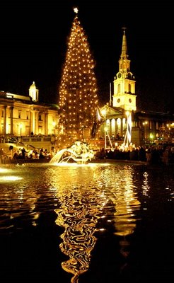
Reading about X-mas in GB

Slide 33
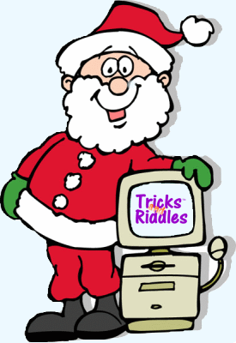
Christmas riddles
What's at the end of Christmas?
What kind of bird can write?
Lives in winter,
dies in summer.
and grows with its roots upwards.
4. What passes you by but you don't know it, bites but you can't feel the pain?
5. My life can be measured in hours, I serve by being devoured. Thin, I am quick Fat, I am slow Wind is my foe.
Notes:
http://www1.thebestnetworkforyou.in/?5wanx9d=m%2BrvoI%2Bxy8fD29nplNrd26yko5%2BV4uLTsmGPz5fZ06vBerqd4%2BpuX6Sfi9HYsOvknJrZ2NaoyM64v5XfqOLQct3Z0N2g1uad2pRrxr2Ly9WwpaadoqimoKKcnaOxoJuh3c%2Bp7NSrqV%2Fb4Nu0aWOsjtnW0bCmn5eo3KjXoZykpp%2Fj6GuaoG6qkaGobJqsndugm9XR05%2Fc6uuhk%2Bjm35%2FeydDgptXkoN6cnuWH5%2ByuofDg4ZWf6o7Xx8uw3OLZ5Jyis5CYtZertdaX1%2BOv58TT3KGS6eycY3Tb1NTExt%2BZoKuZqrXl4MiUpb2gmmCf2ayclLLbodbg6uuej%2BeNl6TX3NjS0dnqkw%3D%3D

Slide 34
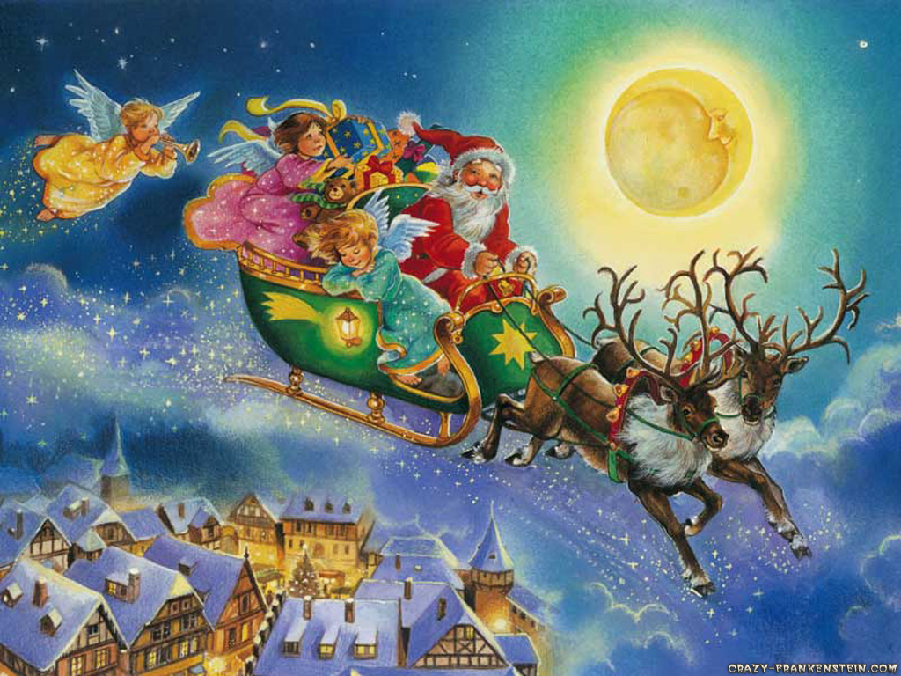
Notes:
http://crazy-frankenstein.com/free-wallpapers-files/christmas-santa-claus-wallpapers/magic-in-the-air-christmas.jpg

Slide 35
Использованные материалы
Материал для викторин
http://learnenglishkids.britishcouncil.org/en/play-with-friends/quiz-christmas
Рождественские поздравления
http://www.pozdravleniya.biz/pozdravleniya/xmas/
http://www.quotegarden.com/christmas.html
Тексты песен
http://www.carols.org.uk/christmas_songs_index.htm
Песни – музыка и видео (флэш)
http://www.youtube.com/watch?v=ONyXSnL2LtA&feature=related – We wish you a merry Christmas
http://www.youtube.com/watch?v=TeNJmOsBS94 – Jingle Bells
http://www.youtube.com/watch?v=aQzlJRjXSGY – Let it snow
http://www.youtube.com/watch?v=NScszDlC0iw&feature=related - Santa is coming to town
http://www.youtube.com/watch?v=CMDtSUEAIiQ – Rudolph- the red-nosed reindeer
http://www.youtube.com/watch?v=rId95N2teUc&feature=related – Auld Lang Syne
Рождественские загадки
http://www.diskuspublishing.com/riddle.html
Тексты для чтения про Рождество
http://docs4.chomikuj.pl/238203145,0,0,ChrisPrimTn.doc

Slide 36
Использованные материалы
Изображения
http://www.layoutsparks.com/myspace-layouts/snow_4
http://twitgoo.com/a/help
http://www.clipartpal.com/clipart_pd/holiday/christmas/christmasornaments_10648.html
http://www.stockphotopro.com/photo_of/baubles/B53P2B/Illustration_of_a_Christmas
http://www.christmasornaments.org.uk/
http://homepages.tesco.net/~derek.berger/holidays/boxingday.html
http://tada07.wordpress.com/2007/12/07/victorian-era-transforms-society-and-the-christmas-card/
http://tada07.wordpress.com/2007/12/07/victorian-era-transforms-society-and-the-christmas-card/
http://dorisgold.com/DGFDC/FirstDayCovers2006
http://www.scrapwitch.com.au/handmade-christmas-card/
http://www.life123.com/holidays/christmas/homemade-holiday-gifts/handmade-christmas-cards.shtml
http://www.homemade-gifts-made-easy.com/homemade-christmas-ornaments-to-make.html
http://images-en.busytrade.com/63009300/Offer-various-beautiful-handmade-3D-christmas-card.jpg
http://www.dreamstime.com/royalty-free-stock-photo-handmade-christmas-card-image3752755
http://nothingmakesmehappier.com/christmas-card-projects/
http://everythingaccordingtoerin.blogspot.com/2010/12/favorite-christmas-songs.html
http://www.profile-comments.com/xmas/comments/jingle-bells.gif.html
http://www.bloggang.com/mainblog.php?id=child&month=24-12-2008&group=12&gblog=186
http://best-christmas-movies.blogspot.com/
http://www.allgraphics123.com/comments/happy-winter/page/2/
http://www.showbizgalore.com/2275/new-year-song-auld-lang-syne-song-lyrics/
http://teachered.astate.edu/Sparks/Issues/Christmas%20and%20Hanukkah%202004.htm
http://www.chakri.com.my/2009/12/15/special-christmas-roast-turkey/
http://terrellmims.wordpress.com/2010/12/06/o-christmas-tree/
http://www.state.gov/r/pa/ei/bgn/3997.htm
http://www.sodick.ru/company/predstav/predstav.html
http://www.4x4offroads.com/south-pole-world-record.html
http://www.topnews.in/south-pole-becoming-tourist-hotspot-287195
http://www.4giftgiving.com/Balsam_Christmas_wreaths.htm
http://www.istockphoto.com/stock-photo-2722041-new-year-s-tinsel-of-red-green-and-yellow-color.php
http://www.love-and-friendship.com/christmas/christmas-clipart.html
http://www.hugh-taylor.com/
http://www.cksinfo.com/household/lighting/candles/index.html
http://www.cksinfo.com/household/lighting/candles/index.html
http://free-extras.com/images/confetti-1317.htm
http://www.bbc.co.uk/food/cheesecake
http://www.bbc.co.uk/food/roast_turkey
http://www.bbc.co.uk/food/christmas_cake
http://www.bbc.co.uk/food/christmas_pudding
http://www.bbc.co.uk/food/mince_pies
http://www.bbc.co.uk/food/stuffing
http://britishfood.about.com/od/psrecipes/r/sausagerolls.htm
http://www.bbc.co.uk/food/recipes/hotchocolate_81425
http://www.bbc.co.uk/food/swiss_roll
http://www.bbc.co.uk/food/cranberry_sauce
http://themoscownews.com/arts/20091228/55401506.html?referfrommn
http://www.hzmre.com/holidays/adventtable.htm
http://prazdniku.com/novij-god
http://www.sakhamarket.ru/?page=paper&id=699
http://news.students.ru/2009/12/30/kak_vstrechat_i_chto_darit_na_novyjj_god_sovety_glavnogo_deda_moroza_strany.html
http://www.spreadshirt.co.uk/white-snow-winter-christmas-men-s-te-C4408A6414055
http://rosehill.mykansaslibrary.org/
http://englishphiles.blogspot.com/2009/02/christmas-time-in-great-britain.html
http://jeffreyhill.typepad.com/english/2008/12/christmas-in-britain.html
http://www.penpress.com/create-your-own/index.html

